Slide 1
Oncology Grand Rounds
New Agents and Strategies in Gastrointestinal Cancers
Thursday, May 28, 2020 5:00 PM – 6:30 PM ET
Faculty
Melony Avella-Howell, NP
Wells A Messersmith, MD
Philip A Philip, MD, PhD, FRCP
Tammy Triglianos, RN, MS, ANP-BC, AOCNP
Moderator Neil Love, MD

Slide 2
Dr Love — Disclosures
Dr Love is president and CEO of Research To Practice. Research To Practice receives funds in the form of educational grants to develop CME activities from the following commercial interests: AbbVie Inc, Acerta Pharma — A member of the AstraZeneca Group, Adaptive Biotechnologies, Agendia Inc, Agios Pharmaceuticals Inc, Amgen Inc, Array BioPharma Inc, Astellas, AstraZeneca Pharmaceuticals LP, Bayer HealthCare Pharmaceuticals, Biodesix Inc, bioTheranostics Inc, Blueprint Medicines, Boehringer Ingelheim Pharmaceuticals Inc, Boston Biomedical Inc, Bristol-Myers Squibb Company, Celgene Corporation, Clovis Oncology, Daiichi Sankyo Inc, Dendreon Pharmaceuticals Inc, Eisai Inc, EMD Serono Inc, Exelixis Inc, Foundation Medicine, Genentech, a member of the Roche Group, Genmab, Genomic Health Inc, Gilead Sciences Inc, GlaxoSmithKline, Guardant Health, Halozyme Inc, ImmunoGen Inc, Incyte Corporation, Infinity Pharmaceuticals Inc, Ipsen Biopharmaceuticals Inc, Janssen Biotech Inc, administered by Janssen Scientific Affairs LLC, Jazz Pharmaceuticals Inc, Kite, A Gilead Company, Lexicon Pharmaceuticals Inc, Lilly, Loxo Oncology Inc, a wholly owned subsidiary of Eli Lilly & Company, Merck, Merrimack Pharmaceuticals Inc, Myriad Genetic Laboratories Inc, Natera Inc, Novartis, Oncopeptides, Pfizer Inc, Pharmacyclics LLC, an AbbVie Company, Prometheus Laboratories Inc, Puma Biotechnology Inc, Regeneron Pharmaceuticals Inc, Sandoz Inc, a Novartis Division, Sanofi Genzyme, Seattle Genetics, Sirtex Medical Ltd, Spectrum Pharmaceuticals Inc, Taiho Oncology Inc, Takeda Oncology, Tesaro, A GSK Company, Teva Oncology, Tokai Pharmaceuticals Inc and Tolero Pharmaceuticals.

Slide 3
Ms Avella-Howell — Disclosures
No financial interests or affiliations to disclose.

Slide 4
Dr Messersmith — Disclosures
Contracted Research | Aduro Biotech, ALX Oncology, AstraZeneca Pharmaceuticals LP, BeiGene, D3 Pharma, Gossamer Bio, Immunomedics Inc, OncoMed Pharmaceuticals Inc, Pfizer Inc
Data and Safety Monitoring Board/Committee | Five Prime Therapeutics, QED Therapeutics

Slide 5
Dr Philip — Disclosures
No financial interests or affiliations to disclose.

Slide 6
Ms Triglianos — Disclosures
No financial interests or affiliations to disclose

Slide 7
Commercial Support
This activity is supported by educational grants from Genentech, a member of the Roche Group, and Taiho Oncology Inc.

Slide 8
Agenda
Module 1: Up-Front Management of Advanced Hepatocellular Carcinoma (HCC)
IMbrave150: Atezolizumab plus bevacizumab versus sorafenib in unresectable HCC
ESMO Asia 2019, November 23, 2019
Module 2: Current Clinical Algorithms for Patients with Metastatic Colorectal Cancer (mCRC)
Clinical implications of tumor sidedness, MSI status, RAS and BRAF in mCRC
Module 3: Sequencing of Systemic Therapy in Patients with Metastatic Gastric Cancer
Impact of MSI status, PD-L1 level and HER2 status on treatment choice
Module 4: Management of Gastrointestinal Cancers in the Era of COVID-19
Telemedicine, minimization of surgeries, reduced infusions and clinic visits

Slide 9
Module 1: Up-Front Management of Advanced Hepatocellular Carcinoma (HCC)
IMbrave150: Atezolizumab plus bevacizumab versus sorafenib in unresectable HCC. ESMO Asia 2019, November 23, 2019

Slide 10
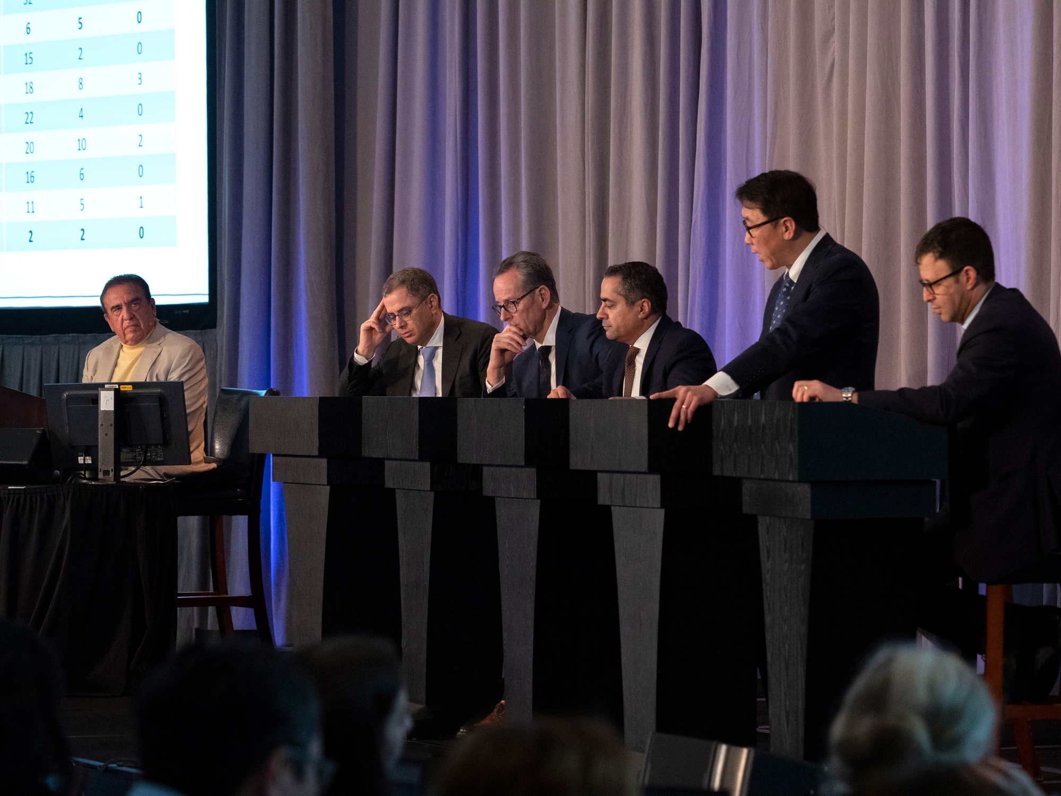
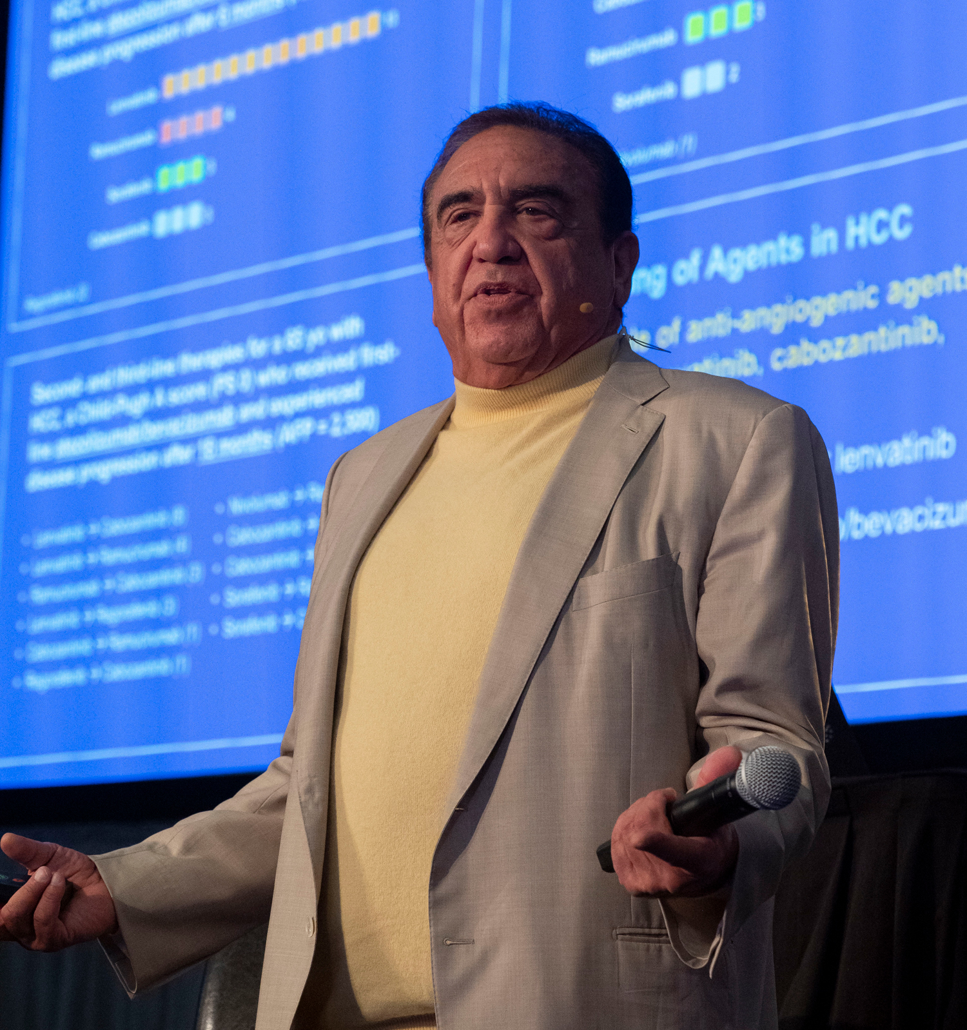
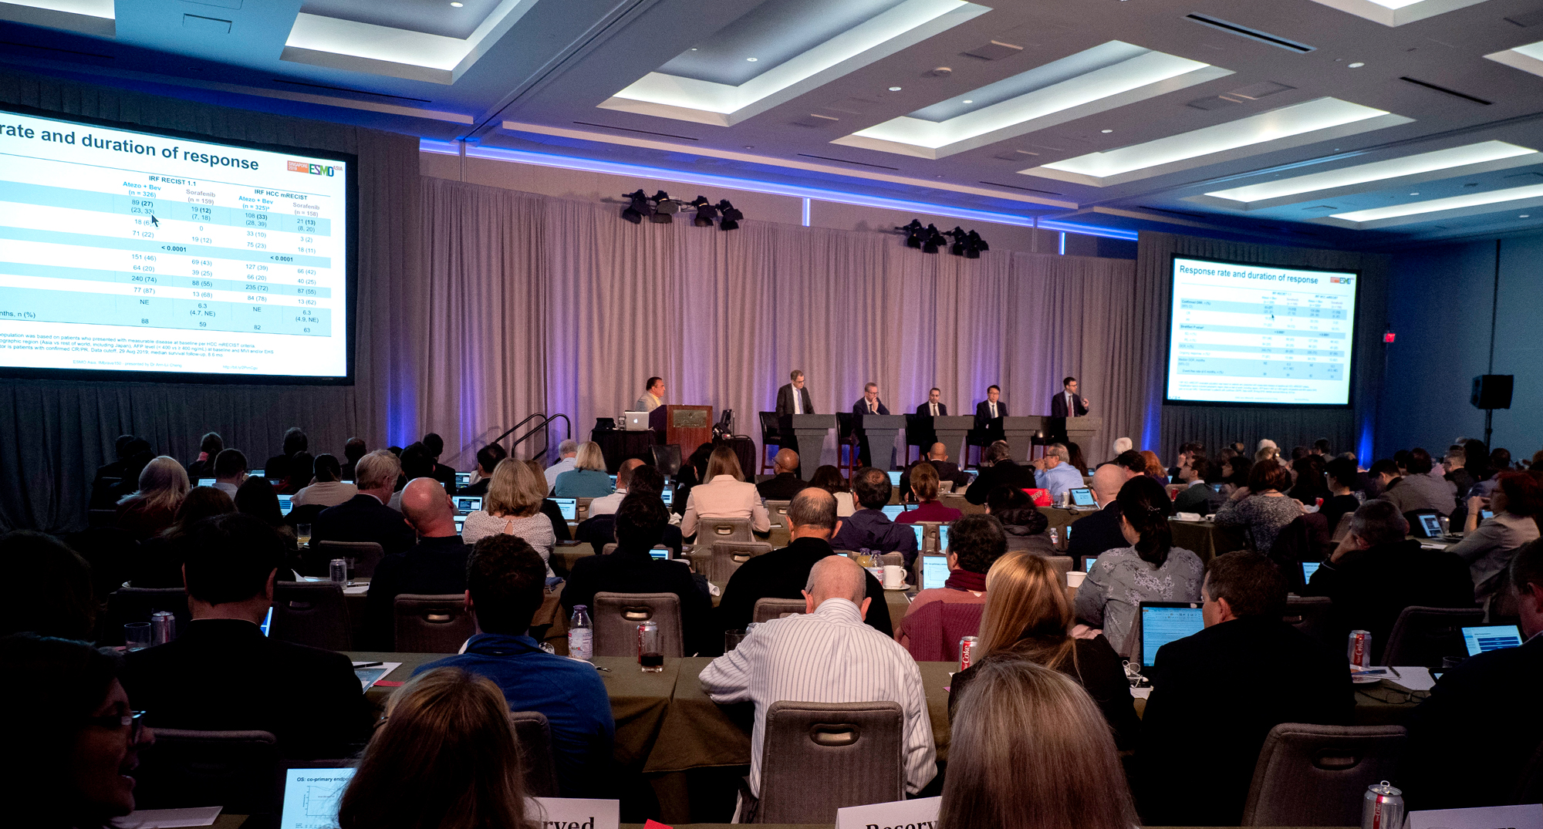

Slide 11
Regulatory and reimbursement issues aside, what would be your current preferred first-line systemic treatment for a 65-year-old patient with HCC, a Child-Pugh B7 score and a PS of 1?
Atezolizumab/ bevacizumab
15
Sorafenib
5
Lenvatinib
3
Sorafenib or lenvatinib — coin flip
2
ASCO Gastrointestinal Symposium, San Francisco CA, January 24, 2020

Slide 12
What would be your most likely first-line systemic treatment for a 65-year-old patient with hepatocellular carcinoma (HCC), a Child-Pugh B score and a performance status (PS) of 1?
Sorafenib
Lenvatinib
Sorafenib or lenvatinib — coin flip
Chemotherapy
Other
Year in Review, Orlando FL, October 26, 2019

Slide 13
Regulatory and reimbursement issues aside, what would be your second-line therapy for a 65 yo with HCC, a Child-Pugh A score and a PS of 0 who received first-line sorafenib, had stable disease for 14 months and experienced disease progression (AFP = 2,500)?
Atezolizumab/bevacizumab
9
Regorafenib
7
Nivolumab
4
Ramucirumab
2
ASCO Gastrointestinal Symposium, San Francisco CA, January 24, 2020

Slide 14
What would be your most likely second-line systemic therapy for a 65-year-old patient with HCC, a Child-Pugh A score and a PS of 0 who received first-line standard-dose sorafenib with minimal toxicity, had stable disease for 14 months and then experienced disease progression (AFP = 2,500)?
Lenvatinib
Regorafenib
Ramucirumab
Chemotherapy
Nivolumab
Pembrolizumab
Cabozantinib
Other
Year in Review, Orlando FL, October 26, 2019

Slide 15
In addition to sorafenib, what is the other FDA-approved first-line systemic treatment for advanced hepatocellular carcinoma (HCC)?
Regorafenib
Lenvatinib
Ramucirumab
An anti-PD-1/PD-L1 antibody
I don’t know

Slide 16
The combination of atezolizumab and bevacizumab as first-line therapy for patients with advanced hepatocellular cancer has been shown in a Phase III trial to result in improved overall survival and quality-of-life outcomes when compared to sorafenib.
I agree
I disagree
I don’t know

Slide 17
Mechanism of Action of Lenvatinib
VEGFR
FGFR
Lenvatinib
X
RAS
Orally available inhibitor of multiple tyrosine kinases including VEGF receptors, FGFR, RET, PDGFR and KIT
Demonstrated promising radiographic response rates and survival results in Phase II and III trials in HCC
PI3K
RAF
MEK
AKT
mTOR
T202/Y204
P
P
T389
ERK1/2
P
S6K
T421/S424
S235/S236
P
S6
Angiogenesis
Finn RS et al. Proc ASCO 2014;Abstract TPS4153; Stjepanovic N et al. Biologics 2014;8:129-39; Cheng AL et al. Proc ASCO 2017;Abstract 4001; Ikeda K et al. J Gastroenterol 2017;52(4):512-9.

Slide 18
Lenvatinib
Mechanism of action
Oral multikinase inhibitor
Indication
For patients with unresectable hepatocellular carcinoma as first-line therapy
Recommended dose
12 mg orally once daily in patients 60 kg or greater actual body weight
8 mg orally once daily in patients less than 60 kg actual body weight
https://www.fda.gov/drugs/resources-information-approved-drugs/fda-approves-lenvatinib-unresectable-hepatocellular-carcinoma

Slide 19
Mechanism of Action of Cabozantinib
VEGF
HGF
VEGFR
MET
Cabozantinib
RAS
Cabozantinib provides dual inhibition of MET and VEFGR2, thereby preventing the MET pathway from acting as an alternative pathway in the development of VEGF
MAPK
STAT
PI3K
NF-κB
RAF
RAS
AKT
MEK
mTOR
MDM2
ERK
BAD
Angiogenesis
Cell survival, migration, invasion, proliferation

Slide 20
Cabozantinib
Mechanism of action
Oral multikinase inhibitor
Indication
For patients with unresectable hepatocellular carcinoma as first-line therapy
Recommended dose
60 mg once daily without food until disease progression or unacceptable toxicity
https://www.fda.gov/drugs/resources-information-approved-drugs/fda-approves-lenvatinib-unresectable-hepatocellular-carcinoma

Slide 21
Mechanism of Action of Ramucirumab
VEGF ligands
Ramucirumab
VEGFR-2
RAS
Ramucirumab is a monoclonal antibody that binds to the extracellular binding domain of the VEGFR-2 receptor, preventing the binding of VEGF ligands
By blocking the activation of VEGFR-2 by VEGF ligands, ramucirumab inhibits the angiogenesis pathways involved in the development and progression of cancer
PI3K/AKT
RAF
Survival
MEK
ERK
Angiogenesis

Slide 22
Ramucirumab
Mechanism of action
Anti-VEGFR2 monoclonal antibody
Indication
Single agent for the treatment of hepatocellular carcinoma in patients who have an alpha fetoprotein of ≥400 ng/mL and have received sorafenib
Dose/schedule
8 mg/kg every 2 weeks
https://www.accessdata.fda.gov/drugsatfda_docs/label/2019/125477s029lbl.pdf; Ramucirumab package insert.

Slide 23
Atezolizumab/Bevacizumab Regimen
Mechanism of action
PD-L1 inhibitor
Anti-VEGF monoclonal antibody
Indication
Investigational
Phase III study dose
Atezolizumab: 1,200 mg every 3 weeks
Bevacizumab: 15 mg/kg every 3 weeks
Key Toxicities
Grade 3/4 hypertension: 15%
Finn RS et al. N Engl J Med 2020;382(20):1894-905.

Slide 24
IMbrave150: A Phase III Trial of Atezolizumab/Bevacizumab
Eligibility (N = 480)
Locally advanced or metastatic and/or unresectable HCC No prior treatment for HCC Child-Pugh A ECOG PS 0-1
Atezolizumab (1,200 mg, d1 q3wk)
+
Bevacizumab (15 mg/kg, d1 q3wk)
R
Sorafenib (oral)
400 mg BID
2:1
Primary endpoints: Overall survival and progression-free survival
Key secondary endpoints include: Objective response, duration of response and quality of life
Clinicaltrials.gov; Accessed May 2020.

Slide 25
IMbrave150: Co-Primary Endpoints (OS and PFS)
OS
PFS (IRF assessed RECIST 1.1)
 | Atezo + bev | Sorafenib
Median, mo | NE | 13.2
HR | 0.58
P-value | 0.0006
 | Atezo + bev | Sorafenib
Median, mo | 6.8 | 4.3
HR | 0.59
P-value | <0.0001
Patients without disease progression or death (%)
Patients who survived (%)
Months
Months
Study demonstrated a statistically significant and clinically meaningful improvement in OS and PFS with atezolizumab/bevacizumab
Galle PR et al. Gastrointestinal Cancers Symposium 2020;Abstract 476

Slide 26
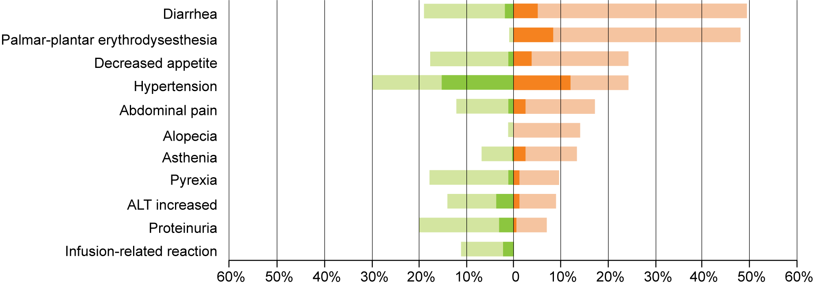
IMbrave150: Safety Results
Atezo + Bev (n = 329)
Sorafenib (n = 156)
All-grade AEs
All-grade AEs
Grade 3-4 AEs
Grade 3-4 AEs
Galle PR et al. Gastrointestinal Cancers Symposium 2020;Abstract 476

Slide 27
Press Release: Supplemental Biologics License Application to the FDA for Atezolizumab/Bevacizumab for Untreated HCC — January 27, 2020
A supplemental Biologics License Application has been submitted to the FDA for atezolizumab in combination with bevacizumab for the treatment of patients with unresectable hepatocellular carcinoma (HCC) who have not received prior systemic therapy. The FDA is reviewing the application under the Real-Time Oncology Review pilot program, which aims to explore a more efficient review process to ensure safe and effective treatments are available to patients as early as possible.
In July 2018, the FDA granted Breakthrough Therapy Designation for atezolizumab in combination with bevacizumab in HCC based on data from an ongoing Phase Ib trial.
This application is based on the results of the Phase III IMbrave150 study, which demonstrated that atezo/bev reduced the risk of death (OS) by 42% (HR = 0.58; p = 0.0006) and reduced the risk of disease worsening or death (PFS) by 41% (HR = 0.59; p < 0.0001), compared with sorafenib. Safety for atezo/bev was consistent with the known safety profiles of the individual agents.
https://www.roche.com/media/releases/med-cor-2020-01-27.htm

Slide 28
Press Release: FDA Grants Accelerated Approval to Nivolumab and Ipilimumab Combination for HCC — March 10, 2020
On March 10, 2020, the Food and Drug Administration granted accelerated approval to the combination of nivolumab and ipilimumab for patients with hepatocellular carcinoma (HCC) who have been previously treated with sorafenib.
Efficacy of the combination was investigated in Cohort 4 of CheckMate-040, (NCT01658878) a multicenter, multiple cohort, open-label trial conducted in patients with HCC who progressed on or were intolerant to sorafenib. A total of 49 patients received nivolumab 1 mg/kg in combination with ipilimumab 3 mg/kg every 3 weeks for four doses, followed by single-agent nivolumab 240 mg every 2 weeks until disease progression or unacceptable toxicity.
https://www.fda.gov/drugs/resources-information-approved-drugs/fda-grants-accelerated-approval-nivolumab-and-ipilimumab-combination-hepatocellular-carcinoma

Slide 29
63-year-old previously healthy, active man (from the practice of Ms Triglianos)
2018: Presented to ER with RUQ abdominal pain (CT scan: large liver mass)
Hepatitis C (eventually treated with ledipasvir-sofosbuvir)
Poorly differentiated 10-cm hepatic and 4.5-cm adrenal adenocarcinoma consistent with HCC (AFP: 193, Ca 19-9 < 1.4)
7/2018: Clinical trial (GO30140): Atezolizumab + bevacizumab
11/2018: Decreasing liver and adrenal lesions
10/2019: Stable dominant liver lesion, slight increase in a satellite lesion, adrenal lesion no longer visible
Hepatectomy, right adrenalectomy
Bevacizumab discontinued due to proteinuria
Currently, off therapy on active surveillance every 3 months

Slide 30
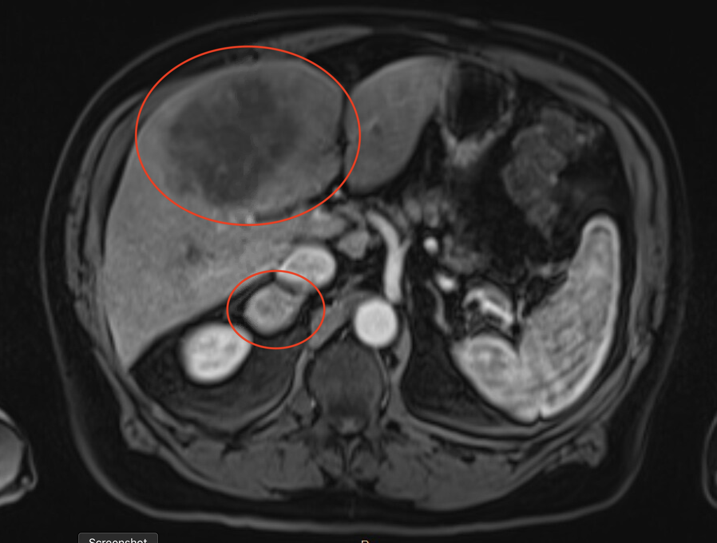
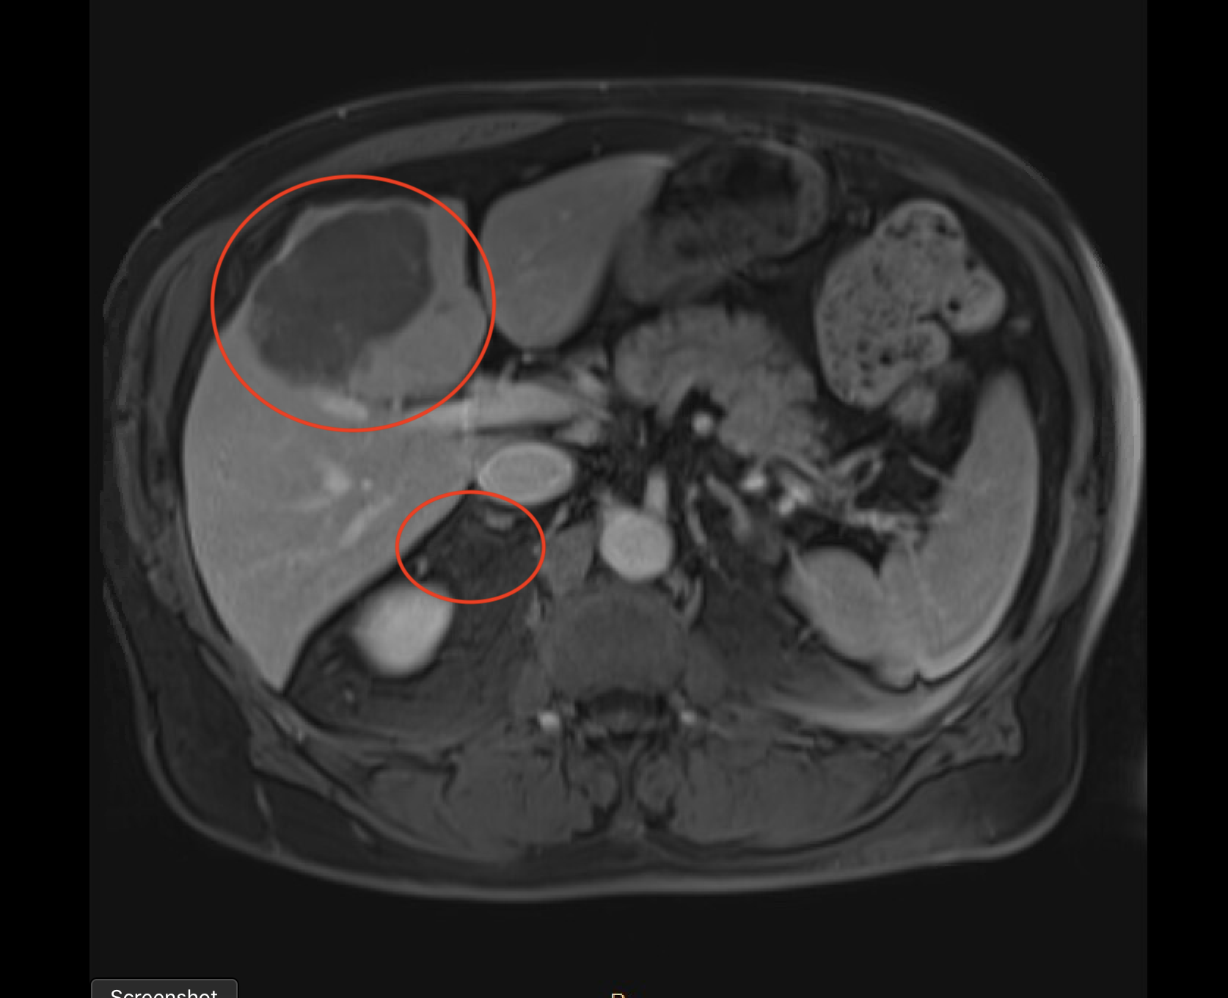
63-year-old man (from the practice of Ms Triglianos)
Prior to
Atezolizumab/bevacizumab
After
Atezolizumab/bevacizumab

Slide 31
63-year-old man with metastatic hepatocellular cancer (from the practice of Ms Triglianos)
Patient education
Review of side effects of immunotherapy:
diarrhea/intestinal issues (colitis)
skin reactions/rash or other skin changes/mouth sores
lung problems/SOB/cough (pneumonitis)
liver problems/yellowing of eyes, bleeding, abd pain (hepatitis)
hormone abnormalities (pituitary, thyroid, pancreas, adrenal glands)
headaches, nausea/vomiting, rapid heart rate, extreme fatigue, excessive thirst or urination, hair loss, changes in mood
brain (encephalitis) – headaches, vision changes, weakness, drooping of eyelids
other teaching points: Avoid systemic steroids for nonimmune-related side effects
Review side effects of bevacizumab:
hypertension, proteinuria, increased risk of bleeding / thrombosis and rare risk of intestinal perforation

Slide 32
Module 2: Current Clinical Algorithms for Patients with Metastatic Colorectal Cancer (mCRC)
Clinical implications of tumor sidedness, MSI status, RAS and BRAF in mCRC

Slide 33
Patients with RAS wild-type metastatic colon cancer generally do not receive an EGFR antibody as part of first-line therapy if their tumor originates on…
The left side
The right side
I don’t know

Slide 34
Patients with metastatic colorectal cancer and a BRAF V600E tumor mutation do not generally respond to targeted treatment with regimens that contain a BRAF inhibitor and an EGFR antibody.
Agree
Disagree
I don’t know

Slide 35
Which of the following regimens recently received FDA approval for the treatment of metastatic colorectal cancer with a BRAF V600E mutation?
Dabrafenib/trametinib
Vemurafenib/cobimetinib
Encorafenib/cetuximab
Encorafenib/binimetinib/cetuximab
I don’t know

Slide 36
Which of the following descriptions best reflects the mechanism of action of TAS-102?
Anti-angiogenic agent
PI3 kinase inhibitor
Novel antimetabolite/chemotherapy agent
Antibody-drug conjugate
I don’t know

Slide 37
Patients with metastatic colorectal cancer who experience neutropenia while receiving TAS-102…
Have a better clinical response rate than those who do not experience neutropenia
Have the same clinical response rate as those who do not not experience neutropenia
Have a worse clinical response rate than those who do not experience neutropenia
I don’t know
I am not familiar with this agent

Slide 38
Based on your clinical experience, how would you compare the tolerability of TAS-102 to that of regorafenib for patients with metastatic colorectal cancer?
About the same
TAS-102 is more tolerable
Regorafenib is more tolerable
I don’t know
I have not used these agents

Slide 39
Patients with microsatellite instability (MSI)-high/mismatch repair-deficient metastatic cancers have been shown to have a high rate of response to…
EGFR antibodies
Bevacizumab
Immune checkpoint inhibitors
I don’t know

Slide 40
Incurable Metastatic Colorectal Cancer Treatment Subsets
Pan-RAS
Mutant
Wild type
Right-sided
Left-sided
MSI-high
HER2 mutation/
amplification
BRAF V600E
mutation

Slide 41
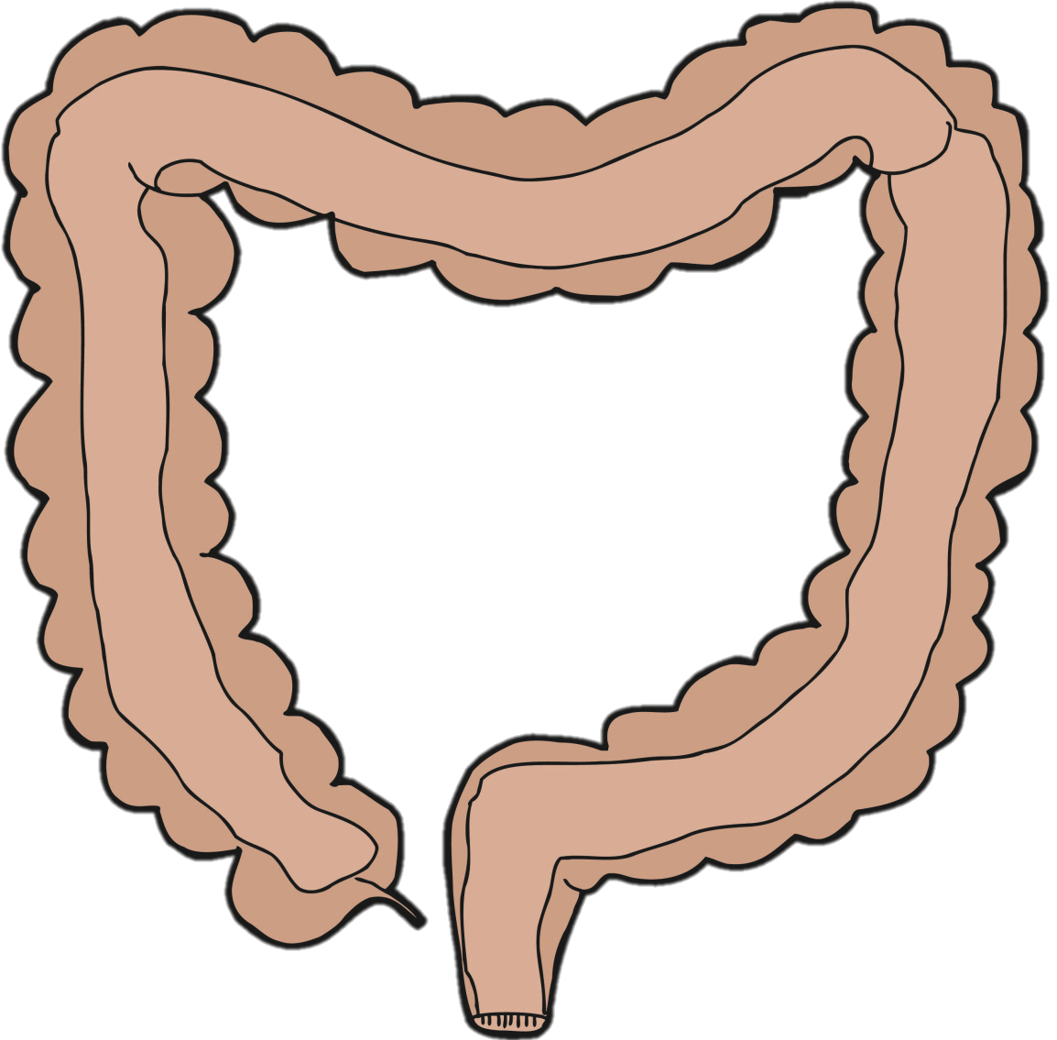
Tumor Sidedness Associated with Genetic Alterations
RAS
MSI
BRAF
PIK3CA
PTEN
RAS
KRAS
HER2/NEU
APC
TP53
RAS
KRAS
HER2/NEU
APC
TP53
© 2017 The Ruesch Center for the Cure of GI Cancers
Venook A et al. Proc ASCO 2016;Abstract 3504.

Slide 42
CALGB/SWOG 80405: Overall Survival by Biologic Agent and Primary Tumor Sidedness
Left-sided primary
Right-sided primary
Agent | N | Median | HR | p-value
Bev | 356 | 31.4 | 0.817 | 0.018
Cetux | 376 | 36.0
Agent | N | Median | HR | p-value
Bev | 150 | 24.2 | 1.269 | 0.065
Cetux | 143 | 16.7
Cetux
Bev
Bev
Cetux
Venook A et al. Proc ASCO 2016;Abstract 3504.

Slide 43
CALGB/SWOG 80405: Overall Survival by Biologic Agent and Primary Tumor Sidedness
Left-sided primary
Right-sided primary
Agent | N | Median | HR | p-value
Bev | 356 | 31.4 | 0.817 | 0.018
Cetux | 376 | 36.0
Agent | N | Median | HR | p-value
Bev | 150 | 24.2 | 1.269 | 0.065
Cetux | 143 | 16.7
NCCN Guidelines:
Only patients whose primary tumors originated on the left side should be offered cetuximab or panitumumab in the first-line treatment of metastatic disease
Cetux
Bev
Bev
Cetux
Venook A et al. Proc ASCO 2016;Abstract 3504.

Slide 44
TAS-102
Mechanism of action
Combination of trifluridine, a nucleoside metabolic inhibitor, and tipiracil, a thymidine phosphorylase inhibitor
Indication
For patients with mCRC who have previously received fluoropyrimidine-, oxaliplatin- and irinotecan-based chemotherapy, an anti-VEGF biologic product and an anti-EGFR therapy, if RAS wild type
Recommended dose
35 mg/m² per dose PO twice daily on days 1 through 5 and days 8 through 12 of each 28-day cycle
http://www.fda.gov/Drugs/InformationOnDrugs/ApprovedDrugs/ucm463743.htm
TAS-102 package insert

Slide 45
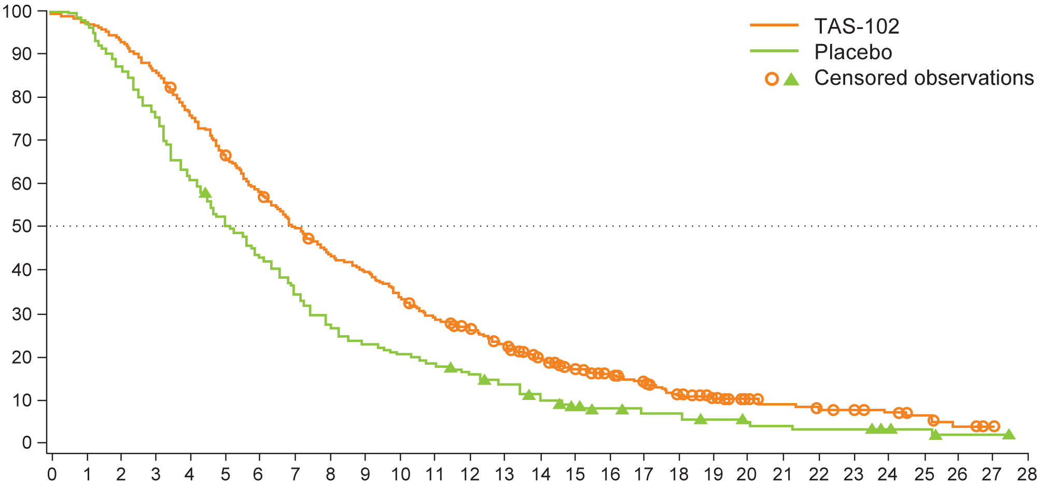
RECOURSE: Final Overall Survival with TAS-102 versus Placebo
Median OS, months
TAS-102 (n = 534): 7.2
Placebo (n = 266): 5.2
HR 0.69; P < 0.0001
Survival (%)
Months from randomisation
Van Cutsem E et al. Eur J Ca 2018;90:62-72.

Slide 46
A Phase II Trial of TAS-102 and Bevacizumab
Eligibility (N = 93)
Patients with metastatic CRC Refractory or intolerant to a fluoropyrimidine, irinotecan, oxaliplatin and cetuximab to panitumumab WHO PS 0-1
TAS-102 + Bevacizumab
(n = 46)
R
TAS-102
(n = 47)
1:1
Primary endpoint: Investigator-assessed progression-free survival
Key secondary endpoints include: Overall survival, response rate, toxicity and tumor markers
Pfeiffer P et al. Lancet Oncol 2020;21(3):412-20.

Slide 47
TAS-102 +/- Bevacizumab: Efficacy Results
Median progression-free survival, months (95% CI)
TAS-102 2.6 (1.6-3.5)
TAS-102 plus bevacizumab 4.6 (3.5-6.5)
HR 0.45 (95% CI 0.29-0.72); p = 0.0015
TAS-102
TAS-102 plus bevacizumab
Progression-free survival (%)
Median overall survival, months (95% CI)
TAS-102 6.7 months (4.9-7.6)
TAS-102 plus bevacizumab 9.4 months (7.6-10.7)
HR 0.55 (95% CI 0.32-0.94); p = 0.028
Time since randomisation (months)
Disease control rate:
TAS-102/Bev = 67%
TAS-102 = 51%
Overall survival (%)
Time since randomisation (months)
Pfeiffer P et al. Lancet Oncol 2020;21(3):412-20.

Slide 48
TAS-102 +/- Bevacizumab: Select AEs
Adverse event, n (%) | TAS-102 (n = 47) |  | TAS-102 + bev (n = 46)
 | Grade 1-2 | Grade 3-5 | Grade 1-2 | Grade 3-5
Fatigue | 74% | 11% | 78% | 7%
Nausea | 64% | 6% | 57% | 2%
Anemia | 55% | 17% | 63% | 4%
Diarrhea | 32% | 0 | 28% | 9%
Neutropenia | 28% | 38% | 17% | 67%
Thrombocytopenia | 17% | 0 | 37% | 2%
Febrile neutropenia | — | 2% | — | 6%
Pfeiffer P et al. Lancet Oncol 2020;21(3):412-20.

Slide 49
Regorafenib
Mechanism of action
Oral multikinase inhibitor
Indication
For patients with mCRC previously treated with fluoropyrimidine-, oxaliplatin- and irinotecan-based chemotherapy, with an anti-VEGF therapy and, if KRAS wild type, with an anti-EGFR therapy
Recommended dose
160 mg orally, once daily for the first 21 days of each 28-day cycle
http://www.fda.gov/Drugs/InformationOnDrugs/ApprovedDrugs/ucm321378.htm
Regorafenib package insert

Slide 50
Regorafenib: Mechanism of Action
Inhibition of proliferation of certain tumor cells
Inhibition of tumor microenvironment signals
Inhibition of neoangiogenesis
Regorafenib is an oral tumor deactivation agent that potently blocks multiple protein kinases, including kinases involved in:
Tumor angiogenesis (VEGFR1, -2, -3, TIE2)
Oncogenesis (KIT, RET, RAF-1, BRAF, BRAFV600E)
Tumor microenvironment (PDGFR, FGBR)
https://www.slideshare.net/BayerAG/meet-management-20130319investorhandoutwebslideshare

Slide 51
Regorafenib Dose-Optimisation in Patients with Refractory Metastatic Colorectal Cancer (ReDOS): A Randomised, Multicentre, Open-Label, Phase 2 Study
Bekaii-Saab TS et al. Lancet Oncol 2019;20(8):1070-82.

Slide 52
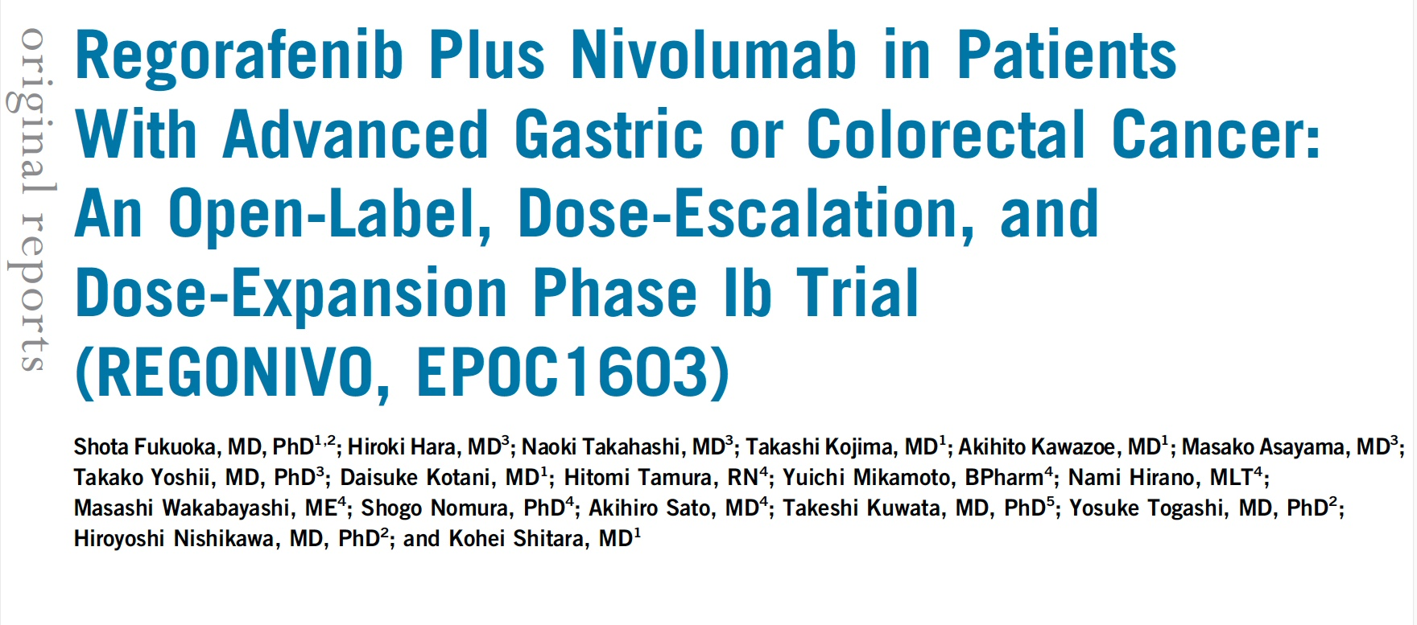
J Clin Oncol 2020;[Online ahead of print].

Slide 53
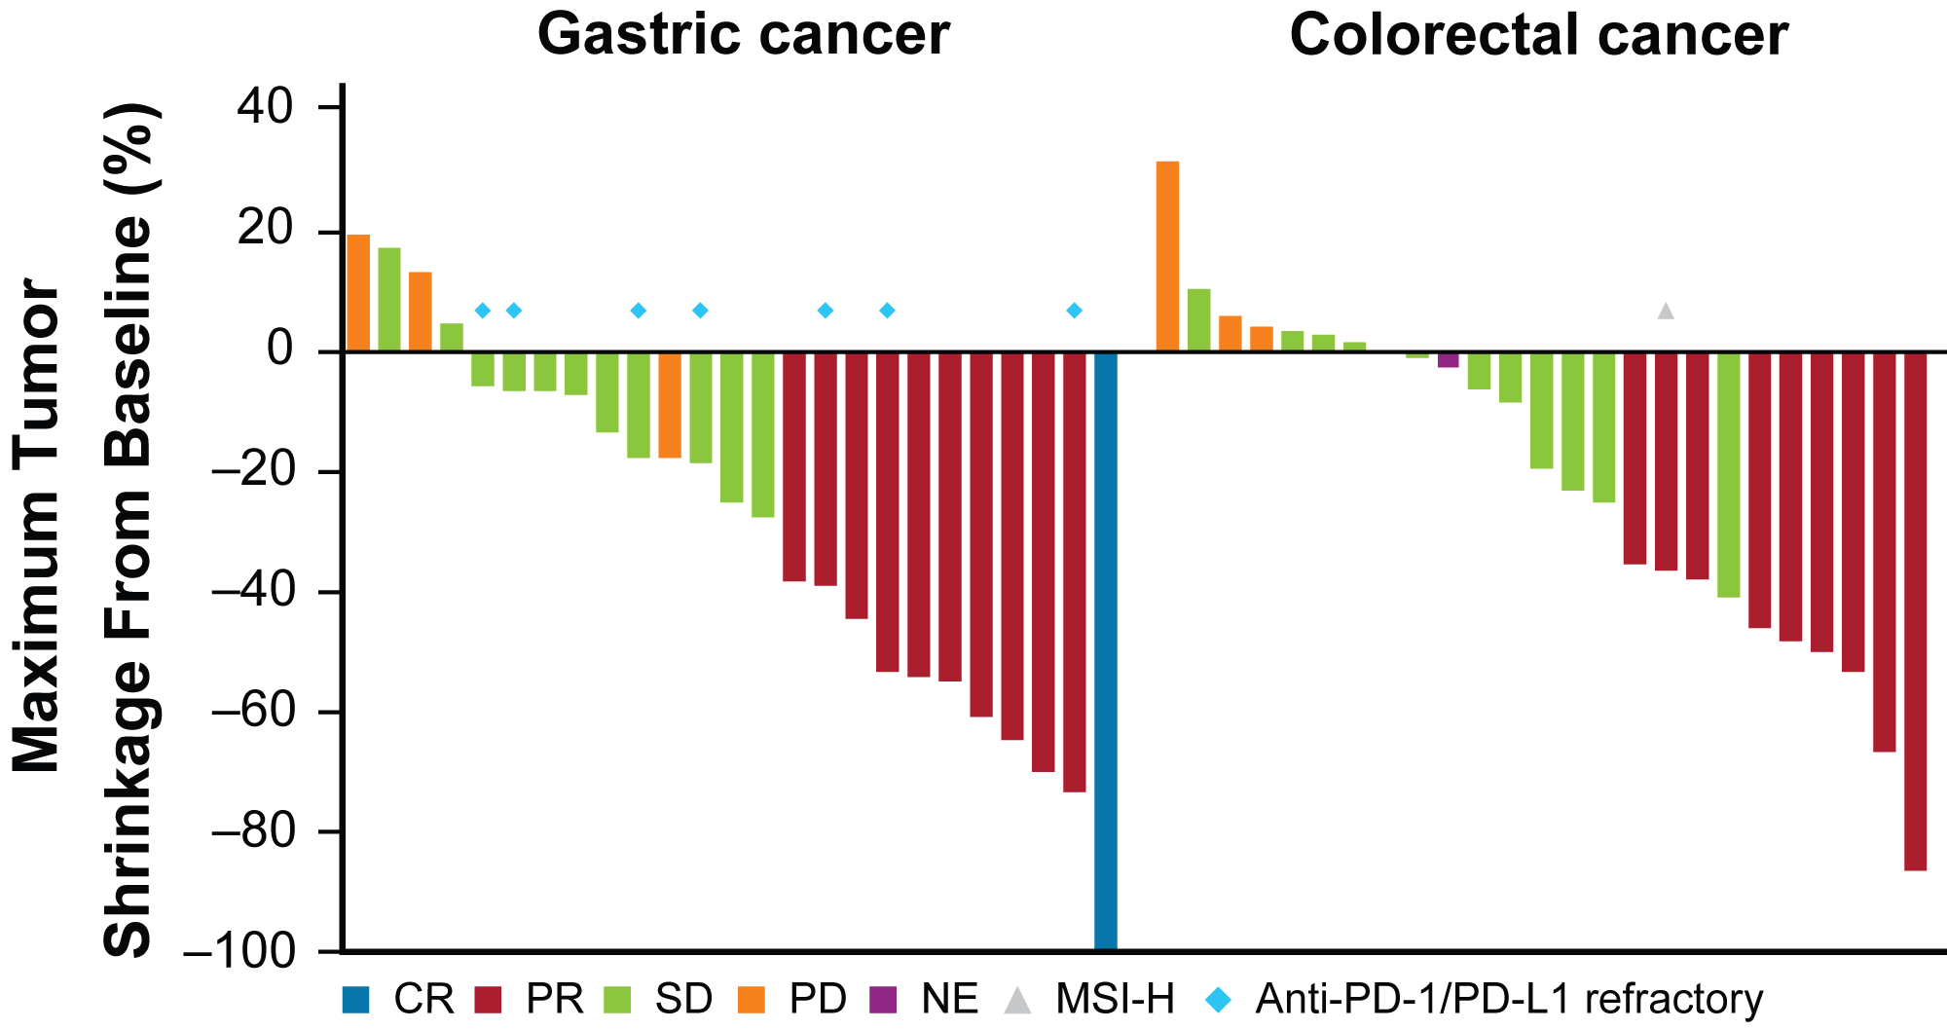
REGONIVO: Waterfall Plot of Maximum Percent Change in Tumor Size from Baseline
Fukuoka S et al. J Clin Oncol 2020;[Online ahead of print].

Slide 54
REGONIVO: Longitudinal Percent Tumor Change from Baseline
Fukuoka S et al. J Clin Oncol 2020;[Online ahead of print].

Slide 55
BRAF Mutations in Colorectal Cancer
BRAF mutated in 10%-20% of CRC
Leads to constitutive activation & cell proliferation
Nonoverlapping pattern with KRAS mutation
Confers inferior prognosis
Poor response to single-agent BRAF inhibitors
Ras
Raf
MEK
ERK
Survival
Proliferation
Courtesy of Charles S Fuchs, MD.
Notes:
In 2002, Davies
et al. reported that BRAF is mutated in approximately 8%
of human tumors, BRAF mutations are found clustered within the P-loop
(exon 11) and activation segment (exon 15) of the kinase
domain (see Figure 2). A single glutamic acid for valine
substitution at residue 600 (V600E, initially designated
V599E) within the activation segment of the kinase
domain is observed in approximately 90% of cases
[2,5]. V600E BRAF mutations are with rare exception
found in a non-overlapping pattern with RAS mutations
suggesting that each of these genetic alterations are
sufficient to activate common downstream effectors of
transformation. pharmacologic inhibition of BRAF and MEK,
abrogates tumor growth in BRAF mutant xenografts
and transgenic mice [17,18,19]. Overall, these data
suggest that V600E BRAF plays an important role in
both tumor initiation and maintenance and that targeting
BRAF or its downstream effectors may have therapeutic
benefit.

Slide 56
Select Systemic Treatments for CRC with BRAF Tumor Mutations
BRAF V600E Mutation-Positive
Dabrafenib + trametinib + (cetuximab or panitumumab)
Encorafenib + binimetinib + (cetuximab or panitumumab)
Vemurafenib + irinotecan + (cetuximab or panitumumab)
Encorafenib + cetuximab
NCCN Guidelines Version 1.2019 – Colon Cancer.

Slide 57
Encorafenib and Cetuximab
Mechanism of action
Encorafenib – oral Raf kinase inhibitor
Cetuximab – anti-EGFR monoclonal antibody
Indication
Encorafenib in combination with cetuximab: For patients with mCRC and a BRAF V600E mutation
Recommended dose
300 mg orally once daily in combination with cetuximab
400 mg/m² initial dose → 250 mg/m² weekly
https://www.accessdata.fda.gov/drugsatfda_docs/label/2020/210496s006lbl.pdf

Slide 58
Encorafenib, Binimetinib, and Cetuximab in BRAF V600E–Mutated Colorectal Cancer
Kopetz S et al. N Engl J Med 2019;381(17):1632-43.

Slide 59
BEACON CRC: Select AEs
Grade 3 | Encora/cetux/bini (n = 222) | Encora/cetux (n = 216) | Control (n = 193)
Diarrhea | 10% | 2% | 10%
Fatigue | 2% | 4% | 4%
Nausea | 5% | <1% | 1%
Dermatitis acneiform | 2% | 1% | 3%
Abdominal pain | 6% | 2% | 5%
Decreased appetite | 2% | 1% | 3%
Arthralgia | 0 | 1% | 0
Rash | <1% | 0 | 2%
Kopetz S et al. N Engl J Med 2019;381(17)1632-43.

Slide 60
FDA Approval of Encorafenib in Combination with Cetuximab for mCRC — April 8, 2020
On April 8, 2020, the FDA approved encorafenib in combination with cetuximab for the treatment of adult patients with metastatic colorectal cancer (CRC) with a BRAF V600E mutation, detected by an FDA-approved test, after prior therapy.
Efficacy was evaluated in a randomized, active-controlled, open-label, multicenter trial (BEACON CRC; NCT02928224). Eligible patients were required to have BRAF V600E mutation-positive metastatic CRC with disease progression after one or two prior regimens.
The most common adverse reactions (≥25%) for encorafenib with cetuximab were fatigue, nausea, diarrhea, dermatitis acneiform, abdominal pain, decreased appetite, arthralgia, and rash.
https://www.fda.gov/drugs/resources-information-approved-drugs/fda-approves-encorafenib-combination-cetuximab-metastatic-colorectal-cancer-braf-v600e-mutation

Slide 61
Encorafenib plus Cetuximab with or without Binimetinib for BRAF V600E Metastatic Colorectal Cancer: Updated Survival Results from a Randomized, Three-Arm, Phase III Study versus Choice of Either Irinotecan or FOLFIRI plus Cetuximab (BEACON CRC)
Kopetz S et al. ASCO 2020;Abstract 4001.

Slide 62
What Is Microsatellite Instability (MSI)?
Microsatellites:
Repetitive segments of DNA
The same number of repeats are present in every cell
Microsatellite instability:
The number of microsatellite repeats differs between normal cells/tissue and tumor cells/tissue
Most MSI tumors are sporadic
Virtually all Lynch tumors are MSI high
Normal microsatellite with 2 repeats
Tumor tissue with MSI variable repeat size 5 & 3
http://www.slideshare.net/Pammy98/hereditary-colorectal-cancer-powerpoint-educational-module

Slide 63
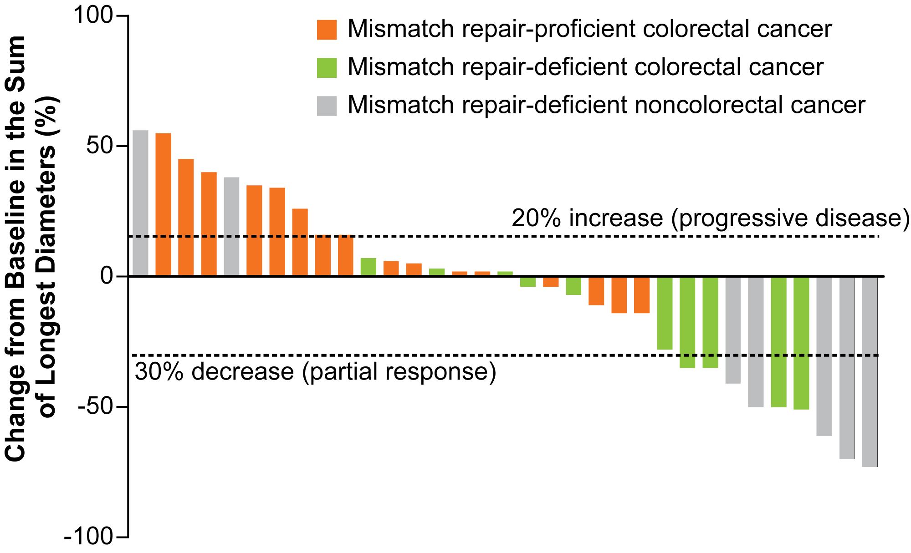
Immunotherapy in Cancers with Mismatch Repair Deficiency
Waterfall Plot: Radiographic Response to Pembrolizumab
Le DT et al. N Engl J Med 2016;372(26):2509-20.

Slide 64
Pembrolizumab Versus Chemotherapy for Microsatellite Instability-High/Mismatch Repair Deficient Metastatic Colorectal Cancer: The Phase 3 KEYNOTE-177 Study
Andre T et al. ASCO 2020;Abstract LBA4 (Plenary).

Slide 65
KEYNOTE-177: A Phase III Trial in MSI-High or dMMR mCRC
Eligibility (N = 308)
Patients with Stage IV CRC Locally confirmed MSI-high or dMMR No prior systemic therapy for Stage IV CRC ECOG PS 0-1
Pembrolizumab
R
Chemotherapy
(mFOLFOX6 or FOLFIRI +/- Bevacizumab or Cetuximab)
Primary endpoints: Progression-free survival and overall survival
Key secondary endpoints include: Overall response rate
Clinicaltrials.gov; Accessed May 2020.

Slide 66
A Phase II, Multicenter, Open-label Study of Trastuzumab Deruxtecan (T-DXd; DS-8201) in Patients (pts) with HER2-Expressing Metastatic Colorectal Cancer (mCRC): DESTINY-CRC01
Siena S et al. ASCO 2020;Abstract 4000.

Slide 67
DESTINY-CRC01: Results from the Trial of Trastuzumab Deruxtecan
All patients | Cohort A (n = 53)
Confirmed ORR | 24 (45.3%)
CR | 1 (2%)
Disease control rate | 44 (83%)
Median PFS | 6.9 mo
Median OS | Not reached
Median duration of treatment | Not reached
In Cohort A: ORR in pts with prior anti-HER2 treatment = 7/16 (43.8%)
No responses were observed in Cohorts B or C.
Sienna S et al. ASCO 2020;Abstract 4000.

Slide 68
DESTINY-CRC01: Safety of Trastuzumab Deruxtecan
Treatment-emergent AEs | Cohort A/B/C (n = 78)
Grade ≥ 3 | 48 (61.5%)
Decreased neutrophil count | 21.8%
Anemia | 14.1%
Interstitial lung disease (ILD)* | 3.8%
Leading to drug discontinuation | 9.0%
* Grade 5 ILD (n = 2)
Sienna S et al. ASCO 2020;Abstract 4000.

Slide 69
84-year-old man with PMH of DM, HTN, HLD and CAD s/p PCI and CABG (from the practice of Ms Triglianos)
Summer 2018: Decreased appetite, nausea, progressive weight loss
Partially obstructing 7-cm mass in cecum, non-obstructing 4-cm mass in the hepatic flexure
Biopsy: adenocarcinoma, CEA normal, no evidence of mets
7/2018: Right colectomy and omentectomy
7.3-cm, Stage IIIB moderately differentiated cecal adenocarcinoma, 1/25 LN
3.5-cm, Stage IIA hepatic flexure adenocarcinoma, 0/25 LN
Molecular profile: MSI-H
Elected observation, due to good prognosis, pre-existing comorbidities
2/2019: Anorexia, new 7.3-cm duodenal mass, 2 retroperitoneal satellite lesions
Biopsy: Recurrent metastatic cecal adenocarcinoma, MSI-H
3/2019: Pembrolizumab
5/2019: “Interval resection” of duodenal mass and decrease in satellite lesions

Slide 70
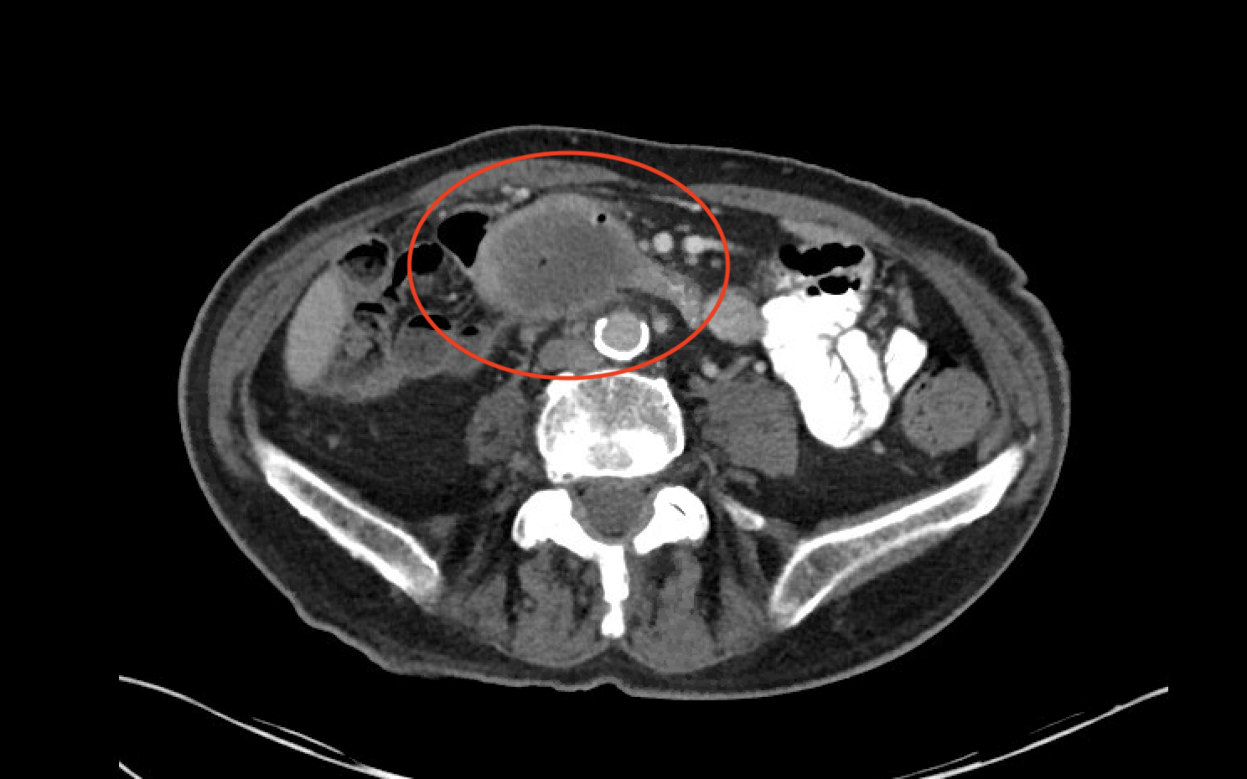
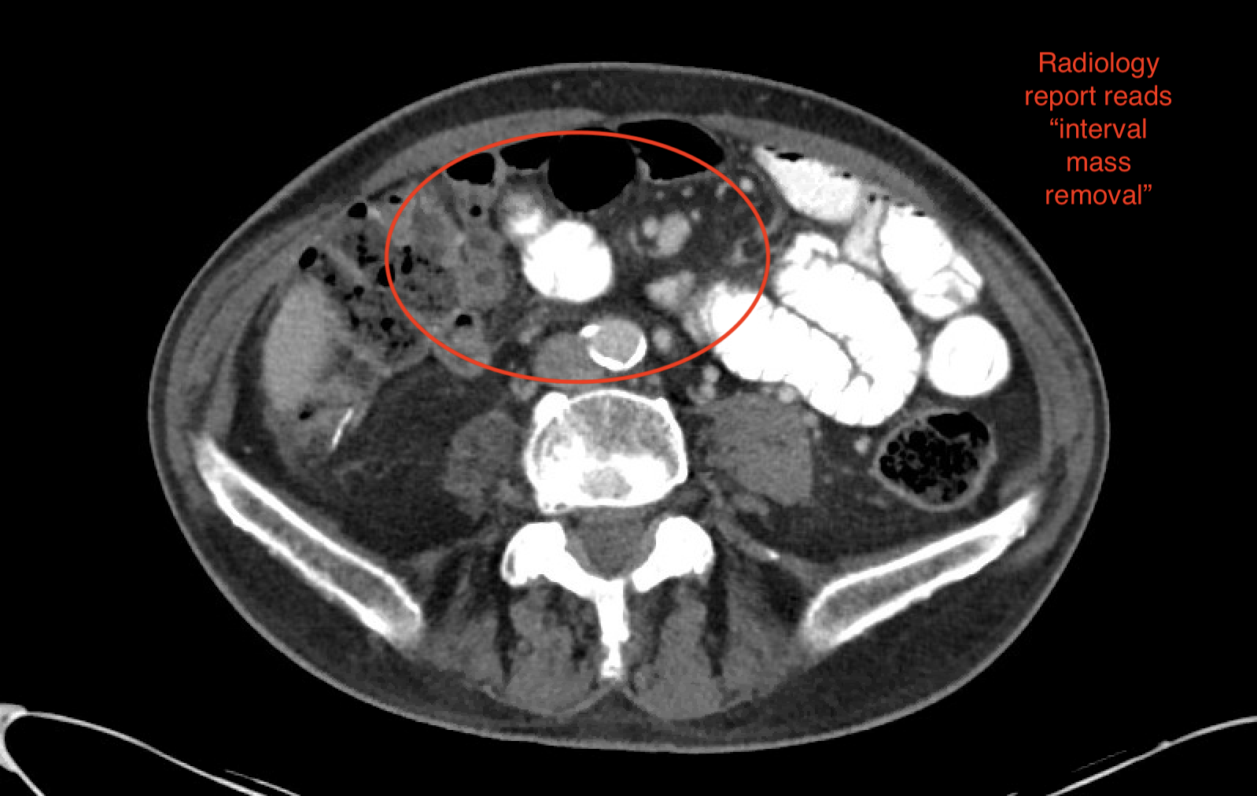
84-year-old man (from the practice of Ms Triglianos)
Prior to pembrolizumab
After pembrolizumab treatment

Slide 71
84-year-old man (from the practice of Ms Triglianos)
Patient education for pembrolizumab
Advise that when triggering the immune system, healthy organs can be adversely affected.
Review of side effects:
diarrhea/intestinal issues (colitis)
skin reactions/rash or other skin changes/mouth sores
lung problems/SOB/cough (pneumonitis)
liver problems/yellowing of eyes, bleeding, abd pain (hepatitis)
hormone abnormalities (pituitary, thyroid, pancreas, adrenal glands)
headaches, nausea/vomiting, rapid heart rate, extreme fatigue, excessive thirst or urination, hair loss, changes in mood
brain (encephalitis) – headaches, vision changes, weakness, drooping of eyelids
Other teaching points: Avoid systemic steroids for nonimmune-related side effects

Slide 72
52-year-old woman with 4 adult offspring and several grandchildren (from the practice of Ms Avella)
1/2015: Abdominal and pelvic pain, anorexia; emotionally distraught
Diagnosed with de novo mCRC, with large sigmoid colon primary, ovarian and pelvic mets
6/2015: Resection of primary
CAPOX/bevacizumab → PD
FOLFIRI/panitumumab x 2 years
Electrolyte insufficiencies (potassium and magnesium infusions)
7/2019: TAS-102 initiated at 35 mg/m² BID
Fatigue (primary complaint), mild nausea and diarrhea, neutropenia
Dose and schedule of TAS-102 modified due to tolerability issues

Slide 73
Module 3: Sequencing of Systemic Therapy in Patients with Metastatic Gastric Cancer
Impact of MSI status, PD-L1 level and HER2 status on treatment choice

Slide 74
The usual second-line therapy for metastatic gastric cancer is…
Ramucirumab
Ramucirumab combined with paclitaxel
TAS-102
Regorafenib
I don’t know

Slide 75
Patients with MSS metastatic gastric adenocarcinoma should generally be offered an anti-PD-1 antibody…
As first-line therapy
As first-line therapy if PD-L1 expression level is high
As second-line therapy
As second-line therapy if PD-L1 expression level is high
I don’t know

Slide 76
Which of the following agents is approved for metastatic gastroesophageal adenocarcinoma previously treated with at least 2 lines of chemotherapy?
Regorafenib
TAS-102
Ibrutinib
Ribociclib
Rucaparib
I don’t know

Slide 77
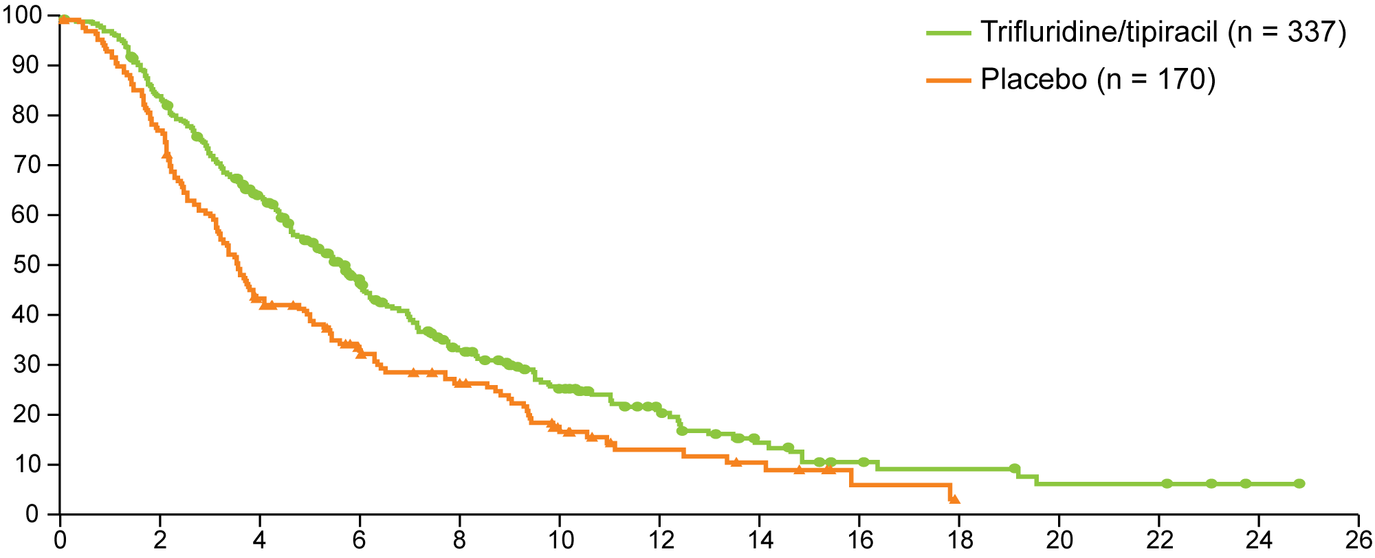
TAGS: Outcome Summary of Phase III Trial of Trifluridine/Tipiracil in Patients with Heavily Pretreated Metastatic Gastric Cancer
Overall Survival
Hazard ratio 0.69 One-sided p = 0.00029; two-sided p = 0.00058
Overall survival (%)
Median OS
Trifluridine/tipiracil 5.7 mo
Placebo 3.6 mo
Time since randomisation (months)
Clinical variable | Trifluridine/tipiracil | Placebo | HR | p-value
Median PFS | 2.0 mo | 1.8 mo | 0.57 | <0.0001
ORR | 4.0% | 2.0% | — | 0.28
Shitara K et al. Lancet Oncol 2018;19(11):1437-48.

Slide 78
Press Release: FDA Approves Trifluridine/Tipiracil (TAS-102) for Previously Treated Advanced Gastric or GEJ Adenocarcinoma — February 25, 2019
The Food and Drug Administration approved trifluridine/tipiracil for the treatment of adult patients with metastatic gastric or GEJ adenocarcinoma previously treated with at least 2 prior lines of chemotherapy that included a fluroropyridimidine, a platinum, either a taxane or ininotecan, and if appropriate, HER2/neu-targeted therapy.
The approval follows an FDA Priority Review designation and is based on data from a global, randomized, Phase III TAGS trial that met its primary and secondary endpoints demonstrating prolonged overall survival (OS) with trifluridine/tipiracil versus placebo, and a safety profile consistent with prior experience with this drug.
https://www.taihooncology.com/us/newsroom/press-releases/2019-02-25-LON-PM-US-1213-FDA-Approves-Gastric

Slide 79
58-year-old man and non smoker with PMH of hyperlipidemia (from the practice of Ms Avella)
Metastatic poorly differentiated adenocarcinoma of the gastroesophageal junction
HER2-negative, MSI-high, PD-L1 CPS score: 15, negative for Lynch Syndrome
2013: FOLFOX x 6, RT; 2014-2015: Paclitaxel + ramucirumab x 6
PET/CT: Worsening mets (solitary liver met, acetabular and cerebellar met – stereotactic RT)
2016: FOLFOX x 12
2/2017 PET/CT: Bone mets with adjacent soft tissue extension
5/2017: Clinical trial of IDO inhibitor epacadostat + pembrolizumab
9/2018 CT: NED, with resolved lymph node, bone mets
11/2018: Dyspnea work up, including cardiac ECHO: LVEF 20-25% consistent with myocarditis
High-dose steroids x 6 weeks → LVEF > 50%
3/2020: Stable disease

Slide 80
68-year-old woman with PMH of diabetes (from the practice of Dr Philip)
Stage IV HER2-negative gastric cardia adenocarcinoma with liver mets (PS=1)
FOLFOX x 9 (best response: PR) → PD
Grade 2 neuropathy, Grade 2 fatigue
Ramucirumab monotherapy due to neuropathy (best response: SD) → PD after 4 months
Mild blood pressure elevation
Tumoral Combined Positive Score (CPS): 0
Overall PS of 2
TAS-102 x 6 months (best response: SD)
Grade 3 neutropenia early in therapy, one level of TAS-102 dose reduction

Slide 81
Module 4: Management of Gastrointestinal Cancers in the Era of COVID-19
Telemedicine, minimization of surgeries, reduced infusions and clinic visits

Slide 82
Do you believe that receiving an anti-PD-1/PD-L1 antibody makes a patient more susceptible to contracting COVID-19?
Yes
No
I don’t know
Do you believe that receiving an anti-PD-1/PD-L1 antibody increases a patient’s risk of developing complications associated with COVID-19?
Yes
No
I don’t know

Slide 83
Has the approach to primary surgery for patients with gastrointestinal cancers changed at your institution during the COVID-19 pandemic?
Yes, quite a bit
Yes, but not very much
No
I don’t know
Has the approach to radiation therapy for patients with gastrointestinal cancers changed at your institution during the COVID-19 pandemic?
Yes, quite a bit
Yes, but not very much
No
I don’t know

Slide 84
Approximately what proportion of your practice was/is telemedicine or virtual visits?
Before COVID-19
None
≥10%
11%-25%
26%-50%
>50%
During COVID-19
None
≥10%
11%-25%
26%-50%
>50%

Slide 85
How does the amount of time you spend on web-based face-to-face patient consultations compare to the amount of time you would have spent conducting in-person office visits before the COVID-19 pandemic?
About the same
I spend more time on web-based patient visits than I did on in-person office visits
I spend less time on web-based patient visits than I did on in-person office visits
I don’t conduct web-based face-to-face patient consultations
Duration of time spent for each web-based face-to-face patient consultation (Median): 20 minutes

Slide 86
Are you restricting the number of visitors allowed in your clinic during the COVID-19 pandemic?
Yes
No
Are the healthcare workers in your clinic required to wear masks or other personal protective equipment (PPE) during the COVID-19 pandemic?
Yes
Are the patients who visit your clinic required to wear masks or other PPE during the COVID-19 pandemic?
Yes
No

