Slide 1
Recent Advances in Medical Oncology:
Melanoma
Wednesday, July 22, 2020
5:00 PM – 6:00 PM ET
Faculty
Michael B Atkins, MD
Professor Georgina Long, AO, BSc, PhD, MBBS
Jason J Luke, MD
Moderator
Neil Love, MD

Slide 2



Faculty
Michael B Atkins, MD
Deputy Director, Georgetown Lombardi Comprehensive Cancer Center
William M Scholl Professor and Vice-Chair Department of Oncology
Professor of Medicine
Georgetown University Medical Center
Washington, DC
Jason J Luke, MD
Associate Professor and Director of the Cancer Immunotherapeutics Center
University of Pittsburgh Medical Center and Hillman Cancer Center
Pittsburgh, Pennsylvania
Professor Georgina Long, AO, BSc, PhD, MBBS
Co-Medical Director of Melanoma Institute Australia
Chair of Melanoma Medical Oncology and Translational Research
Melanoma Institute Australia and Royal North Shore Hospital
The University of Sydney
Sydney, Australia

Slide 3
Commercial Support
This activity is supported by educational grants from Bristol-Myers Squibb Company, Genentech, a member of the Roche Group, and Merck.

Slide 4
Dr Love — Disclosures
Dr Love is president and CEO of Research To Practice. Research To Practice receives funds in the form of educational grants to develop CME activities from the following commercial interests: AbbVie Inc, Acerta Pharma — A member of the AstraZeneca Group, Adaptive Biotechnologies, Agendia Inc, Agios Pharmaceuticals Inc, Amgen Inc, Array BioPharma Inc, a subsidiary of Pfizer Inc, Astellas, AstraZeneca Pharmaceuticals LP, Bayer HealthCare Pharmaceuticals, Biodesix Inc, bioTheranostics Inc, Blueprint Medicines, Boehringer Ingelheim Pharmaceuticals Inc, Boston Biomedical Inc, Bristol-Myers Squibb Company, Celgene Corporation, Clovis Oncology, Daiichi Sankyo Inc, Dendreon Pharmaceuticals Inc, Eisai Inc, EMD Serono Inc, Exelixis Inc, Foundation Medicine, Genentech, a member of the Roche Group, Genmab, Genomic Health Inc, Gilead Sciences Inc, GlaxoSmithKline, Grail Inc, Guardant Health, Halozyme Inc, Helsinn Healthcare SA, ImmunoGen Inc, Incyte Corporation, Infinity Pharmaceuticals Inc, Ipsen Biopharmaceuticals Inc, Janssen Biotech Inc, administered by Janssen Scientific Affairs LLC, Jazz Pharmaceuticals Inc, Kite, A Gilead Company, Lexicon Pharmaceuticals Inc, Lilly, Loxo Oncology Inc, a wholly owned subsidiary of Eli Lilly & Company, Merck, Merrimack Pharmaceuticals Inc, Myriad Genetic Laboratories Inc, Natera Inc, Novartis, Oncopeptides, Pfizer Inc, Pharmacyclics LLC, an AbbVie Company, Prometheus Laboratories Inc, Puma Biotechnology Inc, Regeneron Pharmaceuticals Inc, Sandoz Inc, a Novartis Division, Sanofi Genzyme, Seattle Genetics, Sirtex Medical Ltd, Spectrum Pharmaceuticals Inc, Taiho Oncology Inc, Takeda Oncology, Tesaro, A GSK Company, Teva Oncology, Tokai Pharmaceuticals Inc, Tolero Pharmaceuticals and Verastem Inc.

Slide 5
RESEARCH TO PRACTICE CME PLANNING COMMITTEE MEMBERS, STAFF AND REVIEWERS
Planners, scientific staff and independent reviewers for Research To Practice have no relevant conflicts of interest to disclose.

Slide 6
Dr Atkins — Disclosures
Advisory Committee | Arrowhead Pharmaceuticals, Aveo Pharmaceuticals, Bristol-Myers Squibb Company, Eisai Inc, Exelixis Inc, Genentech, a member of the Roche Group, Idera Pharmaceuticals Inc, Leads Biolabs, Merck, Novartis, PACT Pharma, Pfizer Inc, Pneuma Medical, Pyxis Oncology, Roche Laboratories Inc, Werewolf Therapeutics
Consulting Agreements | Agenus Inc, Apexigen, COTA, Immunocore, Iovance Biotherapeutics, Neoleukin Therapeutics, Third Rock Ventures
Contracted Research (to Institution) | Bristol-Myers Squibb Company, Merck
Data and Safety Monitoring Board/Committee | Novartis, PACT Pharma
Ownership Interest | Pyxis Oncology, Werewolf Therapeutics

Slide 7
Professor Long — Disclosures
Consultant Advisor | Aduro Biotech, Agena Bioscience Inc, Amgen Inc, Bristol-Myers Squibb Company, Highlight Therapeutics, Merck, Merck Sharp & Dohme Corp, Novartis, OncoSec Medical, Pierre Fabre, QBiotics Group, Roche Laboratories Inc, Sandoz Inc, a Novartis Division, Skyline Pharmaceuticals Inc

Slide 8
Dr Luke — Disclosures
Advisory Committee | 7 Hills Pharma LLC, AbbVie Inc, Actym Therapeutics, Alphamab Oncology, Pyxis Oncology, Spring Bank Pharmaceuticals Inc, Tempest Therapeutics Inc
Consulting Agreements | AbbVie Inc, Akrevia Therapeutics, Aligos Therapeutics, Array BioPharma Inc, a subsidiary of Pfizer Inc, Astellas, Bayer HealthCare Pharmaceuticals, Bristol-Myers Squibb Company, Eisai Inc, EMD Serono Inc, IDEAYA Biosciences, Incyte Corporation, Janssen Biotech Inc, Merck, Mersana Therapeutics, Novartis, RefleXion, Silicon Therapeutics, Tesaro, A GSK Company, Vividion Therapeutics
Contracted Research | AbbVie Inc, Agios Pharmaceuticals Inc, Array BioPharma Inc, a subsidiary of Pfizer Inc, Astellas, AstraZeneca Pharmaceuticals LP, Bristol-Myers Squibb Company, Checkmate Pharmaceuticals, Compugen Inc, Corvus Pharmaceuticals, EMD Serono Inc, Evelo Biosciences Inc, Five Prime Therapeutics Inc, Genentech, Immatics Biotechnologies GmbH, Immunocore, Incyte Corporation, Leap Therapeutics Inc, MacroGenics Inc, Merck, Nektar, Novartis, Palleon Pharmaceuticals, RAPT Therapeutics, Spring Bank Pharmaceuticals Inc, Tesaro, A GSK Company, Tizona Therapeutics Inc, Xencor
Data and Safety Monitoring Board/Committee | TTC Oncology
Paid Travel | Akrevia Therapeutics, Bayer HealthCare Pharmaceuticals, Bristol-Myers Squibb Company, EMD Serono Inc, Incyte Corporation, Janssen Biotech Inc, Merck, Mersana Therapeutics, Novartis, Pyxis Oncology, RefleXion
Ownership Interest | AbbVie Inc, Actym Therapeutics, Alphamab Oncology, Pyxis Oncology, Tempest Therapeutics Inc

Slide 9
Agenda
Module 1: Management of Metastatic Melanoma with BRAF Mutation — Dr Luke
Module 2: Case from the Community
Module 3: Adjuvant and Neoadjuvant Treatment — Prof Long
Module 4: Current and Future Use of Checkpoint Inhibition — Dr Atkins

Slide 10
Agenda
Module 1: Management of Metastatic Melanoma with BRAF Mutation — Dr Luke

Slide 11
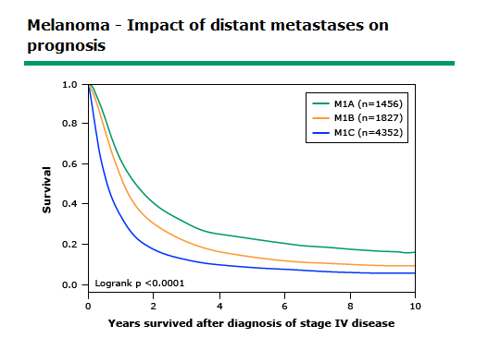

Enormous Change in Treatment for Melanoma
Before 2011:
    Chemotherapy
    Interleukin-2 (fit patients)
In 2020:
  Targeted therapy
    BRAF
      Encorafenib+Binimetinib
      Dabrafenib+Trametinib
      Vemurafenib+Cobimetinib
    KIT
      Imatinib
  Immunotherapy
      Ipilimumab
      Pembrolizumab
      Nivolumab
      Ipilimumab + Nivolumab
  Virotherapy
      Talimogene laherparepvec (TVEC)
Impact of distant metastases on survival in metastatic melanoma – AJCC 7th Ed.
@jasonlukemd
AJCC Cancer Staging Manual, 7th Ed (2010), Springer New York, Inc.
Courtesy of Jason J Luke, MD

Slide 12
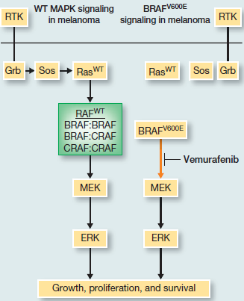
Canonical and BRAF mutant MAPK signaling
BRAF Targeted Therapy:
BRAF inhibitor
MEK inhibitor
@jasonlukemd
Luke et al. Clin Cancer Res. 2012
Courtesy of Jason J Luke, MD

Slide 13
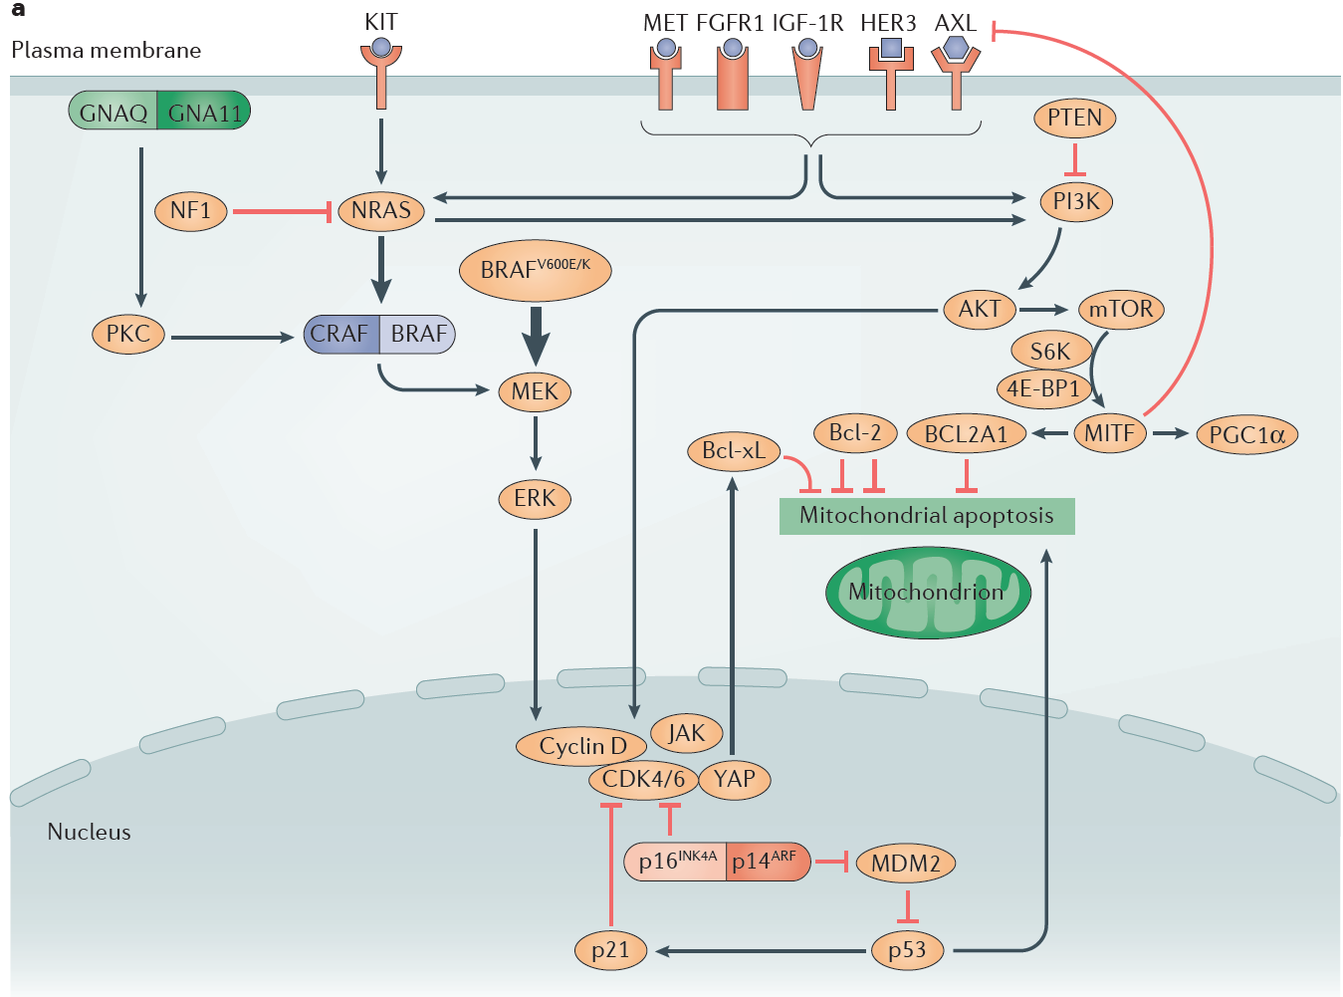
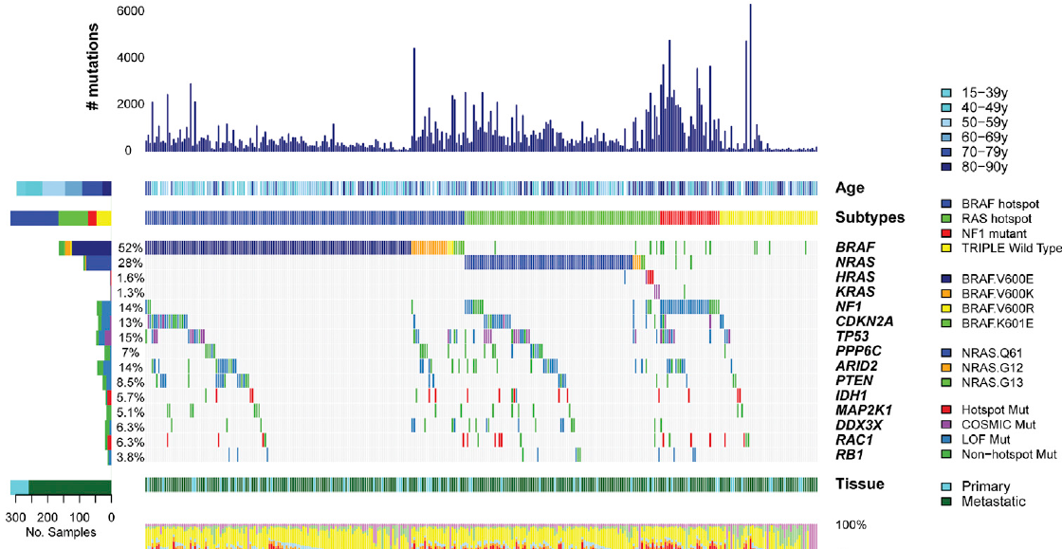
Melanoma signaling networks
TCGA. Cell. 2015; Luke et al. Nat Rev Clin Oncol. 2017
Courtesy of Jason J Luke, MD
@jasonlukemd

Slide 14
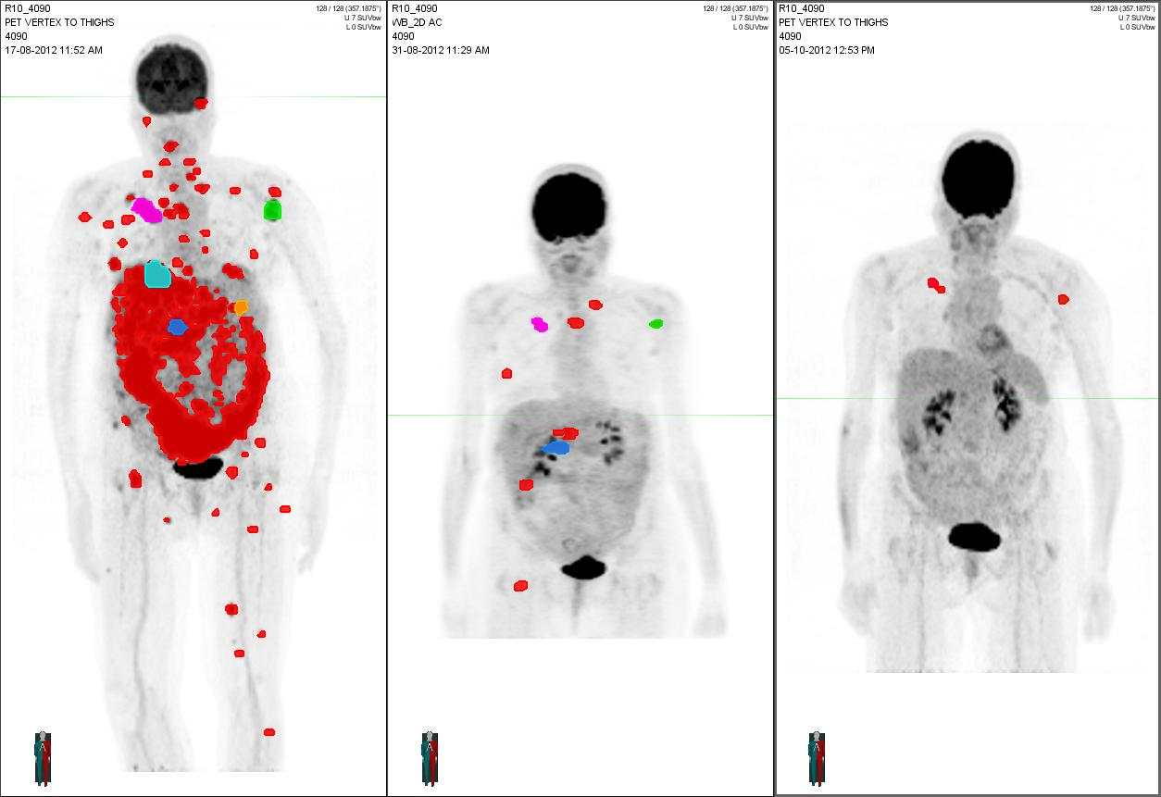
BRAF + MEK inhibitor treatment response
Percent change in tumors
BRAF inhibitor
R² 0.01
p=0.3656
MEK inhibitor
Baseline
Cycle 1
Cycle 2
Luke et al. Clin Can Res 2012
Larkin et al. J Clin Oncol 33, 2015 (suppl; abstr 9006)
Example of patient with high disease burden achieving substantial metabolic response
@jasonlukemd
Courtesy of Jason J Luke, MD

Slide 15
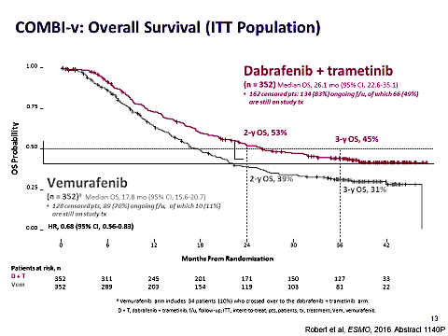
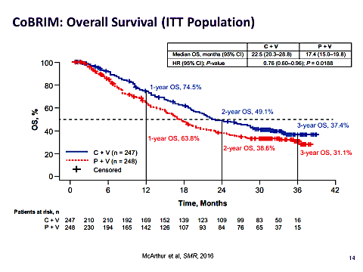
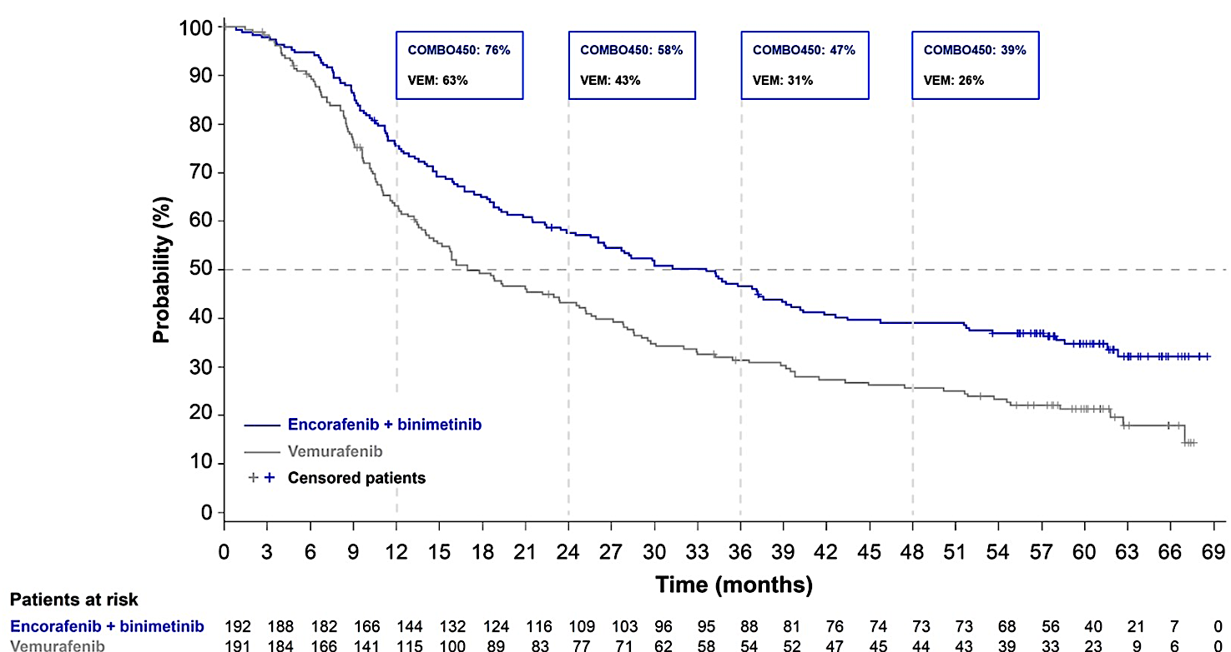
Improved Overall Survival Targeting BRAF
BRAF+MEK Inhibition
Gogas et al. ASCO 2020 abst 10012
@jasonlukemd
Courtesy of Jason J Luke, MD

Slide 16
Toxicities of BRAF and MEK Inhibitors
Dabrafenib + Trametinib | Vemurafenib + Cobimetinib | Encorafenib + Binimetinib
Pyrexia | Rash | Nausea
Fatigue | Diarrhea | Diarrhea
Nausea | Nausea | Vomiting
Headache | Arthralgia | Fatigue
Chills | Fatigue | Arthralgia
Diarrhea | Photosensitivity | Elevated creatinine phosphokinase
Vomiting | Pyrexia | Blurred vision
Arthralgia | ALT, GGT, AST increase | Headache
Rash | Decreased appetite | Asthenia
 | Alopecia | Pyrexia
 | Hyperkeratosis | Abdominal pain
@jasonlukemd
Long et al. N Engl J Med. 2017; Ascierto et al. Lancet Oncol. 2016; Dummer et al. Lancet Oncol. 2018
Courtesy of Jason J Luke, MD

Slide 17
Conclusions
BRAF-MEK inhibition is a standard of care in melanoma
ECOG <1, normal LDH, disease in <3 sites, without brain metastasis do best with BRAF-MEK inhibition
Three BRAF-MEK regimens with slightly different toxicity profiles
Future will include combinations of BRAF-MEK with
PD-1/L1 vs IO combos!
@jasonlukemd
Courtesy of Jason J Luke, MD

Slide 18
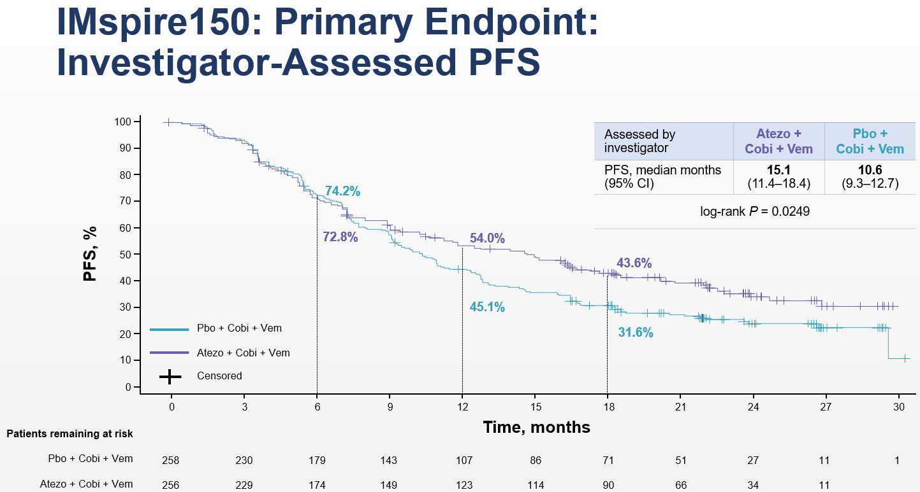
Triplet BRAF+MEK+PD-1/L1 combos
@jasonlukemd
McArthur et al. AACR. 2020
Courtesy of Jason J Luke, MD

Slide 19
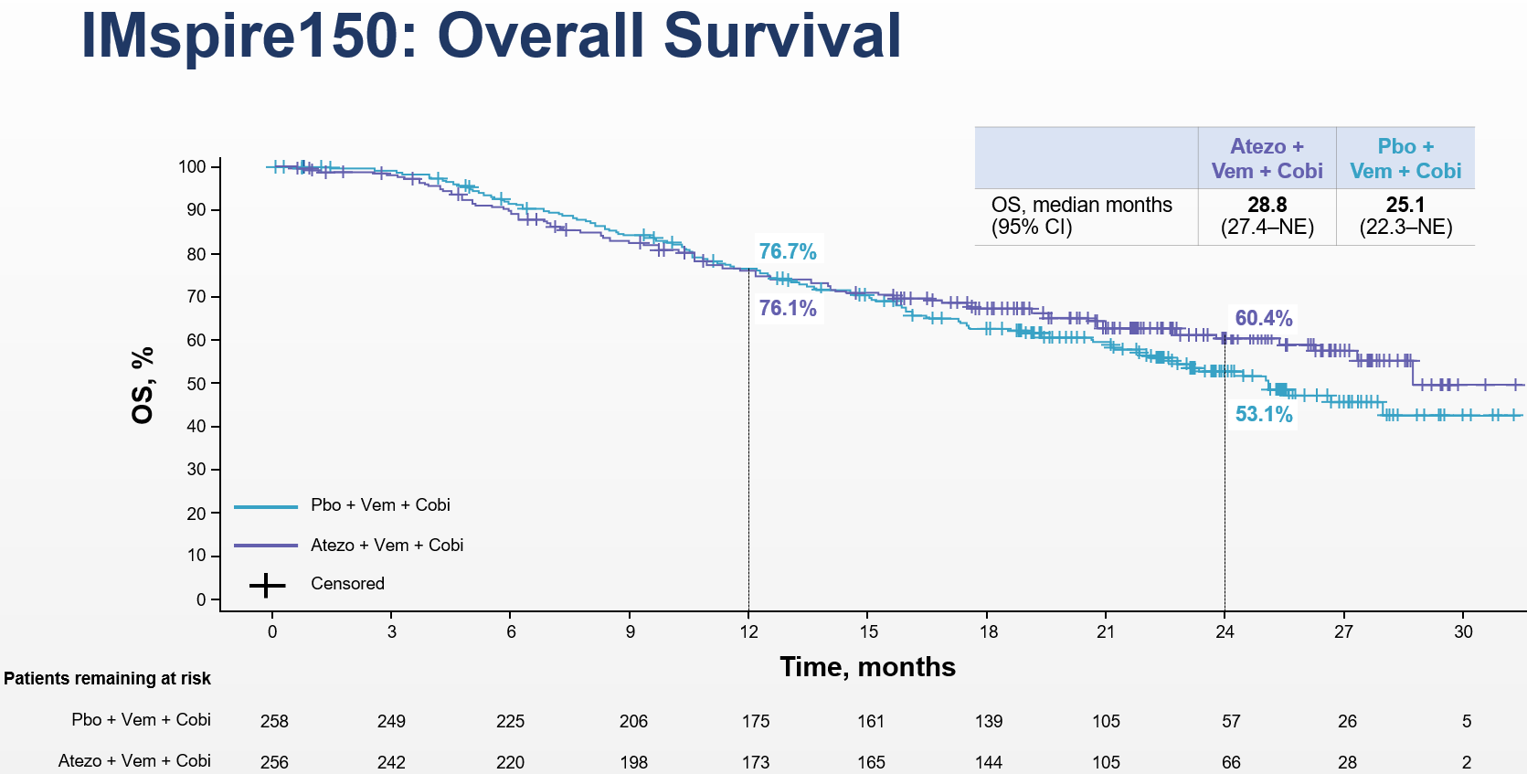
Overall survival atezo+vem+cobi
@jasonlukemd
McArthur et al. AACR. 2020
Courtesy of Jason J Luke, MD

Slide 20
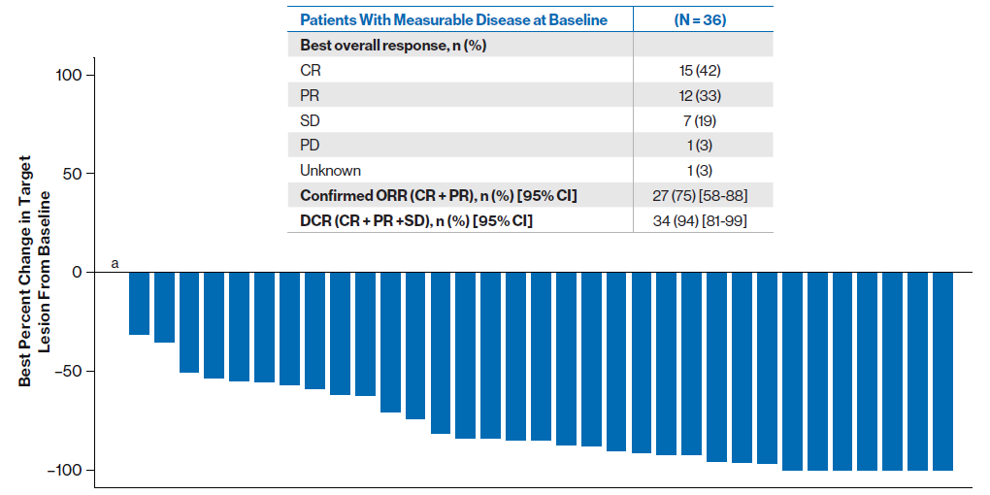
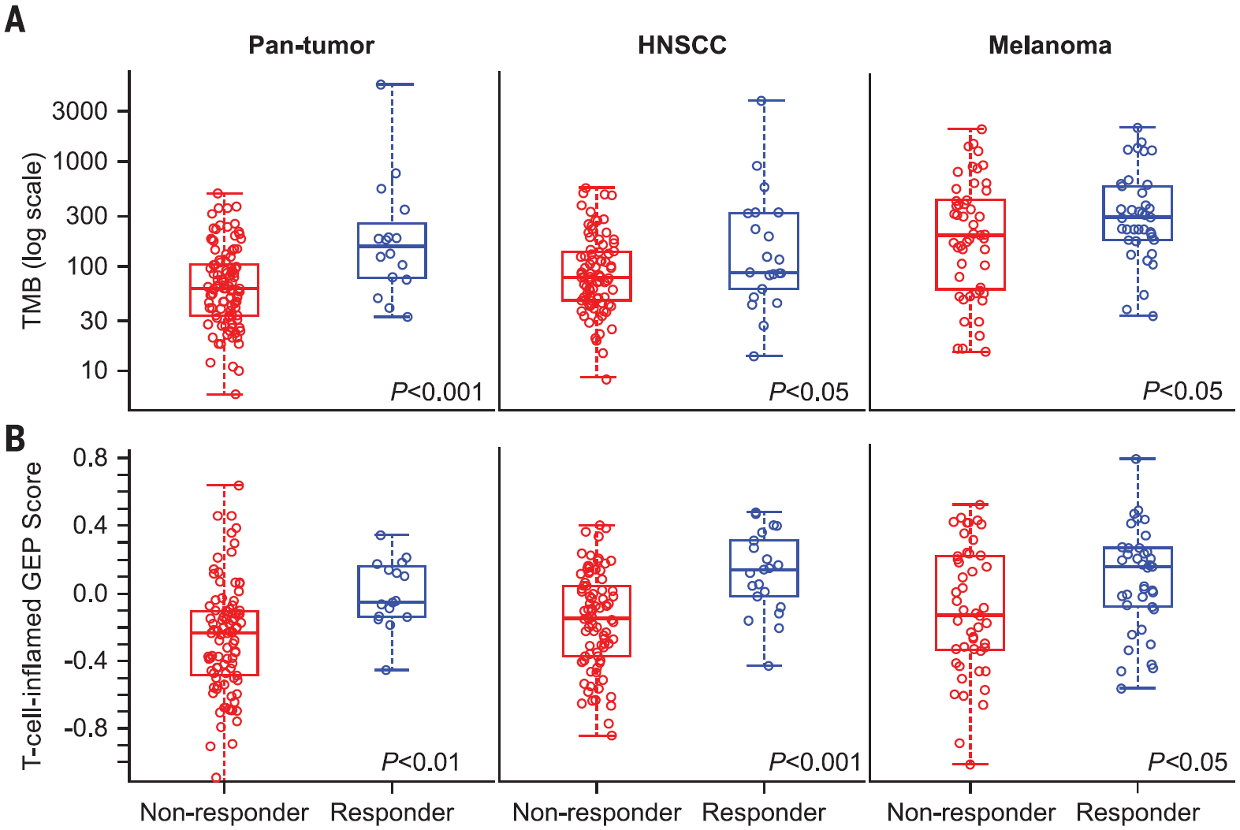
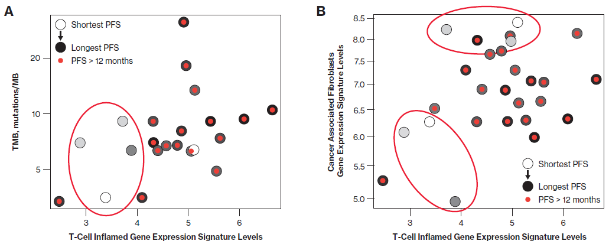
Is BRAF+MEK+PD-1/L1 triplet adequate for all patients?
@jasonlukemd
Cristescu et al. Science 2018; Dummer et al. ASCO 2019
Courtesy of Jason J Luke, MD

Slide 21

Optimal sequence of targeted & immunotherapy?
EA6134 Trial (DREAM-seq):
Ipi+Nivo -> Dab+Tram
or
Dab+Tram -> Ipi+Nivo
PD
Arm 1:
Ipi 3/Nivo 1 mg/kg/ q 3wks x 4 +Maint Nivo
D 150 BID /
T 2 mg QD
R
A
N
D
O
M
I
Z
E
ECOG PS
0
1
LDH
Normal
Elevated
Ipi 3/Nivo 1 mg/kg q 3wks x 4
+Maint Nivo
Arm 2:
D 150 BID /
T 2 mg QD
PD
D = dabrafenib; T = trametinib; PD = disease progression
@jasonlukemd
Courtesy of Jason J Luke, MD

Slide 22
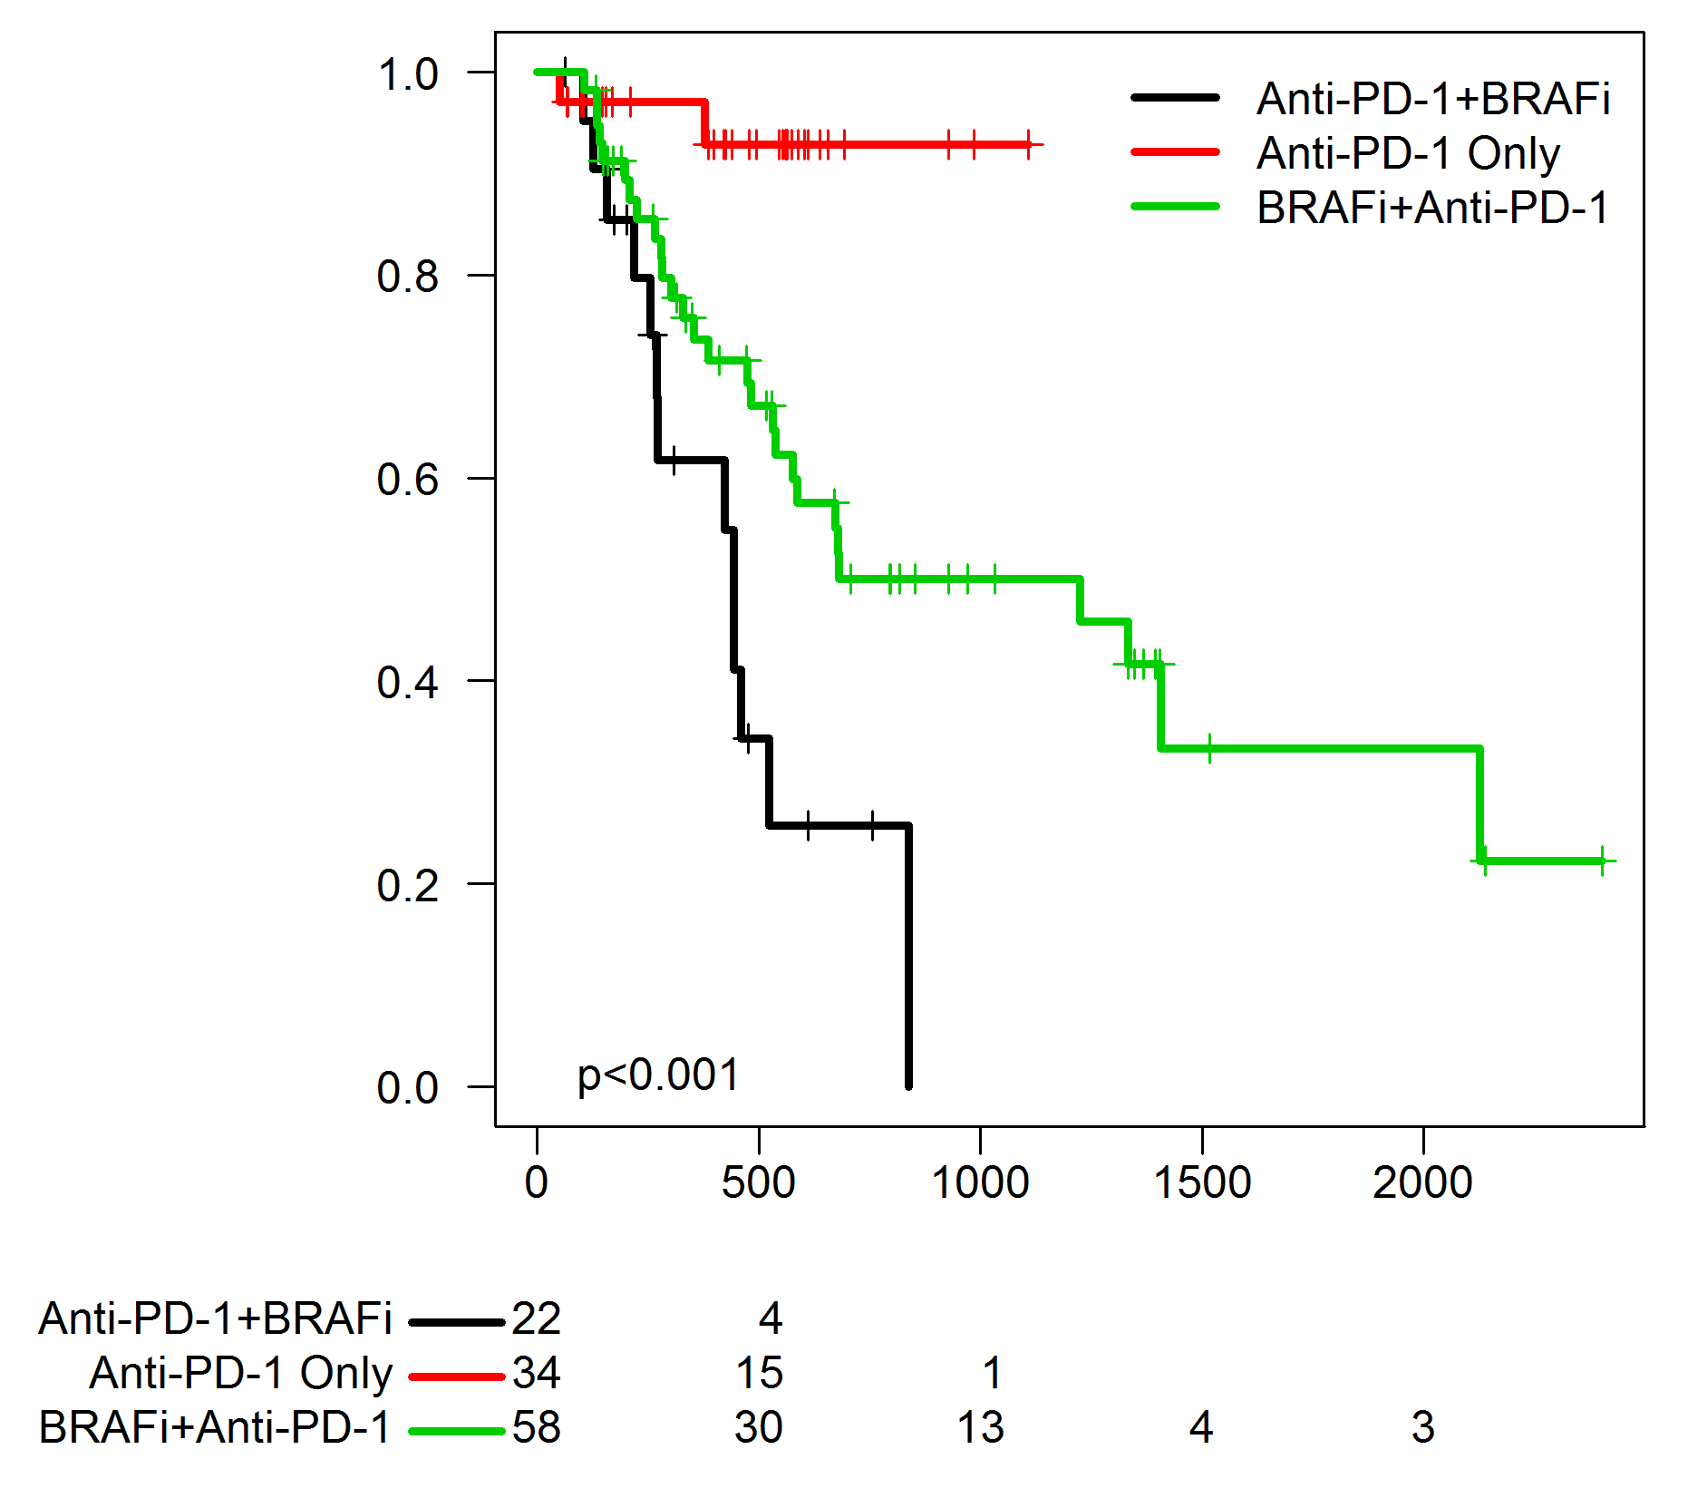
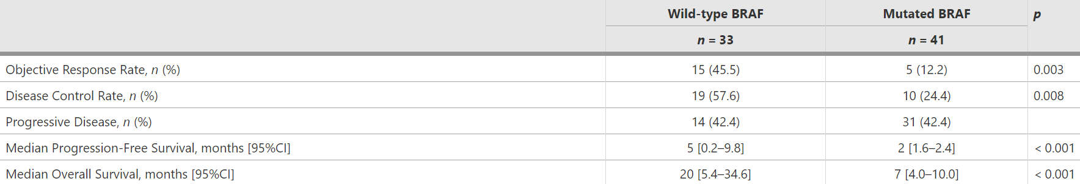
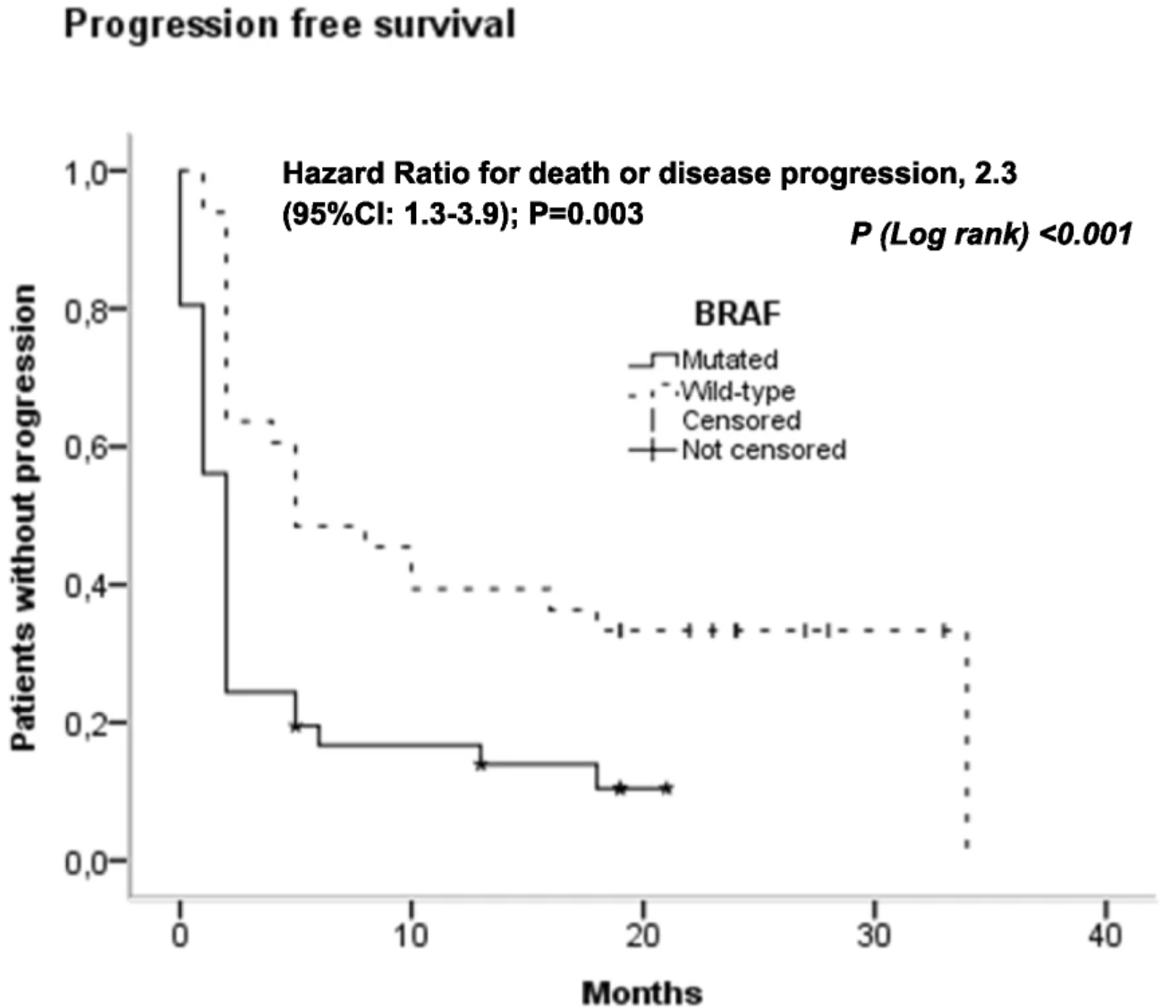
Sequencing BRAF-IO
Anti-PD-1 therapy then BRAF
BRAF then anti-PD-1 therapy
2nd line therapy not as good as first line…
@jasonlukemd
Johnson et al. J Immunother. 2017; Amini-Adle et al. BMC Cancer. 2018
Courtesy of Jason J Luke, MD

Slide 23
Regulatory and reimbursement issues aside, what would you recommend as first-line treatment for a symptomatic younger patient with extensive
BRAF-mutated metastatic melanoma?
Encorafenib/binimetinib
Nivolumab/ipilimumab
Dabrafenib/trametinib
Vemurafenib/cobimetinib + atezolizumab
Nivolumab
Vemurafenib/cobimetinib
Survey of live webinar audience

Slide 24
Regulatory and reimbursement issues aside, what would you recommend as first-line treatment for an asymptomatic, clinically stable younger patient with BRAF-mutated metastatic melanoma?
Dabrafenib/trametinib
Nivolumab/ipilimumab
Vemurafenib/cobimetinib
Nivolumab
Encorafenib/binimetinib
Pembrolizumab
Vemurafenib/cobimetinib + atezolizumab
Survey of 48 US-based medical oncologists

Slide 25
Regulatory and reimbursement issues aside, what would you recommend as first-line treatment for an asymptomatic, clinically stable younger patient with BRAF-mutated metastatic melanoma?
Nivolumab/ipilimumab
Encorafenib/binimetinib
Dabrafenib/trametinib
Vemurafenib/cobimetinib
Pembrolizumab
Vemurafenib/cobimetinib + atezolizumab
Nivolumab
Other
Survey of live webinar audience

Slide 26
Regulatory and reimbursement issues aside, what would you recommend as first-line treatment for a symptomatic younger patient with extensive BRAF-mutated metastatic melanoma?
Dabrafenib/trametinib
Vemurafenib/cobimetinib
Encorafenib/binimetinib
Pembrolizumab
Vemurafenib/cobimetinib + atezolizumab
Nivolumab/ipilimumab
Survey of 49 US-based medical oncologists

Slide 27
Regulatory and reimbursement issues aside, what would you recommend as initial treatment for an asymptomatic younger patient with BRAF-mutated metastatic melanoma including multiple bilateral brain metastases?
Dabrafenib/trametinib
Nivolumab/ipilimumab
Vemurafenib/cobimetinib
Vemurafenib/cobimetinib + atezolizumab
Whole-brain radiation therapy
Pembrolizumab
Encorafenib/binimetinib
Other
Survey of 50 US-based medical oncologists

Slide 28
Case Presentation – Dr Luke: A 53-Year-Old Woman with Stage IIIB Melanoma and a BRAF V600E Mutation
53 year old woman with stage IIIB melanoma on her left arm
  Wide local excision and sentinel node but deferred completion dissection
  BRAF testing showing V600E mutation
Received adjuvant nivolumab but developed severe fatigue by month 8
  Check TSH which was WNL
Restaging imaging showing disease in lung and liver
Started on encorafenib + binimetinib
MRI delayed due to COVID-19 but shows multiple small brain lesions
Nivolumab added to regimen for BRAF-MEK-anti-PD-1 combo
@jasonlukemd

Slide 29
Case Presentation – Dr Luke: A 42-Year-Old Man with Stage IIIC Melanoma and a BRAF V600E Mutation
42 year old man with stage IIIC melanoma on right leg
  Wide local excision, sentinel node with completion dissection due to palpable disease in right groin
  BRAF testing showing V600E mutation
Received adjuvant dabrafenib + trametinib
  Had 1 treatment delay due to pyrexia
Had recurrence with bone and lung mets 1 year after stopping BRAF-MEK inhibitor
Treated with ipilimumab + nivolumab with resolution of lung mets but new bone mets
Started on encorafenib + binimetinib with resolution of pain
@jasonlukemd

Slide 30
Agenda
Module 2: Case from the Community

Slide 31
Hi Dr Love,
I am encountering a challenging case this week and wondering if I could get some opinions from investigators in the field about further management. 69 yr old gentleman presented with small amt of penile bleeding / found to have a small distal urethral nodule and a small skin pigmented lesion - path from urethral biopsy - melanoma. BRAF WT
PET focal uptake in distal penis and no other abn.
Underwent partial penectomy - path showed distal urethral mucosal melanoma
(1.6 x 1.1 x 0.9cm) and a small satellite lesion on skin (0.6cm)
Margins widely neg
No SLN or lymphadenectomy done
Debating on role of immunotherapy
Because of skip lesion, that would be stage 3
Would there be a role for adj immunotherapy? Would they have done surgical ln eval?
Thanks for your time.
P Mallidi

Slide 32
Agenda
Module 3: Adjuvant and Neoadjuvant Treatment — Prof Long

Slide 33

12 Months of Treatment
~50% reduction in risk of recurrence vs placebo
Courtesy of Georgina V Long, MD
Presented by Georgina V Long
@ProfGLongMIA

Slide 34
Phase 3 COMBI-AD
Dabrafenib + Trametinib vs Placebo Resected Stage III Melanoma
AJCC 7th edn: IIIA (>1mm in LN), IIIB, IIIC
Primary analysis¹
RFS, DMFS, OS
Median follow-up,
34 months^{b}
Updated analysis²
RFS, DMFS
Median follow-up,
44 months^{b}
Current analysis
RFS, DMFS
Median follow-up,
60 months^{b}
N = 870
Key eligibility criteriaª
Completely resected cutaneous melanoma
BRAF V600E/K mutant
Stage IIIA, IIIB, or IIIC (AJCC 7)
Resection ≤ 12 weeks before randomization
No prior systemic therapy
ECOG PS 0-1
R
A
N
D
O
M
I
Z
A
T
I
O
N
n = 438
Dabrafenib 150 mg BID
+
Trametinib 2 mg QD
n = 432
2 matched placebos
Stratified by:
BRAF mutation (V600E or V600K)
Disease stage (IIIA, IIIB, or IIIC)
Primary endpoint: RFS
Secondary endpoints: OS, DMFS, FFR, safety
Treatment
(12 months)
Axel Hauschild
Courtesy of Georgina V Long, MD
1. Long GV, et al. N Engl J Med. 2017;377:1813-1823; 2. Hauschild A, et al. J Clin Oncol. 2018;4:1382-1388.

Slide 35
Phase 3 COMBI-AD
Dabrafenib + Trametinib vs Placebo Resected Stage III Melanoma
AJCC 7th edn: IIIA (>1mm in LN), IIIB, IIIC
n
Events
Median (95% CI), mo
438
190
NR (47.9-NR)
1.0
432
262
16.6 (12.7-22.1)
HR 0.51 (95% CI, 0.42-0.61)
0.9
0.8
59%
(95% CI, 55%-64%)
0.7
55%
(95% CI, 50%-60%)
52%
(95% CI, 48%-58%)
0.6
0.5
Proportion Alive and Relapse Free
0.4
39%
(95% CI, 35%-45%)
38%
(95% CI, 34%-43%)
36%
(95% CI, 32%-41%)
0.3
0.2
Dabrafenib plus trametinib
0.1
Placebo
0.0
0
2
4
6
8
10
12
14
16
18
20
22
24
26
28
30
32
34
36
38
40
42
44
46
48
50
52
54
56
58
60
62
64
66
68
70
72
74
76
78
80
Months Since Randomization
No. at risk
Dabrafenib plus trametinib
438
413
405
391
381
372
354
335
324
298
281
275
262
256
249
242
236
233
229
228
221
217
213
210
204
202
199
195
176
156
133
109
92
80
45
38
17
8
6
2
0
Placebo
432
387
322
280
263
243
219
204
199
185
178
175
168
166
164
158
157
151
147
146
143
140
139
137
136
133
133
132
121
115
99
80
69
56
35
26
13
1
1
0
0
Axel Hauschild
Hauschild et al. ASCO 2020
Med Follow up 60 months
Courtesy of Georgina V Long, MD

Slide 36
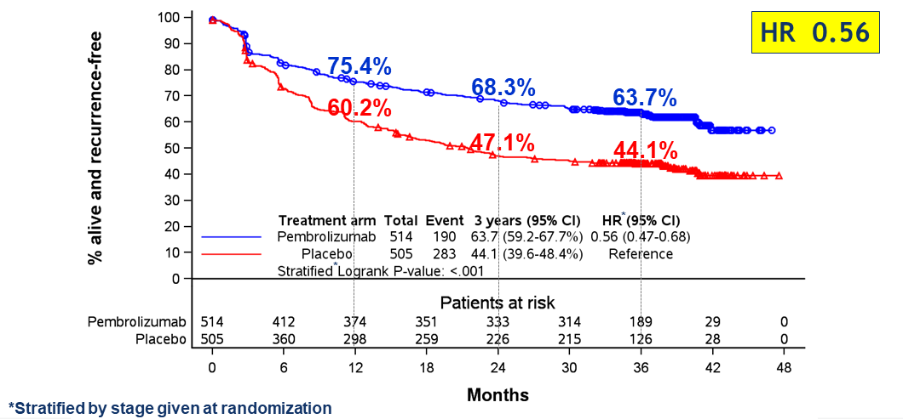
Phase 3 EORTC 1325 - KEYNOTE-054
Pembrolizumab vs Placebo Resected Stage III Melanoma
AJCC 7th edn: IIIA (>1mm in LN), IIIB, IIIC
59%
39%
vs COMBI AD 3 Yr RFS
Med Follow up 36 months
Courtesy of Georgina V Long, MD
Eggermont A et al ASCO 2020

Slide 37
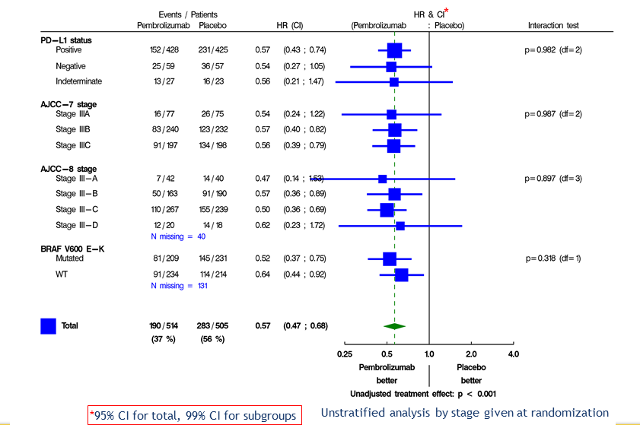
EORTC 1325 - KN-054 RFS: Every Subgroup Benefits
Courtesy of Georgina V Long, MD
Eggermont A et al ASCO 2020

Slide 38
Phase 3 CheckMate 238
Nivolumab vs Ipilimumab Resected Stage III/IV Melanoma
AJCC 7th edn: IIIB, IIIC, IV
 | NIVO (n = 453) | IPI (n = 453)
Events, n | 188 | 239
Median, mo (95% CI) | NR (38.7‒NR) | 24.9 (16.6‒35.1)
HR (95% CI)ª | 0.68 (0.56–0.82)
P^{b} | < 0.0001
100
90
80
70
70%
62%
58%
60
Nivolumab
RFS (%)
61%
50
40
51%
45%
Ipilimumab
30
20
10
0
0
3
6
9
12
15
18
21
24
27
30
33
36
39
42
45
No. at risk
Months
NIVO
453
394
353
331
311
290
280
270
261
249
243
234
178
50
13
0
IPI
453
365
316
272
254
235
221
209
203
193
185
170
122
37
12
0
Minimum follow-up: 36 months
ªStratified; ^{b}Log-rank test. NR, not yet reached.
Weber et al ESMO 2019
Courtesy of Georgina V Long, MD

Slide 39
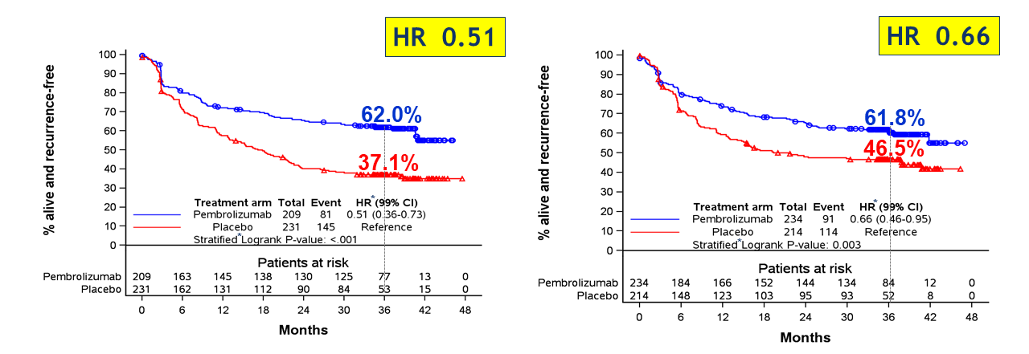
Phase 3 EORTC 1325 - KEYNOTE-054 (Pembrolizumab vs Placebo
Resected Stage III Melanoma)
Compared to Phase III COMBI-AD (Dabrafenib/Trametinib vs Placebo)
V600E/K BRAF mutated
BRAF wildtype
COMBI-AD
1.0
0.9
0.8
59% (95% CI, 55-64%)
0.7
55%
52%
0.6
0.5
39%
Proportion Alive and Relapse Free
38%
36%
0.4
0.3
HR 0.51
0.2
Dabrafenib plus trametinib
0.1
Placebo
Eggermont A et al ASCO 2020
0.0
0
2
4
6
8
10
12
14
16
18
20
22
24
26
28
30
32
34
36
38
40
42
44
46
48
50
52
54
56
58
60
62
64
66
68
70
72
74
76
78
80
Presented by Georgina V Long
@ProfGLongMIA
Months Since Randomization
Hauschild et al. ASCO 2020
Courtesy of Georgina V Long, MD

Slide 40
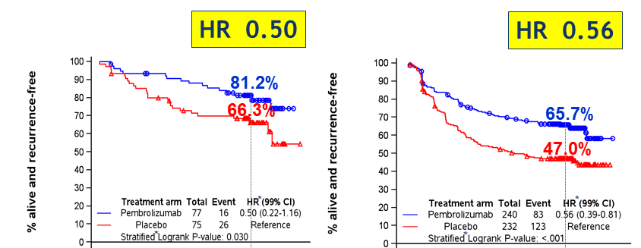
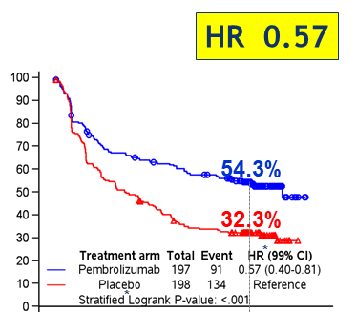
KEYNOTE-054 vs COMBI-AD: Relapse-Free Survival by AJCC Stage (7th edn)
Stage IIIA
Stage IIIB
Stage IIIC
n=152
n=472
n=395
0
12
24
36
48
0
12
24
36
48
0
12
24
36
48
n=154
n=356
n=347
1.0
1.0
1.0
80% (95% CI, 72%-90%)
0.9
0.9
0.9
0.8
72%
0.8
0.8
62%
65%
58% (95% CI, 50%-66%)
51% (95% CI, 44%-60%)
0.7
0.7
0.7
0.6
56%
55%
62%
0.6
46%
0.6
45%
Proportion Alive and Relapse Free
39%
0.5
0.5
0.5
58%
31%
0.4
0.4
0.4
0.3
HR 0.61 (95% CI, 0.35-1.07)
HR 0.50 (95% CI, 0.37-0.67)
37%
34%
29%
0.3
0.3
HR 0.48 (95% CI, 0.36-0.64)
29%
0.2
Dabrafenib plus trametinib
0.2
Dabrafenib plus trametinib
0.2
0.1
Placebo
0.1
Placebo
0.1
Dabrafenib plus trametinib
0.0
0.0
Placebo
0
12
24
36
48
60
0.0
72
0
12
24
36
48
60
0
72
12
24
36
48
60
72
Presented by Georgina V Long
@ProfGLongMIA
Months Since Randomization
Courtesy of Georgina V Long, MD
Notes:
Disucss placebo arms and risk of recurrence. Fact lower landmarks for placebo BRAF mut is in line with older data shoing BRAF mut higher risk of recurrence (poorer prognosis).

Slide 41
COMBI-AD¹ and CheckMate 238²
Relapse Free Survival: Stage IIIB and IIIC
BRAFi + MEKi
1.0
Anti-PD-1
0.9
86%
Anti-CTLA4
0.8
72%
64%
60%
0.7
63%
Nivolumab n=370
62%
54%
0.6
Dabraf+Tram n=350
51%
52%
0.5
46%
Proportion Alive and Relapse Free
39%
Ipilimumab n=366
0.4
35%
0.3
No Drug Therapy
Placebo n=353
0.2
0.1
0.0
0
2
4
6
8
10
12
14
16
18
20
22
24
26
28
30
32
34
36
38
40
42
44
46
48
50
52
Months From Randomisation
1. Long GV et al SMR 2017; 2. Weber et al ESMO 2019
Presented by Georgina V Long
@ProfGLongMIA
Courtesy of Georgina V Long, MD

Slide 42
Adjuvant Studies - Toxicity
Slowly Reversible in some
May not be reversible or need steroids
~1% very dangerous
Slowly Reversible in many
Some not reversible or need steroids
Rapidly Reversible
with cessation
Weber et al NEJM 2017; Long GV et al NEJM 2017;
Eggermont A et al NEJM 2018; Schadendorf D et al ESMO 2019
Presented by Georgina V Long
@ProfGLongMIA
Courtesy of Georgina V Long, MD

Slide 43
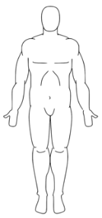


Adjuvant
Pathological Complete Response
Pathological Near Complete Response
Pathological Partial Response
No Pathological Response
NeoAdjuvant
Presented by Georgina V Long
@ProfGLongMIA
Courtesy of Georgina V Long, MD
Notes:
Have compared neoadjuvant versus adjuvant immunotherapy where therapy starts on same day and neoadjuvant txt still superior.

Slide 44
6 Weeks Neoadjuvant Therapy: The Perfect Model
 | pCR | pCR+near pCR
Ipi + Nivo | ~50-60% | ~65-70%
Dabraf + Tram | ~50% | -
Pembro | ~20% | ~30%
TVEC | 17% | -
Nivo+anti-LAG-3
Pem+D+T
Ipi+Nivo+HDACi
Nivo+HIDACi
Pem+Lenva
Completion
Surgery
Drug A+B
NeoAdj drug
0
6
weeks
52
weeks
Path CR rate?
Presented by Georgina V Long
@ProfGLongMIA
Courtesy of Georgina V Long, MD

Slide 45
What is your usual approach to adjuvant systemic treatment, if any, for a
35-year-old patient who is s/p complete surgical resection of Stage IIIB BRAF V600E-mutated primary melanoma with 1 positive axillary node?
Dabrafenib/trametinib
Nivolumab
Pembrolizumab
Ipilimumab
Survey of live webinar audience

Slide 46
What is your usual approach to adjuvant systemic treatment, if any, for a
35-year-old patient who is s/p complete surgical resection of Stage IIIB
BRAF wild-type primary melanoma with 1 positive axillary node?
Nivolumab
Pembrolizumab
Other
Survey of 50 US-based medical oncologists

Slide 47
What is your usual approach to adjuvant systemic treatment, if any, for an
80-year-old patient who is s/p complete surgical resection of Stage IIIB BRAF wild-type primary melanoma with 1 positive axillary node?
Nivolumab
Pembrolizumab
Ipilimumab
Survey of live webinar audience

Slide 48
What is your usual approach to adjuvant systemic treatment, if any, for an 80-year-old patient who is s/p complete surgical resection of Stage IIIB BRAF wild-type primary melanoma with 1 positive axillary node?
Nivolumab
Pembrolizumab
Other
Survey of 50 US-based medical oncologists

Slide 49
What is your usual approach to adjuvant systemic treatment, if any, for a
35-year-old patient who is s/p complete surgical resection of Stage IIIB BRAF wild-type primary melanoma with 1 positive axillary node?
Nivolumab
Pembrolizumab
None
Survey of live webinar audience

Slide 50
What is your usual approach to adjuvant systemic treatment, if any, for a
35-year-old patient who is s/p complete surgical resection of Stage IIIB primary melanoma with a BRAF V600E mutation and 1 positive axillary node?
Dabrafenib/trametinib
Nivolumab
Pembrolizumab
Other
Survey of 50 US-based medical oncologists

Slide 51
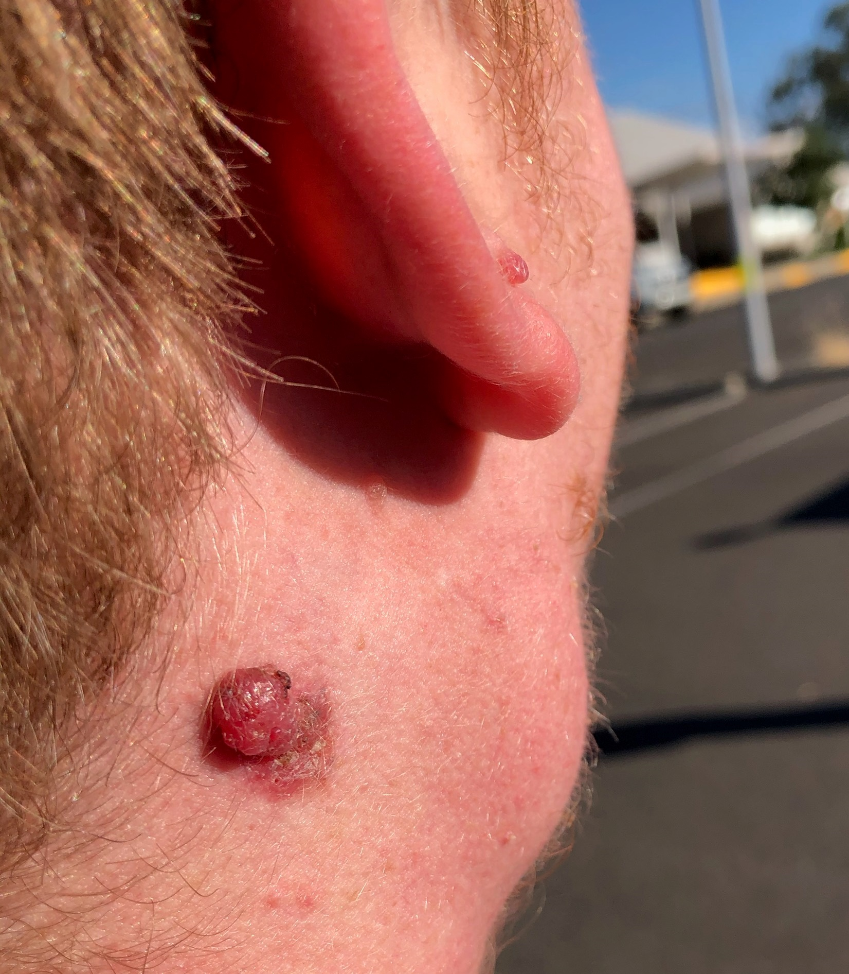
Case Presentation – Prof Long: A 19-Year-Old Male with Stage IIIC Melanoma
19 yo male
Significant developmental delay
Regional Australia (4h from major city)
Presents to family doctor with
  Mass in parotid
  Lesion right post auricular
Referred to general surgeon
Height of COVID pandemic
Presented by Georgina V Long
@ProfGLongMIA

Slide 52
Case Presentation (continued)
Excision biopsy post-auricular lesion:
  6.5mm
  Ulcerated
  2 mitosis/mm²
  Involved margin
Right superficial parotidectomy + resection 2 neck lymph nodes
  Intra-parotid lymph node involved with melanoma
  Extra-nodal extension
  Involved margin
  0/2 neck lymph nodes involved with melanoma
Presented by Georgina V Long
@ProfGLongMIA

Slide 53
Case Presentation (continued)
COVID-pandemic
4 weeks later → Wider local Excision of Primary Site
  Melanoma
  Margins clear
AJCC Staging - T4b N1b
Presented by Georgina V Long
@ProfGLongMIA

Slide 54
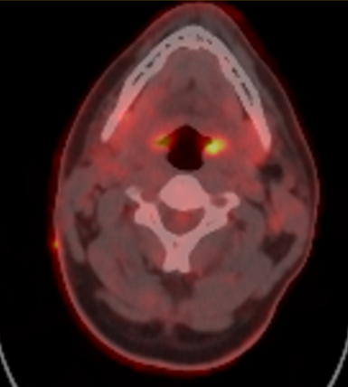
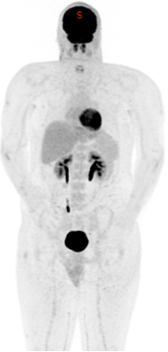
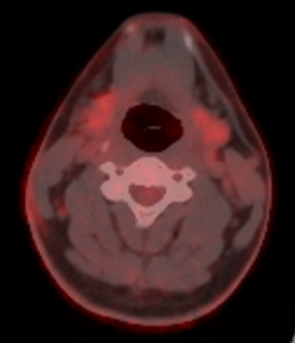
Case Presentation (continued)
Management
  Referred to medical oncologist
  Staging
  MRI Brain clear
  Referred to quaternary centre
Presented by Georgina V Long
@ProfGLongMIA

Slide 55
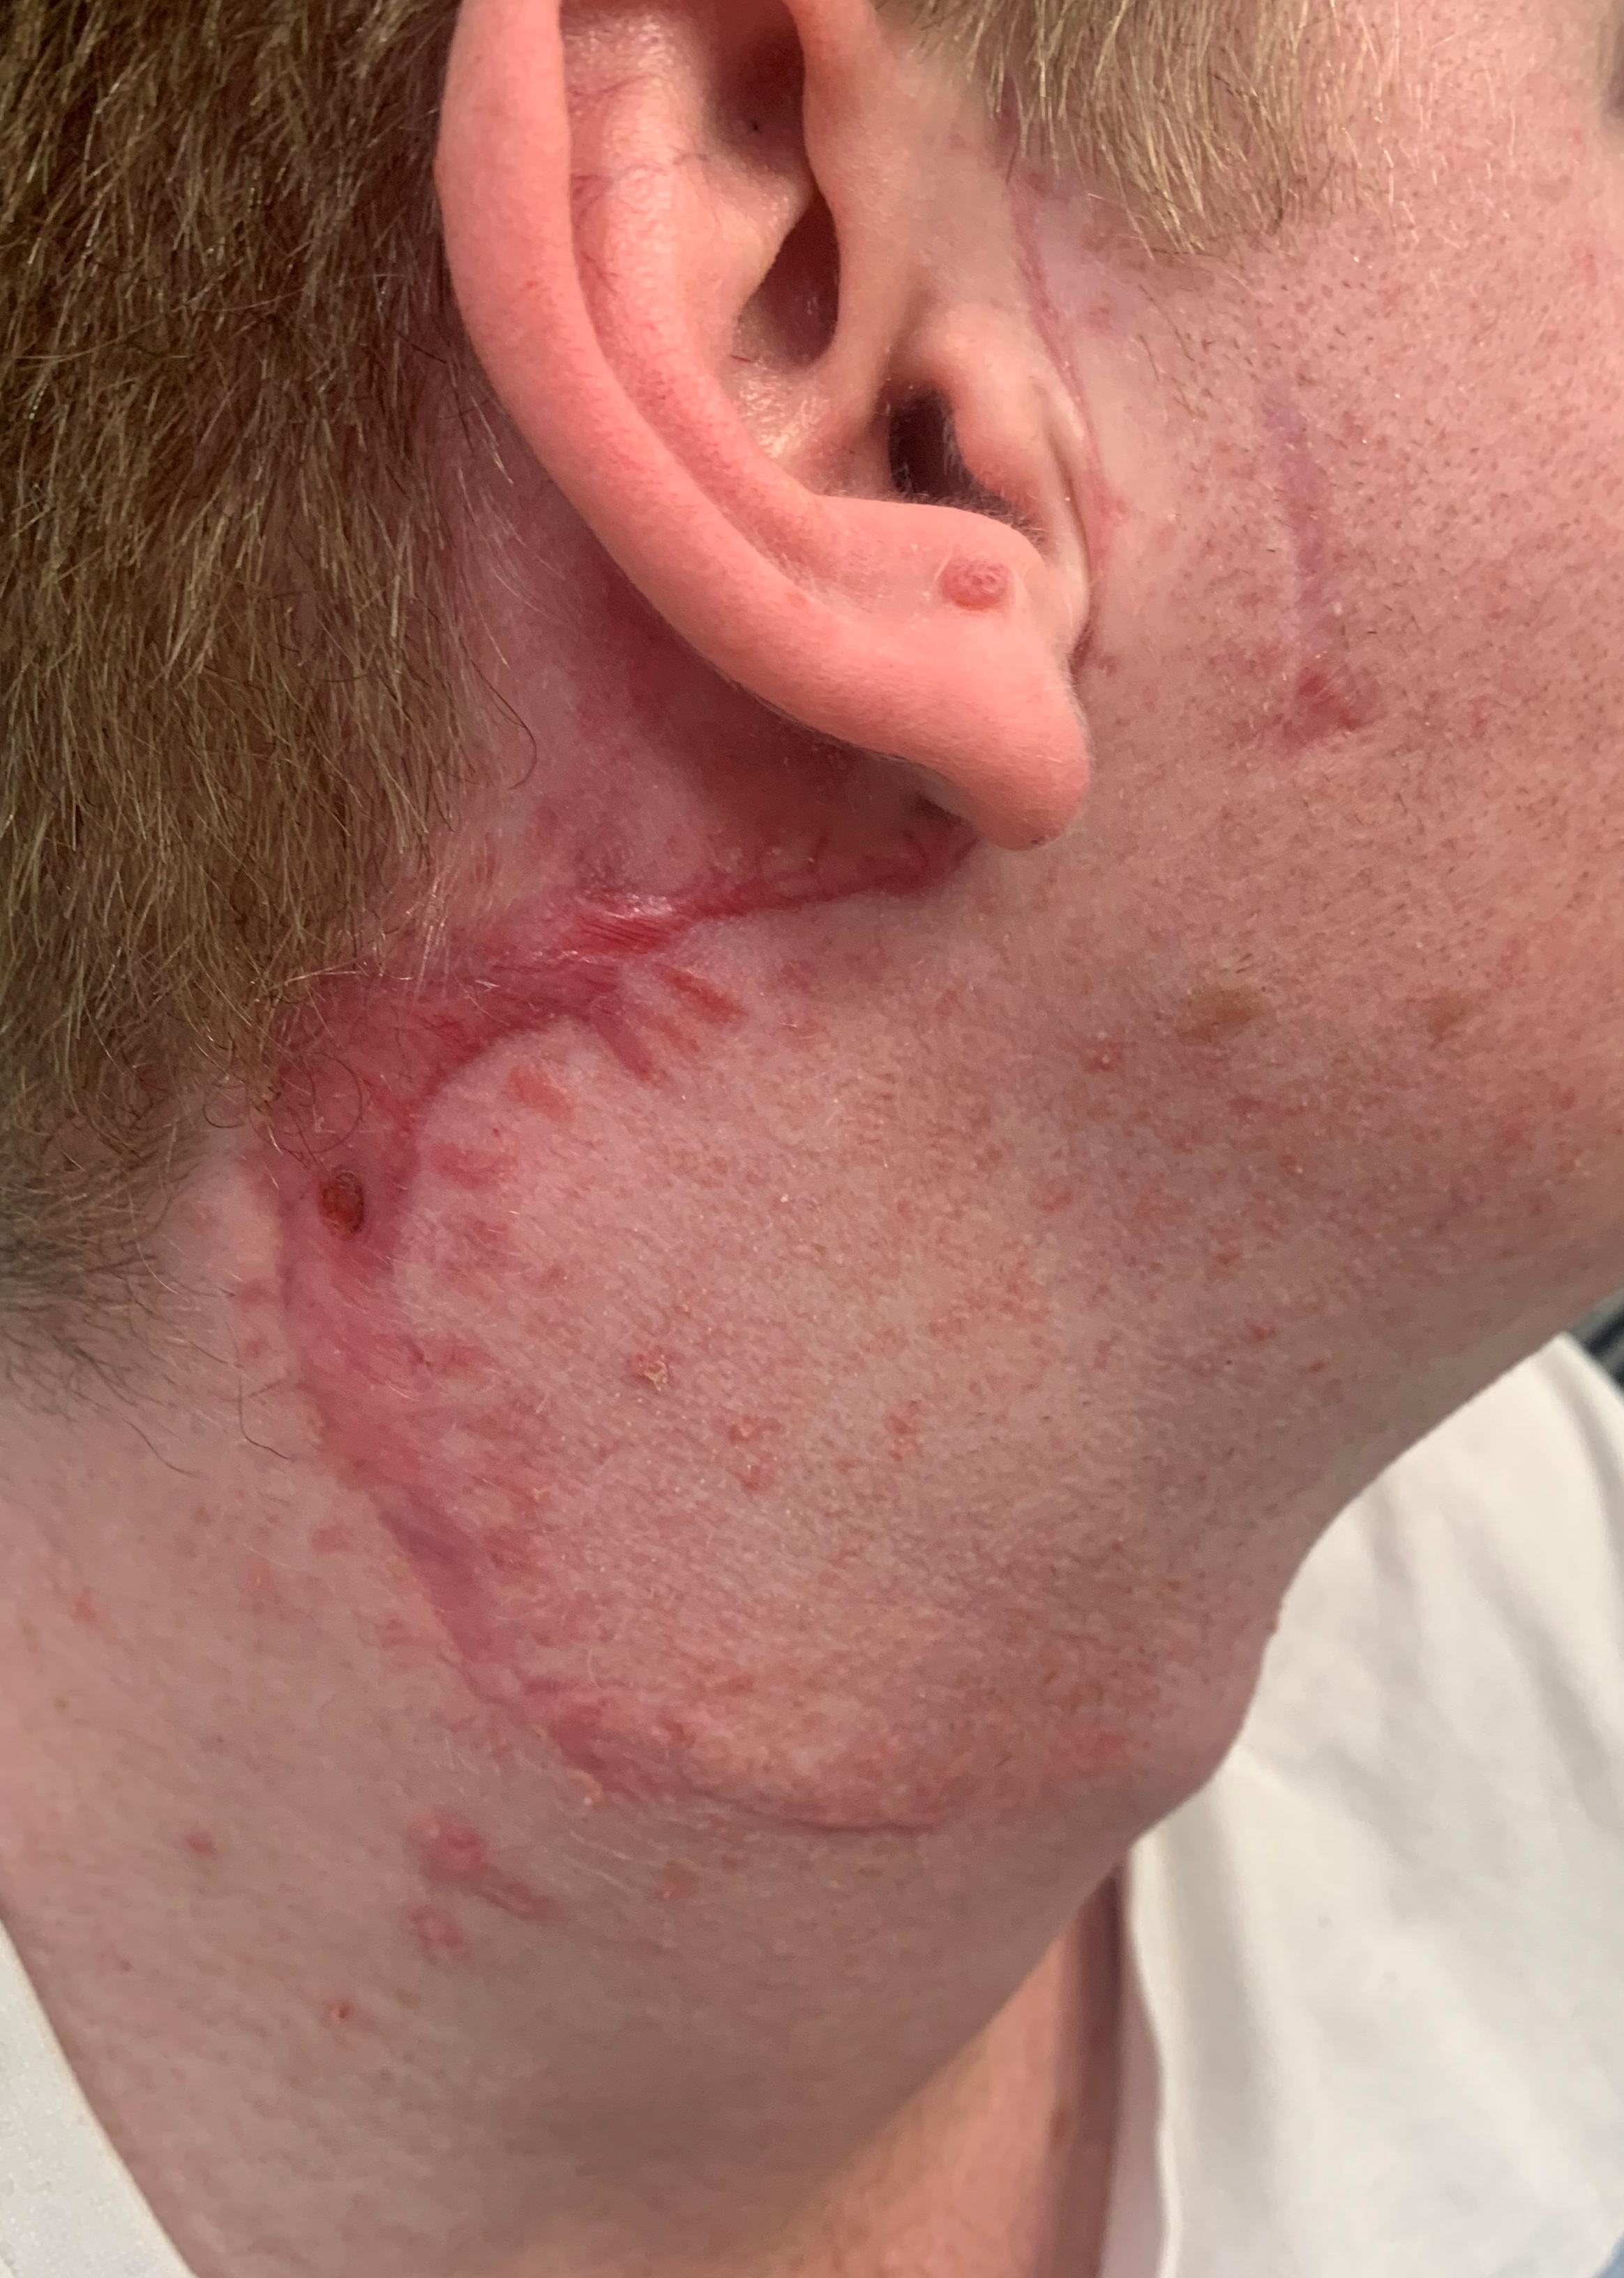
Case Presentation (continued)
Management
Presented by Georgina V Long
@ProfGLongMIA
High resolution Ultra Sound R neck – nil evidence of recurrence

Slide 56
T4b N1b M0 – Stage IIIC (AJCC 8thedn)
Risk of Recurrence² ~ 60-70%
2 Long GV et al COMBI-AD NEJM 2017; Hauschild A et al COMBI-AD JCO 2019
Presented by Georgina V Long
@ProfGLongMIA

Slide 57
Case Presentation (continued)
Management
  Discussed adjuvant drug options
    Anti-PD1 vs BRAFi+MEKi
    Fear of irreversible toxicity in develop’l delay
    Needle phobia
    Dabrafenib dissolvable
    Trametinib small
    Better long term outcome IIIC?
  Further Surgery?
  Role for radiotherapy?
  Tumour Board Discussion
Presented by Georgina V Long
@ProfGLongMIA

Slide 58
Alternative: Neoadjuvant therapy at diagnosis?
Presented by Georgina V Long
@ProfGLongMIA

Slide 59
Agenda
Module 4: Current and Future Use of Checkpoint Inhibition — Dr Atkins

Slide 60
Topics
CheckMate 067 combination vs monotherapy
IMMUNED study
  Less Ipi
IO Treatment of CNS metastases
Optimal treatment for patients with BRAF WT Disease progressing after adjuvant anti-PD-1 therapy
Novel IO approaches
  PIVOT-02
  Relatlimab
Courtesy of Michael Atkins, MD

Slide 61
Who should get Nivo/ipi vs Single Agent?
Patients with aggressive/advanced disease
  PS > 1, elevated LDH, or stage IVC-D
Lacking significant co-morbidities
  No autoimmune conditions, need for steroids, or inability to tolerate grade 3 toxicity of HD steroids
Other
  BRAF Mutant, PD-L1 negative
  Mucosal or acral primary
  Prior adjuvant or BRAF/MEK inhibitor Rx
Courtesy of Michael Atkins, MD

Slide 62
My Approach
Goal of Immunotherapy is to cure patients
Those relapsing after adjuvant anti-PD-1 therapy (whether on treatment, within 6 months or after 6 months) can’t be cured with single agent anti-PD-1 therapy
Therefore, a different approach is needed – guided by stage IV disease data
Courtesy of Michael Atkins, MD

Slide 63
Novel Combinations
Nivo + NKTR 214 (bempegaldesleukin) or anti-LAG-3 (relatlimab) show some promising activity in small phase II trials
Lack of single agent activity or activity of combo in anti-PD-1 failures for bempegaldesleukin is concerning
Relatlimab activity in anti-PD-1 failures and link to a biomarker is encouraging but may have limited application
Phase III trials underway compared to nivo monotherapy
Unlikely to produce better results than nivo/ipi combos
Courtesy of Michael Atkins, MD

Slide 64
What is your usual first-line treatment for an asymptomatic, clinically stable younger patient with BRAF wild-type metastatic melanoma?
Nivolumab/ipilimumab
Pembrolizumab
Nivolumab
Ipilimumab
Survey of 50 US-based medical oncologists

Slide 65
Case Presentation – Dr Atkins:
A 51-year-old man with metastatic
BRAF WT melanoma to liver and axilla

Slide 66
History (1)
2014: Noted changing mole R arm
2017: bx = 1.5 mm thick mel, no ulceration, 7 mitoses/mm2
WLE neg, SLN bx + micromet
Stage IIIA, declined adjuvant Rx
2018: R axillary nodes, Scan with liver met.
Bx = mel; BRAF WT.
Brain MRI: no mets

Slide 67
History (2)
Treatment plan: Nivo 1/ipi 3 x 4 doses to be followed by nivo 480 mg q 4 weeks
Developed fevers after dose 1, treated with NSAIDs
Developed grade 3 LFTs at week 5. Treated with steroids, then MMF taking 3 months to taper off.
Scans at week 12 show PR.

Slide 68
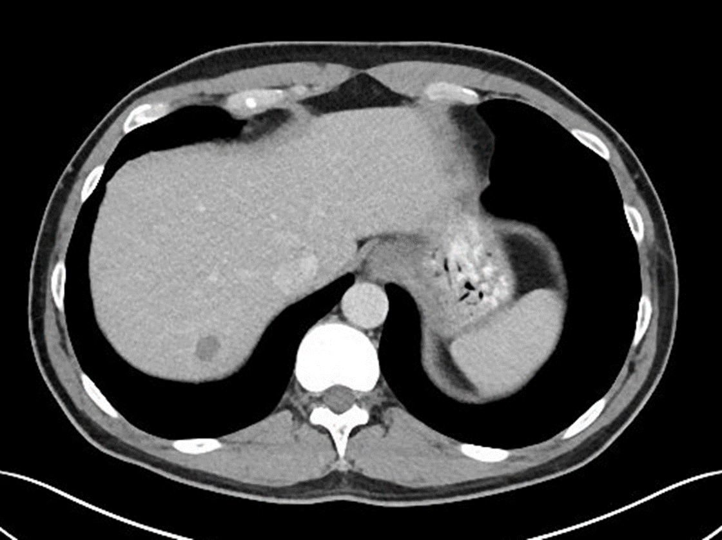
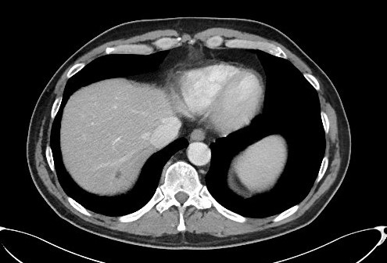
Imaging (1)
Pre-Treatment Scan Dec 2018
Post-Treatment Scan March 2019 (3 months)

Slide 69
History (3)
Scan 6 months shows regrowth of R axillary adenopathy and new liver mets.
Patient c/o fatigue and R axillary pain

Slide 70
History (4)
Started on nivo 480 mg q 4 weeks
Week 8 grade 2 fatigue
Labs: Grade 2 LFTs, low cortisol and NA+
Begun on hydrocortisone replacement. Nivo continued.
Fatigue and LFTs improve
Liver and axillary lesions shrink.
Returns to PS 0
6/2020- PET-CT No liver uptake

Slide 71
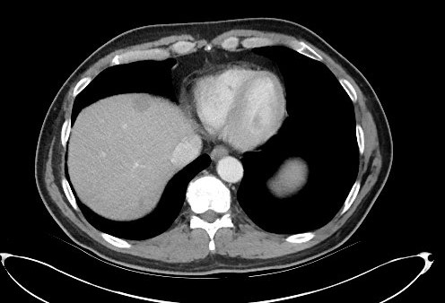
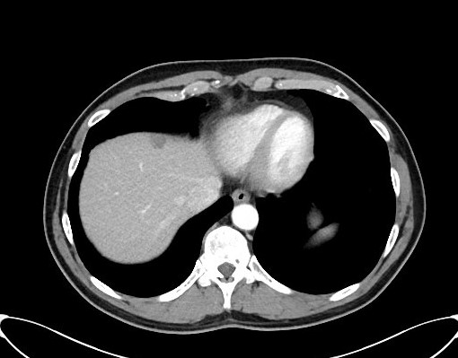
Imaging 2
Treatment Scan : June 2019 (6 months)
Treatment Scan: December 2019 (12 months)

Slide 72
Take Home Messages
Ipi 3/Nivo 1 is the treatment of choice for patients with stage IVC met melanoma
Toxicity is common and prolonged Immunosuppressive treatment may blunt response
Worth considering maintenance Nivo monotherapy in a responding patient with relapse after induction therapy-related toxicity

Slide 73
Case Presentation – Dr Atkins: A 66-year-old man presenting with large CNS Metastases

Slide 74
History (1)
66 yo otherwise healthy male presents in February 2016, with pigmented lesion on scalp. Derm bx showed melanoma.
Staging CT scans showed bilateral lung nodules, largest 3.2cm and a right paracolic mass measuring 1.7cm
Brain showed 6 intracranial lesions with surrounding vasogenic edema. The two largest lesions were in the left temporal and right frontal areas and measured 2.5 and 2 cm.

Slide 75
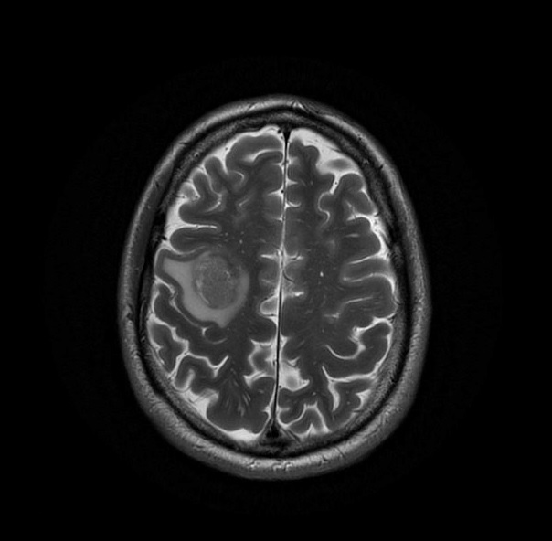
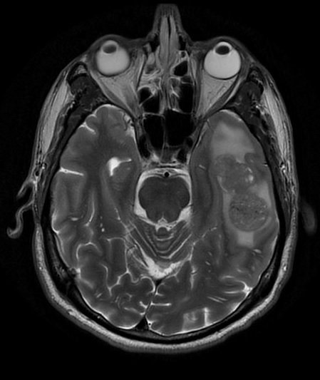
Baseline MRI Brain

Slide 76
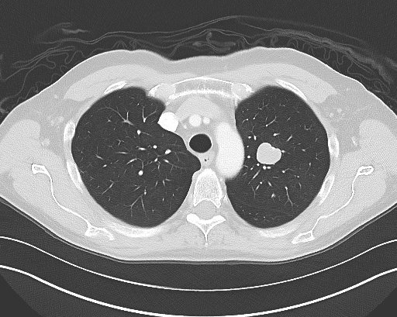
LUL nodule
Baseline 3/2017

Slide 77
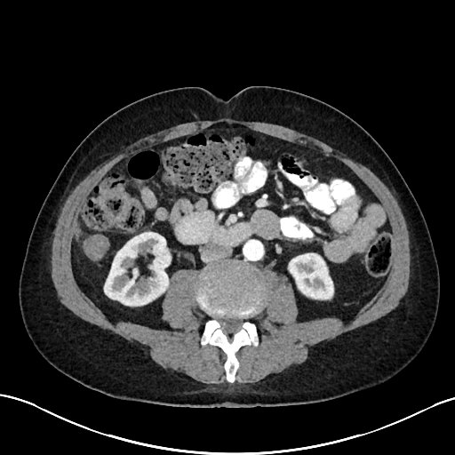
Right paracolic mass
Baseline 3/2017

Slide 78
History (2)
He underwent L temporal and R frontal craniotomies with resection of lesions
Path confirmed to be melanoma, BRAF WT
Patient referred to Med Onc
Taking dexamethasone 4 mg BID for cerebral edema

Slide 79
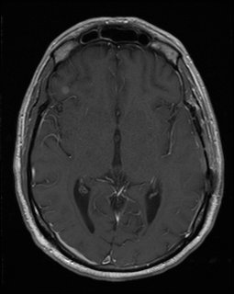
Post-surgical scan- 3/29/17
R frontal lesion 5x5 mm
Post-Craniotomy Presentation

Slide 80
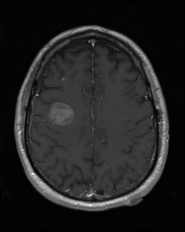
Post-Craniotomy Presentation
3/29/17: Post-surgical R posterior frontal lesion; R frontal lesion 3X4 mm

Slide 81
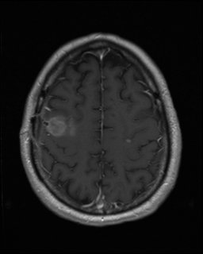
Post-Craniotomy Presentation
Post-surgical 3/29/17:
left parietal lesion- 4 x 3 mm

Slide 82
History (3)
Weaned off steroids and started immediately on nivo/ipi brain met study (CheckMate 204) Cohort B
Week 6 CT scans and brain MRI showed improvement of systemic and CNS mets
Week 13 scans showed continued response
Week 24 scans showed systemic PR, CR in brain
Week 48 scans showed continued CNS CR, systemic PR

Slide 83
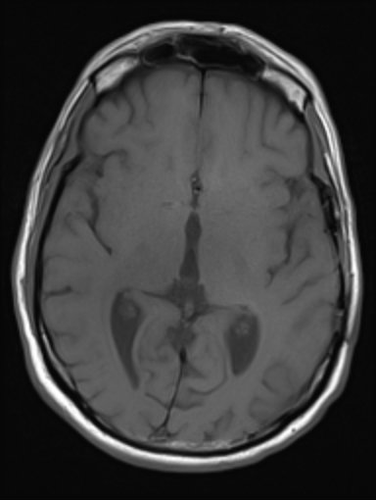
Post-surgical scan- 3/29/17
R frontal lesion 5x5 mm
One year Post-treatment Initiation
CR of R frontal lesion

Slide 84
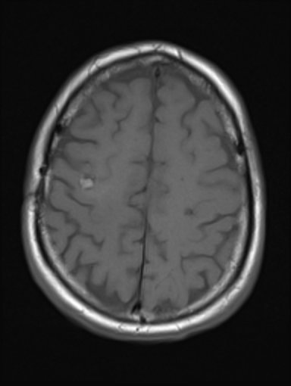
One year post treatment initiation
3/29/17: Post-surgical R posterior frontal lesion; R frontal lesion 3X4 mm
Resolving R posterior frontal resection cavity; absent R frontal lesion

Slide 85
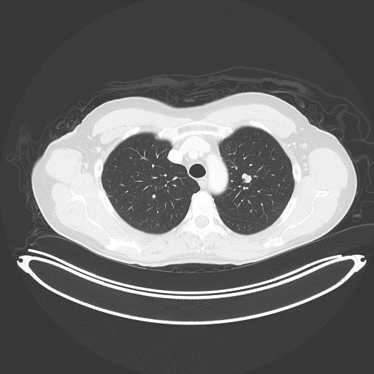
One year post treatment
LUL nodule

Slide 86
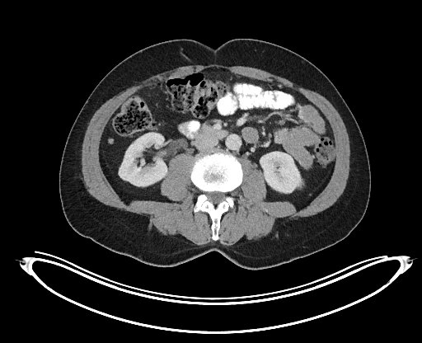
One year post Treatment
Right peritoneum

Slide 87
History (4)
PET-CT was performed which showed no active disease
Treatment was stopped 4/2018
Currently remains free of disease progression
Patient has taken up biking and rides his bike in for clinic appointments

Slide 88
Take Home Messages
Large melanoma brain mets should be resected if this will allow patients to come off steroids and receive systemic therapy
Asymptomatic patients with small CNS mets can be treated with ipi/nivo instead of SRS
IO therapy can eliminate CNS disease
Stopping IO therapy at 1 year in CT or PET-CT based CRs appears safe and can turn survivors into thrivers

Slide 89
Subsequent to this interview, on July 30, 2020, the FDA approved atezolizumab in combination with cobimetinib and vemurafenib for patients with unresectable or metastatic melanoma with BRAF V600 mutations. The approval is based on data from the Phase III IMspire150 study, which demonstrated that the addition of atezolizumab to cobimetinib and vemurafenib led to a significant improvement in progression-free survival versus placebo with cobimetinib/vemurafenib for patients with previously untreated advanced melanoma with BRAF V600 mutations.

