Slide 1
1. In general, when do you typically order mutation testing for your patients with newly diagnosed ovarian cancer?
Medical Oncologists
Gynecologic Oncologists
At initial diagnosis
12
12
At first relapse
0
0
At second relapse
0
0

Slide 2
2. In general, what type of mutation testing do you order for patients with ovarian cancer at initial diagnosis?
Medical Oncologists
Gynecologic Oncologists
Germline mutation testing
9
3
Both germline and somatic mutation testing
2
8
Somatic mutation testing
1
1

Slide 3
3. Aside from the detection of a germline BRCA1/2 mutation, what other findings from mutation analyses would lead you to offer, or consider offering, a PARP inhibitor to a patient with ovarian cancer during their treatment course? (Please select all that apply)
Medical Oncologists
Gynecologic Oncologists
None
1
0
Somatic mutation in BRCA1/2
10
12
Positivity for HRD
5
8
Germline PALB2
4
5
Somatic PALB2
2
5
Germline RAD51C
5
7
Somatic RAD51C
5
7
Germline ATM
4
5
Somatic ATM
2
5
Other mutations
2
4
HRD = homologous recombination repair deficiency

Slide 4
4. Do you order microsatellite instability (MSI)/DNA mismatch repair testing for your patients with ovarian cancer?
Medical Oncologists
Gynecologic Oncologists
Yes, I order MSI/DNA mismatch repair testing
7
11
No, I do not order MSI/DNA mismatch repair testing
5
1

Slide 5
5. Approximately what percentage of patients with ovarian cancer in your practice receive neoadjuvant chemotherapy as opposed to primary debulking surgery?
Medical Oncologists
Gynecologic Oncologists
Median % patients
42.5%
50%

Slide 6
A 60-year-old woman presents with abdominal distension and is found to have bilateral ovarian masses and ascites. Core biopsy results provide histological confirmation of epithelial ovarian carcinoma. The patient’s performance status (PS) is 0-1 and she has no comorbid conditions. She has lost 20 pounds over the past year, and her CA125 is 1,140 units/mL. She has no family history of ovarian or breast cancer. 6. What initial management strategy would you recommend if mutation testing revealed the disease to be BRCA wild type?
Medical Oncologists
Gynecologic Oncologists
Surgery
10
7
Laparoscopy
1
1
Carboplatin/ paclitaxel
0
2
Carboplatin/ paclitaxel + bevacizumab
1
2

Slide 7
7. What initial management strategy would you recommend if mutation testing revealed that the patient had a BRCA germline mutation?
Medical Oncologists
Gynecologic Oncologists
Surgery
11
7
Carboplatin/ paclitaxel
0
3
Carboplatin/ paclitaxel + bevacizumab
1
2

Slide 8
A 60-year-old woman presents with abdominal distension and is found to have ascites, bilateral ovarian masses and bilateral pleural effusions. Core biopsy results provide histological confirmation of epithelial ovarian carcinoma. She has lost 20 pounds over the past year, and her PS is 0-1. Her CA125 is 1,140 units/mL. She has no family history of ovarian or breast cancer. 8. What initial management strategy would you recommend if mutation testing revealed the disease to be BRCA wild type?
Medical Oncologists
Gynecologic Oncologists
Carboplatin/ paclitaxel
8
6
Laparoscopy
1
0
Surgery
2
3
Carboplatin/paclitaxel + bevacizumab
1
3

Slide 9
9. What initial management strategy would you recommend if mutation testing revealed that the patient had a BRCA germline mutation?
Medical Oncologists
Gynecologic Oncologists
Surgery
2
3
Carboplatin/ paclitaxel
9
7
Carboplatin/ paclitaxel + bevacizumab
1
2

Slide 10
A 77-year-old woman presents with abdominal distension and is found to have bilateral ovarian masses and ascites. Core biopsy results provide histological confirmation of epithelial ovarian carcinoma. The patient’s PS is 0-1 and she has no comorbid conditions. She has lost 20 pounds over the past year, and her CA125 is 1,140 units/mL. She has no family history of ovarian or breast cancer. 10. What initial management strategy would you recommend if mutation testing revealed the disease to be BRCA wild type?
Medical Oncologists
Gynecologic Oncologists
Carboplatin/ paclitaxel
1
4
Laparoscopy
1
0
Surgery
9
6
Carboplatin/paclitaxel + bevacizumab
1
2

Slide 11
11. What initial management strategy would you recommend if mutation testing revealed that the patient had a BRCA germline mutation?
Medical Oncologists
Gynecologic Oncologists
Carboplatin/ paclitaxel
1
4
Laparoscopy
1
0
Surgery
9
6
Carboplatin/ paclitaxel + bevacizumab
1
2

Slide 12
A 77-year-old woman presents with abdominal distension and is found to have ascites, bilateral ovarian masses and bilateral pleural effusions. Core biopsy results provide histological confirmation of epithelial ovarian carcinoma. She has lost 20 pounds over the past year, and her PS is 0-1. Her CA125 is 1,140 units/mL. She has no family history of ovarian or breast cancer. 12. What initial management strategy would you recommend if mutation testing revealed the disease to be BRCA wild type?
Medical Oncologists
Gynecologic Oncologists
Surgery
2
3
Carboplatin/ paclitaxel
9
7
Carboplatin/ paclitaxel + bevacizumab
1
2

Slide 13
13. What initial management strategy would you recommend if mutation testing revealed that the patient had a BRCA germline mutation?
Medical Oncologists
Gynecologic Oncologists
Surgery
2
3
Carboplatin/ paclitaxel
9
7
Carboplatin/ paclitaxel + bevacizumab
1
2

Slide 14
SOLO-1
PFS by Investigator Assessment
 | Olaparib (N=260) | Placebo (N=131)
Events (%) [50.6% maturity] | 102 (39.2) | 96 (73.3)
Median PFS, months | NR | 13.8
 | HR 0.30
 | 95% CI 0.23, 0.41; P<0.0001
Stop trial drug
100
60.4% progression free at 3 years
90
80
70
60
Olaparib
Investigator-assessed
progression-free survival (%)
50
40
30
20
26.9% progression free at 3 years
10
Placebo
0
0
3
6
9
12
15
18
21
24
27
30
33
36
39
42
45
48
51
54
57
60
No. at risk
Placebo
Months since randomization
Olaparib
260
240
229
221
212
201
194
184
172
149
138
133
111
88
45
36
4
3
0
0
0
118
103
82
65
56
53
47
41
39
38
31
28
22
6
5
1
0
0
0
131
0
Moore KN, et al. ESMO. 2018. Abstract LBA7_PR; Moore K, et al. N Engl J Med. 2018.

Slide 15
A 60-year-old woman with Stage IIIC epithelial ovarian cancer is s/p primary optimal debulking surgery with no gross residual disease. She has no family history of ovarian or breast cancer. 14. What postsurgical treatment strategy would you recommend if mutation testing revealed the disease to be BRCA wild type?
Medical Oncologists
Gynecologic Oncologists
Carboplatin/ paclitaxel q3wk + bevacizumab
3
3
Carboplatin/ paclitaxel q3wk
7
5
Carboplatin/ paclitaxel dose dense
1
0
IP/IV chemotherapy
1
4
14a. Would you recommend maintenance therapy to this patient?
Yes, bevacizumab
3
2
Yes, olaparib
1
0
No
8
10

Slide 16
A 60-year-old woman with Stage IIIC epithelial ovarian cancer is s/p primary debulking surgery with gross residual macroscopic disease (>1 cm). She has no family history of ovarian or breast cancer. 15. What postsurgical treatment strategy would you recommend if mutation testing revealed the disease was BRCA wild type?
Medical Oncologists
Gynecologic Oncologists
Carboplatin/ paclitaxel q3wk + bevacizumab
9
10
Carboplatin/ paclitaxel q3wk
3
1
Carboplatin/ paclitaxel dose dense
0
1
15a. Would you recommend maintenance therapy to this patient?
Yes, bevacizumab
10
9
No
2
3

Slide 17
GOG 218: Study Design (June 13, 2018)
Arm
Carboplatin AUC 6
CPP
Paclitaxel 175 mg/m²
Epithelial ovarian, fallopian tube, or primary peritoneal cancer in first line
Stage III optimal (macroscopic)
Stage III suboptimal
Stage IV
(N = 1,873)
Placebo
Carboplatin AUC 6
R
CP
+ Bev
Paclitaxel 175 mg/m²
1:1:1
Placebo
Bevacizumab 15 mg/kg Cycles 2-6
Primary endpoint: PFS
Secondary endpoints: OS, ORR
Stratification variables:
PS
Stage/debulking status
Carboplatin AUC 6
CP
+ Bev
→ Bev
Paclitaxel 175 mg/m²
Bevacizumab 15 mg/kg Cycles 2 - 22
AUC, area under the curve; Bev, bevacizumab; CP, carboplatin + paclitaxel; CPP, CP + placebo; GOG, Gynecologic Oncology Group; ORR, overall response rate; OS, overall survival; PFS, progression-free survival; PS, performance status.
Burger et al. N Engl J Med. 2011;365:2473-2483.
15 mo
Notes:
17
2008
17
Burger RA, Brday MF, Bookman MA, et al. Incorporation of bevacizumab in the primary treatment of ovarian cancer. N Engl J Med. 2011;365:2473-2483.

Slide 18
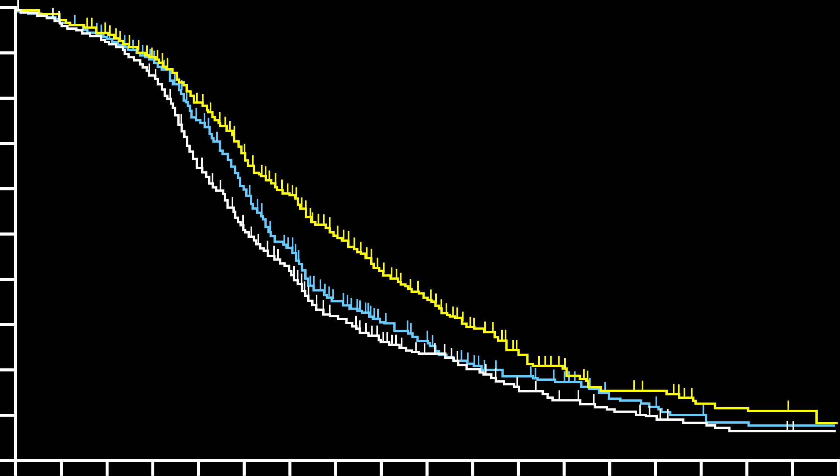
GOG 218: Primary Endpoint Primary PFS Analysis
 | CPP (n = 625) | CP + Bev (n = 625) | CP + Bev → Bev (n = 623)
Patients with event, n (%) | 423 (68) | 418 (69) | 360 (58)
Median PFS, mo | 10.3 | 11.2 | 14.1
Stratified analysis HR (95% CI) |  | 0.908 (0.795-1.040) | 0.717 (0.625-0.824)
One-sided P (log rank) |  | .16 | <.001
Updated median PFS, mo | 12.0 | 12.8 | 18.2
Stratified HR (95% CI) |  | 0.83 (0.70, 0.98) | 0.62 (0.52, 0.75)
Two-sided p-value |  | Not significant | <0.0001
1.0
0.9
0.8
0.7
0.6
Proportion Surviving Progression Free
0.5
0.4
0.3
0.2
CP
CP + Bev
0.1
CP + Bev → Bev
0
0
12
24
36
Patients at risk:
Time Since Randomization, mo
CPP
625
199
33
8
CP + Bev
625
219
29
6
CP + Bev → Bev
623
254
38
8
Bev, bevacizumab; CP, carboplatin + paclitaxel; CPP, CP + placebo; GOG, Gynecologic Oncology Group; PFS, progression-free survival.
Burger et al. N Engl J Med. 2011;365:2473-2483; FDA News Release, 2018; News Release, 2018.
Notes:
Burger RA, Brday MF, Bookman MA, et al. Incorporation of bevacizumab in the primary treatment of ovarian cancer. N Engl J Med. 2011;365:2473-2483.
FDA News Release. June 13, 2018. FDA approves bevacizumab in combination with chemotherapy for ovarian cancer. https://www.fda.gov/Drugs/InformationOnDrugs/ApprovedDrugs/ucm610664.htm.
News Release. June 13, 2018. FDA Approves Genentech’s Avastin (Bevacizumab) Plus Chemotherapy as a Treatment for Women With Advanced Ovarian Cancer Following Initial Surgery. https://www.gene.com/media/press-releases/14729/2018-06-13/fda-approves-genentechs-avastin-bevacizu.

Slide 19
A 60-year-old woman with Stage IIIC epithelial ovarian cancer is s/p primary optimal debulking surgery with no gross residual disease. She has no family history of ovarian or breast cancer. 16. What postsurgical treatment strategy would you recommend if mutation testing revealed that the patient had a BRCA germline mutation?
Medical Oncologists
Gynecologic Oncologists
Carboplatin/ paclitaxel q3wk
10
8
Carboplatin/paclitaxel dose dense
1
0
IP/IV chemotherapy
1
3
Carboplatin/paclitaxel q3wk + bevacizumab
0
1
16a. Would you recommend maintenance therapy to this patient?
Yes, olaparib
12
11
No
0
1

Slide 20
A 60-year-old woman with Stage IIIC epithelial ovarian cancer is s/p primary debulking surgery with gross residual macroscopic disease (>1 cm). She has no family history of ovarian or breast cancer. 17. What postsurgical treatment strategy would you recommend if mutation testing revealed that the patient had a BRCA germline mutation?
Medical Oncologists
Gynecologic Oncologists
Carboplatin/paclitaxel dose dense
1
1
Carboplatin/ paclitaxel q3wk
9
8
Carboplatin/paclitaxel dose dense + bevacizumab
1
0
Carboplatin/paclitaxel q3wk + bevacizumab
1
1
IP/IV chemotherapy
0
1
Weekly carboplatin/paclitaxel
0
1
17a. Would you recommend maintenance therapy to this patient?
Yes, olaparib
11
11
Yes, bevacizumab
1
0
No
0
1

Slide 21
18. Have you or would you administer a PARP inhibitor in combination with bevacizumab as maintenance therapy for a patient with advanced ovarian cancer?
Medical Oncologists
Gynecologic Oncologists
I have not, but I would for the right patient
3
3
I have not and would not
9
9

Slide 22
A 56-year-old woman undergoes total abdominal hysterectomy and bilateral salpingo-oophorectomy for Stage IIIA epithelial ovarian cancer. She has no past medical history of diabetes or peripheral neuropathy. She is started on adjuvant every 3-week carboplatin/paclitaxel. She tolerates the first 4 cycles of chemotherapy well but develops Grade 1 peripheral sensory neuropathy. 21. What would be your treatment approach for this patient?
Medical Oncologists
Gynecologic Oncologists
Continue chemotherapy and reduce the dose of paclitaxel
6
3
Continue chemotherapy with no modification
6
9

Slide 23
Following completion of 6 cycles (min 4 cycles) of chemotherapy, if CT/MRI show ‘CR’ or ‘PR’ and patients are eligible they will be randomised
Arm 1
Olaparib
+
Cediranib
Relapsed platinum sensitive ovarian, fallopian tube, primary peritoneal cancer (1st relapse)
Arm 2
Olaparib
Patient Number: 618 (max 250 BRCA mutant)
Stratified by 6-12 vs >12 month progression free interval; surgery vs no surgery at relapse prior to chemotherapy; prior bevacizumab therapy; BRCA status; country
Olaparib: 300 mg tablets BD
Cediranib: 20 mg tablets OD
Other specified histologies permitted if patients have a known or suspected deleterious gBRCAm
Clinicaltrials.gov identifier: NCT03278717
Study start date: 2018
Clinicaltrials.gov identifier: NCT02446600; Status: Open to enrollment
Notes:
Trial Overview : Maintenance trial- builds on the data from ICON6 and the NCI phase 2 trial (Liu et al)
We hypothesise that there may be more marked benefit in the BRCA wt group where the additional toxicity from the combination may be more justified –hence we will cap the number of BRCA mutants to 250 to ensure we have sufficient wt patients to see a benefit.

Slide 24
FDA Grants Breakthrough Therapy Designation to Lenvatinib Plus Pembrolizumab in Endometrial Carcinoma
Press Release: August 6, 2018
“The U.S. Food and Drug Administration (FDA) has granted Breakthrough Therapy designation for lenvatinib in combination with pembrolizumab for the potential treatment of patients with advanced and/or metastatic non–microsatellite instability high (MSI-H)/proficient mismatch repair (pMMR) endometrial carcinoma that has progressed following at least one prior systemic therapy.
This Breakthrough Therapy designation was based on interim results of the endometrial carcinoma cohort in Study 111/KEYNOTE-146, which were presented by Makker et al at the 2018 ASCO Annual Meeting (Abstract 5596). Study 111/KEYNOTE-146 is a multicenter, open-label, single-arm phase Ib/II basket trial evaluating the efficacy and safety of lenvatinib (20 mg/d) in combination with pembrolizumab (200 mg intravenously every 3 weeks) in patients with selected solid tumors (renal cell carcinoma, endometrial carcinoma, non–small cell lung cancer, urothelial cancer, squamous cell head and neck cancer, and melanoma).”
http://www.ascopost.com/News/59131

Slide 25
Key exclusion criteria:
Mucinous histology
Bowel obstruction within 3 months
Active autoimmune disease
Active CNS metastases and/or carcinomatous meningitis
Presented By Ursula Matulonis at 2018 ASCO Annual Meeting
J Clin Oncol 36, 2018 (suppl; abstr 5511)

Slide 26
FIRST
ClinicalTrials.gov Identifier: NCT03602859
GOG 218
PAOLA-1
Triplet
Does not sort out the relative contribution of TSR-042

Slide 31
PAOLA-1: olaparib vs placebo plus bevacizumab as maintenance treatment in patients with advanced ovarian cancer — Phase 3 trial
Study design
FIGO stage III–IV high-grade ovarian cancer (serous or endometrioid)* or non- mucinous BRCAm
No evidence of disease or CR or PR following first-line platinum-based chemotherapy plus bevacizumab
A minimum of 3 cycles of platinum-based chemotherapy plus bevacizumab (2 after interval debulking)
ECOG PS 0–1
Olaparib
300mg† po bid +
Bevacizumab 15mg/kg Q3W
15 months
Primary endpoint
PFS1 (RECIST 1.1)
Secondary endpoints
PFS2
TSST
OS
Safety
PRO/HRQoL
BRCA testing prior to randomisation
Randomise 2:1
N≈806 European + 24 Japanese patients
Placebo +
Bevacizumab 15mg/kg Q3W
15 months
Stratify by:
tBRCA status
CR/PR/NED
Status: Completed enrolment
*Includes patients with primary peritoneal and/or fallopian tube cancer
†Tablet formulation (2 tablets twice daily)
ECOG=Eastern Cooperative Oncology Group; OS=overall survival; po=by mouth; PFS=progression-free survival; PFS2=time to second progression; HRQoL=Health-related quality of life; TSST=time to second subsequent therapy; Q3W=every 3 weeks; PRO=patient reported outcome
Ray-Coquard I et al. J Clin Oncol 34, 2016 (suppl; abstr TPS5607 and poster presentation); Clinicaltrials.gov identifier: NCT02477644; Closed Aug 2017 N=782

Slide 32
SOLO-1 Trial
Front-line Maintenance Therapy with PARP Inhibitors (BRCAmut)
Study treatment continued until disease progression
Patients with no evidence of disease at 2 years stopped treatment
Patients with a partial response at 2 years could continue treatment
Primary endpoint
Newly diagnosed, FIGO stage III–IV, high-grade serous or endometrioid ovarian, primary peritoneal, or fallopian tube cancer
Germline or somatic BRCAm
ECOG performance status 0–1
Cytoreductive surgery*
In clinical complete response or partial response after platinum-based chemotherapy
Olaparib 300 mg bd (N=260)
Investigator-assessed PFS (modified RECIST 1.1)
2:1 randomization
Secondary endpoints
Stratified by response to platinum-based chemotherapy
PFS using BICR
PFS2
Overall survival
Time from randomization to first subsequent therapy or death
Time from randomization to second subsequent therapy or death
HRQoL (FACT-O TOI score)
Placebo (N=131)
2 years’ treatment if no evidence of disease
*Upfront or interval attempt at optimal cytoreductive surgery for stage III disease and either biopsy and/or upfront or interval cytoreductive surgery for stage IV disease.
Moore KN, et al. ESMO. 2018. Abstract LBA7_PR; Moore K, et al. N Engl J Med. 2018.

Slide 34
JAVELIN Ovarian 100 Avelumab Platinum Combo + Maintenance (Frontline)
Randomized Phase 3 Study (NCT02718417)
Chemotherapy Maintenance
Enrollment Criteria
Previously untreated
Stage III-IV
Prior debulking surgery or plan for neoadjuvant chemotherapy
ECOG PS 0 or 1
Mandatory archival tissue
Arm A
Chemotherapy
Observation
Arm B
Chemotherapy
Avelumab Q2W
R
A
N
D
O
M
I
Z
A T I O N
Arm C
Chemotherapy
+ Avelumab Q3W
Avelumab Q2W
1:1:1
n = ~951
Primary Endpoint:
PFS
Secondary Endpoints:
Maintenance PFS, OS, ORR, duration of response, pCR, PROs, safety, PK
Patients with SD or better will be allowed to continue to maintenance
Chemotherapy: Choice of Q3W carboplatin-paclitaxel OR carboplatin + weekly paclitaxel
Maintenance avelumab up to 2 years
ORR, overall response rate; OS, overall survival, pCR, pathological complete response; PFS, progression-free survival, PK, pharmacokinetics; PROs, patient-reported outcomes; SD, stable disease.
Clinicaltrials.gov. Accessed October 11, 2016.

Slide 35
Overview of Phase 3 1L Maintenance Trials: Completed & Pending
Study Design |  | GOG-0218 (N=1873)¹⁻³ | SOLO-1 (N=451)³ | Velia (N=1140)⁴ | PRIMA (N=620)³ | PAOLA-1 (N=612)⁴
Treatment arms vs placebo |  | Bevacizumab (n=625) | Olaparib (n=260) | Veliparib | Niraparib | Bevacizumab ± Olaparib
Key Patient Population |  | All comers | BRCA mutation | All comers | All comers | All comers
Undergo tumor testing |  | HRR (post-hoc) | BRCA | BRCA | HRD | BRCA
Stage | III | 73.8% | 84.6% | Eligible | Eligible: Attempt upfront debulking | Eligible
 | IV | 26.2% | 15.4% | Eligible | Eligible: Any debulking attempts | Eligible
Surgery | Residual disease after surgery | Stage III incomplete Macroscopic: 32.8% >1 cm: 41.0% | Macroscopicª Primary: 23.0% Interval: 19.1% | Primary or Interval | Required for Stage III | NR^{b}
 | Inoperable disease | 0 | 1.5% |  | Eligible | NR^{b}
Treatment Duration |  | 15 months | 24 months | 24 months | Until PD | 15 months for Bev 24 months for Olaparib
ªResidual disease based on stage was not reported. ^{b}Stage III and IV eligible, but requirements for prior surgery not reported (NR) on clinicaltrials.gov
1. Burger RA, et al. N Engl J Med. 2011;365:2473-2483. 2. Norquist B, et al. Clin Cancer Res. 2018;24(4):777-783. 3. Bevacizumab [prescribing information] South San Francisco, CA: Genentech, Inc; 2016. 4. ClinicalTrials.gov. https://clinicaltrials.gov/ct2/show/NCT02470585. Accessed 1 October 2018. 5. Clinicaltrials.gov. NCT02655016. 6. Gonzalez-Martin A, et al. Presented at ASCO Annual Meeting 2016; June 3-7, 2016; Chicago, IL. Abstract TPS5606. 7. Clinicaltrials.gov. NCT02477644
Notes:
https://clinicaltrials.gov/ct2/show/NCT01844986 (SOLO-1)
https://clinicaltrials.gov/ct2/show/NCT02655016 (PRIMA)
https://clinicaltrials.gov/ct2/show/NCT02477644 (PAOLA-1)
https://clinicaltrials.gov/ct2/show/NCT00262847 (GOG-0218)

Slide 36
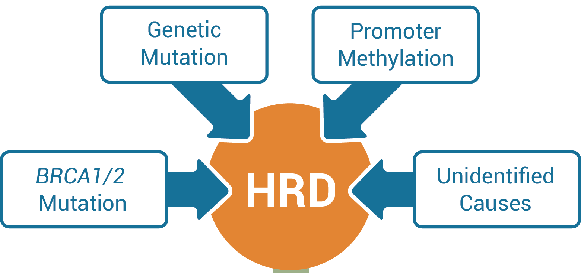
Multiple Factors Can Cause Homologous Recombination Deficiency (HRD)
Other HR Pathway Genetic Mutation
Causes of HRD
If only looking for genetic mutations, HRD produced by other causes can be missed
Inability to repair DNA
Phenotype of HRD
Measure tumor GIS, determine sensitivity to PARP inhibitors
Genomic Instability (GIS)
Sensitivity to PARP inhibitors
Watkins JA, et al. Breast Cancer Res. 2014; Mirza MR, et al. N Engl J Med. 2016.

Slide 37
HRD testing to select PARP inhibitor benefit – NOVA (niraparib), ARIEL3 (rucaparib)
Niraparib (non gBRCA)
Rucaparib all
HRD +ve
 | Niraparib (n=35) | Placebo (n=12)
PFS median (95% CI) (Months) | 20.9 (9.7–NR) | 11.0 (2.0–NR)
Hazard ratio (95% CI); P value | 0.27 (0.081–0.903); P=0.0248
% of patients without progression or death at 12 mo | 62% | 19%
LOH high
BRCA^{wt}
 | Median (months) | 95% CI
Rucaparib (n=106) | 9.7 | 7.9–13.1
Placebo (n=52) | 5.4 | 4.1–5.7
 | HR, 0.44; 95% CI, 0.29–0.66; P<0.0001
sBRCA mut
(n=47)
HRD +ve
 | Niraparib (n=71) | Placebo (n=44)
PFS median (95% CI) (Months) | 9.3 (5.8–15.4) | 3.7 (3.3–5.6)
Hazard ratio (95% CI); P value | 0.38 (0.231–0.628); P=0.0001
% of patients without progression or death at 12 mo | 45% | 11%
BRCA wt
(n=115)
LOH low
BRCA^{wt}
 | Median (months) | 95% CI
Rucaparib (n=107) | 6.7 | 5.4–9.1
Placebo (n=54) | 5.4 | 5.3–7.4
 | HR, 0.58; 95% CI, 0.40–0.85; P=0.0049
HRD -ve
 | Niraparib (n=92) | Placebo (n=42)
PFS median (95% CI) (Months) | 6.9 (5.6–9.6) | 3.8 (3.7–5.6)
Hazard ratio (95% CI); P value | 0.58 (0.361–0.922); P=0.0226
% of patients without progression or death at 12 mo | 27% | 7%
BRCA wt
(n=134)
Mirza et al NEJM 2016; Coleman et al Lancet 2017

