Slide 1
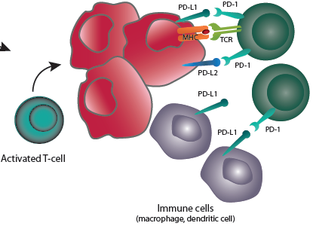
Tumors with substantial susceptibility to anti-PD1 antibody (partial list…)
FDA approved:
Melanoma
Non-Small Cell Lung Cancer
Renal Cell Carcinoma - Clear Cell
Urothelial Cancer
Hodgkin’s Lymphoma
Head and Neck Squamous Carcinoma
FDA fast track designation
Mis-Match Repair Deficient Colorectal Carcinoma
Merkel Cell Carcinoma
Registrational trial on-going
Gastroesophageal Cancer
Hepatocellular Carcinoma
Mesothelioma
Triple-Negative Breast Cancer
Small Cell Lung Cancer
Ovarian Cancer
Glioblastoma
Luke et al. Oncotarget, 2015

Slide 2
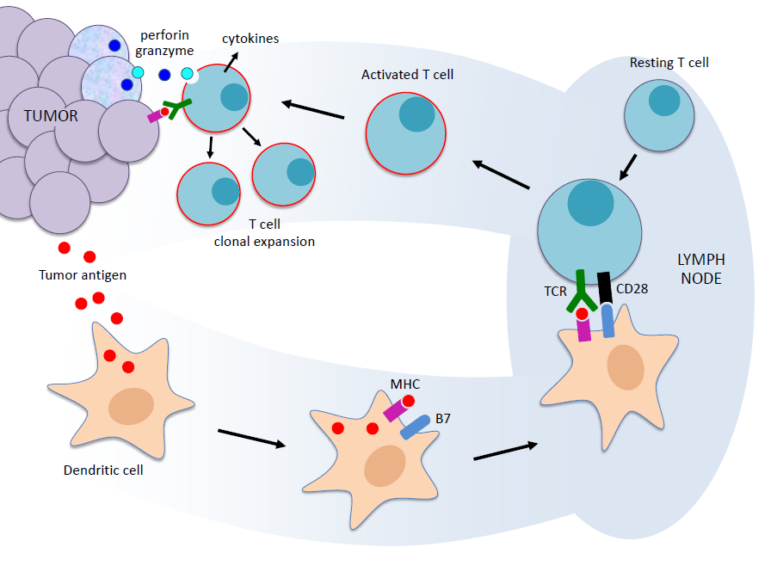
Tumor Immunology: Overview
Courtesy of Scott Gettinger, MD – Yale

Slide 3
The Immunoediting Hypothesis: Shaping Tumor Development
Elimination
Equilibrium
Escape
T reg
T reg
T reg
CTL
NKT
CTL
CTL
NK
NK
CTL
T reg
T cyto
Genetic instability/tumor
heterogeneity
Immune selection
Dunn, et al. Nat Immuno. 2002
Schreiber, et al. Science. 2011
Mittal, et al. Curr Opin Immunol. 2014

Slide 4
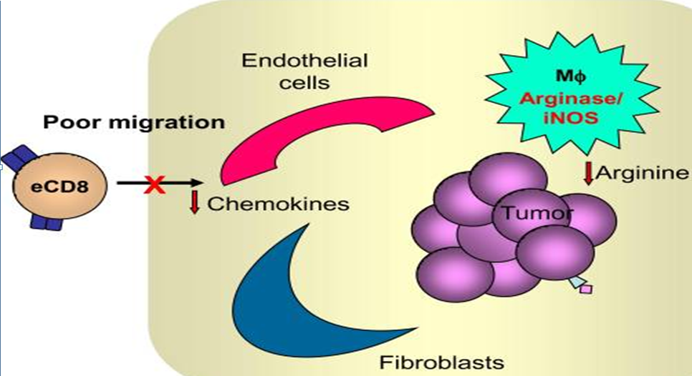
Noninflamed Tumor Phenotype
Poor effector cell trafficking due to:
  High expression of vascular markers, macrophages, fibroblasts
  Low inflammation and chemokine expression, few lymphocytes
Gajewski, et al. Curr Opin Immunol. 2011

Slide 5
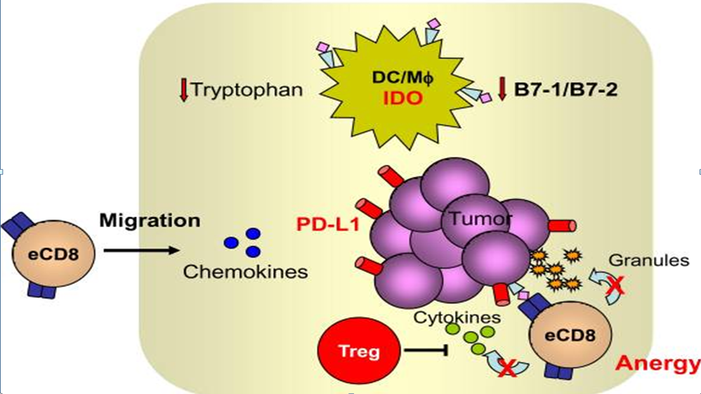
Inflamed Tumor Phenotype
T cell recruitment
  High levels of innate immune signals
  Chemokine expression
Nevertheless, negative immune regulators dominate
Cytotoxic
T cell
Gajewski, et al. Curr Opin Immunol. 2011

Slide 6
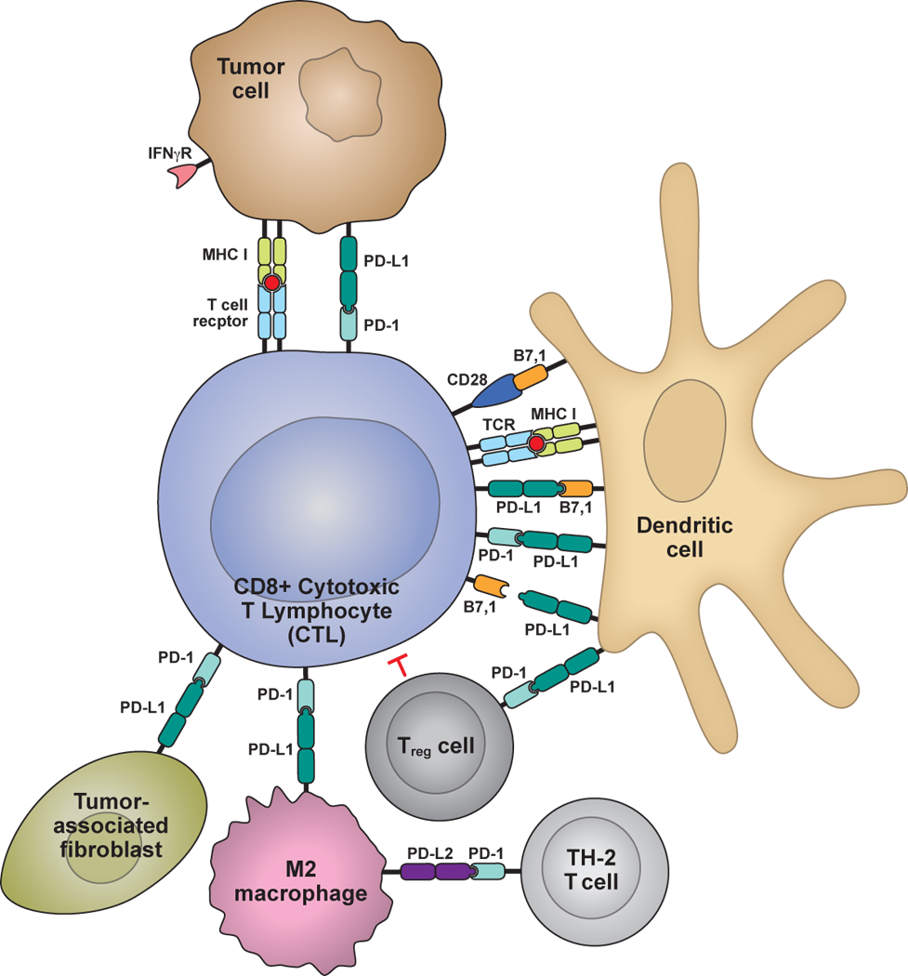
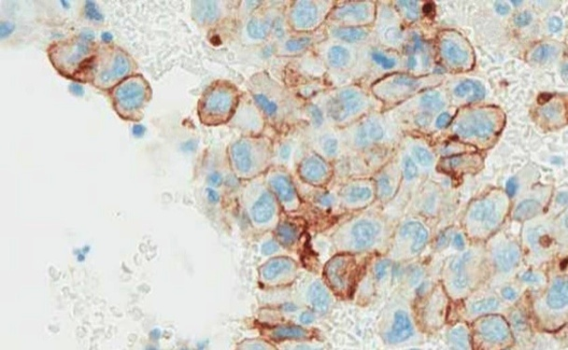
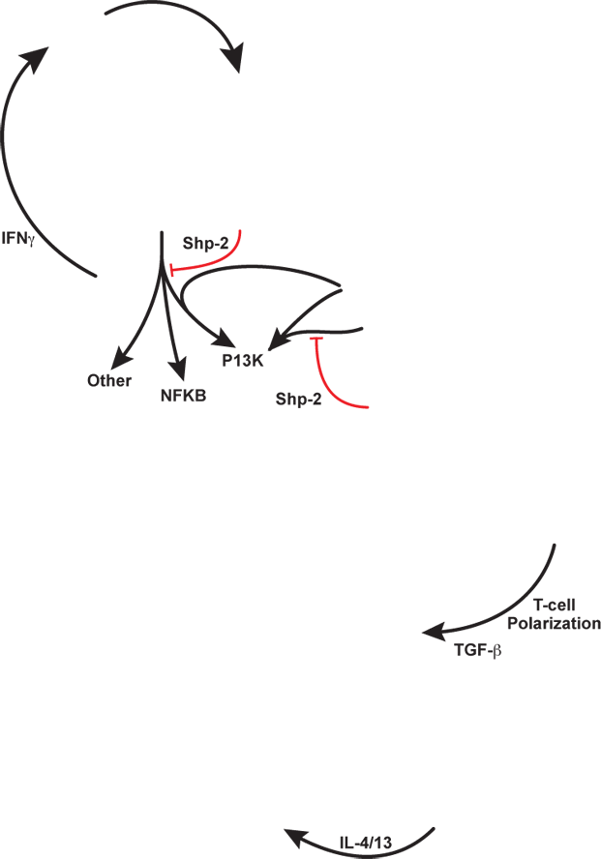

PD-L1 dampens the anti-tumor immune response
PD-L1
IFNγ-mediated
up-regulation of tumor PD-L1
PD-L1/PD-1-mediated Inhibition of
tumor cell killing
receptor
lymphocyte
cancer cell
Priming and
Activation of T cells
Presence of intratumoral T-cells may lead to adaptive immune resistance
PD-L1 expression in the tumor microenvironment can inhibit anti-tumor T cell activity:
PD-L1 expression by tumor infiltrating immune cells
PD-L1 expression by cancer cells
Immune cell modulation of T cells
Stromal PD-L1 modulation of T cells
PD-L2 mediated inhibition of TH-2 T cells
Chen DS, Irving BA, Hodi FS.
Clin Cancer Res. 2012;18:6580.
Powderly et al. ASCO (2013) Abstract 9010

Slide 7
Analysis of over 100,000 patients with cancer for CD274 (PD-L1) amplification: Implications for treatment with immune checkpoint blockade
Goodman A et al.
Proc ASCO SITC 2018;Abstract 47.

Slide 8
Analysis of CD274 (PD-L1) Gene Amplification in Patients with Cancer
Analysis of CD274 gene copy number amplification (CNA) in >100,000 patient samples from Foundation Medicine database and UC San Diego.
CD274 CNAs detected in 0.7% of all tumor samples
Select tumor type | Total patients | % with CD274 CNA
Soft tissue sarcoma undifferentiated | 313 | 3.8
Thyroid anaplastic sarcoma | 165 | 3.0
Lung adenocarcinoma | ≥10,000 | 0.6
Breast cancer | 2,000-9,999 | 2.0
Colon cancer | 2,000-9,999 | 0.2
Prostate cancer | 2,000-9,999 | 0.2
9 patients with CD274 CNA received PD-1/PD-L1 blockade at UC San Diego
  Response rate = 6/9 (67%); median PFS = 15.1 mo
Goodman A et al. Proc ASCO SITC 2018;Abstract 47.
Notes:
8
8

Slide 9
The T cell-inflamed tumor microenvironment is characterized
by expression of immune-inhibitory pathways and
predicts patient outcomes to immunotherapy
Gajewski et al. J Clin Oncol 33, 2015 (suppl; abstr 3002)
Harlin et al. Clin Can Res 2009
Ribas et al. J Clin Oncol 33, 2015 (suppl; abstr 3001)

Slide 10
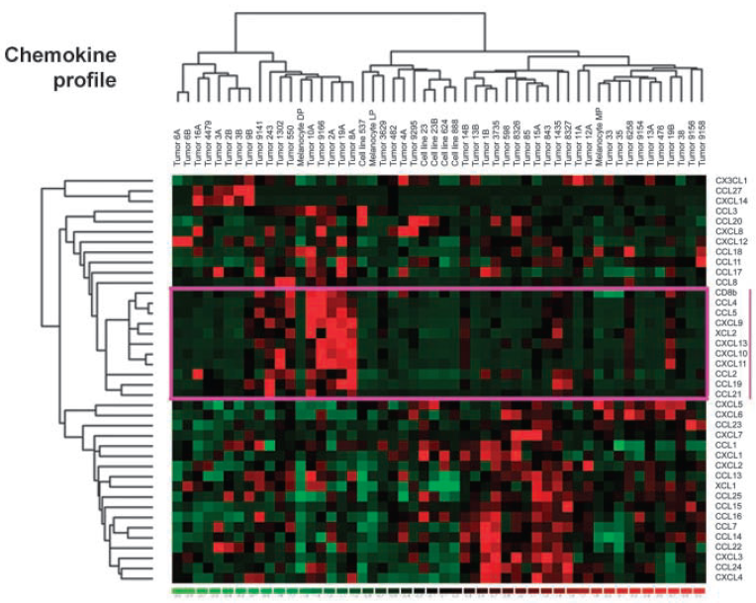
The T cell-inflamed tumor microenvironment is characterized
by expression of immune-inhibitory pathways and predicts
patient outcomes to immunotherapy
Gajewski et al. J Clin Oncol 33, 2015 (suppl; abstr 3002)
Harlin et al. Clin Can Res 2009
Ribas et al. J Clin Oncol 33, 2015 (suppl; abstr 3001)

Slide 11
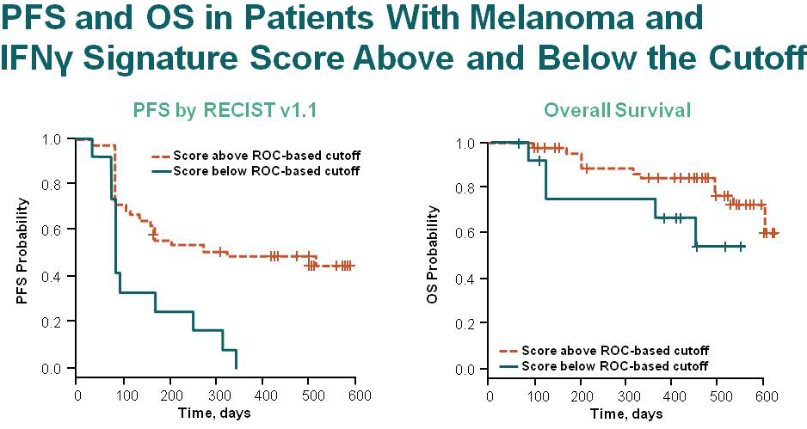
The T cell-inflamed tumor microenvironment is characterized
by expression of immune-inhibitory pathways and predicts
patient outcomes to immunotherapy
Gajewski et al. J Clin Oncol 33, 2015 (suppl; abstr 3002)
Harlin et al. Clin Can Res 2009
Ribas et al. J Clin Oncol 33, 2015 (suppl; abstr 3001)

Slide 12
Association of IFN-γ Signature and Progression-Free Survival in Patients with Head and Neck Cancer
IR-group: Inflamed – Responders
  Gamma-IFN Inflamed
  Benefitting from anti-PD1 therapy
INR-group: Inflamed – Non-Responders
  Gamma-IFN Inflamed
  Not Benefitting from anti-PD1 therapy
  Given biologic signal - Can these patients be converted into responders e.g. via combinations, vaccine etc.
NI-group: Non-Inflamed
  Very high negative predictive value
  Not benefitting from anti-PD1 therapy
  Clinically potentially useful: Identify patients who should NOT receive PD-1 Ab monotherapy
  Unclear whether non-inflamed phenotype can be converted into inflamed phenotype
40
0
30
0
PFS cutoff
at 5 or 6 months
Progression-Free Survival (Days)
20
0
10
0
0
1
.
5
2
.
0
2
.
5
Other
IFN-γ Signature Score
Partial Response
Stable Disease
Presented By Tanguy Seiwert at 2015 ASCO Annual Meeting - J Clin Oncol 33, 2015 (suppl; abstr 6017)

Slide 13
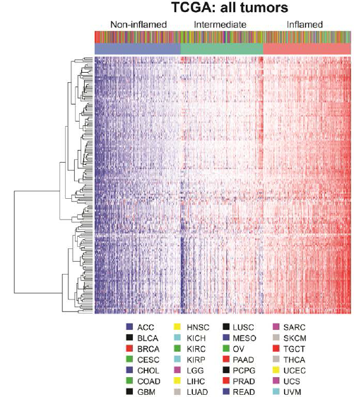
Genetic landscape of the T cell-inflamed tumor microenvironment across TCGA solid tumors
Cancer Type | Non-inflamed | Int | Inflamed | Total
30 solid primary tumors | 3000 (32.7%) | 2873 (32.3%) | 3017 (33.9%) | 8890
Luke and Spranger et al. PNAS 2016

Slide 14
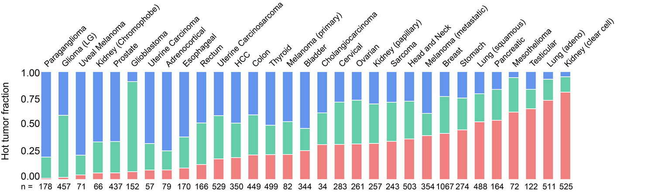
T cell-inflamed tumor microenvironment by tumor type in increasing frequency
Luke and Spranger et al. PNAS 2016

Slide 15
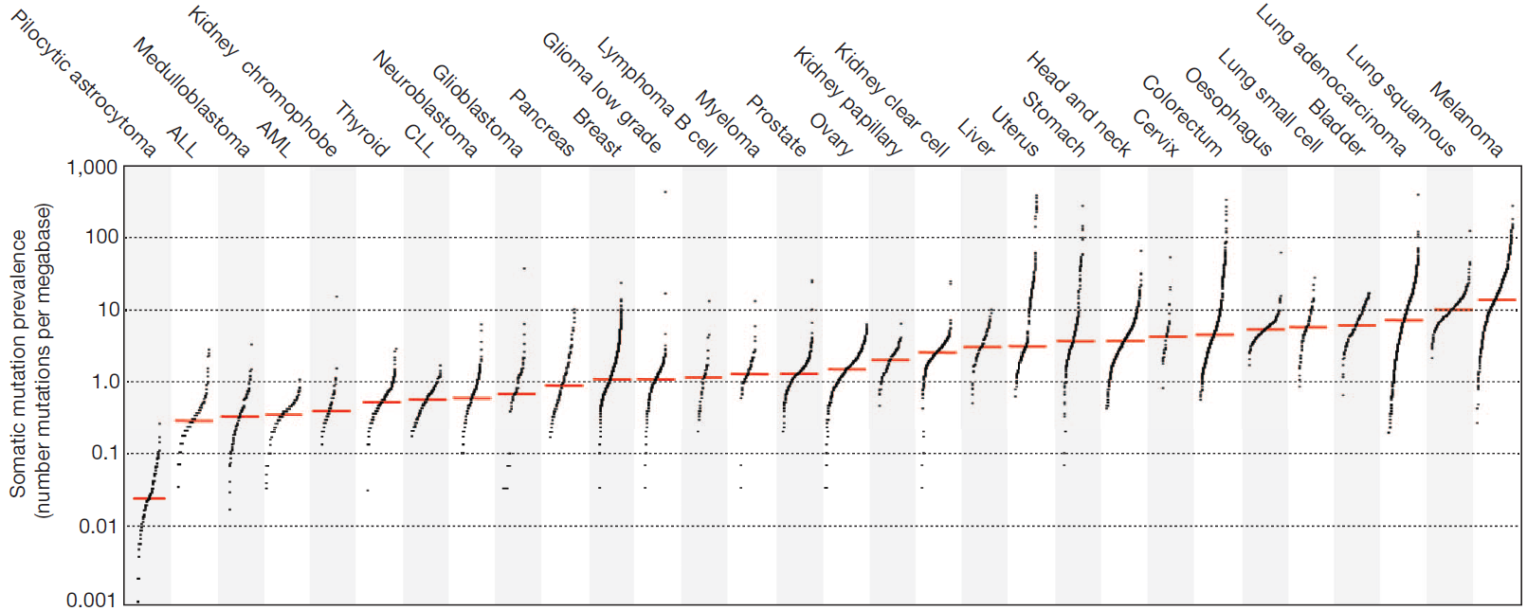
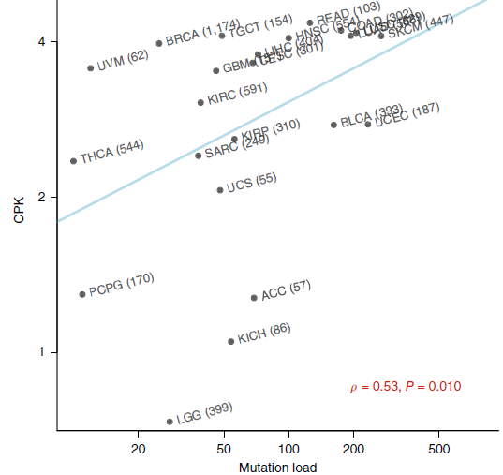
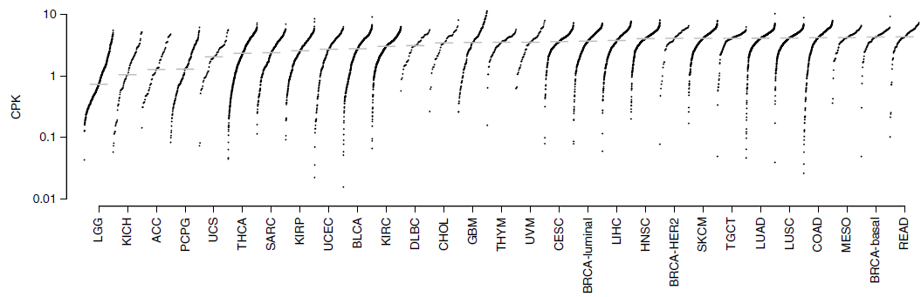
Association of mutational load and TCR diversity
TCGA. Nature 2013
Li et al. Nature Genetics 2015

Slide 16
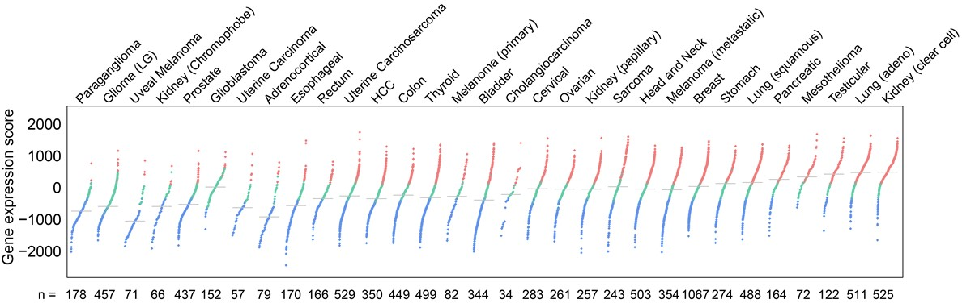
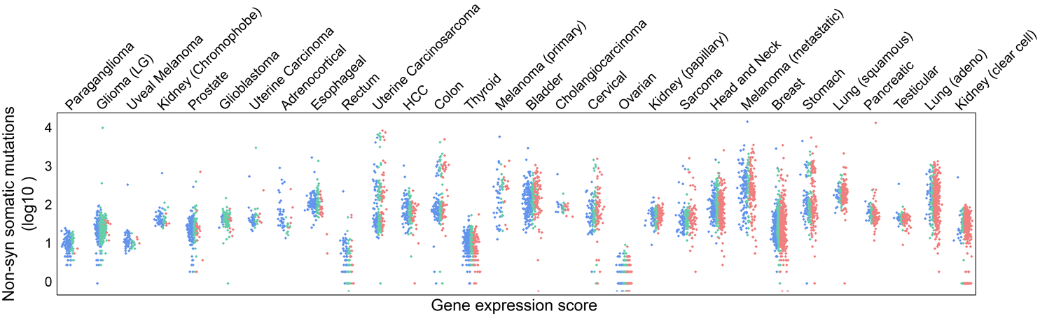
Mutational burden of T cell-inflamed tumor microenvironment within tumor types
Luke and Spranger et al. PNAS 2016

Slide 17
Antigen is not rate-limiting in non-T cell-inflamed tumors, rather Batf3 DCs appear to be
Luke et al. PNAS 2016;113(48):E7759-68.

Slide 18
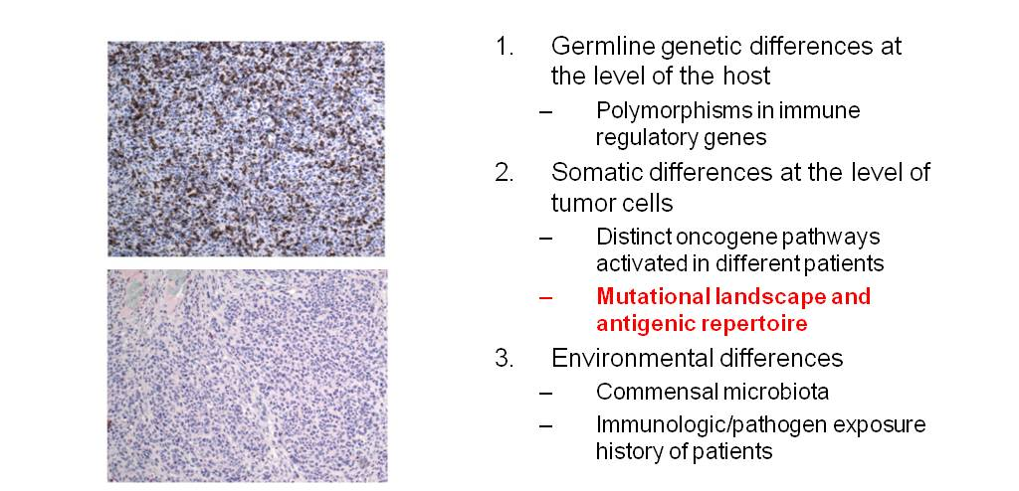
Hypotheses for molecular mechanisms to explain the T cell-inflamed versus non-inflamed tumor microenvironments
What are the molecular mechanisms that explain the T cell-inflamed versus non-inflamed tumor microenvironments?
Somatic differences at the level of tumor cells
  Distinct oncogene pathways activated in different patients
  Mutational landscape and antigenic repertoire
Germline genetic differences at the level of the host (patient)
  Polymorphisms in immune regulatory genes
3. Environmental differences
- Commensal microbiota

Slide 19
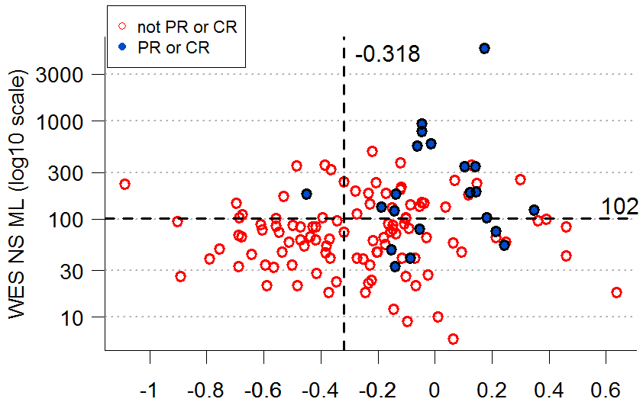
ML and GEP Association With BOR
Not PR or CR
PR or CR
Cutoff Status | Total | PR or CR | Response % (CI)
ML ≥102 ML <102 | 50 85 | 15 6 | 30 (18, 45) 7 (3, 15)
GEP ≥-0.318 GEP <-0.318 | 80 48 | 20 1 | 25 (16, 36) 2 (0, 11)
ML ≥102 & GEP ≥-0.318 ML <102 & GEP <-0.318 | 37 36 | 14 0 | 38 (22, 55) 0 (0, 10)
ML =102, cutoff associated with ROC Youden Index; GEP = -0.318, cutoff selected via analysis of pan-cancer data; equivalent but numerically different clinical assay cutoff is currently under evaluation; BOR = best overall response; PR=partial and CR=complete response
GEP 18-Gene Score
ORR for all patients: KN028 (42/422 = 10.0%);
KN012 (29/136 = 21.3%)
ML and GEP remained significant predictors of response in multivariate model adjusted for each measure (GEP P = 0.0010; ML P = 0.0004)
All patients, r = 0.202; P = 0.022
PR or CR, r = 0.088; P = 0.368
Not PR or CR, r = 0.161; P = 0.484
ML = mutational load; GEP = gene expression profile; BOR = best overall response

Slide 20
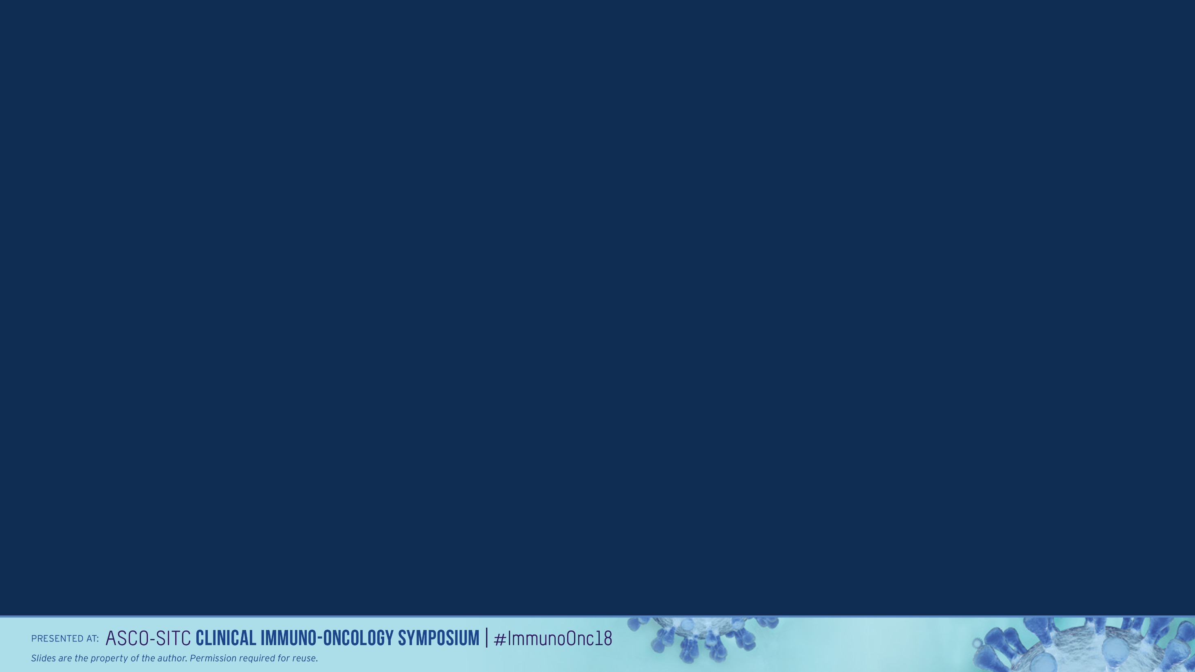
Traditional Paradigm for Approval in Oncology
Based on tumor type, stage of disease, and line of therapy
  First line metastatic pancreatic cancer: gemcitabine/nab-paclitaxel
Based on a biomarker with a tumor type
  First line metastatic HER2 positive gastric cancer: 5FU/cisplatin + trastuzumab
Randomized controlled trial
  Gemcitabine/nab-paclitaxel versus gemcitabine
Presented by: Dung Le

Slide 21
Tissue Agnostic Development
Targeting a biomarker across histologies
Does it make sense scientifically?
Is the effect heterogenous (e.g. BRAF)?
Is the underlying disease prognostically different? E.g. prostate vs pancreas
How will treatment effects be measured across tumor types? RR? OS?
Does this actually slow development? Common vs rare patient populations
What is the incidence across different tumor types?
Is there an unmet need?
Is the response clinically meaningful?
Who will enroll these patients?
Should pediatric patients be included?
Companion Diagnostic: Validation across tumor types
Presented by: Dung Le

Slide 22
Pembrolizumab for Microsatellite Instability High or Mismatch Repair Deficient Cancers
1st Tissue Agnostic Approval
Presented by: Dung Le

Slide 23
FDA Approvals Timeline (Solid Tumors)
nivolumab (non squamous lung CA)
pembrolizumab (PD-L1+ NSCLC)
nivolumab + ipilimumab (MEL, 1st line)
ipilimumab (MEL, adjuvant)
nivolumab
(squamous lung CA)
ipilimumab (MEL)
pembrolizumab (MEL)
nivolumab (MEL)
March 2011
Sept 2014
Dec 2014
March 2015
Oct 2015
pembrolizumab
(NSCLC, 1st line)
atezolizumab (NSCLC)
nivolumab
(RCC)
pembrolizumab
(MEL, 1st line)
atezolizumab
(bladder CA)
pembrolizumab
(HNSCC)
nivolumab
(HNSCC)
Nov 2015
Dec 2015
May 2016
Aug 2016
Oct 2016
Nov 2016
durvalumab, avelumab, pembrolizumab (bladder)
pembrolizumab + chemo (NSCLC, 1st Line)
pembrolizumab (MSI-H cancers)
pembrolizumab
(gastric/GE)
nivolumab (HCC)
nivolumab
(bladder)
avelumab
(merkel cell)
nivolumab
(MSI-H CRC)
Jan 2017
March 2017
May 2017
Jul 2017
Sept 2017
Presented by: Dung Le

Slide 24
Mismatch Repair Deficient Colorectal Cancer
  Genetic and epigenetic defects in mismatch repair lead to microsatellite instability (MSI-H)
      germline (HNPCC/Lynch) and/or sporadic mutations (MLH1, MSH2, MSH6, PMS2, EpCAM)
      epigenetic silencing (MLH1 hyper-methylation)
  15% of colorectal carcinomas across all stages
16%
12%
12%
4%
Presented by: Dung Le

Slide 25
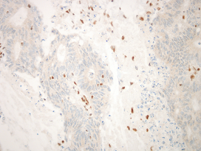
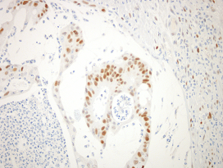
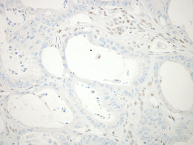
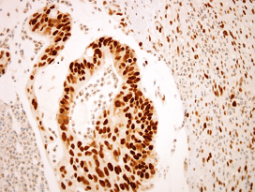
IHC: MLH1 & PMS2 Deficient
MLH1
MSH6
PMS2
MSH2
Courtesy:
Elizabeth Montgomery
Presented by: Dung Le

Slide 26
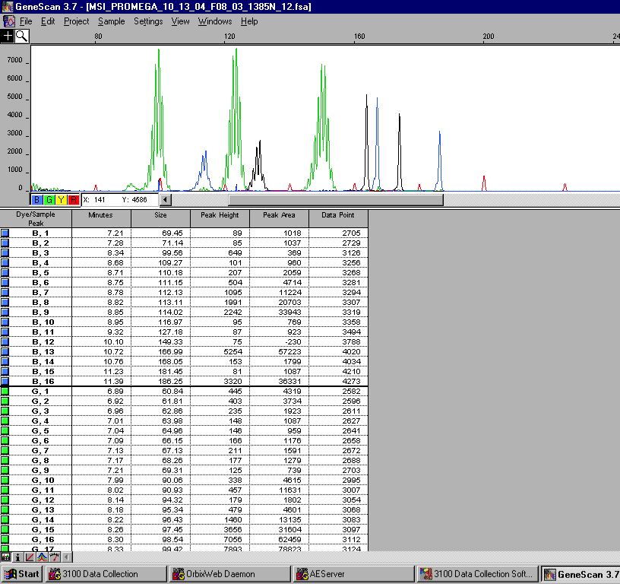
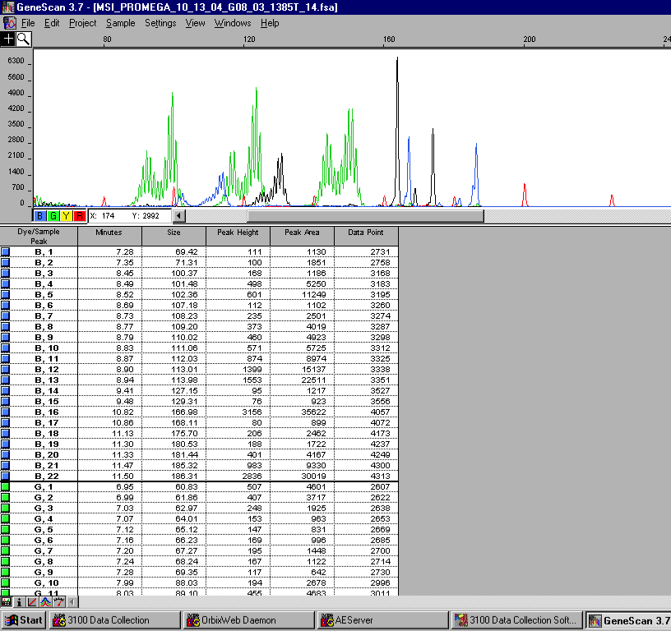
PCR: Microsatellite Instability
Normal
BAT-25
Mono-27
NR-21
Penta C, D
BAT-26
NR-24
Tumor
Courtesy:
James Eshleman
Presented by: Dung Le

Slide 27
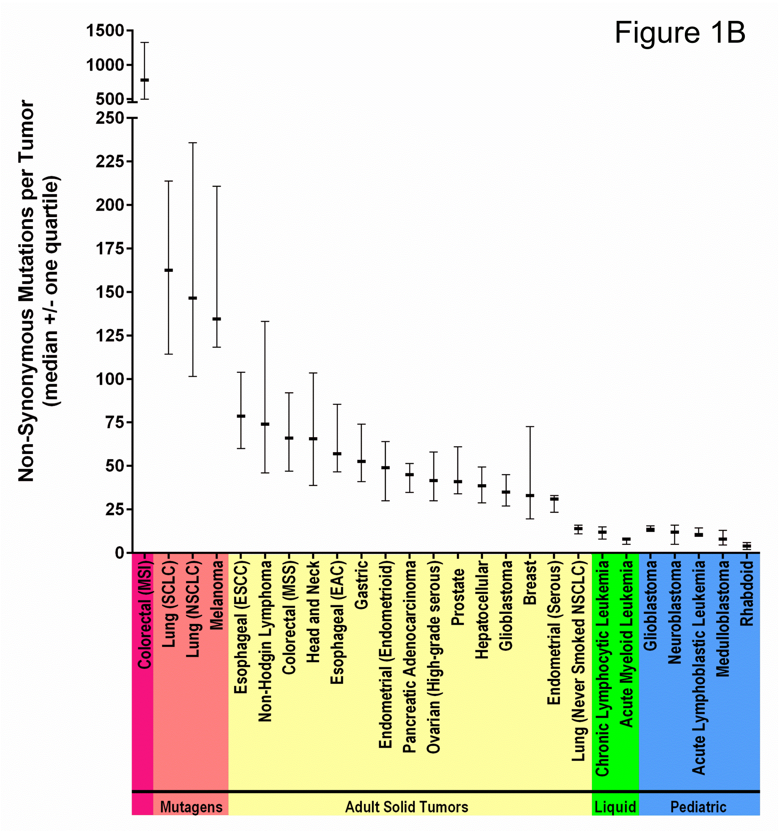
Mutational Burden
Non-Hodgkin Lymphoma
Courtesy: Luis Diaz
Presented by: Dung Le

Slide 28
Mutational Burden
Hyper-mutated Colorectal Cancer
15% CRC
Non-hypermutated Colorectal Cancer
Non-Hodgkin Lymphoma
Courtesy: Luis Diaz
Presented by: Dung Le

Slide 29
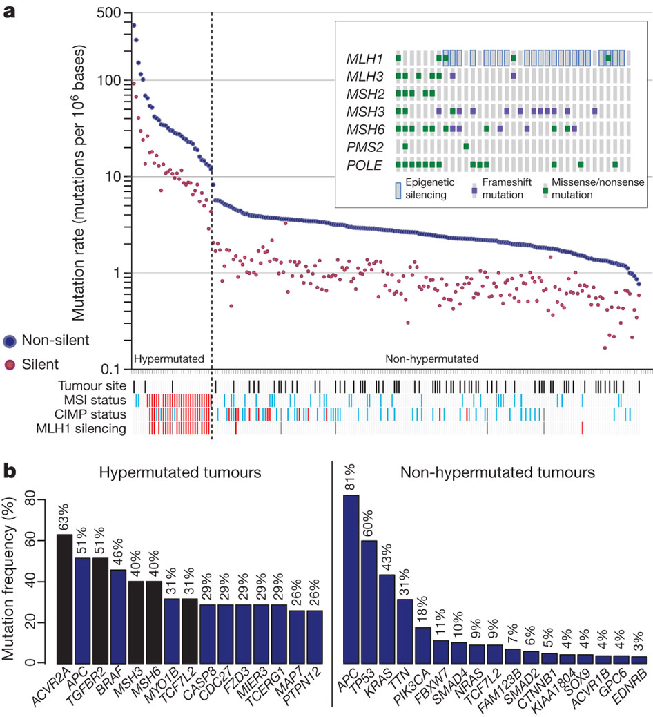
Mutation Frequencies in Human CRC
The Cancer Genome Atlas Network Nature 487, 330-337 (2012) doi:10.1038/nature11252
Presented by: Dung Le

Slide 30
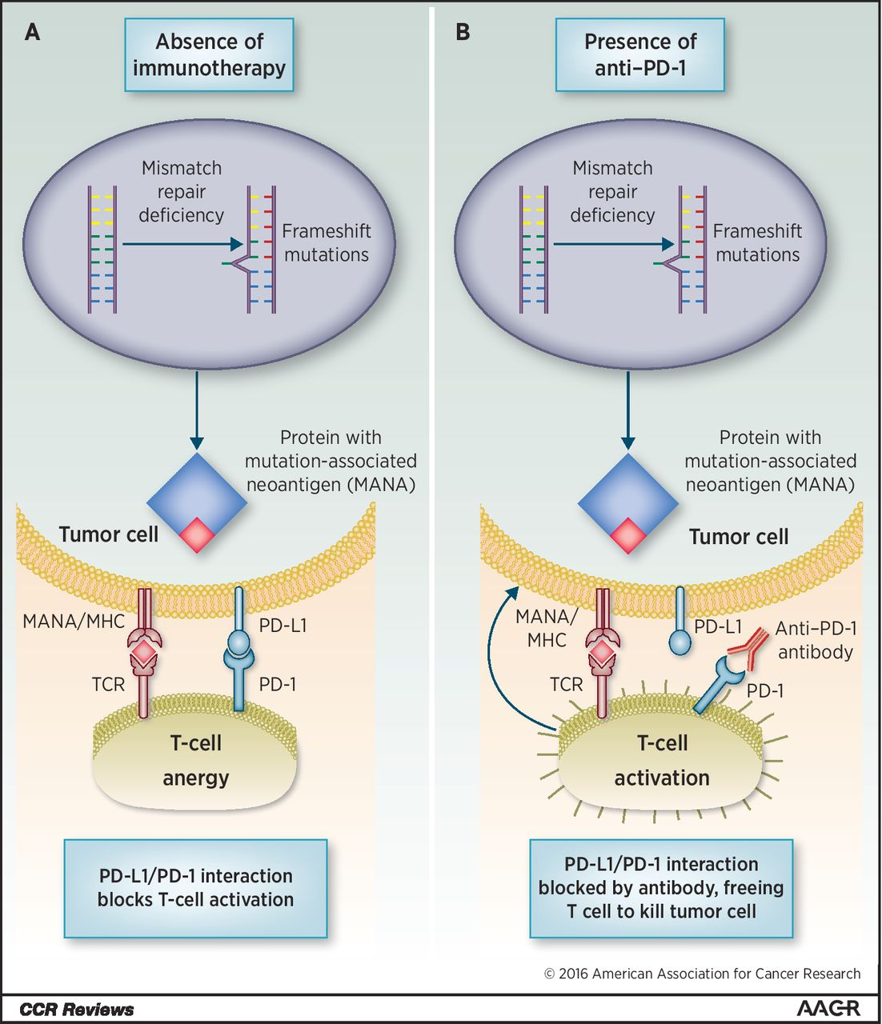
Neoantigens
Jonathan C. Dudley et al. Clin Cancer Res 2016;22:813-820
Presented by: Dung Le

Slide 31
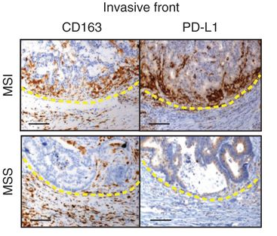
PD-L1+ Tumor Infiltrating Myeloid Cells
Cd163: myeloid cells
Nicolas J. Llosa et al. Cancer Discovery 2015;5:43-51
Presented by: Dung Le

Slide 32
Hypothesis
Mutations have been shown to encode proteins that can be recognized and targeted by the immune system
Average tumor has dozens of somatic mutations; mismatch repair-deficient tumors harbor thousands of mutations
Mismatch repair-deficient tumors are infiltrated with T cells
Immune augmentation with PD-1 blockade may be highly effective in mismatch repair-deficient tumors
HISTOLOGY SHOULD NOT MATTER
Presented by: Dung Le

Slide 33
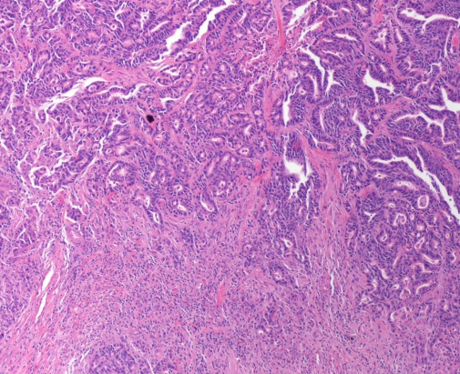
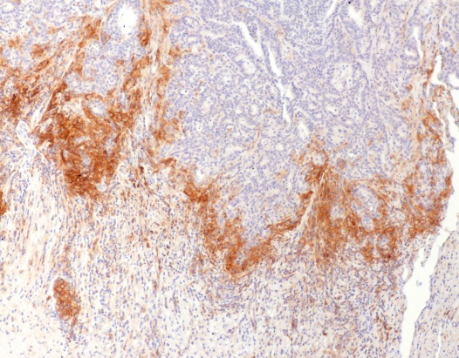
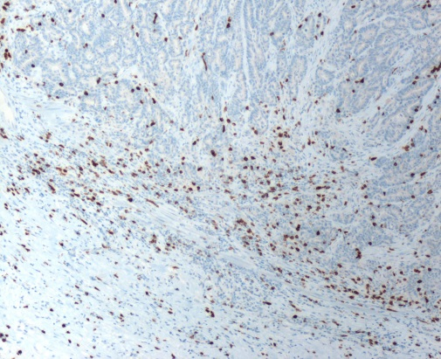
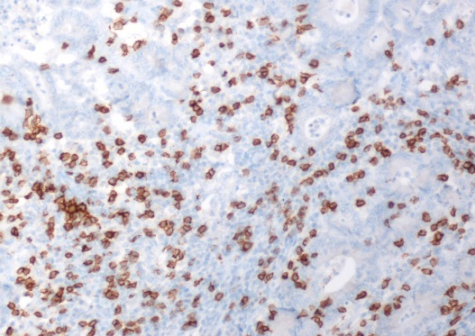
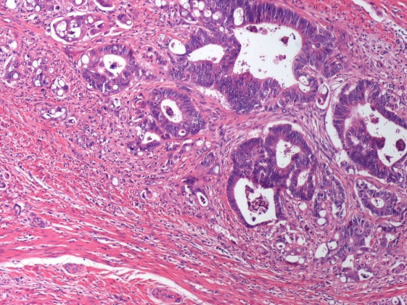
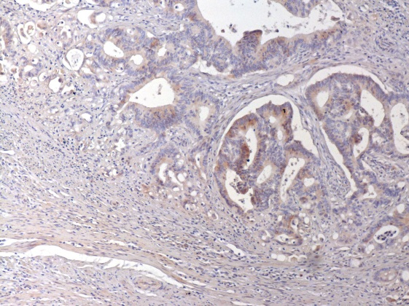
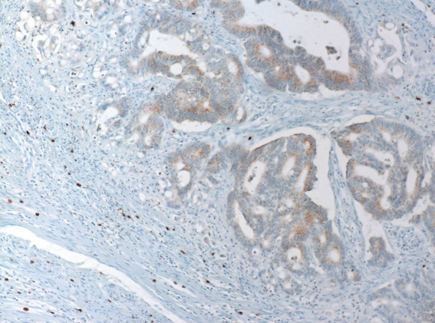
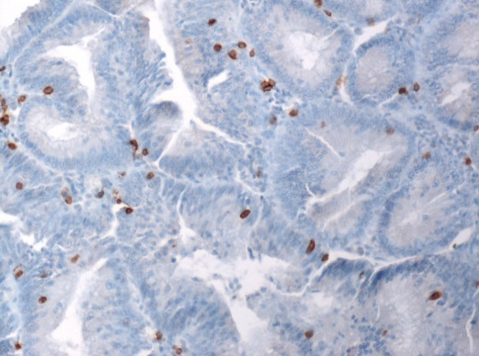
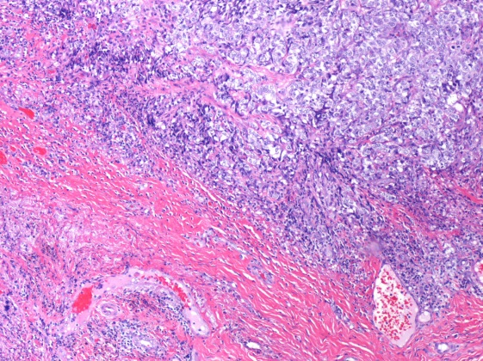
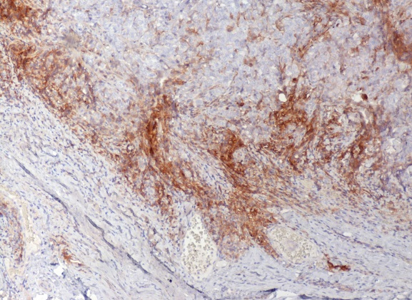
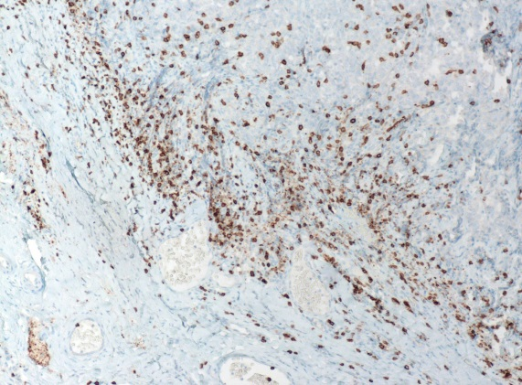
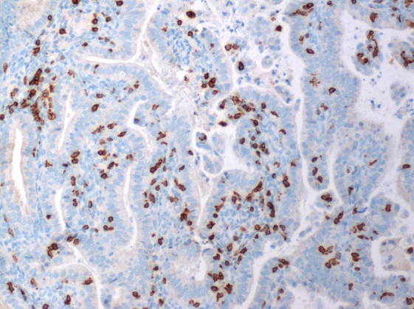
Baseline PD-L1 Expression and CD8 T Cell Infiltration
H&E
PD-L1
CD8
CD8
T
T
T
dMMR CRC
N
N
N
T
T
T
pMMR CRC
N
N
N
T
T
T
dMMR non-CRC
N
N
N
Invasive Front
TIL
Courtesy: Robert Anders
Presented by: Dung Le

Slide 34
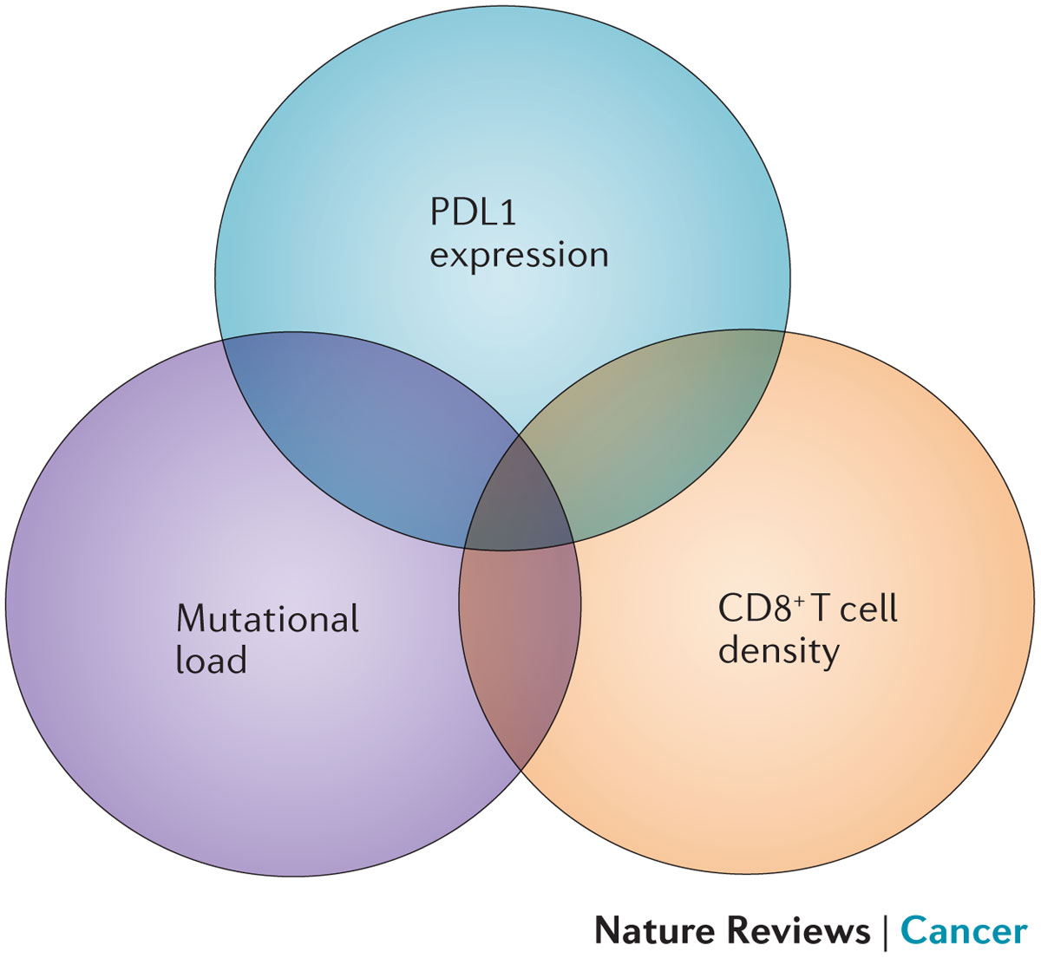
Baseline PD-L1 Expression and CD8 T Cell Infiltration
H&E
PD-L1
CD8
CD8
T
T
T
dMMR CRC
N
N
N
T
T
T
pMMR CRC
N
N
N
T
T
T
dMMR non-CRC
Topalian et al. 2016
N
N
N
Invasive Front
TIL
Presented by: Dung Le

Slide 35
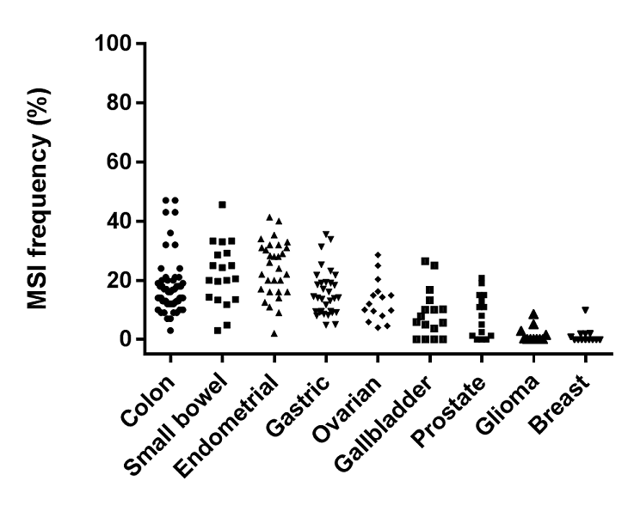
Associated Tumor Types
Lee, et al. The Oncologist 2016; 21:1200-1211
Presented by: Dung Le

Slide 36
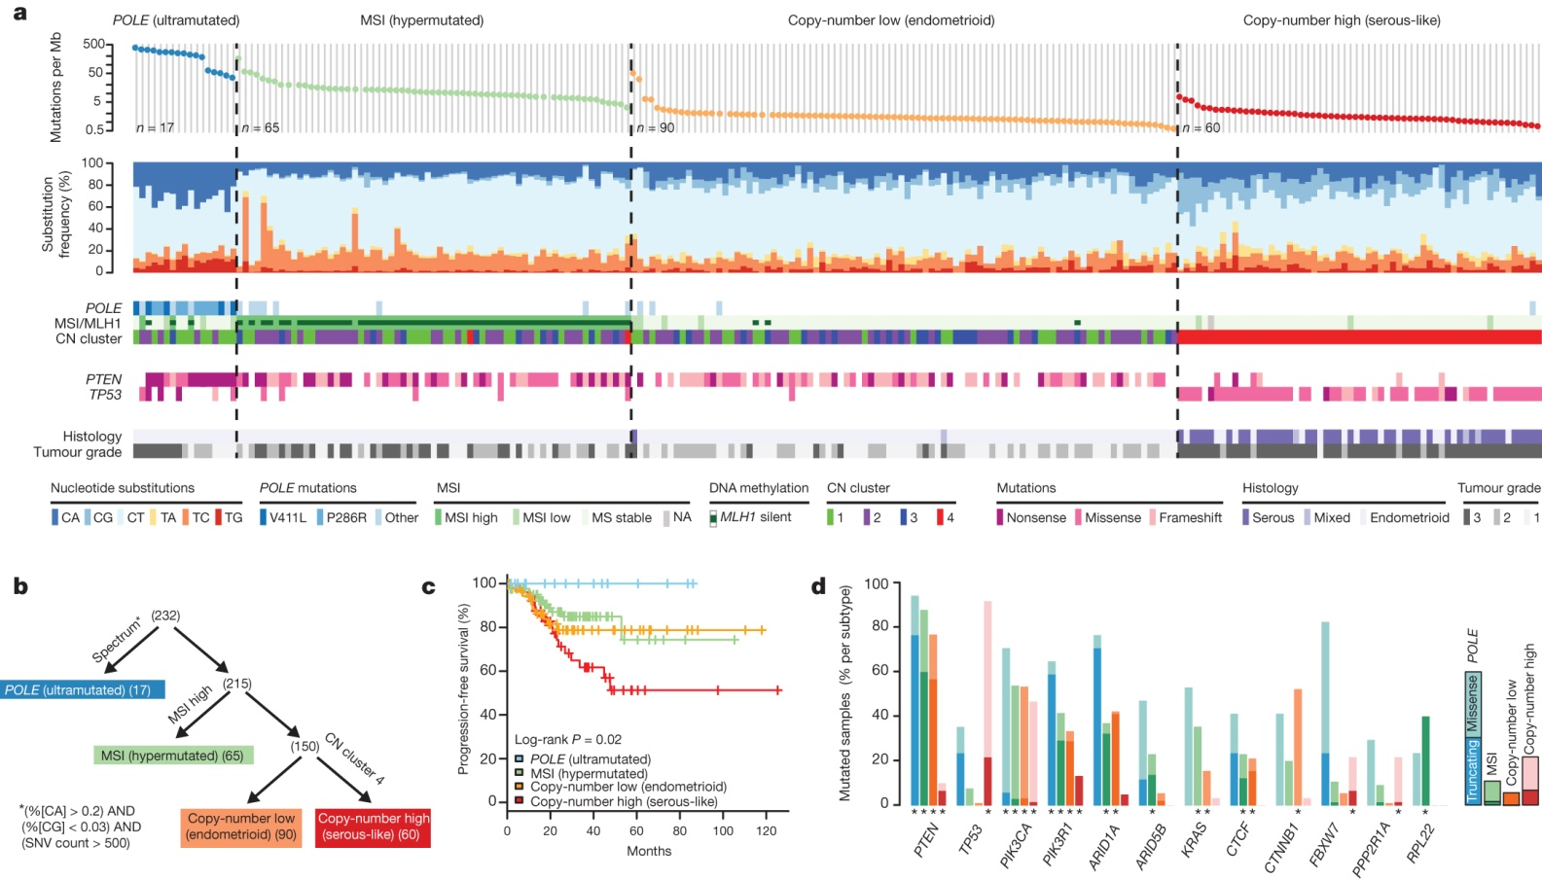
Mutation spectra: endometrial carcinomas
G Getz et al. Nature 497, 67-73 (2013) doi:10.1038/nature12113
Presented by: Dung Le

Slide 37
Neoantigen Prediction and T Cell Infiltration in Hypermutated Endometrial Cancer
Howitt et al. Jama Oncology 2015
Presented by: Dung Le

Slide 38
T Cell Infiltration in Hypermutated Endometrial Cancer
Representative photomicrographs of MSS, MSI, and POLE endometrial adenocarcinomas (original magnification x40). CD3⁺ TILs are infrequent in MSS tumors but significantly increased in MSI and POLE tumors. Almost all CD3⁺
TILs are CD8⁺ (right column). H&E indicates hematoxylin-eosin, and HPF, high-power field.
Howitt et al. Jama Oncology 2015
Presented by: Dung Le

Slide 39
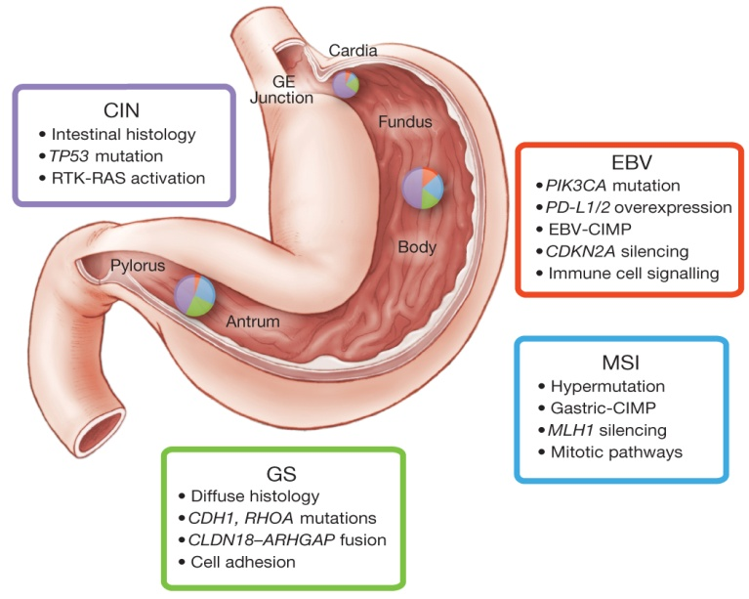
Key Features of Gastric Cancer Subtypes
AJ Bass et al. Nature 000, 1-8 (2014) doi:10.1038/nature13480
Presented by: Dung Le

Slide 40
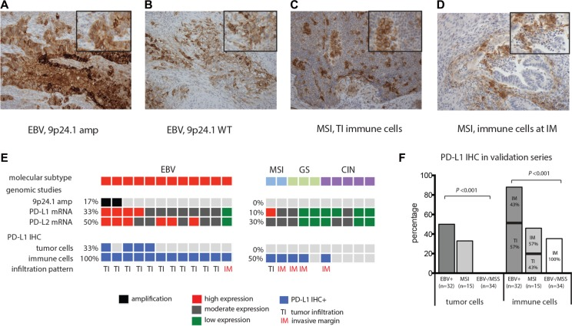
PD-L1 and PD-L2 Expression in
Molecular Subtypes of Gastric Cancer
Derks et al. Oncotarget. 2016 May 31.
Presented by: Dung Le

Slide 41
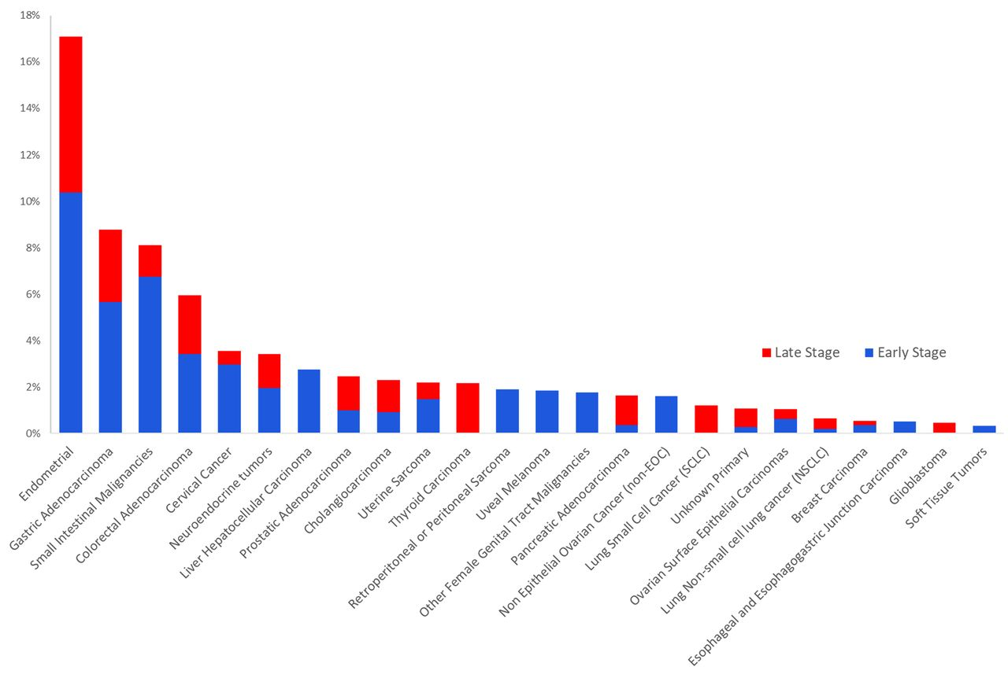
Mismatch repair deficiency across 12,019 tumors
Dung T. Le et al. Science 2017;science.aan6733
Presented by: Dung Le

Slide 42
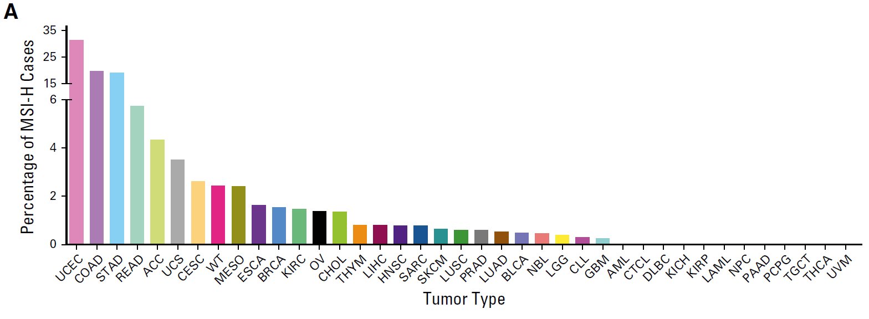
MSI-H found across 27 tumor types (MANTIS)
Endometrial (31.4%)
Colon (19.7%)
MSI in 3.8% of all cancers
Gastric AdenoCA (19.1%)
Rectal (5.7%)
Esophageal (1.6%)
Cholangiocarcinoma (1.4%)
Hepatocellular (0.8%)
Pancreatic AdenoCA (0%)
Whole exome data from 11,139 tumor-normal pairs (TCGA, TARGET)
Assessed mutation burden, mutational signatures, and somatic variants associated with MSI (2,530 microsatellite regions; only two from the five chosen in 1997)
Bonneville, JCO Precision Oncology 2017
Presented by: Dung Le

Slide 43
KEYNOTE-016: Study Cohorts
Colorectal Cancers
Non-Colorectal Cancers
Cohort A
Deficient in
Mismatch Repair
(n=28)
Cohort B
Proficient in
Mismatch Repair
(n=25)
Cohort C
Deficient in
Mismatch Repair
(n=30)
Anti-PD1 (Pembrolizumab) – 10 mg/kg every 2 weeks
Le, D, et al. ASCO 2016, Abstract 103.
Diaz LA, et al. ASCO 2016. Abstract 3003.
Presented by: Dung Le

Slide 44
Colorectal Cancer: Best Radiographic Responses
Le, DT, et al. ASCO 2016. Abstract 103.
Presented by: Dung Le

Slide 45
Colorectal Cancer: Radiographic Responses
Le, DT, et al. ASCO 2016, Abstract 103.
Presented by: Dung Le

Slide 46
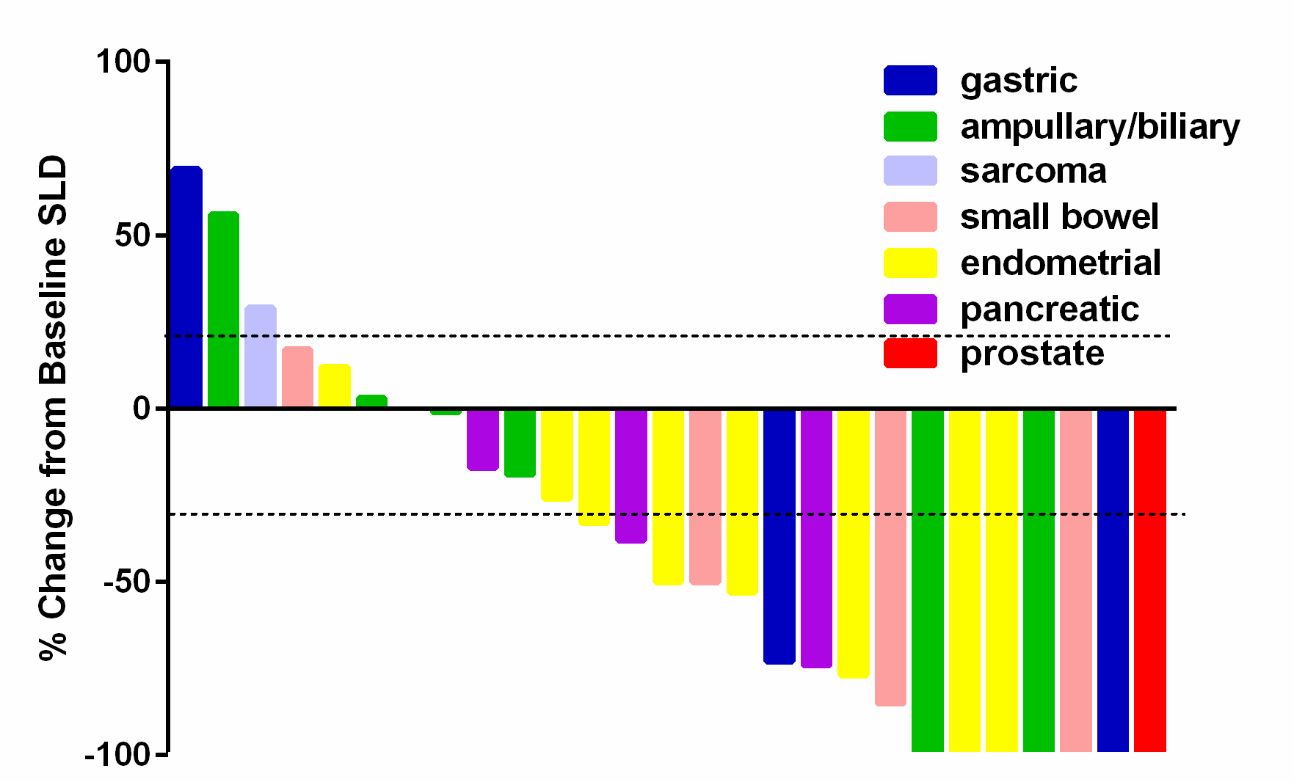
Target Lesion Measurements
Diaz LA, et al. ASCO 2016. Abstract 3003.
Presented by: Dung Le

Slide 47
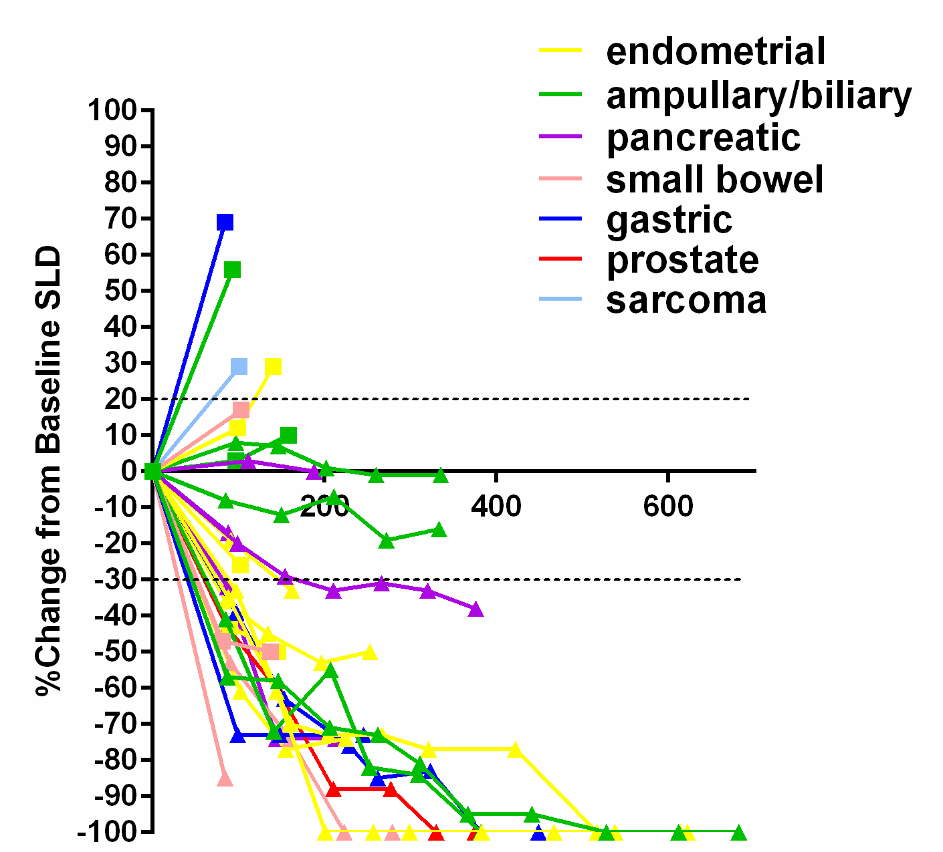

Durability of Disease Control
Diaz LA, et al. ASCO 2016. Abstract 3003.
Presented by: Dung Le

Slide 48
KEYNOTE-016: Study Cohorts
Colorectal Cancers
Non-Colorectal Cancers
Cohort A
Deficient in
Mismatch Repair
(n=40)
Cohort C
Deficient in
Mismatch Repair
(n=46)
Anti-PD1 (Pembrolizumab) – 10 mg/kg every 2 weeks
Presented by: Dung Le

Slide 49
Baseline Characteristics
Dung T. Le et al. Science 2017;science.aan6733
Presented by: Dung Le

Slide 50
Treatment Response: CRC vs Non-CRC
Dung T. Le et al. Science 2017;science.aan6733
Presented by: Dung Le

Slide 51
Treatment Response by Tumor Type
Dung T. Le et al. Science 2017;science.aan6733
Presented by: Dung Le

Slide 52

RESPONSES
Dung T. Le et al. Science 2017;science.aan6733
Presented by: Dung Le

Slide 53
RESPONSES
B
C
A
Dung T. Le et al. Science 2017;science.aan6733
Presented by: Dung Le

Slide 54
Total Somatic Mutations
Primary
Metastasis
Unique Mutations
Shared Mutations
Unique Mutations
A
1,361
1,407
B
948
1,088
964
397
1,010
100
848
240
Dung T. Le et al. Science 2017;science.aan6733
Presented by: Dung Le

Slide 55
B2M Alterations Associated with Variable Resistance
Pt | Tissue | Amino Acid | Mutation Type | Consequence | Outcome
9 | Primary | No_Data | Deletion | Frameshift | SD
9 | Primary | No_Data | Deletion | Frameshift
25 | Primary | V69Wfs*34 | Deletion | Frameshift | PR/PD in brain
25 | Recurrent | 12L>P | Substitution | Nonsynonymous coding
25 | Recurrent | V69Wfs*34 | Deletion | Frameshift
29 | Primary | D96Mfs*7 | Deletion | Frameshift | CR
30 | Primary | 101R>H | Substitution | Nonsynonymous coding | CR
36 | Primary | T93Hfs*2 | Insertion | Frameshift | SD
36 | Primary | D116Ifs | Deletion | Frameshift
52 | Primary | 67+4A>G | Substitution | Splice site donor | PR
4-002 | Recurrent | L15Ffs*41 | Deletion | Frameshift | PR/PD in brain
Dung T. Le et al. Science 2017;science.aan6733
Presented by: Dung Le

Slide 56
Pembrolizumab Approved for MSI-H or Mismatch Repair Deficient Tumors
For the treatment of adult and pediatric patients with unresectable or metastatic,
Microsatellite instability-high (MSI-H) or mismatch repair deficient
  Solid tumors that have progressed following prior treatment and who have no satisfactory alternative treatment options, or
  Colorectal cancer that has progressed following treatment with a fluoropyrimidine, oxaliplatin, and irinotecan
Pembrolizumab 200mg every 3 weeks for adults and 2mg/kg (up to 200mg) every 3 weeks for children
Package insert
Presented by: Dung Le

Slide 57

Pembrolizumab Approved for MSI-H or Mismatch Repair Deficient Tumors
Package insert
Presented by: Dung Le

Slide 58

Pembrolizumab Approved for MSI-H or Mismatch Repair Deficient Tumors
Package insert
Presented by: Dung Le

Slide 59

Pembrolizumab Approved for MSI-H or Mismatch Repair Deficient Tumors
Package insert
Presented by: Dung Le

Slide 60
KEYNOTE-164 and 158: Efficacy of Pembrolizumab in Phase 2 KEYNOTE-164 and KEYNOTE-158 Studies of Microsatellite Instability High Cancers
L.A. Diaz Jr^{1,2}; A. Marabelle³; T.W. Kim⁴; R. Geva^{5a}; E. Van Cutsem⁶; T. Andre⁷; P. A. Ascierto⁸; M. Maio⁹; J.P. Delord¹⁰; M. Gottfried¹¹; R. Guimbaud¹²; D. Jaeger¹³; E. Elez¹⁴; T. Yoshino¹⁵; A.K. Joe¹⁶; B. Lam¹⁶; Jie Ding¹⁶; S. K. Pruitt¹⁶; S. Peter Kang¹⁶; D.T. Le¹
¹Sidney Kimmel Comprehensive Cancer Center at Johns Hopkins, Baltimore, MD, USA; ²Current affiliation: Memorial Sloan Kettering Cancer Center, NY, USA; ³Gustave Roussy, Villejuif, France;⁴Asan Medical Center, Republic of Korea; ⁵Sourasky Medical Center, Tel Aviv, Israel; ⁶University Hospital Gasthuisberg, Leuven, Belgium; ⁷Hopital Saint Antoine, Paris, France; ⁸Istituto Nazionale Tumori Fondazione Pascale, Naples, Italy; ⁹Policlinico Le Scotte, A.O Senese, Italy; ¹⁰Institut Claudius Regaud IUCT-Oncopole, Toulouse, France; ¹¹Meir Medical Center, Kfar Saba, Israel; ¹²Centre Hospitalier Universitaire de Toulouse, Hopital Rangueil, France; ¹³Nationales Centrum Tumorerkrankungen, Heidelberg, Germany; ¹⁴Vall d’Hebron Institute of Oncology, Barcelona, Spain; ¹⁵National Cancer Center Hospital East, Chiba, Japan; ¹⁶Merck & Co., Inc., Kenilworth, NJ, USA
ªPresenting author
Diaz L, ESMO 2017
Presented by:
Presented by: Dung Le

Slide 61
KEYNOTE-164 and KEYNOTE-158: Study Design
KEYNOTE-164ª/158^{b}
(MSI-H CRC/non-CRC)
Age ≥18 years
MSI-H by PCR or IHC
Previously treated^{c}
ECOG PS 0-1
Measurable disease (RECIST v1.1)
Life expectancy
≥3 months
Adequate organ function
Pembrolizumab 200 mg
Q3W
Treated for 2 years,
35 treatments, or until PD, unacceptable AEs, or study withdrawal
Survival
follow-up
Primary end point:
ORR (RECIST v1.1,
central review)
^{c} ≥2 prior therapies and ≥1 prior therapy for MSI-H CRC and non-CRC, respectively.
Clinicaltrials.gov: ª NCT02460198 and ^{b} NCT02628067
Presented by: Dung Le

Slide 62

Baseline Characteristics and Demographics in Patients
With MSI-H CRC and MSI-H Non-CRC
ECOG PS, Eastern Cooperative Oncology Group performance status.
ªMutation status was not assessed for MSI-H non-CRC tumors.
^{b}These patients progressed <1 year after adjuvant therapy.
Presented by:
Presented by: Dung Le
Diaz et al, KN164 and KN158, ESMO, 2017

Slide 63

MSI-H Tumor Types Represented in KEYNOTE-164 and KEYNOTE-158
Presented by:
Presented by: Dung Le
Diaz et al, KN164 and KN158, ESMO, 2017

Slide 64

Best Overall Response (RECIST v1.1 per IRC) in Patients With MSI-H CRC and MSI-H Non-CRC
DCR, disease control rate; CR, complete response; PR, partial response; SD, stable disease
ª2 patients were nonevaluable
^{b}10 patients were nonevaluable
Presented by:
Presented by: Dung Le
Diaz et al, KN164 and KN158, ESMO, 2017

Slide 65

Best Percentage Change From Baseline in Target Lesion Size (RECIST v1.1 per IRC)
Patients With MSI-H CRC
Presented by:
Presented by: Dung Le
Diaz et al, KN164 and KN158, ESMO, 2017

Slide 66

Best Percentage Change From Baseline in Target Lesion Size (RECIST v1.1 per IRC)
Patients With MSI-H Non-CRC
Presented by:
Presented by: Dung Le
Diaz et al, KN164 and KN158, ESMO, 2017

Slide 67

Duration of Response (RECIST v1.1 per IRC)
Patients With MSI-H CRC
Presented by:
Presented by: Dung Le
Diaz et al, KN164 and KN158, ESMO, 2017

Slide 68

Duration of Response (RECIST v1.1 per IRC)
Patients With MSI-H Non-CRC
Presented by:
Presented by: Dung Le
Diaz et al, KN164 and KN158, ESMO, 2017

Slide 69


Overall Survival, Kaplan-Meier Estimate
Patients With MSI-H CRC
Presented by:
Presented by: Dung Le
Diaz et al, KN164 and KN158, ESMO, 2017

Slide 70


Overall Survival, Kaplan-Meier Estimate
Patients With MSI-H Non-CRC
Presented by:
Presented by: Dung Le
Diaz et al, KN164 and KN158, ESMO, 2017

Slide 71
Post Marketing Requirement
Submit report showing the clinic benefit of pembrolizumab 200mg IV every 3 weeks
  At least 124 patients with colorectal cancer
  At least 300 patients with non-colorectal cancer including a sufficient number of patients
    Prostate cancer
    Thyroid cancer
    Small cell lung cancer
    Ovarian cancer
  25 children
  Children with CNS malignancies
Presented by:
Presented by: Dung Le

Slide 72
Nivolumab in mismatch-repair deficient (MMR-d) non-colorectal cancers: NCI-MATCH Trial (Molecular Analysis for Therapy Choice) Arm Z1D
Nilofer Azad, Michael Overman, Robert Gray, Jonathan Schoenfeld, Carlos Arteaga, Brent Coffey, David Patton, Shuli Li, Lisa McShane, Larry Rubinstein, Lyndsay Harris, Robert Comis, Jeffrey Abrams, Paul M. Williams, Edith Mitchell, James Zweibel, Elad Sharon, Howard Streicher, Peter J. Dwyer, Stanley Hamilton, Barbara Conley, Alice P. Chen, Keith Flaherty
Presented by Nilo Azad at SITC 2017
Presented by:
Presented by: Dung Le

Slide 73
STUDY DESIGN
Baseline imaging and then reassessment every 2 cycles
Treatment until progression***
MMR-deficient, non colorectal cancer subjects
N=35*
Nivolumab 3 mg/kg IV q2weeks x 4 cycles**
After cycle 4, nivolumab 480 mg IV q4weeks
* 12 additional patients enrolled in expansion – not reported here
**Cycle = 28 days
***Treatment past progression allowed if patients were clinically stable, per provider discretion, in the first 24 weeks of therapy if no more than 4 new lesions and less than 40% change in sum of index lesions
Presented by Nilo Azad at SITC 2017
Presented by:
Presented by: Dung Le

Slide 74
Histologic type | (N = 34)
Adenocarcinoma - GEJ | 1
Adenocarcinoma - small intestine | 1
Cholangiocarcinoma | 1
Gall bladder carcinoma | 1
Endometrioid endometrial adenocarcinoma | 11
Uterine cancer, not specified | 1
Carcinosarcoma of the uterus | 3
Leiomyosarcoma - uterus | 1
Hurthle cell neoplasm | 1
Parathyroid cancer | 1
Prostate cancer | 6
Invasive breast carcinoma | 3
Salivary gland cancer | 1
Small cell lung cancer | 1
Presented by Nilo Azad at SITC 2017
Presented by:
Presented by: Dung Le

Slide 75

Depth of response
Presented by Nilo Azad at SITC 2017
Presented by:
Presented by: Dung Le

Slide 76

Presented by:
Presented by: Dung Le

Slide 77
Future Directions
Use PD-1 inhibition in earlier stages and lines of therapy
Broader testing of solid tumors for mismatch repair deficiency using simple IHC or PCR
More patients identified as a by product of NGS testing
Dissect mechanisms of primary and secondary resistance
Develop immunotherapy as an option for patients with high mutational burden regardless of histology
Presented by:
Presented by: Dung Le

Slide 78
Biomarkers of response
Topalian et al, Nature Reviews Cancer 2016

Slide 79
PD-L1 as a biomarker in 2nd line nivolumab treatment
 | Docetaxel | Nivolumab
017 | All | All | PD-L1 < 1% | PD-L1 > 1% | PD-L1>10%
ORR | 9% | 20% | 17% | 18% | 19%
mPFS (mo.) | 2.8 | 3.5
mOS (mo.) | 6.0 | 9.2 | 8.7 | 9.3 | 11
057
ORR | 12% | 19% | 9% | 31% | 37%
mPFS (mo.) | 4.2 | 2.3
mOS (mo.) | 9.4 | 12.2 | 10.4 | 17.2 | 19.4
Brahmer et al NEJM 2015
Borghaei et al NEJM 2015

Slide 80
KEYNOTE-024: First line NSCLC in PD-L1 > 50%
 | Pembrolizumab | Chemotherapy | Hazard Ratio
RR | 45% | 28%
CR | 9% | 2%
PFS | 10.3 mo. | 6 mo. | 0.5
OS | NR | NR | 0.6
DOR | NR | 6.3 mo.
Reck et al, NEJM 2016

Slide 81
CheckMate 026: First line NSCLC in PD-L1 > 5%
 | Nivolumab | Chemotherapy | Hazard Ratio
RR | 26% | 33%
CR | 2% | 0.5%
PFS | 4.2 mo | 5.9 mo | 1.15
OS | 14.4 mo. | 13.2 mo. | 1.02
DOR | 12.1 mo. | 5.7 mo.
Socinski et al, ESMO 2016
Carbone et al, NMEJM 2017

Slide 82

KEYNOTE-21G: Carbo/Pem +/- pembrolizumab: is there a biomarker of PD-1 + chemotherapy response?
100
PFS
Δ26%
P = 0.0016
77%
63%
90
80
%
70
,
60
13.0 mo
8.9 mo
S
50
F
P
40
30
20
10
0
0
5
6
10
15
20
No. at risk
Time, months
60
43
20
1
0
 | Events, n | HR (95% CI)
Pembro + chemo | 23 | 0.53 (0.31-0.91) P = 0.0102
Chemo alone | 33
63
32
13
1
0
Pembro +
Chemo
Chemo
Alone
Langer et al, Lancet Oncology 2016

Slide 83
Press Release – Phase III KEYNOTE-189 Trial of First-Line Pembrolizumab plus Pemetrexed and Platinum
January 16, 2018
The pivotal Phase III KEYNOTE-189 trial investigating pembrolizumab, an anti-PD-1 antibody, in combination with pemetrexed and cisplatin or carboplatin, for the first-line treatment of metastatic non-squamous non-small cell lung cancer (NSCLC), met its dual primary endpoints of overall survival (OS) and progression-free survival (PFS). Based on an interim analysis conducted by the independent Data Monitoring Committee, pembrolizumab in combination with pemetrexed/platinum resulted in significantly longer OS and PFS versus pemetrexed and platinum chemotherapy alone. The safety profile of the pembrolizumab combination was consistent with that previously observed.
https://www.businesswire.com/news/home/20180116005680/en/Mercks-KEYTRUDA-pembrolizumab-Significantly-Improved-Survival-Progression-Free

Slide 84
Primary PFS and Safety Analyses of a Randomized Phase III Study of Carboplatin + Paclitaxel +/− Bevacizumab, with or without Atezolizumab in 1L Non-Squamous Metastatic NSCLC (IMpower150)
Reck M et al.
Proc ESMO 2017;Abstract LBA1_PR.

Slide 85

IMpower150: Investigator (INV)-Assessed PFS and OS
PFS (ITT-WT)
Arm B: atezo + bev + CP
Arm C: bev + CP
WT = Patients without EGFR or ALK gene alterations
HR = 0.617
p < 0.0001
Median follow-up: ~15 mo
Progression-free survival (%)
n = 356
n = 336
OS (ITT-WT)
Arm B: atezo + bev + CP
Arm C: bev + CP
HR = 0.775
p = 0.0262
6.8 mo
8.3 mo
Months
Overall survival (%)
n = 356
n = 336
Teff-high* WT population | Arm B (n = 155) | Arm C (n = 129)
Median PFS | 6.8 mo | 11.3 mo
HR | 0.505
p-value | <0.0001
14.4 mo
19.2 mo
Months
* Teff-high = high T-effector gene signature expression
Reck M et al. Proc ESMO 2017;Abstract LBA1_PR.

Slide 86

Blood-based TMB in POPLAR and OAK
bTMB = blood-based tumor mutation burden
Gandara, ESMO 2017

Slide 87

Blood-based TMB in POPLAR and OAK
Gandara, ESMO 2017

Slide 88
CheckMate 026 TMB Analysis: Nivolumab in First-line NSCLC
Tumor
DNA
Germline
DNA (blood)
 | Nivolumab | Chemotherapy | Hazard Ratio
RR | 26% | 33%
CR | 2% | 0.5%
PFS | 4.2 mo | 5.9 mo | 1.15
OS | 14.4 mo. | 13.2 mo. | 1.02
DOR | 12.1 mo. | 5.7 mo.
Whole exome
sequencing
Tumor exome data
Germline exome data
Somatic missense
mutations
TMB
Matched tumor-germline exome sequences for TMB analysis | 312 (58%)

Slide 89
CheckMate 026 TMB Analysis: Nivolumab in First-line NSCLC
Nivolumab Arm
Chemotherapy Arm
100
Low
Medium
High
100
Low
Medium
High
n = 62
n = 49
n = 47
n = 41
n = 53
n = 60
90
90
Median PFS, months
4.2
3.6
9.7
Median PFS, months
6.9
6.5
5.8
80
(95% CI)
(1.5, 5.6)
(2.7, 6.9)
(5.1, NR)
80
(95% CI)
(5.4, NR)
(4.3, 8.6)
(4.2, 8.5)
70
70
60
60
PFS (%)
50
50
40
High
40
Low
30
30
20
Low
20
10
10
High
0
Medium
0
Medium
0
3
6
9
12
15
18
21
24
0
3
6
9
12
15
18
21
Months
Months
Data for patients with low and medium TMB were pooled in subsequent analyses

Slide 90
CheckMate 026: PFS by TMB Subgroup and PD-L1 Expression
100
Nivolumab Arm
100
Chemotherapy Arm
75
High TMB,
PD-L1 ≥50%
75
PFS (%)
50
50
Low/medium TMB,
PD-L1 ≥50%
High TMB,
PD-L1 1–49%
25
25
Low/medium TMB,
PD-L1 1–49%
Low/medium TMB,
PD-L1 1–49%
Low/medium TMB,
PD-L1 ≥50%
High TMB,
PD-L1 1–49%
High TMB,
PD-L1 ≥50%
0
0
0
3
6
9
12
15
18
21
24
0
3
6
9
12
15
18
21
Months
Months
Peters et al, AACR 2017
Carbone et al, NEJM 2017

Slide 91
Total Exome Mutations vs Genes in FoundationOne Panelª
CheckMate 026 TMB Analysis: Nivolumab in First-line NSCLC
100
50
Total exome mutations
(mutations/MB)
10
1
1
10
50
100
FoundationOne panelª (mutations/MB)
Frampton GM, et al. Nat Biotechnol 2013;31:1023–1031
ªBased on in silico analysis filtering on 315 genes in FoundationOne comprehensive genomic profile (Foundation Medicine, Inc, Cambridge, MA, USA)¹

Slide 92



Neoantigen clonality and PD-1 benefit
McGranahan et al, Science 2016

Slide 93
ORR by Tumor Mutation Burden Subgroup
CheckMate 032 Exploratory TMB Analysis Nivo ± Ipi in Previously Treated SCLC
46.2
28.2
22.2
21.3
16.0
11.3
4.8
6.8
n
133
78
42
27
44
25
47
26
Nivolumab
Nivolumab + ipilimumab
Antonia et al, WCLC 2017

Slide 94
OS by Tumor Mutation Burden Subgroup
CheckMate 032 Exploratory TMB Analysis Nivo ± Ipi in Previously Treated SCLC
Nivolumab
Nivolumab + ipilimumab
 | Low TMB | Med TMB | High TMB
Median OS (95% CI), mo | 3.1 (2.4, 6.8) | 3.9 (2.4, 9.9) | 5.4 (2.8, 8.0)
 | Low TMB | Med TMB | High TMB
Median OS (95% CI), mo | 3.4 (2.8, 7.3) | 3.6 (1.8, 7.7) | 22.0 (8.2, NR)
100
100
75
75
1-y OS = 62.4%
OS, %
50
50
1-y OS = 35.2%
1-y OS = 26.0%
1-y OS = 23.4%
25
25
1-y OS = 19.6%
1-y OS = 22.1%
0
0
0
3
6
9
12
15
18
21
24
27
30
33
36
0
3
6
9
12
15
18
21
24
27
30
33
36
Months
Months
No. at risk
Low
42
19
13
9
4
3
1
0
0
0
0
0
0
27
15
9
7
5
2
2
1
1
1
1
1
1
Medium
44
23
17
12
6
2
2
1
0
0
0
0
0
25
15
9
4
3
2
2
2
2
1
1
0
0
High
47
29
20
14
8
5
5
5
2
2
2
2
2
26
20
17
14
10
9
8
8
6
2
0
0
0
Median (95% CI) OS, overall TMB-evaluable population: 3.9 (2.8, 6.1) months for nivolumab and 7.0 (3.2, 8.8) months for nivolumab + ipilimumab
NR = not reached
Antonia et al, WCLC 2017

Slide 95
PFS by Tumor Mutation Burden Subgroup
CheckMate 032 Exploratory TMB Analysis Nivo ± Ipi in Previously Treated SCLC
Nivolumab
Nivolumab + ipilimumab
 | Low TMB | Med TMB | High TMB
Median PFS (95% CI), mo | 1.3 (1.2, 1.4) | 1.3 (1.2, 1.4) | 1.4 (1.3, 2.7)
 | Low TMB | Med TMB | High TMB
Median PFS (95% CI), mo | 1.5 (1.3, 2.7) | 1.3 (1.2, 2.1) | 7.8 (1.8, 10.7)
100
100
75
75
PFS, %
50
50
1-y PFS = 21.2%
1-y PFS = 30.0%
25
25
1-y PFS = 8.0%
1-y PFS = NC
1-y PFS = 6.2%
0
1-y PFS = 3.1%
0
0
3
6
9
12
15
18
21
24
27
30
33
36
0
3
6
9
12
15
18
21
24
27
30
33
36
Months
Months
No. at risk
Low
42
3
2
1
0
0
0
0
0
0
0
0
0
27
6
5
2
1
0
0
0
0
0
0
0
0
Medium
44
5
1
1
1
0
0
0
0
0
0
0
0
25
5
3
2
2
2
2
1
1
0
0
0
0
High
47
15
12
8
5
5
5
2
2
2
2
2
1
26
15
12
10
5
4
4
3
2
1
0
0
0
Antonia et al, WCLC 2017
Median (95% CI) PFS, overall TMB-evaluable population: 1.4 (1.3, 1.4) months for nivolumab and 1.7 (1.4, 2.7) months for nivolumab + ipilimumab
NC = not calculable

Slide 96
CheckMate 026: PFS by TMB Subgroup and PD-L1 Expression
100
Nivolumab Arm
100
Chemotherapy Arm
75
High TMB,
PD-L1 ≥50%
75
PD-(L)1 monotherapy
PFS (%)
50
50
Combination therapy
Low/medium TMB,
PD-L1 ≥50%
High TMB,
PD-L1 1–49%
25
25
Low/medium TMB,
PD-L1 1–49%
Low/medium TMB,
PD-L1 1–49%
More personalized approach?
Low/medium TMB,
PD-L1 ≥50%
High TMB,
PD-L1 1–49%
High TMB,
PD-L1 ≥50%
0
0
0
3
6
9
12
15
18
21
24
0
3
6
9
12
15
18
21
Months
Months
Peters et al, AACR 2017
Carbone et al, NEJM 2017

Slide 97
Immune monitoring assays for biomarker discovery
Yuan et al, JITC 2016

