Slide 1
Integration of Novel Agents Into Myeloma Management 2017
Bortezomib, Lenalidomide, Thalidomide, Bortezomib/Liposomal Doxorubicin, Carfilzomib, Pomalidomide, Panobinostat, Daratumumab, Elotuzumab, Ixazomib, Glycosylated Melphalan
Target MM in the BM microenvironment to overcome conventional drug resistance in vitro and in vivo
Effective in relapsed/refractory, relapsed, induction, consolidation, and maintenance therapy
Twenty one FDA approvals in the last 14 years: median survival prolonged from 3-5 to 7-10 years, with additional prolongation from maintenance
New approaches needed to treat and prevent relapse

Slide 2
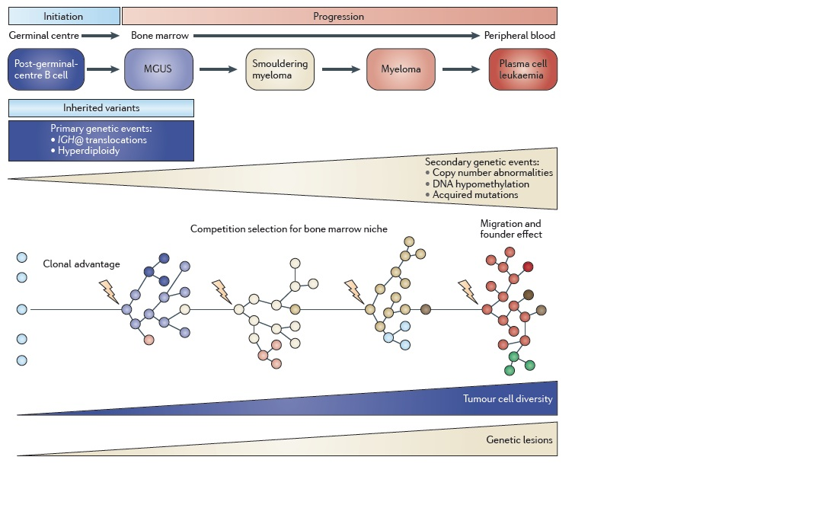
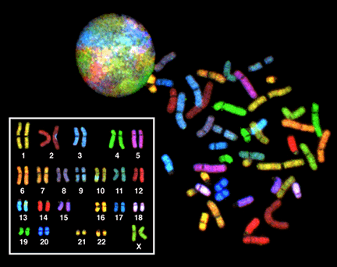
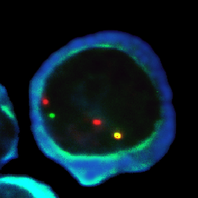
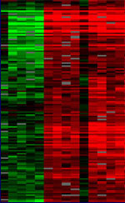
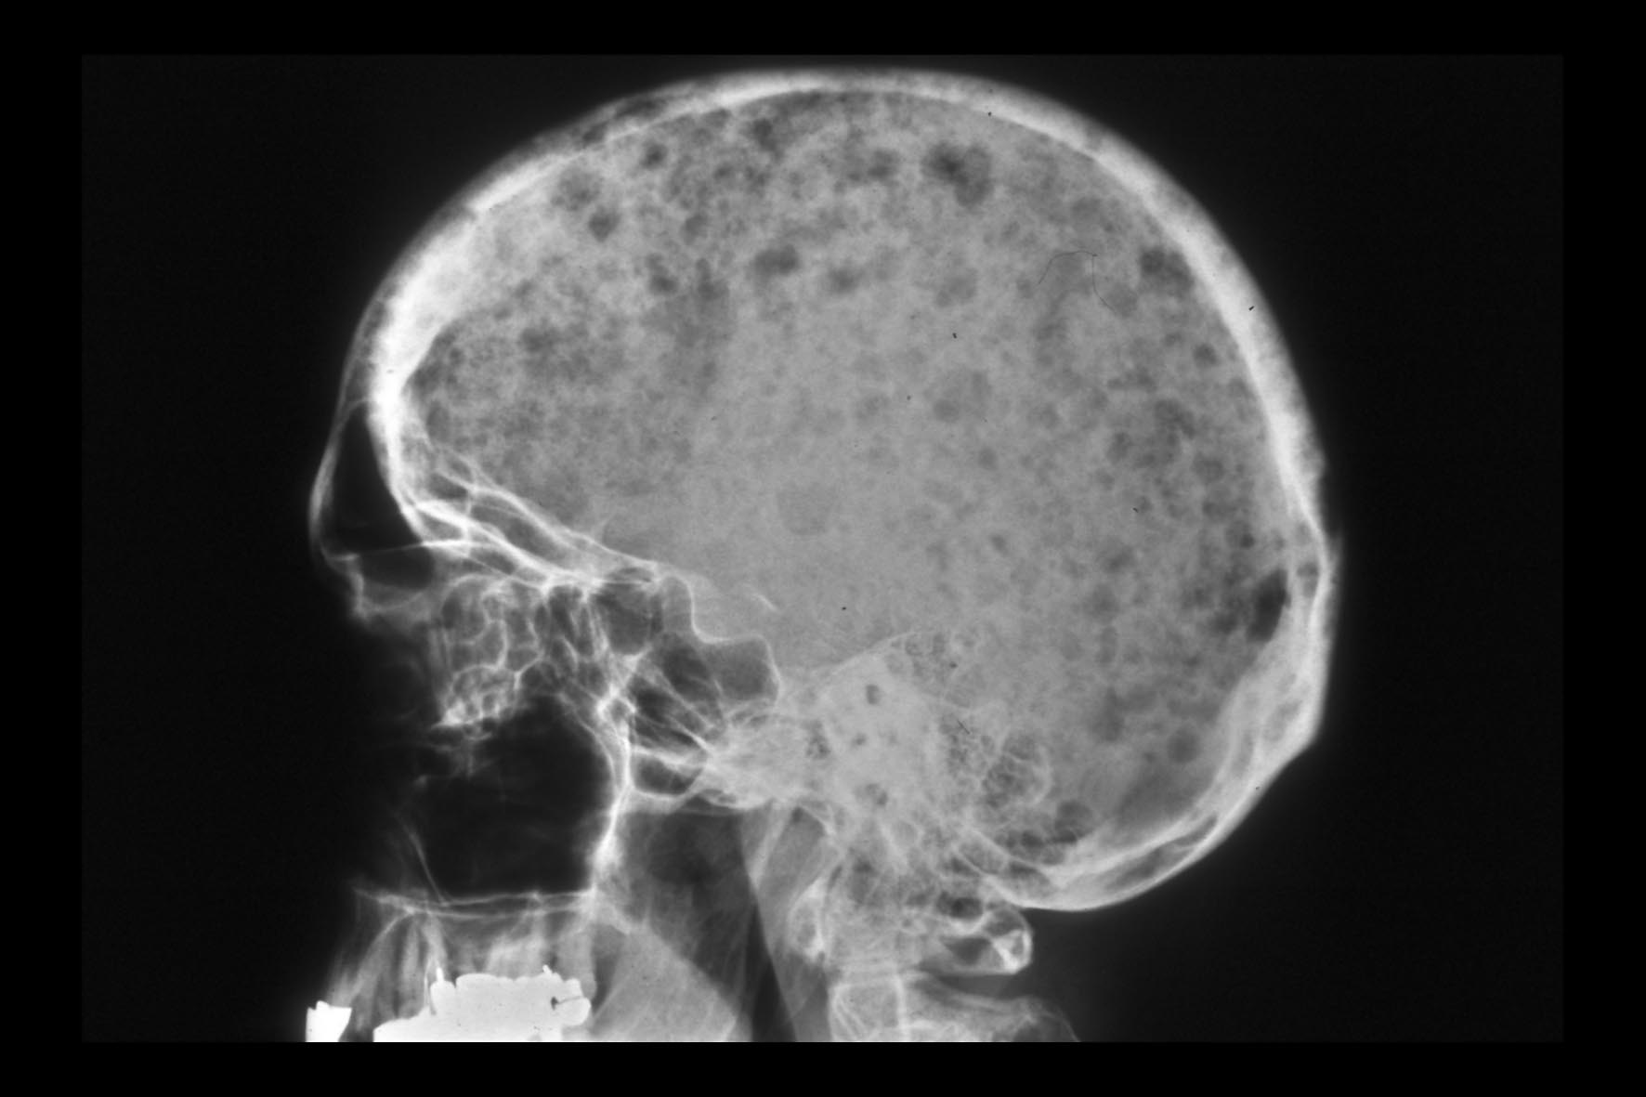
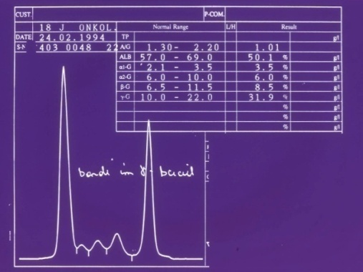
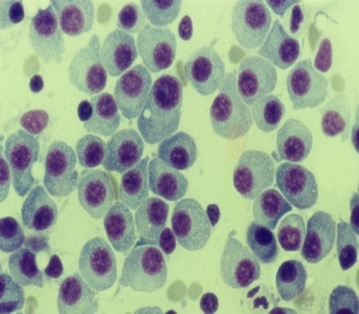
MULTIPLE MYELOMA
…not just one disease!
Risk stratification, recognition of clonal heterogeneity
Individualization of treatment, advent of novel therapies
3 decades
Drach J, ASH 2012
Morgan et al. Nat Rev Cancer 2012;12:335-348
Notes:
Recent Developments and Future Directions in the Treatment of
Multiple Myeloma
2

Slide 3
Treating MM is a Marathon, not a Sprint
Asymptomatic
Symptomatic
Relapsing
Refractory
100
2nd RELAPSE
1st RELAPSE
50
Smoldering
myeloma
or MGUS
M-protein level (g/L)
20
Plateau remission
First line
Second line
Third line
Adapted from Borrello I. et al. Leuk Res. 2012;36 Suppl 1:S3–12.

Slide 4
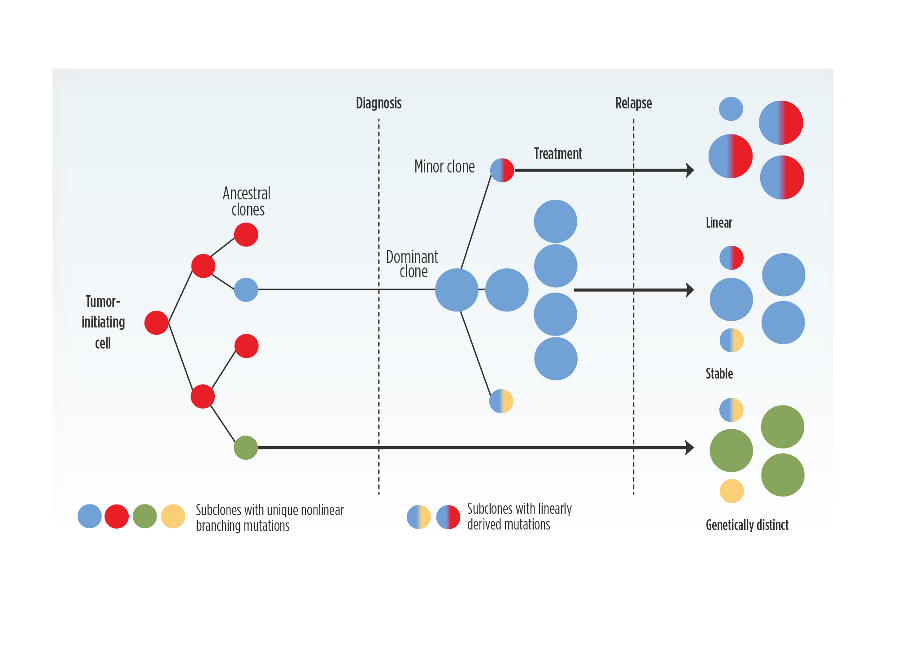
Multiple genetically distinct subclones are present at diagnosis¹⁻⁴
These evolve over time due to selective pressures from treatment and factors in the microenvironment^{1,4}
This clonal evolution can result in disease progression and treatment resistance⁵
1. Bahlis N et al. Blood 2012;120:927–28
2. Keats JJ et al. Blood 2012;120:1067–76
3. Bianchi G, Ghobrial IM. Curr Cancer Ther Rev 2014;10:70–9
4. Bolli N et al. Nat Commun 2014;5:2997
5. Brioli A et al. Br J Haematol 2014;165:441–54.

Slide 5
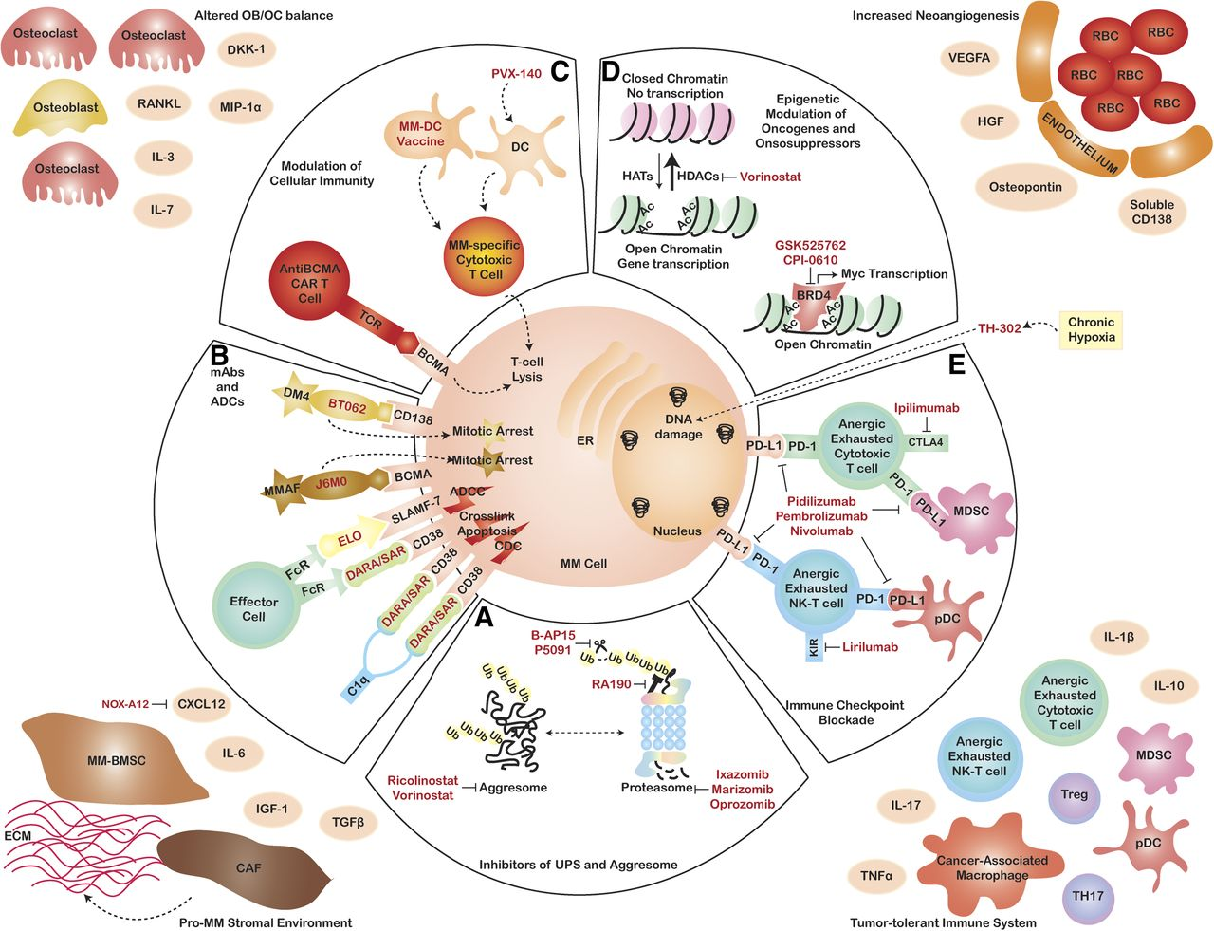
Multimodality targeting of MM in
the context of the BM microenvironment
G. Bianchi, PG. Richardson and KC. Anderson, Blood 2015; 126:300-310.

Slide 6
Multiple Options are now available to treat in NDMM and RR MM…
How do we sequence therapies to ensure the best outcomes for patients?
Bortezomib
Carfilzomib
Daratumumab
Elotuzumab
?
1st line
Ixazomib
Lenalidomide
2nd line
Panobinostat
Pomalidomide
Thalidomide
3rd line
Adapted from Laubach JP et al, Leukemia 2016

Slide 7
Key Targets in MM 2017
Genomic abnormalities:
Target and overcome mutations
Critical Role of Combination Therapy
Evolving Position and Timing of ASCT
The Importance of Continuous Treatment
Excess Protein Production:
Target Protein degradation
Immune Suppression:
Restore anti-MM immunity

Slide 8
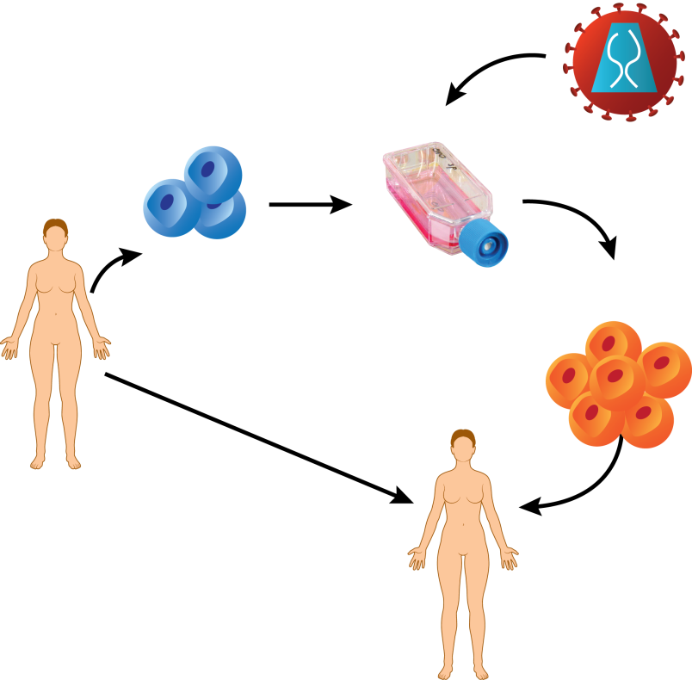
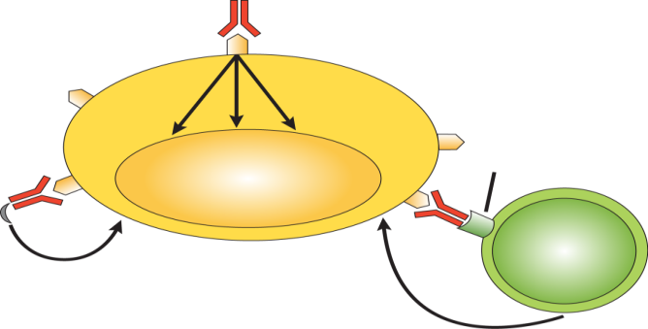
Harnessing the Immune System to Fight Myeloma:
Types of Immunotherapy, Immuno-Oncology
Passive
Active
Monoclonal
antibodies
Chimeric antigen receptor (CAR) T cells
Vaccines (therapeutic
not preventive)
Direct effects
1. Extract WBCs
from patient
Monoclonal antibody
2. Modify and
expand cells
in lab
Antigen
ADCC
CDC
Fc receptor
Myeloma cell
3. Infuse MM-targeted
cells back to
patient
C1q
Lysis
NK cell
MAC
Cell death
Richardson PG et al, ASH 2016

Slide 9
MM 2017: Integration and Impact of Novel Agents
Innovations (PIs, IMiDs) to date have produced significant improvements in PFS, OS: recent approvals (e.g. Carfilzomib, Ixazomib, HDACi, MoAbs) will augment this, with the next wave of therapies agnostic to mutational thrust
Baseline immune function appears a key barrier to success and is targetable (e.g. use of
PD-1/PD-L1 blockade)
MoAbs (Elo, DARA, ISA, MOR 202) active in high risk disease, represent true new novel mechanisms, as well as other immuno-therapeutics (e.g. checkpoint inhibitors, vaccines)
New insights to mechanisms of drug action (e.g. IMiDs, Ixazomib, Marizomib, Panobinostat, AC 241) will further expand therapeutic opportunities
Numerous other small molecule inhibitors, targeted chemotherapeutics show promise
(e.g. HDACi’s, CXCR4, BCL, AKT, CDK, HSP 90, Nuclear Transport, KSP, BET bromodomain proteins/Myc, DUBs, MEK, melflufen) – with nelfinavir, venetoclax, melflufen and selinexor
showing promise moving forward into advanced phase studies
Further refinement of prognostics and MRD will guide therapy

Slide 10
The Impact Of Novel Therapies in MM ~ 2017
2009 –
Patient age 62 years
High Risk IgG kappa MM
DSS 3, ISS 2,
Elevated LDH
17 del positive ,
13 del positive (by FISH) PMH – HTN, nil else.
RD + zoledronic acid => RVD (VGPR) Well tolerated, minimal PN (G1)
2010 ASCT (CY – HDM) (CR)
R/Z maintenance

Slide 11
The Impact Of Novel Therapies in MM ~ 2017
2009 –
Patient age 62 years
High Risk IgG kappa MM
DSS 3, ISS 2,
Elevated LDH
17 del positive ,
13 del positive (by FISH) PMH – HTN, nil else.
RD + zoledronic acid => RVD (VGPR) Well tolerated, minimal PN (G1)
2010 ASCT (CY – HDM) (CR)
R/Z maintenance
PD – RVD (PR)
PD – PomVD (VGPR)
PD (aggressive relapse with extra-medullary disease) DARA [501] 16 mg/kg (CR) to present (> 4 years) “Best I have ever felt since prior to diagnosis”

Slide 12
Patient Demographics and Initial Diagnosis
Age: 61 yr. old gentleman
Race: White
Ethnicity: Not Hispanic or Latino
Date of initial diagnosis: 18/Jul/2005
Disease type: IgG Kappa Multiple Myeloma
Durie Salmon Stage: IIIA
ISS Stage: I
Evidence of lytic bone disease: Yes
Evidence of extramedullary disease: No

Slide 13
Therapy History
Induction:
  August 2005 – October 2007: thalidomide + dexamethasone + concurrent zoledronic acid; bortezomib added in December 2006
Transplant:
  November 2007: high dose melphalan + autologous stem cell transplant
Maintenance:
  March 2008 – July 2013: thalidomide + dexamethasone
Current Therapy:
  July 2013 – present: Ixazomib + lenalidomide + dexamethasone
    Best response: PR

Slide 14
Disease Course
Cytogenetics 8/Jul/2013
  No clonal abnormality was present.
FISH 8/Jul/2013
  Insufficient plasma cells were observed.
C1D1: 23/Jul/2013
Response to treatment:
  Stable Disease from July 2013-January 2015
  Partial Response from January 2015-present
  “No complaints, and working full time!”

Slide 15
Patient Demographics and Initial Diagnosis
Age: 64 yr. old gentleman
Race: White
Ethnicity: Not Hispanic or Latino
Date of initial diagnosis: 11/Nov/2008
Disease type: IgG Kappa Multiple Myeloma
Durie Salmon Stage: IIIA
ISS Stage: I
Evidence of lytic bone disease: Yes
Evidence of extramedullary disease: No
Cytogenetics at Diagnosis
  Trisomy 4, Trisomy 15, and abnormalities of 11, 9 and 15
FISH at Diagnosis
  Chromosome 13 deletion

Slide 16
Therapy History
Induction:
  December 2008 – March 2009: bortezomib + dexamethasone, developed peripheral neuropathy;
  April 2009 – June 2009: bortezomib + cisplatin + doxorubicin + cyclophosphamide + etoposide
Transplant:
  June 2009: high dose melphalan + autologous stem cell transplant
Maintenance:
  July 2009 – August 2010: lenalidomide + dexamethasone + concurrent zoledronic acid
Current Therapy:
  August 2010 – present: single-agent Ixazomib (biw)
    Best response: PR

Slide 17
Disease Course
C1D1: 30/Aug/2010
Response to treatment (initial dose 3 mgs BIW):
  MR from September 2010 - December 2014
  PR from January 2014
Continues on ixazomib therapy ( current dose 2.3 mgs BIW)
  23/May/2017 to present
  “Feeling great and looking forward to driving across the USA in a Land Rover with my wife!”

Slide 18
Continuing Evolution of Multiple Myeloma Treatment: Selected New Classes and Targets 2016- 2017
1st Generation Novel Agents
2nd Generation Novel Therapies/Immunotherapy
Atezolizumab*
Durvalumab*
Nivolumab*
Pembrolizumab*
Lenalidomide
Carfilzomib
Ixazomib
Thalidomide
AC-241/1215*
Vaccines*
Bortezomib + Liposomal doxorubicin
Pomalidomide
Daratumumab
CAR-T*
Marizomib*
Bortezomib
Panobinostat
Elotuzumab
Isatuximab*
3rd Generation IMiDs*
Melflufen*
Selinexor*
Venetoclax*
Nelfinavir*
2003
2006
2007
2012
2013
2015
2016+
IMiD
HDAC inhibitor
Monoclonal antibody
Vaccines
IMiD, immunomodulatory drug;
HDAC, histone deacetylase
*Not yet FDA-approved for MM;
available in clinical trials
Proteasome inhibitor
Targeted Therapy
Adoptive T cell therapy
Checkpoint inhibitors
Adapted from Richardson PG. et al ASH 2015, MMRF 2016

Slide 19
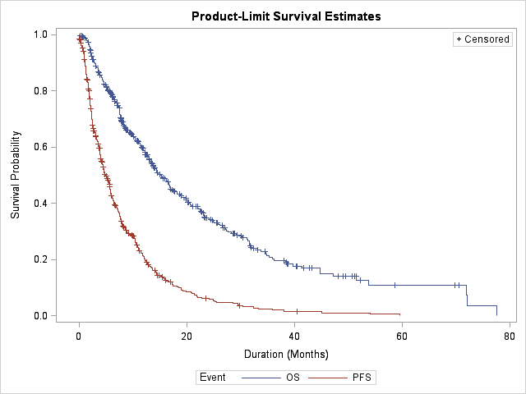
Outcomes from relapse
Median OS: 15.2 months
Median PFS: 5 months
Initial relapse
Refractory relapse
Kumar et al, ASH 2015, Leukemia 2017

Slide 20
Why care about sequencing?
Need to treat multiple relapses
Better understanding of disease biology/risk
Increasing drug/combination choices: Evidence based using emerging phase 3 data
Adapting treatment to individual patients: disease heterogeneity
Need to optimize efficacy, while minimizing toxicity

Slide 21
Clonal selection and resistance
Kumar et al, Keats et al, Blood

Slide 22
More treatment options
Old drugs
  Steroids (dex/pred)
  Alkylators (cyclo/ mel)
  Anthracycline
  Carmustine
Newer classes of drugs
  IMiDs
    Thalidomide
    Lenalidomide
  Proteasome inhibitors
    Bortezomib
Novel drugs
  Carfilzomib
  Ixazomib
  Pomalidomide
Novel classes
Monoclonal antibodies
HDAC inhibitor

Slide 23
Disease heterogeneity
Biochemical relapse does not always warrant start of a new therapy
Disease can evolve into high risk disease at time of relapse
Presence of residual toxicity from prior therapies
Patient performance status
Variation in patient goals/ preferences?

Slide 24
General principles
Duration of initial response defines biology
Triplet (two active classes + dex) preferred over doublet
  At least one drug from a non-refractory class
Consider PS, age and comorbidities when selecting drug/ doses
Take into account prior toxicities/ residual toxicities
Treat to maximum response and maintain on one drug till progression or tolerability

Slide 25
The landscape of relapsed MM
VRD / VCD
VRD / VCD
RD
SCT
With or without
Break
With or without
Break
Len / Btz Maintenance
First Relapse

Slide 26
Randomized trials of Btz-Dex combinations
Trial | Regimen | Control | N | >=PR | >=VGPR | >=CR | PFS (months)
ENDEAVOR | Cfz-Dex | Btz-Dex | 464 | 76 | 54 | 13 | 18.7 (vs. 9.4)
PANORAMA | Pano-Btz-Dex | Btz-Dex | 387 | 61 | 28 | 11 | 12 (vs. 8)
CASTOR | Dara-Btz-Dex | Btz-Dex | 251 | 83 | 59 | 19 | NR (vs. 7.2)
Randomized Phase 2 | Elo-Btz-Dex | Btz-Dex | 77 | 67 | 37 | 4 | 9.7 (vs. 6.9)

Slide 27
Randomized trials of Len-Dex combinations
Trial | Regimen | Control | N | >=PR | >=VGPR | >=CR | PFS (months)
ASPIRE | Cfz-Len-Dex | Len-Dex | 207 | 87 | 70 | 32 | 26.3 (vs. 17.6)
TOURMALINE | Ixa-Len-Dex | Len-Dex | 360 | 78 | 48 | 12 | 20.6 (vs. 14.7)
POLLUX | Dara-Len-Dex | Len-Dex | 286 | 87 | 70 | 32 | NR (vs. 7.2)
ELOQUENT | Elo-Len-Dex | Len-Dex | 299 | 79 | 33 | 4 | 19.4 (vs. 14.9)

Slide 28
Many options
Consider bortezomib, lenalidomide, dex (VRd)
Repeat induction regimen
Any of the triplets discussed so far
VCd is another choice

Slide 29
Changing the drug
(≥PR) %
Kumar et al, Leukemia 2017

Slide 30
Changing the drug class
OS
Dara
Kumar et al, ASH 2016

Slide 31
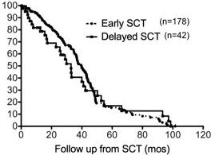
Transplant for relapse
Progression-free survival
Percent survival
Delayed SCT
Salvage SCT
Cancer. 2012 Mar 15; 118(6): 1585–1592; Cook et al, 15 (8), July 2014, 874–885

