Slide 1
Please note, these are the actual video-recorded proceedings from the live CME event and may include the use of trade names and other raw, unedited content.

Slide 2
Novel and Emerging Strategies in the Management of Gastrointestinal Cancers
Philip A Philip, MD, PhD
Professor of Oncology and Pharmacology
Director of GI and Neuroendocrine Tumors
Vice President of Medical Affairs
Karmanos Cancer Institute
Wayne State University
Detroit, Michigan

Slide 3
Disclosures
Advisory Committee | Bayer HealthCare Pharmaceuticals, Celgene Corporation, Genentech BioOncology, Halozyme Inc, Lilly, Merrimack Pharmaceuticals Inc, Novartis
Consulting Agreements | Celgene Corporation, Halozyme Inc, Lilly; Contracted Research: Bayer HealthCare Pharmaceuticals, Celgene Corporation, Lilly, Merck, Novartis
Speakers Bureau | Amgen Inc, Bayer HealthCare Pharmaceuticals, Celgene Corporation, Genentech BioOncology, Lilly, Merrimack Pharmaceuticals Inc, Novartis, Sanofi Genzyme

Slide 4
Grand Rounds Program Steering Committee
Tanios Bekaii-Saab, MD, FACP
Professor, Mayo Clinic College of Medicine and Science
Co-Leader, GI Cancer Program
Mayo Clinic Cancer Center
Senior Associate Consultant
Mayo Clinic Scottsdale, Arizona
Axel Grothey, MD Professor of Oncology Department of Medical Oncology Mayo Clinic Rochester, Minnesota
Johanna C Bendell, MD Director GI Oncology Research Associate Director Drug Development Unit Sarah Cannon Research Institute Nashville, Tennessee
Howard S Hochster, MD Associate Director (Clinical Research) Yale Cancer Center Professor of Medicine Yale School of Medicine New Haven, Connecticut

Slide 5
Grand Rounds Program Steering Committee
Heinz-Josef Lenz, MD Professor of Medicine and Preventive Medicine J Terrence Lanni Chair in Cancer Research; Co-Director, USC Center for Molecular Pathways and Drug Discovery Keck School of Medicine, University of Southern California Associate Director of Adult Oncology Co-Director, Colorectal Center Scientific Director, Cancer Genetics Unit USC/Norris Comprehensive Cancer Center Los Angeles, California
Philip A Philip, MD, PhD Professor of Oncology and Pharmacology Director of GI and Neuroendocrine Tumors Vice President of Medical Affairs Karmanos Cancer Institute Wayne State University Detroit, Michigan
Bert H O’Neil, MD Professor of Medicine Director, Phase I and GI Malignancies Programs Indiana University Simon Cancer Center Indianapolis, Indiana
Project Chair Neil Love, MD Research To Practice Miami, Florida

Slide 6
Beyond the Guidelines …
SECOND-LINE TX
FIRST-LINE TX
PD ON FOLFIRINOX
PD ON GEM/NAB PAC
Gem/nab pac
Gem/nab pac or gem/capecitabine
Nal-IRI + 5-FU/LV
Gem/nab pac
Gem/nab pac
Nal-IRI + 5-FU/LV
mFOLFIRINOX
Gem/nab pac
Nal-IRI + 5-FU/LV
mFOLFIRINOX
Gem/nab pac
FOLFOX
FOLFIRINOX
Gem/nab pac
FOLFOX
FOLFIRINOX
Gem/nab pac
Nal-IRI + 5-FU/LV
Gem/nab pac
Gem/nab pac
Nal-IRI + 5-FU/LV
… Focusing on actual practical clinical decisions that investigators make in gastrointestinal cancers

Slide 7
Novel and Emerging Strategies in the Management of Gastrointestinal Cancers
Module 1: Pancreatic Cancer
Indications for and selection of neoadjuvant therapy
Gemcitabine-capecitabine as adjuvant therapy (ESPAC-4)
Integration of nanoliposomal irinotecan (nal-IRI) + 5-FU into the management of metastatic disease (NAPOLI-1)
Module 2: Colon Cancer
Microsatellite instability and treatment with anti-PD-1/PD-L1 checkpoint inhibitors
Ramucirumab, aflibercept and bevacizumab continuation
Tumor sidedness for prognostication and in systemic treatment decision-making
Module 3: Hepatocellular Carcinoma
Regorafenib as second-line systemic therapy (RESORCE)
Ongoing Phase III CELESTIAL study of cabozantinib as second- or later-line therapy
Early data and ongoing trials with anti-PD-1/PD-L1 checkpoint inhibitors
Module 4: Gastric Cancer
Second- and third-line treatment of metastatic disease: Role of ramucirumab, checkpoint inhibitors
Ramucirumab alone or with paclitaxel as second- or later-line therapy (REGARD, RAINBOW)
Emerging data and ongoing trials with anti-PD-1/PD-L1 checkpoint inhibitors
Early data and ongoing studies with napabucasin (BBI-608) in GI cancers
Module 5: Gastrointestinal Neuroendocrine Tumors (GI NET)
Peptide receptor radionuclide therapy (PPRT) with ¹⁷⁷Lu-Dotatate (NETTER-1)
Telotristat ethyl for carcinoid syndrome diarrhea that is not well controlled on somatostatin analogues

Slide 8
Which neoadjuvant regimen would you likely recommend for an otherwise healthy patient with pancreatic cancer that is deemed by the surgeon to be…
Unresectable but may become resectable with tumor shrinkage?
Resectable?
What is the likelihood that significant tumor shrinkage will occur in response to neoadjuvant chemotherapy to improve the chances of achieving resectability?
NEOADJUVANT TX:
NEEDS TUMOR SHRINKAGE
NEOADJUVANT TX:
RESECTABLE
LIKELIHOOD OF SIGNIFICANT SHRINKAGE WITH NEOADJ TX
mFOLFIRINOX
None
Locally adv: 10% - 30%
Borderline resect: 50% - 80%
FOLFIRINOX (or mFOLFIRINOX)
None
30%
mFOLFIRINOX
mFOLFIRINOX
30%
mFOLFIRINOX
None
20%
FOLFIRINOX (or mFOLFIRINOX)
None
30%
FOLFIRINOX (or mFOLFIRINOX)
FOLFIRINOX (or mFOLFIRINOX)
10%
FOLFIRINOX (or mFOLFIRINOX)
None
Locally adv: 5%
Borderline resect: 50%
mFOLFIRINOX = modified FOLFIRINOX

Slide 9
Neoadjuvant FOLFIRINOX in Localized Pancreatic Cancer
Study | N | Stage | Resection rate | Path CR | R0 resection
Katz et al* | 22 | Borderline | 68% | 13% | 93%
Blazer et al | 43 | Borderline/ locally advanced | 51% | — | 85.7%
Hackert et al | 575 | Locally advanced | 61% | 5.3% | 41%
Kushman et al | 51 | Borderline/ locally advanced | 25% | 2% | 70%
Petrelli et al | 253 | Borderline resectable/locally advanced | 43% | — | 85%
Suker et al | 325 | Locally advanced | 25.9% | — | 74%
* Prospective study
Katz et al, JAMA Surg, 2016; Hackert et al, Ann Surg 2016;264:457-63; Blazer et al, JCO 32 suppl 3, #274; Kushman et al, Pancreatology 15 (2015) 667e673, Pancreatology, 2015, 667-73; Suker M et al, Lancet Oncol 2016; 17: 801-10; Petrelli Pancreas 2015;44: 515-21.
Courtesy of Philip A Philip, MD, PhD
Notes:
mOSTLY MODIFEIED

Slide 10
SWOG-S1505 Randomized Phase II Study Schema
Target Enrollment: 112
mFOLFIRINOX
X 3 mo
R
E
S
T
A
G
E
S
U
R
G
E
R
Y
mFOLFIRINOX
X 3 mo
Eligibility
Pancreatic adenocarcinoma, resectable based on contrast-enhanced CT or MRI
R
Pick the winner
Gem/nab paclitaxel
X 3 mo
Gem/nab paclitaxel
X 3 mo
www.clinicaltrials.gov. Accessed April 2017

Slide 11
A 60 year-old patient is s/p surgical removal of T3N1 pancreatic cancer with 2 of 12 positive peripancreatic lymph nodes. What adjuvant systemic therapy, if any, would you most likely recommend? What is your usual dose of capecitabine when you administer it as part of an adjuvant treatment regimen for an otherwise healthy patient?
SYSTEMIC ADJUVANT TX: 60-YEAR-OLD
USUAL DOSE OF CAPECITABINE
Gemcitabine/capecitabine
750 mg/m² BID 3 wk on, 1 wk off
Gemcitabine/capecitabine
830 mg/m² BID 3 wk on, 1 wk off
Gemcitabine/capecitabine
830 mg/m² BID
3 wk on, 1 wk off
Gemcitabine/capecitabine
830 mg/m² BID
3 wk on, 1 wk off
Gemcitabine/nab paclitaxel
830 mg/m² BID
3 wk on, 1 wk off
Gemcitabine/capecitabine
750 mg/m² BID
3 wk on, 1 wk off
Gemcitabine/capecitabine
750 mg/m² BID
3 wk on, 1 wk off

Slide 12
ESPAC-4 Schema
Total Accrual: 722
Eligibility
Pancreatic ductal adenocarcinoma R0 or R1 resection No ascites, liver or peritoneal metastasis or any other distant abdominal or extra-abdominal organ spread No restriction based on postoperative CA19-9
Gemcitabine
1,000 mg/m²
D1, 8, 15 x 6 cycles
1:1
R
Gemcitabine
1,000 mg/m²
D1, 8, 15 x 6 cycles
Capecitabine*
1,660 mg/m²/day
21/28d
Primary endpoint: Overall survival (ITT)
* Protocol-driven dose reduction
when required
Neoptolemos JP et al. Proc ASCO 2016;Abstract LBA4006.
Neoptolemos JP et al. Lancet 2017;389(10073):1011-24.

Slide 13
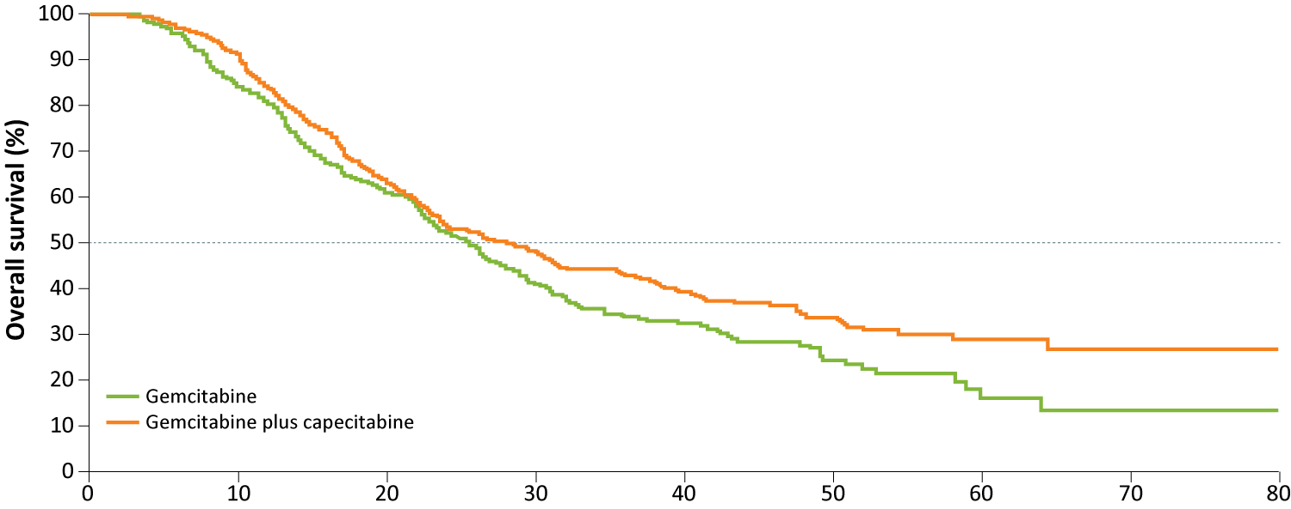
ESPAC-4: Overall Survival (ITT) and by Margin Status
Endpoint | Gem-cape (n = 364) | Gem (n = 366) | Hazard ratio | p-value
OS | 28.0 mo | 25.5 mo | 0.82 | 0.032
Median OS
Gem margin+ (n = 219) 23.0 mo
Gem margin- (n = 147) 27.9 mo
Gem-cape margin+ (n = 221) 23.7 mo
Gem-cape margin- (n = 143) 39.5 mo
Neoptolemos JP et al. Lancet 2017;389(10073):1011-24.

Slide 14
ESPAC-4: Adverse Events
 | Gemcitabine (n = 366) |  | Gem-capecitabine (n = 359)
 | Grade 1-2 | Grade ≥3 | Grade 1-2 | Grade ≥3
Anemia | 58% | 4% | 56% | 2%
Diarrhea | 41% | 2% | 45% | 5%
Fatigue | 66% | 5% | 64% | 6%
Infection/infestations | 15% | 7% | 10% | 3%
Lymphocyte count decreased | 27% | 3% | 22% | 3%
Neutropenia | 40% | 24% | 49% | 38%
Hand-foot syndrome | 2% | 0% | 31% | 7%
Platelets | 24% | 2% | 29% | 2%
Thromboembolic events | 2% | 2% | 4% | 2%
Neoptolemos JP et al. Lancet 2017;389(10073):1011-24.

Slide 15
What is your usual first-line systemic treatment recommendation for an otherwise healthy nonelderly patient (<65 years) with metastatic pancreatic cancer? What is your usual second-line systemic treatment recommendation for an otherwise healthy patient with metastatic pancreatic cancer who responds to FOLFIRINOX or gemcitabine/nab paclitaxel and then experiences disease progression?
SECOND-LINE TX
FIRST-LINE TX
PD ON FOLFIRINOX
PD ON GEM/NAB PAC
Gem/nab pac
Gem/nab pac or gem/capecitabine
Nal-IRI + 5-FU/LV
Gem/nab pac
Gem/nab pac
Nal-IRI + 5-FU/LV
mFOLFIRINOX
Gem/nab pac
Nal-IRI + 5-FU/LV
mFOLFIRINOX
Gem/nab pac
FOLFOX
FOLFIRINOX
Gem/nab pac
FOLFOX
FOLFIRINOX
Gem/nab pac
Nal-IRI + 5-FU/LV
Gem/nab pac
Gem/nab pac
Nal-IRI + 5-FU/LV
Gem/nab pac = gemcitabine/nab paclitaxel

Slide 16
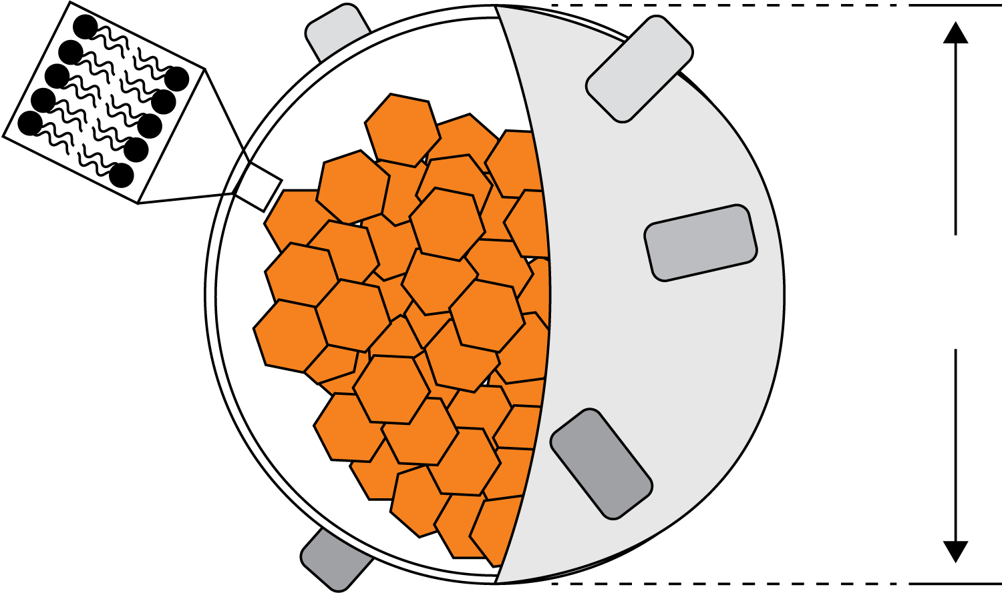
Nanoliposomal Irinotecan (nal-IRI) Design
MM-398, nanoliposomal irinotecan (nal-IRI)*
Liquid membrane
MM-398, lipsome irinotecan injection, (120 mg/m²) has extended circulation
AUC of total irinotecan in blood is 1652 vs. 24 hr-μg/ml of conventional irinotecan (300 mg/m²)¹
72 hours after MM-398 dosing, SN-38 (active metabolite) level was 9.6 ng/g in tumor tissue and 1.7 ng/ml in blood²
PEG-DSPE
IRINOTECAN
~100 nm
~80,000 molecules
Internal aqueous space
~80,000 irinotecan molecules/liposome
Chen LT et al. GI Cancers Symposium 2015;Abstract 234.

Slide 17
NAPOLI-1 Schema
n = 151
Nal-IRI
120 mg/m² q3wk
Trial Identifier: NCT01494506 Enrollment: 417
Eligibility
Metastatic pancreatic cancer Received prior gemcitabine-based therapy
R
5-FU/LV
2,000/200 mg/m² wkly
x 4, q6wk
n = 149
Nal-IRI + 5-FU/LV
80 mg/m² + 2,400/400 mg/m² q2wk
n = 117
Primary endpoint: Overall survival
Wang-Gillam A et al. GI Cancers Symposium 2017;Abstract 4126.

Slide 18
NAPOLI-1: Updated Survival Analyses
Combination
 | 5-FU/LV (n = 119) | nal-IRI + 5-FU/LV (n = 117) | Hazard ratio | p-value
Overall survival | 4.2 mo | 6.2 mo | 0.75 | 0.042
Progression-free survival | 1.5 mo | 3.1 mo | 0.56 | <0.0001
Monotherapy
 | 5-FU/LV (n = 149) | nal-IRI (n = 151) | Hazard ratio | p-value
Overall survival | 4.2 mo | 4.9 mo | 1.08 | 0.51
Progression-free survival | 1.6 mo | 2.7 mo | 0.81 | 0.11
Wang-Gillam A et al. GI Cancers Symposium 2017;Abstract 4126.

Slide 19
NAPOLI-1: Select Adverse Events
 | 5-FU/LV (n = 134) |  | Nal-IRI (n = 147) |  | Nal-IRI + 5-FU/LV (n = 117)
 | Any grade | Grade 3-4 | Any grade | Grade 3-4 | Any grade | Grade 3-4
Diarrhea | 26% | 4% | 70% | 21% | 59% | 13%
Vomiting | 26% | 3% | 54% | 14% | 52% | 11%
Decreased appetite | 32% | 2% | 49% | 19% | 44% | 4%
Fatigue | 28% | 4% | 37% | 6% | 40% | 14%
Neutropenia | 5% | 1% | 25% | 15% | 39% | 27%
Anemia | 23% | 7% | 33% | 11% | 38% | 9%
Hypokalemia | 9% | 2% | 22% | 12% | 12% | 3%
Wang-Gillam A et al. Lancet 2016;387:545-57.

Slide 20
Phase II Randomized Trial of Nal-IRI-Containing Regimens in Previously Untreated Pancreatic Cancer
Trial Identifier: NCT02551991
Enrollment: 168 (Open)
Nal-IRI +
5-FU/LV +
oxaliplatin
Eligibility
Unresectable, locally advanced or metastatic pancreatic cancer No prior treatment in the metastatic setting with surgery, radiotherapy, chemotherapy or investigational therapy
R
Nal-IRI +
5-FU/LV
Nab-paclitaxel +
gemcitabine
Primary endpoint: Progression-free survival
www.clinicaltrials.gov. Accessed April 2017.

Slide 21
Novel and Emerging Strategies in the Management of Gastrointestinal Cancers
Module 1: Pancreatic Cancer
Indications for and selection of neoadjuvant therapy
Gemcitabine-capecitabine as adjuvant therapy (ESPAC-4)
Integration of nanoliposomal irinotecan (nal-IRI) + 5-FU into the management of metastatic disease (NAPOLI-1)
Module 2: Colon Cancer
Microsatellite instability and treatment with anti-PD-1/PD-L1 checkpoint inhibitors
Ramucirumab, aflibercept and bevacizumab continuation
Tumor sidedness for prognostication and in systemic treatment decision-making
Module 3: Hepatocellular Carcinoma
Regorafenib as second-line systemic therapy (RESORCE)
Ongoing Phase III CELESTIAL study of cabozantinib as second- or later-line therapy
Early data and ongoing trials with anti-PD-1/PD-L1 checkpoint inhibitors
Module 4: Gastric Cancer
Second- and third-line treatment of metastatic disease: Role of ramucirumab, checkpoint inhibitors
Ramucirumab alone or with paclitaxel as second- or later-line therapy (REGARD, RAINBOW)
Emerging data and ongoing trials with anti-PD-1/PD-L1 checkpoint inhibitors
Early data and ongoing studies with napabucasin (BBI-608) in GI cancers
Module 5: Gastrointestinal Neuroendocrine Tumors (GI NET)
Peptide receptor radionuclide therapy (PPRT) with ¹⁷⁷Lu-Dotatate (NETTER-1)
Telotristat ethyl for carcinoid syndrome diarrhea that is not well controlled on somatostatin analogues

Slide 22
Do you routinely order MSI testing for patients with colorectal cancer? Cost and reimbursement issues aside, for a patient with MSI-high mCRC, in what line of therapy, if any, would you like to use an anti-PD-1/PD-L1 antibody as monotherapy? For a patient with MSS mCRC?
MSI TESTING?
ANTI-PD-1/PD-L1 AB FOR MSI-HIGH MCRC
ANTI-PD-1/PD-L1 AB FOR MSS MCRC
Yes, for all patients
First line
I would not use in this setting
Yes, only Stage II and mCRC
First line — if disease burden not large
I would not use in this setting
Yes, for all patients
Second line
I would not use in this setting
Yes, for all patients
Second line
I would not use in this setting
Yes, for all patients
First line
I would not use in this setting
Yes, for all patients
Second line
I would not use in this setting
Yes, for all patients
Second line
I would not use in this setting
MSI = microsatellite instability; MSS = microsatellite stable

Slide 23
DNA Mismatch Repair Model
DNA mismatch repair (MMR) gene
Courtesy of JC Bendell, MD
Imai K, Yamamoto H. Carcinogenesis 2008;29(4):673-80.

Slide 24
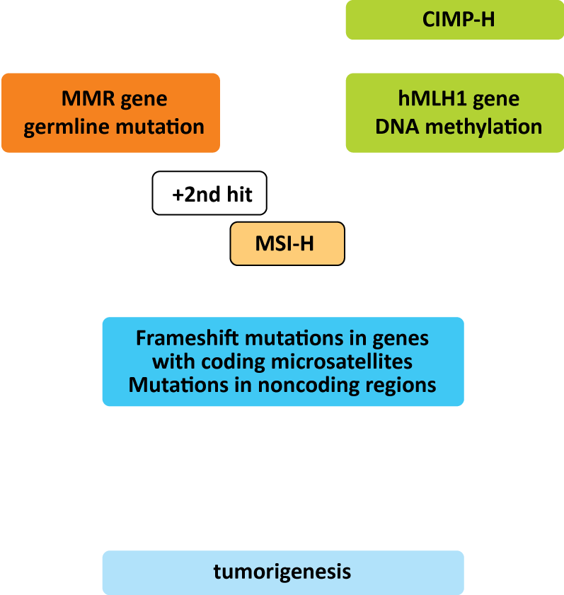
Defects in DNA Repair May Lead to Microsatellite Instability and Tumorigenesis
Sporadic CRC
Lynch syndrome (HNPCC)
MMR gene inactivation
Epimutation?
DNA methylation
Other mutations
Courtesy of JC Bendell, MD
Imai K, Yamamoto H. Carcinogenesis 2008;29(4):673-80.

Slide 25
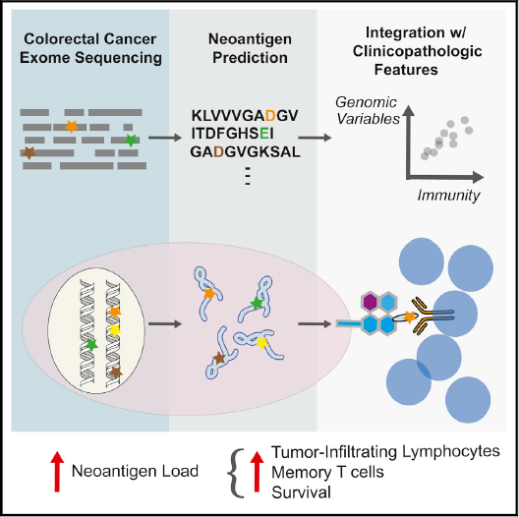
Hypermutation and Immuno-Oncology
In CRC, MSI-H is associated with increases in immune infiltration and expression of immune checkpoint regulators^{1,2}
MSI-H is also associated with increased number of mutations per tumor
Tumor mutations produce tumor-specific neoantigens, which, when expressed on the tumor cell surface, are a target for T cells
May improve response to immunotherapy
Elevated neoantigen load in CRC is associated with improved survival²
Llosa NJ et al. Cancer Discov 2015;5:43-51.
Giannakis M et al. Cell Reports 2016;15:857-65.

Slide 26
MSI-High Tumors: Response to PD-1 Inhibitors
Pembrolizumab (KEYNOTE 016, phase II)^{1,*}
Nivolumab ± ipilimumab
(CheckMate-142, phase II)²
Nivolumab 3mg/kg
Nivolumab 3mg/kg
+ ipilimumab 1mg/kg
125
Off treatment
100
MMR-proficient CRC
100
Nivolumab treatment ongoing
100
Off treatment
75
MMR-deficient CRC
75
1st occurrence of new lesion
75
Nivolumab + ipilimumab treatment ongoing
50
50
CR or PR
50
1st occurrence of new lesion
Change from baseline SLD (%)
25
25
25
Change from baseline (%)
CR or PR
0
Change from baseline (%)
% change truncated to 100
–25
365
730
0
0
–50
–25
–25
–75
–50
–50
–100
–75
–75
–125
–100
–100
0
6
12
18
24
30
36
42
48
54
60
66
72
78
84
0
6
12
18
24
30
36
42
48
54
60
66
72
78
84
Time (weeks)
Time (weeks)
100
MMR-proficient CRC
100
% change truncated to 100%
100
MMR-deficient CRC
75
75
50
50
56% of patients with reduction
50
81% of patients with reduction
25
Best reduction from baseline in target lesion (%)
Best reduction from baseline in target lesion (%)
25
Change from baseline SLD (%)
0
0
0
–25
*
*
–25
*
–50
–50
*
*
*
*
*
–50
*
*
*
–75
*
*
*
*
*
–75
*
*
*
–100
–100
–100
*
*
* Lynch Syndrome (yes/no/unknown): MMR-deficient CRC = 54/7/39; MMR-proficient CRC = 0/100/0

Slide 27
FDA Grants Nivolumab Accelerated Approval for MSI-H or dMMR Colorectal Cancer
“On July 31, 2017, the US Food and Drug Administration granted accelerated approval to nivolumab for the treatment of patients 12 years and older with mismatch repair deficient (dMMR) and microsatellite instability high (MSI-H) metastatic colorectal cancer that has progressed following treatment with a fluoropyrimidine, oxaliplatin, and irinotecan.”
https://www.fda.gov/Drugs/InformationOnDrugs/ApprovedDrugs/ucm569366.htm

Slide 28
FDA Grants Accelerated Approval to Pembrolizumab for Its First Tissue/ Site-Agnostic Indication
“On May 23, 2017, the US Food and Drug Administration granted accelerated approval to pembrolizumab for adult and pediatric patients with unresectable or metastatic, microsatellite instability-high (MSI-H) or mismatch repair deficient (dMMR) solid tumors that have progressed following prior treatment and who have no satisfactory alternative treatment options or with MSI-H or dMMR colorectal cancer that has progressed following treatment with a fluoropyrimidine, oxaliplatin, and irinotecan.
This is the FDA’s first tissue/site-agnostic approval.”
https://www.fda.gov/Drugs/InformationOnDrugs/ApprovedDrugs/ucm560040.htm

Slide 29
KEYNOTE-177 Phase III Schema
Target Accrual: 270
Clinical Trial Identifier: NCT02563002
Pembrolizumab
200 mg IV q3wk
Eligibility
Treatment-naïve metastatic CRC MMR-deficient or MSI-high ECOG PS 0-1 No active brain metastases
1:1
R
Investigator’s choice*
mFOLFOX6 +/- bev or cetuximab
FOLFIRI +/- bev or cetuximab
Primary endpoint: Progression-free survival
* Patients with progressive disease have the option of receiving pembrolizumab 200 mg IV q3wk
Treatment will be continued until disease progression, intolerable toxicity or completion of 35 cycles (pembrolizumab arm only)
Diaz LA Jr et al. GI Cancers Symp 2017;Abstract TPS815.

Slide 30
How Can We Best Treat the Other 95% of CRC Tumors That Are MSS: Combination Approaches
Can we convert noninflamed tumors to become inflamed?
INFLAMED
IMMUNE EXCLUDED
IMMUNE DESERT
CD8+ T cells infiltrated
but nonfunctional
CD8+ T cells accumulated but not efficiently infiltrated
CD8+ T cells absent
from tumour and periphery
Accelerate or remove brakes on T cell response
Bring T cells in contact with cancer cells
Increase number of antigen-specific T cells or increase antigen presentation
Courtesy of Johanna C Bendell, MD
Kim, Chen. Ann Oncol 2016;27(8):1492-504. Hegde et al. Clin Cancer Res 2016;22(8):1865-74.

Slide 31
In what situations, if any, do you incorporate ramucirumab into the management of mCRC?
None
None
None
None
None
None
Second line, short PD on first-line bev, RAS mutated

Slide 32
Comparison of Phase III Trials of Anti-Angiogenic Agents in Colon Cancer
Agent | Bevacizumab (bev) |  | Ziv-aflibercept |  | Ramucirumab
Study | TML |  | VELOUR |  | RAISE
1st Line Tx | Chemo + bev |  | FP-oxali +/- bev |  | FP-oxali + bev
 | Chemo-bev | Chemo | FOLFIRI + AFL | FOLFIRI + PL | FOLFIRI + RAM | FOLFIRI + PL
No. of pts | 409 | 411 | 612 | 614 | 536 | 536
mOS (mos) | 11.2 | 9.8 | 13.5 | 12.1 | 13.3 | 11.7
 | HR 0.81 p = 0.0062 |  | HR 0.82 p = 0.0032 |  | HR 0.84 p = 0.022
mPFS (mos) | 5.7 | 4.1 | 6.9 | 4.7 | 5.7 | 4.5
 | HR 0.68 p < 0.0001 |  | HR 0.76 p = 0.00007 |  | HR 0.79 p = 0.0005
RR (%) | 5.4 | 3.9 | 19.8 | 11.1 | 13.4 | 12.5
FP = fluoropyrimidine
Bennouna J et al. Lancet Oncol 2013;14(1):29-37.
Van Cutsem E et al. J Clin Oncol 2012;30(28):3499-506.
Tabernero J et al. Lancet Oncol 2015;16(5):499-508.

Slide 33
Cost and reimbursement issues aside, what would you generally recommend as first- and second-line treatments for a 60-year-old patient with left-sided or right-sided pan-RAS wild-type mCRC that is microsatellite stable?
LEFT-SIDED TUMOR
RIGHT-SIDED TUMOR
FIRST LINE
SECOND LINE
FIRST LINE
SECOND LINE
FOLFIRI/bev
FOLFIRI + EGFR Ab
FOLFIRI/bev
FOLFOX/bev
FOLFOX/bev
FOLFIRI + EGFR Ab
FOLFOX/bev
FOLFIRI + EGFR Ab
FOLFOX + EGFR Ab
FOLFIRI/bev
FOLFOX/bev
FOLFIRI/bev
FOLFOX/bev
Irinotecan + EGFR Ab
FOLFOX/bev
FOLFIRI/bev
FOLFOX + EGFR Ab
FOLFIRI/bev
FOLFIRI/bev
FOLFOX + EGFR Ab
FOLFOX + EGFR Ab
FOLFIRI/bev
FOLFOX/bev
FOLFIRI/bev
FOLFOX/bev
Irinotecan + EGFR Ab
FOLFOX/bev
FOLFIRI/bev

Slide 34
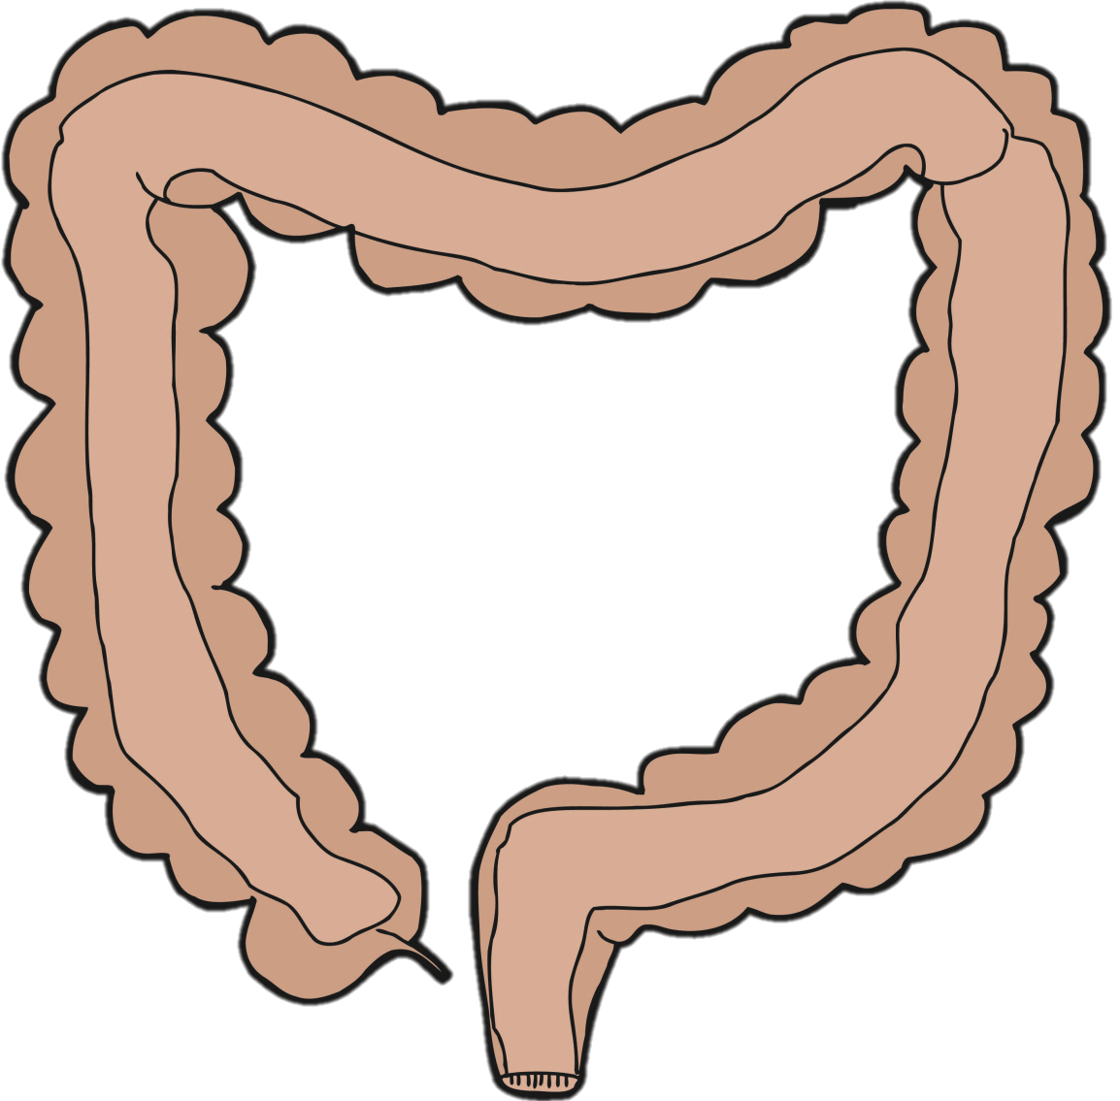
Tumor Sidedness Associated with Genetic Alterations
RAS
MSI
BRAF
PIK3CA
PTEN
RAS
KRAS
HER2/NEU
APC
TP53
RAS
KRAS
HER2/NEU
APC
TP53
© 2017 The Ruesch Center for the Cure of GI Cancers
Venook A et al. Proc ASCO 2016;Abstract 3504.

Slide 35
CALGB/SWOG 80405
Amended June 2008
Reported June 2014
Chemo + cetuximab
OS = 32.0 mos
PFS = 11.4 mos
Chemo + Cetuximab
mCRC 1st line KRAS wt
FOLFIRI or FOLFOX MD choice
Chemo + bevacizumab
OS = 31.2 mos
PFS = 11.3 mos
Chemo + Bevacizumab
N = 1,137
Conclusion: No difference in 1st line
Venook A et al. JAMA 2017;317(23):2393-401.

Slide 36
80405: OS by Sidedness
 | Left (n = 732) | Right (n = 293) | HR | p-value
All | 33.3 mo | 19.4 mo | 1.55 | <0.0001
Bevacizumab
Cetuximab
Side | N | Median | HR | p-value
Left | 356 | 31.4 | 1.32 | 0.01
Right | 150 | 24.2
Side | N | Median | HR | p-value
Left | 376 | 36.0 | 1.87 | <0.0001
Right | 143 | 16.7
Left
Left
Right
Right
Tumor location is independently prognostic when adjusted for age, gender, synchronous/metachronous, CMS, MSI and BRAF status.
Venook A et al. Proc ASCO 2016;Abstract 3504; Proc ASCO 2017;Abstract 3503.

Slide 37
80405: OS by Biologic Agent
Left-sided primary
Right-sided primary
Agent | N | Median | HR | p-value
Bev | 356 | 31.4 | 0.817 | 0.018
Cetux | 376 | 36.0
Agent | N | Median | HR | p-value
Bev | 150 | 24.2 | 1.269 | 0.065
Cetux | 143 | 16.7
Cetux
Bev
Bev
Cetux
Venook A et al. Proc ASCO 2016;Abstract 3504.

Slide 38
Novel and Emerging Strategies in the Management of Gastrointestinal Cancers
Module 1: Pancreatic Cancer
Indications for and selection of neoadjuvant therapy
Gemcitabine-capecitabine as adjuvant therapy (ESPAC-4)
Integration of nanoliposomal irinotecan (nal-IRI) + 5-FU into the management of metastatic disease (NAPOLI-1)
Module 2: Colon Cancer
Microsatellite instability and treatment with anti-PD-1/PD-L1 checkpoint inhibitors
Ramucirumab, aflibercept and bevacizumab continuation
Tumor sidedness for prognostication and in systemic treatment decision-making
Module 3: Hepatocellular Carcinoma
Regorafenib as second-line systemic therapy (RESORCE)
Ongoing Phase III CELESTIAL study of cabozantinib as second- or later-line therapy
Early data and ongoing trials with anti-PD-1/PD-L1 checkpoint inhibitors
Module 4: Gastric Cancer
Second- and third-line treatment of metastatic disease: Role of ramucirumab, checkpoint inhibitors
Ramucirumab alone or with paclitaxel as second- or later-line therapy (REGARD, RAINBOW)
Emerging data and ongoing trials with anti-PD-1/PD-L1 checkpoint inhibitors
Early data and ongoing studies with napabucasin (BBI-608) in GI cancers
Module 5: Gastrointestinal Neuroendocrine Tumors (GI NET)
Peptide receptor radionuclide therapy (PPRT) with ¹⁷⁷Lu-Dotatate (NETTER-1)
Telotristat ethyl for carcinoid syndrome diarrhea that is not well controlled on somatostatin analogues

Slide 39
What would be your most likely second-line therapy recommendation for a patient with metastatic HCC who responded to sorafenib and then experienced disease progression?
Regorafenib
Regorafenib
Regorafenib
Regorafenib
PD-1/PD-L1 antibody
PD-1/PD-L1 antibody
Regorafenib

Slide 40
RESORCE Phase III Schema
Accrual: 573
Clinical Trial Identifier: NCT01774344
Regorafenib
160 mg orally once daily
3 weeks on/1 week off
(n = 379)
Eligibility
Advanced HCC Child-Pugh A Tolerated sorafenib ≥400 mg daily for at least 20 of last 28 days of treatment Progressed on prior sorafenib ECOG PS 0-1
2:1
R
Placebo
(n = 194)
Primary endpoint: Overall survival
Bruix J et al. Lancet 2017;389:56-66. www.clinicaltrials.gov. Accessed April 2017.

Slide 41
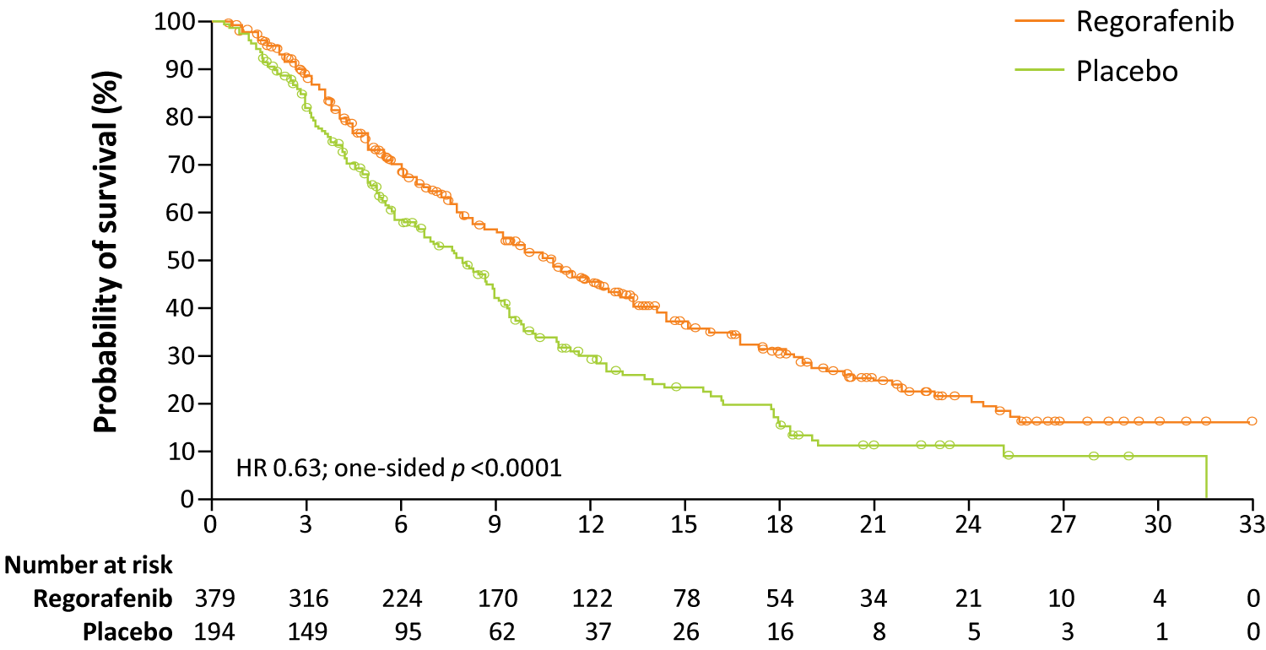
RESORCE: Survival Analyses
 | Regorafenib (n = 374) | Placebo (n = 193) | HR | p-value
OS | 10.6 mo | 7.8 mo | 0.63 | <0.0001
PFS | 3.1 mo | 1.5 mo | 0.46 | <0.0001
Months
Bruix J et al. Lancet 2017;389:56-66.

Slide 42
RESORCE: Common Treatment-Emergent Drug-Related AEs
 | Regorafenib (n = 374) |  | Placebo (n = 193)
 | Any grade | Grade ≥3 | Any grade | Grade ≥3
Hand-foot skin reaction | 52% | 13% | 7% | 1%
Diarrhea | 33% | 2% | 9% | 0%
Fatigue | 29% | 6% | 19% | 2%
Hypertension | 23% | 13% | 5% | 3%
Bruix J et al. Lancet 2017;389:56-66.

Slide 43
FDA Expands Approved Use of Regorafenib to Treat HCC
On April 27, 2017 the FDA expanded the approved use of regorafenib to include treatment of patients with hepatocellular carcinoma who have been previously treated with the drug sorafenib.
This is the first FDA-approved treatment for liver cancer in almost a decade.
https://www.fda.gov/NewsEvents/Newsroom/PressAnnouncements/ucm555608.htm

Slide 44
Phase III Study 304 of First-Line Lenvatinib in Unresectable HCC
Clinical Trial Identifier: NCT01761266
Eligibility
Advanced HCC not amenable to resection Child-Pugh A No prior systemic therapy for advanced/unresectable HCC ECOG PS 0-1
Lenvatinib
12 mg (or 8 mg) orally once daily
R
Sorafenib
400 mg BID
Primary endpoint: Overall survival
Median OS: Lenvatinib 13.6 mo, sorafenib 12.3 mo (HR 0.92)
Median PFS: Lenvatinib 7.4 mo, sorafenib 3.7 mo (HR 0.66, p < 0.00001)
www.clinicaltrials.gov. Accessed April 2017; Cheng A et al. Proc ASCO 2017;Abstract 4001.

Slide 45
CELESTIAL Phase III Schema
Target Accrual: 760
Clinical Trial Identifier: NCT01908426
Eligibility
Advanced HCC not amenable to curative treatment Child-Pugh A Progression following ≥1 prior systemic treatment for HCC Prior treatment with sorafenib ECOG PS 0-1
Cabozantinib
60 mg orally once daily
2:1
R
Placebo
Primary endpoint: Overall survival
Abou-Alfa GK et al. GI Cancers Symp 2017;Abstract TPS496.

Slide 46
Phase III CELESTIAL Trial Meets Primary Endpoint of Overall Survival for Patients with Advanced HCC October 16, 2017 — Press Release
The Phase III CELESTIAL trial met its primary endpoint of overall survival with cabozantinib providing a statistically significant and clinically meaningful improvement in median OS in comparison to placebo for patients with advanced HCC. The independent data monitoring committee for the study recommended that the trial should be stopped because of efficacy after review of the second planned interim analysis.
http://www.businesswire.com/news/home/20171016005563/en/Ipsen-Announces-Phase-3-CELESTIAL-Trial-Cabozantinib

Slide 47
REACH-2 Phase III Schema of Second-Line Ramucirumab
Target Accrual: 399
Trial Identifier: NCT02435433
Eligibility
Advanced HCC Child Pugh A Disease progression on or after first-line sorafenib, or sorafenib discontinuation due to intolerance Sorafenib sole systemic therapy for HCC Baseline AFP ≥400 ng/mL
Ramucirumab + BSC
R
Placebo + BSC
Primary endpoint: Overall survival
www.clinicaltrials.gov. Accessed April 2017

Slide 48
CheckMate-040: Nivolumab Dose Escalation and Expansion for Patients with Advanced HCC
Eligibility
Advanced HCC not amenable to curative resection
Child-Pugh scores ≤7 (escalation) or ≤6 (expansion)
Disease progression on 1 prior line of systemic therapy or intolerance or refusal of sorafenib
Primary endpoints: Safety, response
Dose escalation (n = 48)
3 + 3 design
Dose expansion (n = 214)
3 mg/kg
n = 6
n = 9
n = 10
n = 10
n = 13
Sorafenib untreated or intolerant (n = 56)
Without viral hepatitis
0.1 mg/kg (n = 1)
0.3 mg/kg (n = 3)
1.0 mg/kg (n = 3)
3.0 mg/kg (n = 3)
10 mg/kg (n = 13)
Sorafenib progressor (n = 57)
HCV infected
0.3 mg/kg (n = 3)
1.0 mg/kg (n = 4)
3.0 mg/kg (n = 3)
HCV infected (n = 50)
HBV infected
0.1 mg/kg (n = 5)
0.3 mg/kg (n = 3)
1.0 mg/kg (n = 3)
3.0 mg/kg (n = 4)
HBV infected (n = 51)
El-Khoueiry A et al. Lancet 2017;[Epub ahead of print].

Slide 49
Nivolumab in HCC (Dose Expansion): Response, Survival and Tolerability
 | All patients (n = 214)
Objective response rate (ORR) | 20%
Complete response | 1%
Partial response | 18%
Stable disease | 45%
9-month OS rate | 74%
Nivolumab had a manageable safety profile, and no new signals were observed.
In the dose-expansion phase, ORR (n = 145) for patients who previously received sorafenib was 19%, including 5 patients with complete responses.
El-Khoueiry A et al. Lancet 2017;[Epub ahead of print].

Slide 50
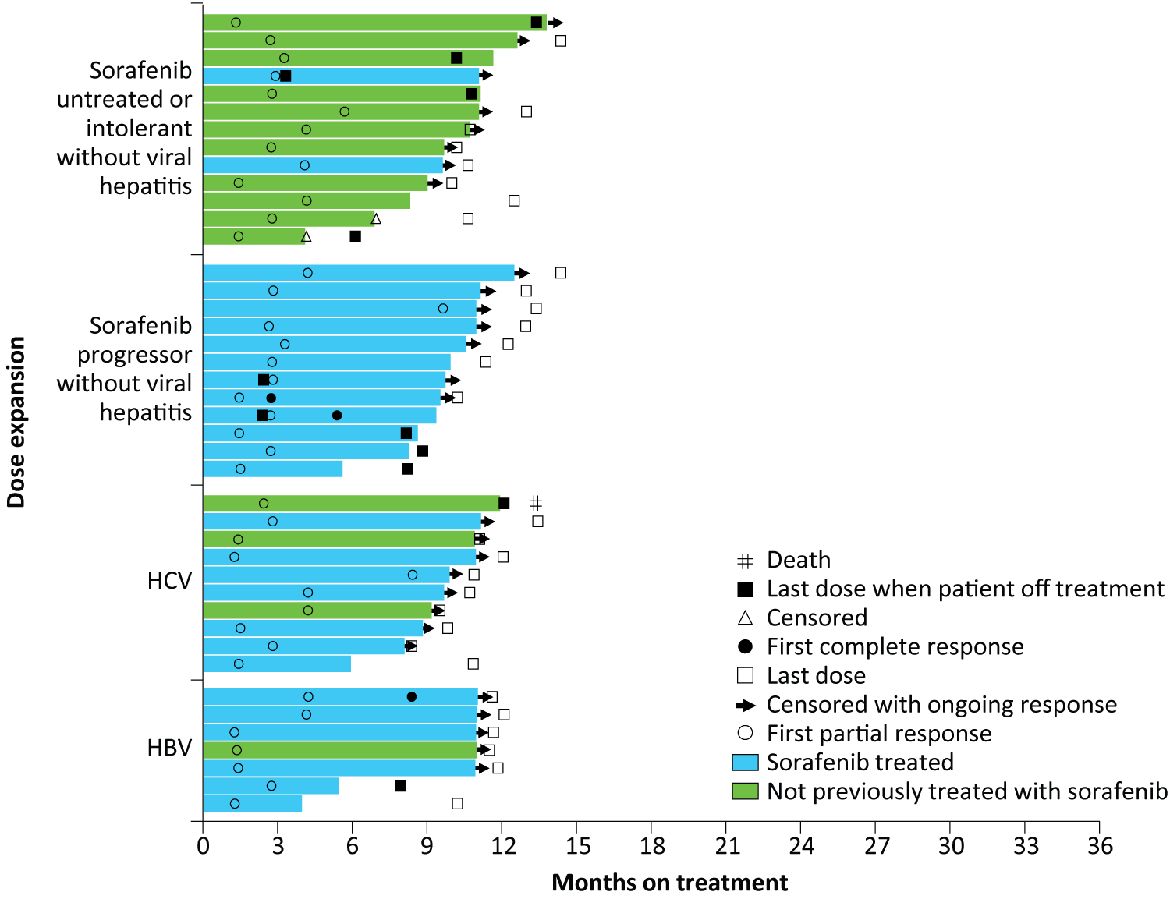
Time to Response and Duration of Response to Nivolumab — Dose-Expansion Phase*
* Patients who achieved a complete or partial response
El-Khoueiry A et al. Lancet 2017;[Epub ahead of print].

Slide 51
Nivolumab Receives Accelerated Approval for HCC Previously Treated with Sorafenib Press Release
"On September 22, 2017, the Food and Drug Administration granted accelerated approval to nivolumab for the treatment of hepatocellular carcinoma (HCC) in patients who have been previously treated with sorafenib. Approval was based on a 154-patient subgroup of CHECKMATE-040 (NCT 01658878), a multicenter, open-label trial conducted in patients with HCC and Child-Pugh A cirrhosis who progressed on or were intolerant to sorafenib."
https://www.fda.gov/Drugs/InformationOnDrugs/ApprovedDrugs/ucm577166.htm

Slide 52
CheckMate 049 Phase III First-Line Study of Nivolumab
Target Accrual: 726
Clinical Trial Identifier: NCT02576509
Eligibility
Advanced HCC not eligible for surgical or locoregional therapies; or progressive disease after surgical or locoregional therapies Child-Pugh A ECOG PS 0-1
Nivolumab
R
Sorafenib
Primary endpoints: Overall survival, overall response rate
www.clinicaltrials.gov. Accessed April 2017.

Slide 53
KEYNOTE-240 Phase III Study of Second-Line Pembrolizumab
Target Accrual: 408
Clinical Trial Identifier: NCT02702401
Pembrolizumab
200 mg q3wk
+
Best Supportive Care
Eligibility
Advanced HCC Progressed on or intolerant to first-line sorafenib Child-Pugh A ECOG PS 0-1
2:1
R
Placebo
+
Best Supportive Care
Primary endpoint: Progression-free survival, overall survival
Finn RS et al. GI Cancers Symp 2017;Abstract TPS503.

Slide 54
Novel and Emerging Strategies in the Management of Gastrointestinal Cancers
Module 1: Pancreatic Cancer
Indications for and selection of neoadjuvant therapy
Gemcitabine-capecitabine as adjuvant therapy (ESPAC-4)
Integration of nanoliposomal irinotecan (nal-IRI) + 5-FU into the management of metastatic disease (NAPOLI-1)
Module 2: Colon Cancer
Microsatellite instability and treatment with anti-PD-1/PD-L1 checkpoint inhibitors
Ramucirumab, aflibercept and bevacizumab continuation
Tumor sidedness for prognostication and in systemic treatment decision-making
Module 3: Hepatocellular Carcinoma
Regorafenib as second-line systemic therapy (RESORCE)
Ongoing Phase III CELESTIAL study of cabozantinib as second- or later-line therapy
Early data and ongoing trials with anti-PD-1/PD-L1 checkpoint inhibitors
Module 4: Gastric Cancer
Second- and third-line treatment of metastatic disease: Role of ramucirumab, checkpoint inhibitors
Ramucirumab alone or with paclitaxel as second- or later-line therapy (REGARD, RAINBOW)
Emerging data and ongoing trials with anti-PD-1/PD-L1 checkpoint inhibitors
Early data and ongoing studies with napabucasin (BBI-608) in GI cancers
Module 5: Gastrointestinal Neuroendocrine Tumors (GI NET)
Peptide receptor radionuclide therapy (PPRT) with ¹⁷⁷Lu-Dotatate (NETTER-1)
Telotristat ethyl for carcinoid syndrome diarrhea that is not well controlled on somatostatin analogues

Slide 55
For HER2-positive gastric cancer, what is your usual…
First-line treatment?
Second-line treatment after FOLFOX + trastuzumab?
Third-line treatment after FOLFOX + trastuzumab and paclitaxel + ramucirumab?
FIRST LINE
SECOND LINE
THIRD LINE
FOLFOX + trastuzumab
Paclitaxel + ramucirumab
Nivolumab or pembrolizumab
FOLFOX + trastuzumab
Paclitaxel + ramucirumab
Cisplatin/irinotecan/
trastuzumab
FOLFOX + trastuzumab
Continue tras; switch chemo
FOLFIRI + trastuzumab
FOLFOX + trastuzumab
Continue tras; switch chemo
FOLFIRI + trastuzumab
FOLFOX + trastuzumab
PD-1/PD-L1 antibody
FOLFIRI or PD-1/PD-L1 antibody
FOLFOX + trastuzumab
Continue tras; switch chemo
FOLFIRI + trastuzumab
FOLFOX + trastuzumab
Continue tras; switch chemo
Irinotecan + trastuzumab

Slide 56
For HER2-negative gastric cancer, what is your usual…
First-line treatment?
Second-line treatment after FOLFOX?
Third-line treatment after FOLFOX and paclitaxel + ramucirumab?
FIRST LINE
SECOND LINE
THIRD LINE
FOLFOX
Paclitaxel + ramucirumab
Nivolumab or pembrolizumab
FOLFOX
Paclitaxel + ramucirumab
FOLFIRI
FOLFOX
FOLFIRI
FOLFIRI
FOLFOX
FOLFIRI
FOLFIRI
FOLFOX
Paclitaxel + ramucirumab
FOLFIRI or PD-1/PD-L1 antibody
FOLFOX
Paclitaxel + ramucirumab
Irinotecan
FOLFOX or CAPOX
Paclitaxel + ramucirumab
Irinotecan

Slide 57
RAINFALL Phase III Schema
Target Accrual: 616
Clinical Trial Identifier: NCT02314117
Ramucirumab +
capecitabine* +
cisplatin
Eligibility
Metastatic gastric/GEJ No prior first-line therapy
R
Placebo +
capecitabine* +
cisplatin
* Pts unable to take capecitabine receive 5-FU
Primary endpoint: Progression-free survival
www.clinicaltrials.gov. Accessed April 2017.

Slide 58
Examples of Therapeutic Agents Under Evaluation in Ongoing or Planned Phase III Studies in Advanced Gastric/GEJ Cancers
TAS-102
Regorafenib
Andecaliximab
Anti-PD-1/PD-L1 agents
Napabucasin
www.clinicaltrials.gov. Accessed April 2017.

Slide 59
ATTRACTION-2 Phase III Schema
Target Accrual: 493
Clinical Trial Identifier: NCT02267343
Eligibility
Unresectable advanced or recurrent gastric or GEJ cancer Histologically confirmed adenocarcinoma Prior treatment with ≥2 regimens and refractory to/intolerant of standard therapy PS 0 or 1
Nivolumab
3mg/kg q2wk
2:1
R
Placebo
Primary endpoint: Overall survival
Patients were permitted to continue treatment beyond initial RECIST v1.1-defined disease progression, as assessed by the investigator, if receiving clinical benefit and tolerating treatment drug.
Kang YK et al. GI Cancers Symposium 2017;Abstract 02.

Slide 60
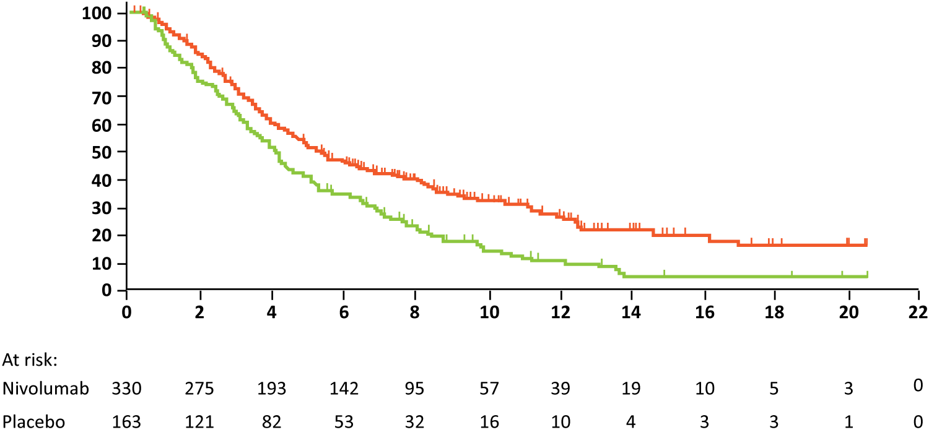
ATTRACTION-2: Overall Survival
 | Patients, n | Events, n | Median OS, months | 12-month OS rate, %
Nivolumab | 330 | 225 | 5.32 | 26.6
Placebo | 163 | 141 | 4.14 | 10.9
Probability of survival (%)
Hazard ratio, 0.63
p < 0.0001
Time (months)
Kang YK et al. GI Cancers Symposium 2017;Abstract 02.

Slide 61
Examples of Ongoing Phase III Studies of Anti-PD-1/ PD-L1 Checkpoint Inhibitors in Gastric/GEJ Cancers
Study | N | Setting | Randomization
CheckMate 577 | 760 | Adjuvant, gastric or GEJ after preop chemoRT | Nivolumab Placebo
ONO-4538-38 | 700 | Adjuvant, gastric (Japan) | S-1 or CAPOX + nivolumab S-1 or CAPOX + placebo
CheckMate 649 | 1,266 | 1st line, gastric or GEJ | Nivolumab/ipilimumab → nivolumab CAPOX or FOLFOX CAPOX or FOLFOX + nivolumab
KEYNOTE-062 | 750 | 1st line, gastric or GEJ | Pembrolizumab Pembrolizumab + cisplatin/5-FU Placebo + cisplatin/5-fu
KEYNOTE-061 | 720 | 2nd line, gastric or GEJ | Pembrolizumab Paclitaxel
JAVELIN Gastric 100 | 666 | 1st line, gastric | Avelumab Oxiplatin/fluoropyrimidine doublet
JAVELIN Gastric 300 | 330 | 3rd line, gastric | Avelumab + BSC Physician’s choice of chemo + BSC or BSC alone
www.clinicaltrials.gov. Accessed April 2017.

Slide 62
Primary Models of Cancer Stem Cells and Tumor Heterogeneity
1. Clonal evolution model
2. Classical CSC model
CSC
Unidirectional conversions
Acquisition of mutations
non-CSC
3. Plastic CSC model
Self-renewal
CSC
Expansion of dominant clones
Bidirectional conversions
non-CSC
Plastic non-CSC
Legend:
CSC
non-CSC
plastic non-CSC
Bekaii-Saab T et al. Cancer 2017; [Epub ahead of print].

Slide 63
Targeting Cancer Stem Cells in the Treatment of Gastric Cancer
Inhibiting the signal transducer and activator of transcription 3 (STAT3) signaling pathway with napabucasin
WNT
β-CAT
Cancer stem cell
Napabucasin (BBI-608)
β-CAT, STAT3, Nanog
Bekaii-Saab T et al. Cancer 2017; [Epub ahead of print].

Slide 64
Phase Ib/2 Study of Napabucasin Combined with Paclitaxel in Advanced Gastric and GEJ Adenocarcinoma
 | All patients (n = 46) | Prior taxane (n = 19) | No taxane (n = 16)
Objective response rate | 15% | 11% | 31%
Disease control | 54% | 68% | 75%
Median PFS | 13.0 wks | 12.6 wks | 20.6 wks
Median OS | 31.6 wks | 33.1 wks | 39.3 wks
Evaluable patients who received 1 prior line of therapy without
a taxane (n = 6): ORR = 50%; DCR = 83%
Grade 3 adverse events included: vomiting (8.7%), diarrhea (6.5%), nausea, abdominal pain and decrease in white blood cell count (each 2.2%)
Becerra C et al. Proc ASCO 2015;Abstract 4069.

Slide 65
Phase III Studies of Napabucasin (BBI-608) in GI Cancers
Study | Disease & setting | No. of patients | Randomization
BRIGHTER NCT02178956 | Previously treated, advanced gastric, GEJ | 700 | Napabucasin + weekly paclitaxel Placebo + weekly paclitaxel
CanStem303C NCT02753127 | Previously treated, metastatic CRC | 1,250 | Napabucasin + FOLFIRI FOLFIRI
NCIC C023 NCT01830621 (Completed) | Previously treated, metastatic CRC | 282 | Napabucasin + BSC Placebo + BSC
CanStem111P | Untreated metastatic pancreatic cancer | 1,132 | Napabucasin + nab paclitaxel + gemcitabine Nab paclitaxel + gemcitabine
www.clinicaltrials.gov. Accessed April 2017.

Slide 66
Novel and Emerging Strategies in the Management of Gastrointestinal Cancers
Module 1: Pancreatic Cancer
Indications for and selection of neoadjuvant therapy
Gemcitabine-capecitabine as adjuvant therapy (ESPAC-4)
Integration of nanoliposomal irinotecan (nal-IRI) + 5-FU into the management of metastatic disease (NAPOLI-1)
Module 2: Colon Cancer
Microsatellite instability and treatment with anti-PD-1/PD-L1 checkpoint inhibitors
Ramucirumab, aflibercept and bevacizumab continuation
Tumor sidedness for prognostication and in systemic treatment decision-making
Module 3: Hepatocellular Carcinoma
Regorafenib as second-line systemic therapy (RESORCE)
Ongoing Phase III CELESTIAL study of cabozantinib as second- or later-line therapy
Early data and ongoing trials with anti-PD-1/PD-L1 checkpoint inhibitors
Module 4: Gastric Cancer
Second- and third-line treatment of metastatic disease: Role of ramucirumab, checkpoint inhibitors
Ramucirumab alone or with paclitaxel as second- or later-line therapy (REGARD, RAINBOW)
Emerging data and ongoing trials with anti-PD-1/PD-L1 checkpoint inhibitors
Early data and ongoing studies with napabucasin (BBI-608) in GI cancers
Module 5: Gastrointestinal Neuroendocrine Tumors (GI NET)
Peptide receptor radionuclide therapy (PPRT) with ¹⁷⁷Lu-Dotatate (NETTER-1)
Telotristat ethyl for carcinoid syndrome diarrhea that is not well controlled on somatostatin analogues

Slide 67
Which somatostatin analogue (SSA) do you generally use as initial therapy for a patient with an advanced, well-differentiated gastrointestinal NET that is deemed unresectable by a surgeon? In what clinical situations, if any, would you like to use ¹⁷⁷Lu-Dotatate in the treatment of gastrointestinal NET?
SSA
¹⁷⁷LU-DOTATATE
Octreotide
PD on SSA
Lanreotide
Octreotide scan-positive disease
Octreotide
Pts meeting NETTER trial criteria
Octreotide
2nd line, extensive bone disease
Octreotide
PD on SSA
Octreotide
PD on SSA; prior to chemo or everolimus
Lanreotide
PD on front-line SSA

Slide 68
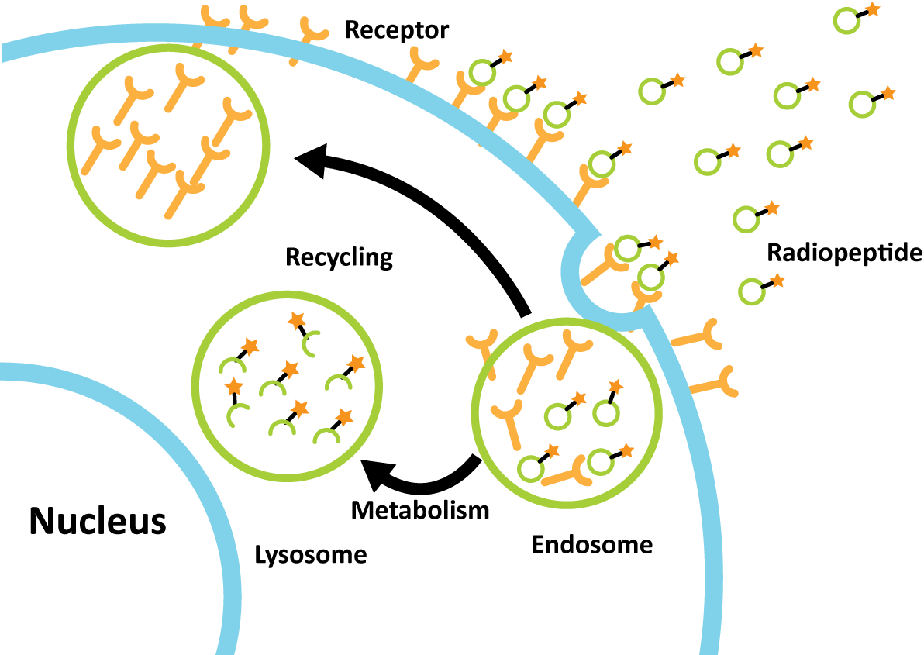
Mechanism of Action of PRRT (Peptide Receptor Radionuclide Therapy)
The radiolabeled SSAs are internalized, and the breakdown products of the radiolabeled peptides are stored in lysosomes, thus enabling a long irradiation of tumor cells.
¹⁷⁷Lu-DOTATATE is both a β-emitter and γ-emitter
Kwekkeboom DJ et al. Hematol Oncol Clin N Am 2016;30:179-91.

Slide 69
NETTER-1 Study Schema
Total Accrual: 229
Eligibility
Metastatic or locally advanced, inoperable, histologically proven, midgut NET Ki-67 index ≤20% (Grade 1–2) Progressive disease on uninterrupted fixed dose of octreotide LAR (20-30 mg every 3-4 weeks) Somatostatin receptor-positive disease
¹⁷⁷Lu-Dotatate x 4
q8wk + SSAs (symptom control)
1:1
R
Octreotide LAR
(high dose – 60mg q4wk)
Primary endpoint: Progression-free survival
Strosberg J et al. N Engl J Med 2017;376:125-35.

Slide 70
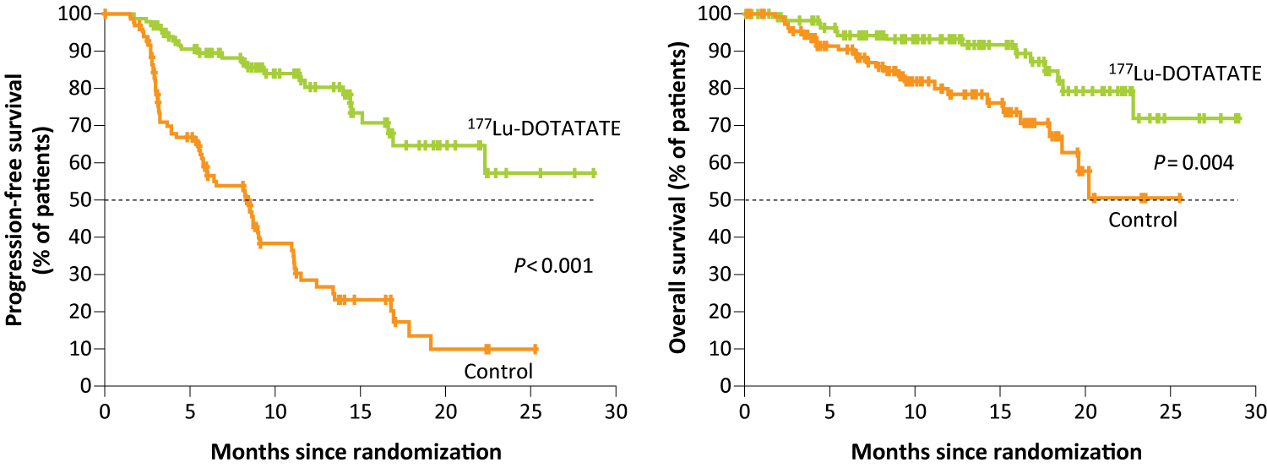
NETTER-1: Survival Analysis
Progression-Free Survival
Overall Survival
Endpoint | ¹⁷⁷Lu-Dotatate (n = 116) | Control (n = 113) | Hazard ratio | p-value
Median PFS | Not reached | 8.4 mo | 0.21 | <0.0001
20-mo estimated PFS | 65.2% | 10.8%
Interim OS | 14 deaths | 26 deaths | 0.40 | 0.004
Strosberg J et al. N Engl J Med 2017;376:125-35.

Slide 71
NETTER-1: Select Adverse Events
 | ¹⁷⁷Lu-Dotatate (n = 111) |  | Control (n = 110)
 | Any grade | Grade ≥3 | Any grade | Grade ≥3
Nausea | 59% | 4% | 12% | 2%
Vomiting | 47% | 7% | 10% | 1%
Fatigue | 40% | 2% | 25% | 2%
Thrombocytopenia | 25% | 2% | 1% | 0%
Anemia | 14% | 0% | 5% | 0%
Lymphopenia | 18% | 9% | 2% | 0%
Leukopenia | 10% | 1% | 1% | 0%
Neutropenia | 5% | 1% | 1% | 0%
Strosberg J et al. N Engl J Med 2017;376:125-35.

Slide 72
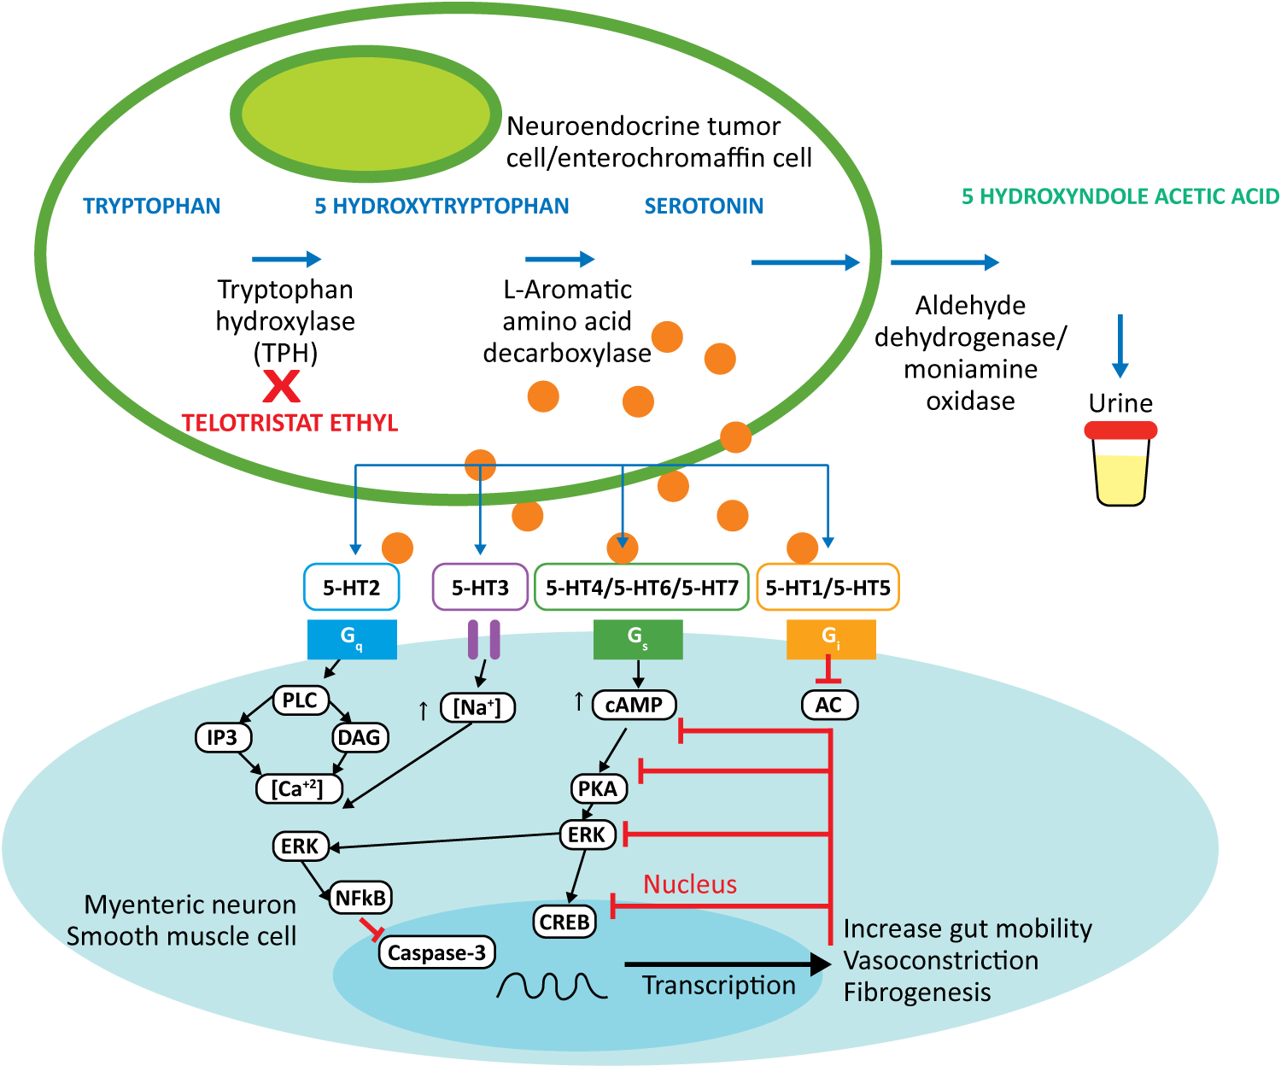
Telotristat Ethyl (TE) A Tryptophan Hydroxylase (TPH) Inhibitor
Molina-Cerrillo J et al. The Oncologist 2016;21:701-7.

Slide 73
TELESTAR Phase III Schema
Trial Identifier: NCT01677910
Enrollment: 135
Placebo TID
Eligibility
Carcinoid syndrome Experiencing ≥4 bowel movements (BMs) per day despite stable-dose somatostatin analogue (SSA) therapy Continue SSA throughout study period
3-4-week
run-in
Evaluation of
BM frequency
1:1:1
R
Telotristat ethyl
250 mg TID
Telotristat ethyl
500 mg TID
Telotristat ethyl
500 mg TID
Primary endpoint: Change from baseline in BM frequency
Kulke MH et al. J Clin Oncol 2017;35(1):14-23.

Slide 74
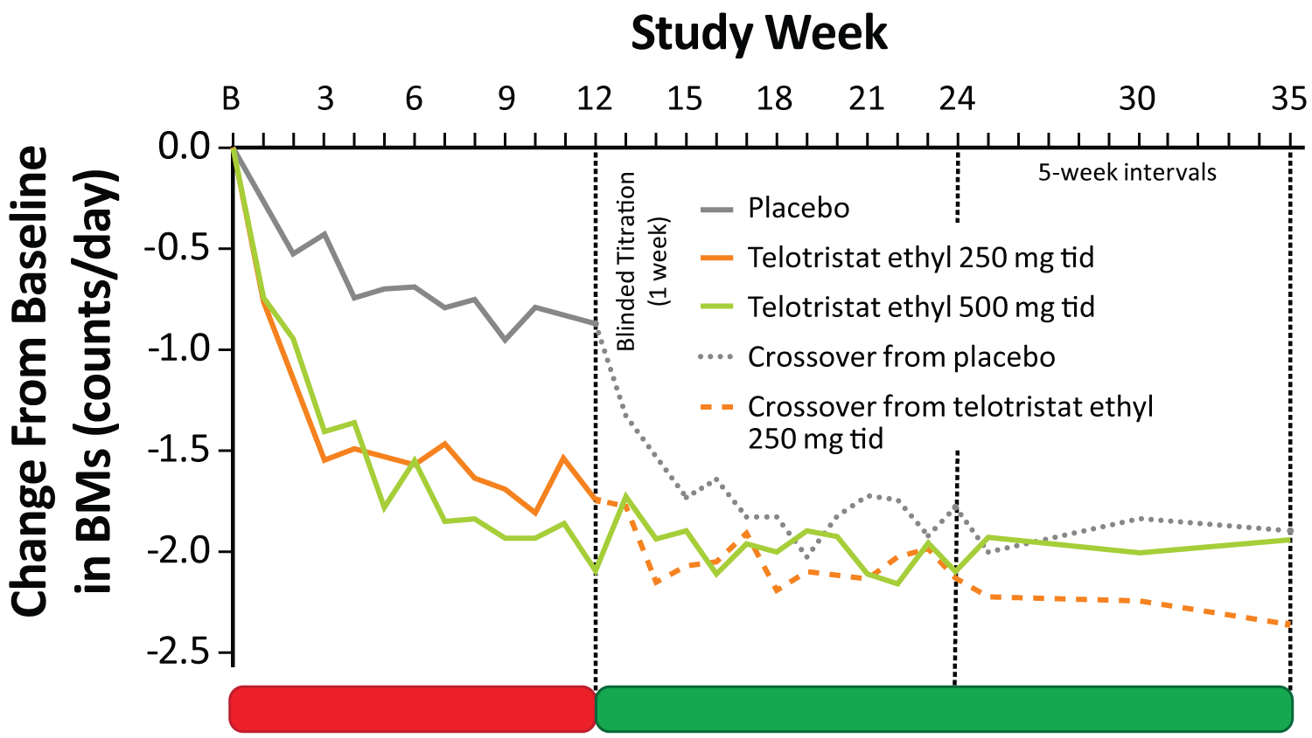
TELESTAR: Change from Baseline in BMs Per Day
Double-Blind Treatment
Open-Label Extension
Kulke MH et al. J Clin Oncol 2017;35(1):14-23.

Slide 75
TELESTAR: Change in Frequency of BMs from Baseline to Week 12
Mean reduction in daily BM frequency
from baseline to week 12
250 mg three times per day: -1.7
Placebo: -0.9
Mean reduction in daily BM frequency
from baseline to week 12
500 mg three times per day: -2.1
Placebo: -0.9
Kulke MH et al. J Clin Oncol 2017;35(1):14-23.

Slide 76
TELESTAR: Percentage Change from Baseline in Urinary 5-Hydyroxyindoleacetic Acid (u5-HIAA) Levels at Week 12
78% reduction in u5-HIAA
84% reduction in u5-HIAA
Kulke MH et al. J Clin Oncol 2017;35(1):14-23.

Slide 77
TELECAST Phase III Trial
Eligibility (N = 76)
Experiencing ≥1 carcinoid syndrome-associated symptom SSA treated (<4 BMs/day) or SSA naïve
Placebo
TID x 12 wk
1:1:1
R
Telotristat ethyl
250 mg
TID x 12 wk
Responders were predefined as patients experiencing ≥30% reduction in BM frequency for ≥50% of days
Telotristat ethyl
500 mg
TID x 12 wk
For each telotristat ethyl (TE) dose: 10 (40%) patients were responders vs 0 on placebo
Estimated treatment differences in mean u5-HIAA compared to placebo:
TE 250 mg, -30 mg/day (-54%) TE 500 mg, -41 mg/day (-90%)
Mild to moderate hepatic enzyme elevations observed in TE-treated patients
Pavel M et al. NANETS 2016;Abstract C8.

Slide 78
Novel and Emerging Strategies in the Management of Gastrointestinal Cancers
Philip A Philip, MD, PhD
Professor of Oncology and Pharmacology
Director of GI and Neuroendocrine Tumors
Vice President of Medical Affairs
Karmanos Cancer Institute
Wayne State University
Detroit, Michigan

