Slide 1
YIR On Demand
Breast
Hope S Rugo, MD
Professor of Medicine
Director, Breast Oncology and Clinical Trials Education
University of California, San Francisco
Helen Diller Family Comprehensive Cancer Center
San Francisco, California

Slide 2
Disclosures
Contracted Research | Eisai Inc, Genentech BioOncology, Lilly, MacroGenics Inc, Merck, Novartis, OBI Pharma Inc, Pfizer Inc, Plexxikon Inc, Roche Laboratories Inc
Paid Travel | Lilly, Mylan NV, Puma Biotechnology Inc

Slide 3
CDK4/6 Inhibitors in the Treatment of ER-Positive, HER2-Negative Breast Cancer (BC)

Slide 4
Abemaciclib for Pre/Peri-Menopausal Women with HR+, HER2-Advanced Breast Cancer
Neven P et al. Proc ASCO 2018;Abstract 1002.

Slide 5
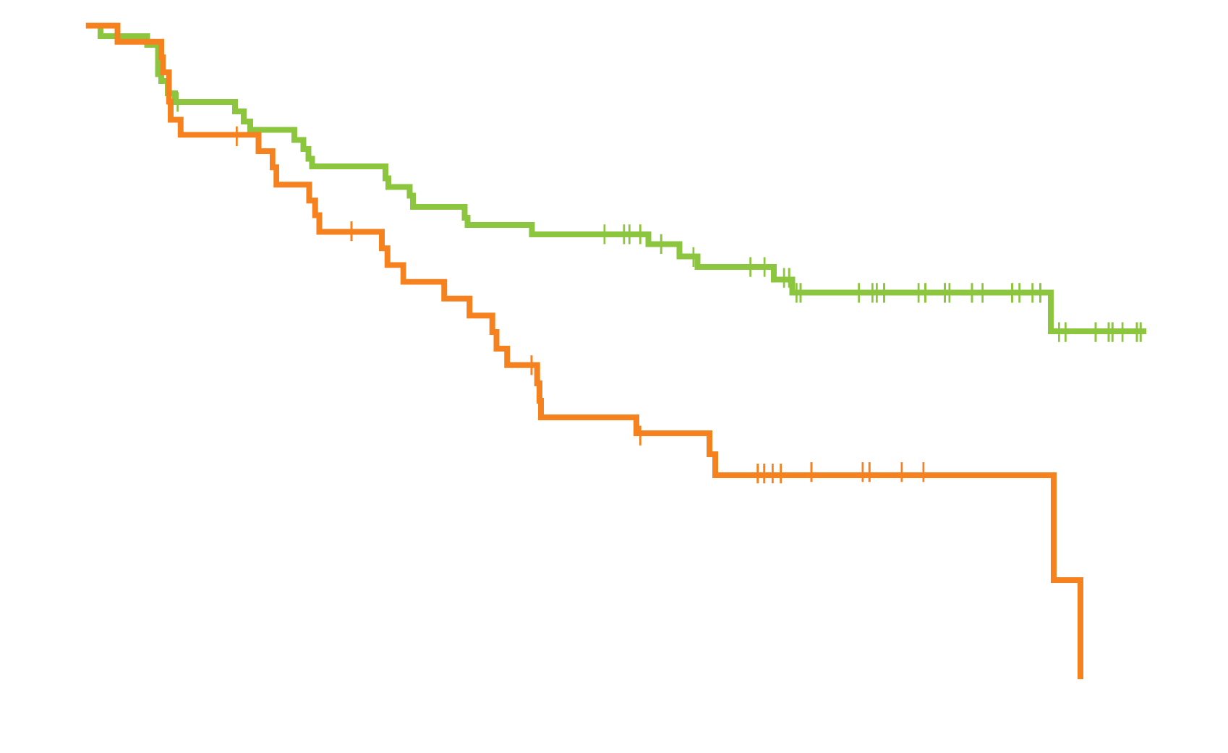
MONARCH 2: Investigator-Assessed PFS
PFS in Pre/perimenopausal Population
Median PFS
Abemaciclib + fulvestrant (n = 72): not reached
Placebo + fulvestrant (n = 42): 10.5 months
HR: 0.446; p = 0.002
Progression-free survival (%)
Time (months)
 | Abema + Fulv | Placebo + Fulv | HR (p-value)
Median PFS – ITT (n = 446; 223) | 16.4 mo | 9.3 mo | 0.553 (<0.0000001)
Median PFS – Pre/perimenopausal with no prior AI (n = 62; 30) | Not reached | 11.3 mo | 0.451 (0.009)
AI = aromatase inhibitor
Neven P et al. Proc ASCO 2018;Abstract 1002.

Slide 6
MONARCH 2: Select Treatment-Emergent Adverse Events
Adverse event (%) | Abema + Fulv (n = 71) |  |  |  | Placebo + Fulv (n = 42)
 | Any gr | Gr 2 | Gr 3 | Gr 4 | Any gr | Gr 2 | Gr 3 | Gr 4
Diarrhea | 87.3 | 31.0 | 11.3 | 0 | 23.8 | 2.4 | 0 | 0
Neutropenia | 59.2 | 12.7 | 39.4 | 2.8 | 7.1 | 2.4 | 2.4 | 0
Leukopenia | 43.7 | 21.1 | 16.9 | 0 | 4.8 | 2.4 | 0 | 0
Infections, infestations | 43.7 | 36.6 | 1.4 | 0 | 26.2 | 16.7 | 4.8 | 0
Vomiting | 32.4 | 7.0 | 1.4 | 0 | 7.1 | 0 | 2.4 | 0
Diarrhea associated with abemaciclib was generally predictable (occurred early), manageable and reversible
After protocol amendment to lower abemaciclib starting dose from 200 mg to 150 mg, no treatment discontinuations due to diarrhea were observed
Neven P et al. Proc ASCO 2018;Abstract 1002.

Slide 7
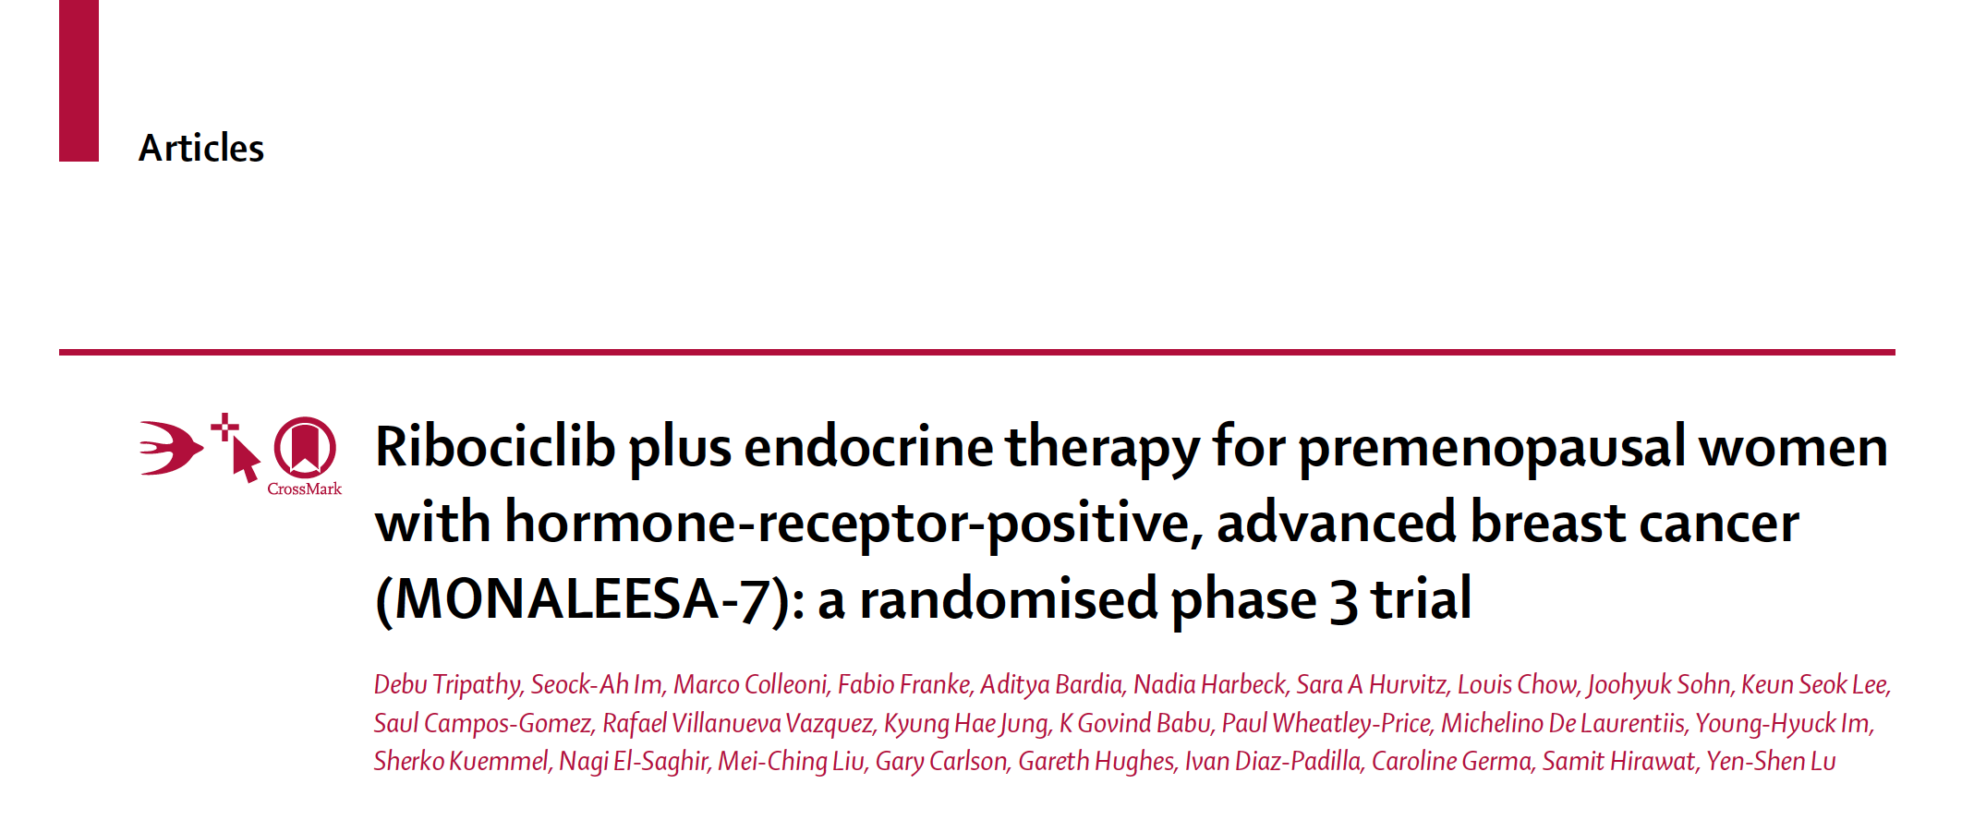
Lancet Oncol 2018;19(7):904-15.
Premenopausal women with HER2-negative breast cancer who were treatment naïve or had received up to 1 line of prior chemotherapy for advanced breast cancer
672 women were randomized 1:1 to ribociclib versus placebo, in combination with tamoxifen and goserelin or NSAI and goserelin.

Slide 8
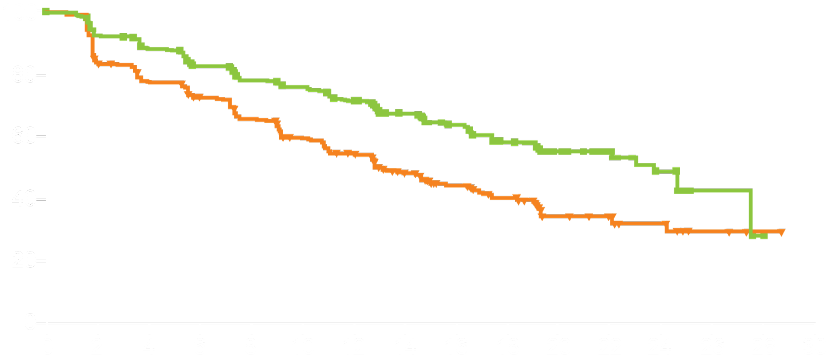
MONALEESA-7: Efficacy Summary
Median PFS
23.8 mo
13.0 mo
Ribociclib group (n = 335)
Placebo group (n = 337)
HR 0.55; p <0.0001
Progression-free survival (%)
ORR = 41% versus 30% for the ribociclib arm versus the placebo arm, respectively (p = 0.00098)
OS data were immature at the time of analysis
Tripathy D et al. Lancet Oncol 2018;19(7):904-15.

Slide 9
MONALEESA-7: Select Adverse Events (≥5% of Patients)
Adverse event (%) | Ribociclib (n = 335) |  |  | Placebo (n = 337)
 | Gr 1-2 | Gr 3 | Gr 4 | Gr 1-2 | Gr 3 | Gr 4
Neutropenia | 15 | 51 | 10 | 4 | 3 | 1
Leukopenia | 17 | 13 | 1 | 4 | 1 | 0
Elevated ALT | 7 | 5 | 0 | 6 | 1 | 0
Elevated AST | 8 | 4 | 0 | 8 | 1 | 0
Electrocardiogram QT prolonged | 10 | 1 | 0 | 4 | 0 | <1
Dose reductions due to AEs (ribociclib vs placebo): 31% vs 5%
Tripathy D et al. Lancet Oncol 2018;19(7):904-15.

Slide 10
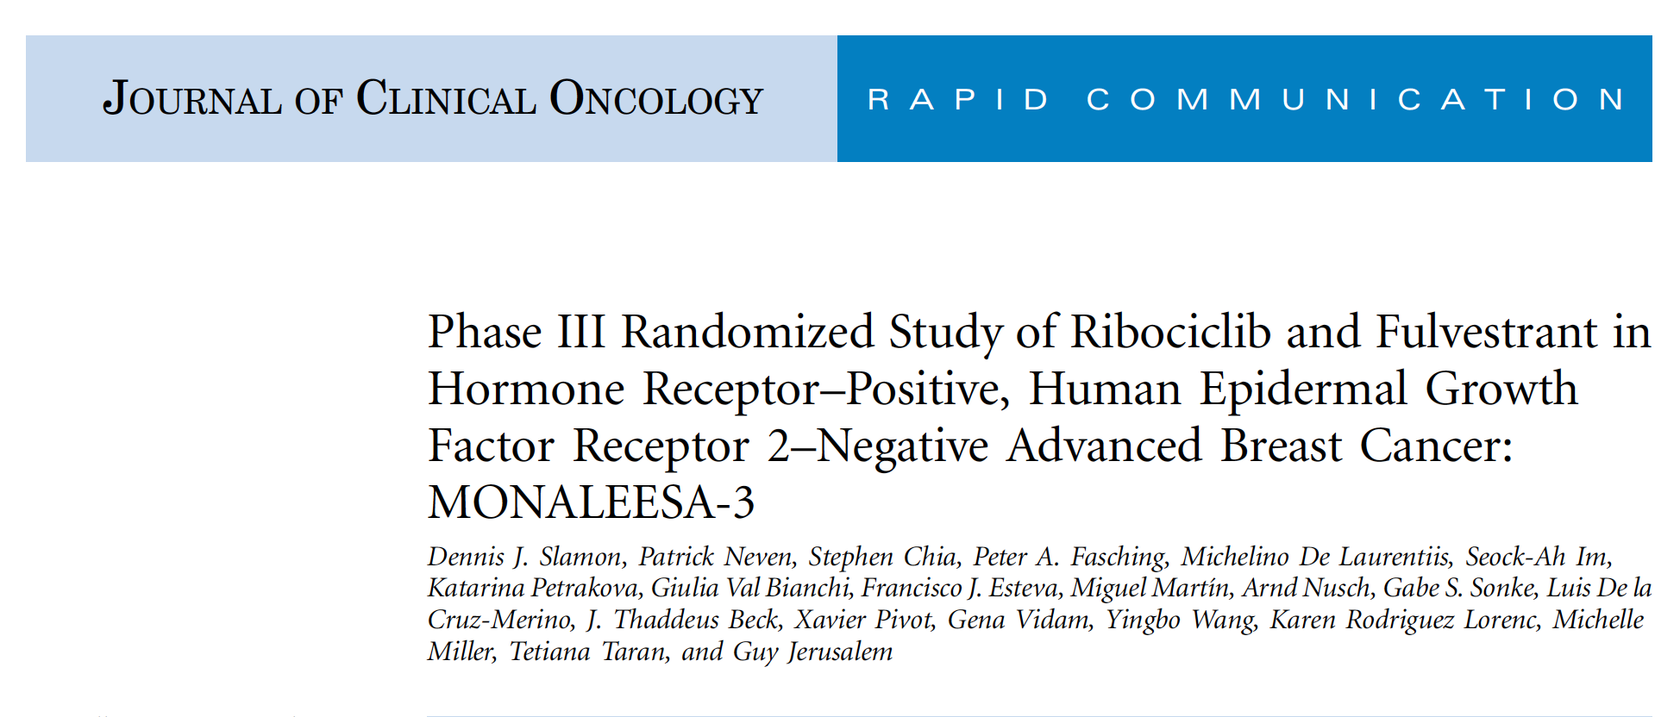
Slamon DJ et el. J Clin Oncol 2018;36(24):2465-72.
Postmenopausal women with HER2-negative breast cancer who were treatment naïve or had received up to 1 line of prior endocrine therapy for advanced breast cancer
726 women were randomized 2:1 to ribociclib plus fulvestrant or placebo plus fulvestrant.

Slide 11
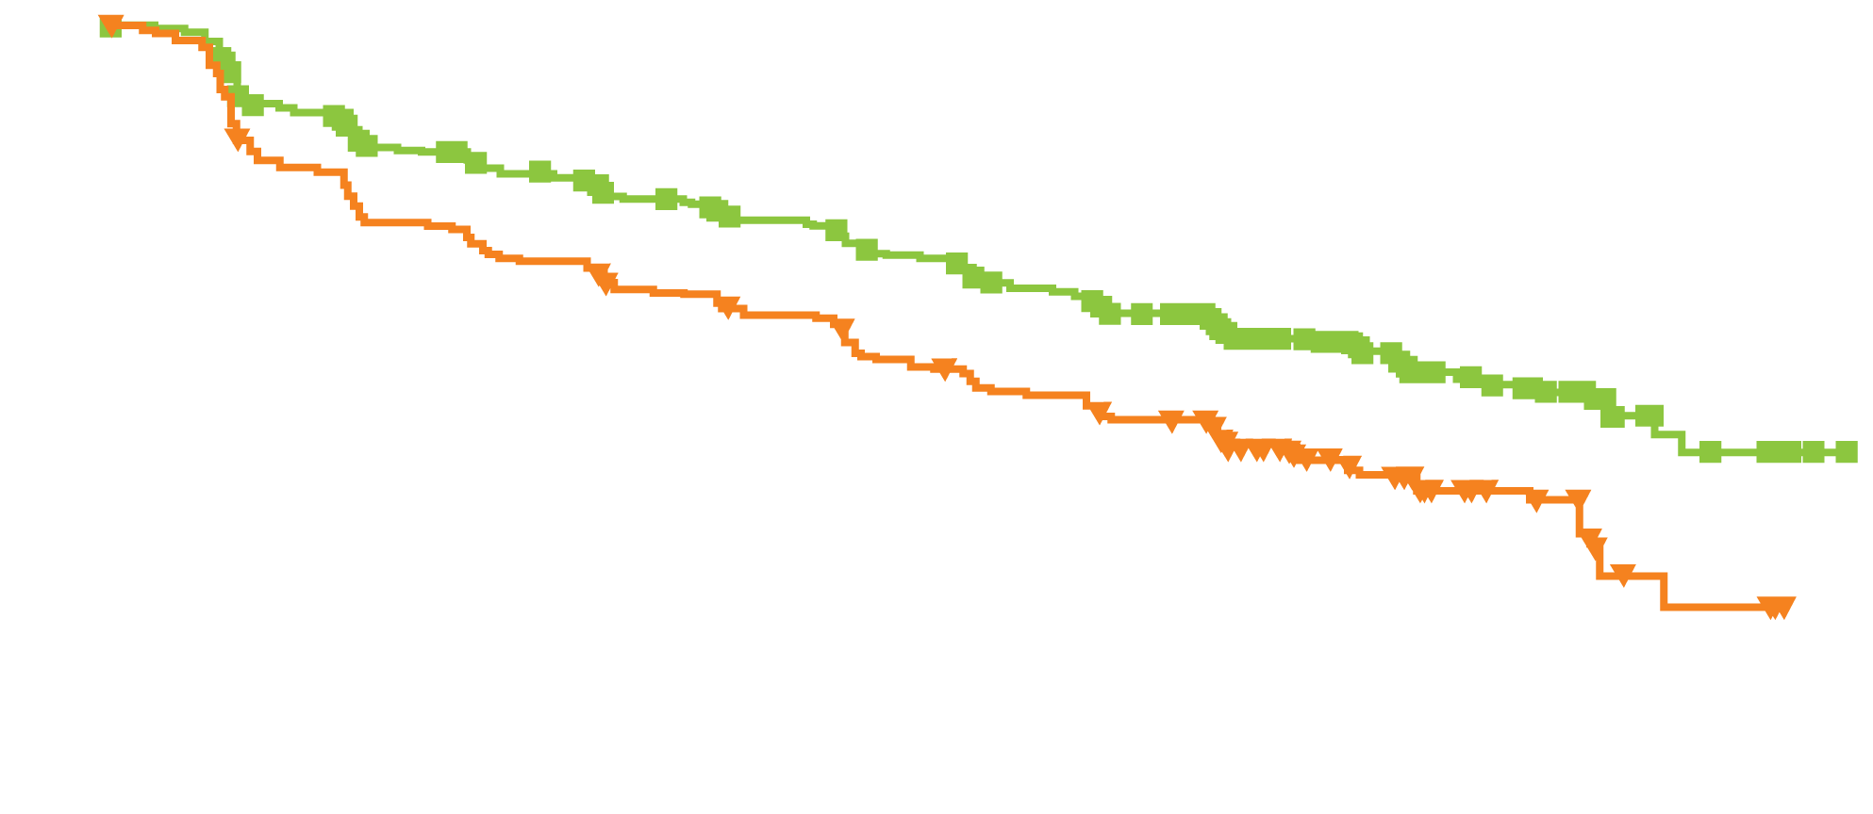
MONALEESA-3: Efficacy Summary
Locally-Assessed PFS
PFS (%)
Median PFS
Ribociclib + fulvestrant (n = 484): 20.5 months
Placebo + fulvestrant (n = 242): 12.8 months
Hazard ratio, 0.593; p < 0.001
Time (months)
ORR in all patients = 32.4% for the ribociclib + fulvestrant arm versus 21.5% for the placebo + fulvestrant arm (p < 0.001)
At the first planned interim analysis, OS data were immature
Slamon DJ et al. J. Clin Oncol 2018;36(24):2465-72.

Slide 12
MONALEESA-3: Select Adverse Events (≥15% of Patients)
Adverse event (%) | Ribociclib + Fulv (n = 483) |  |  | Placebo + Fulv (n = 241)
 | All gr | Gr 3 | Gr 4 | All gr | Gr 3 | Gr 4
Neutropenia | 69.6 | 46.6 | 6.8 | 2.1 | 0 | 0
Nausea | 45.3 | 1.4 | 0 | 28.2 | 0.8 | 0
Fatigue | 31.5 | 1.7 | 0 | 33.2 | 0.4 | 0
Leukopenia | 28.4 | 13.5 | 0.6 | 1.7 | 0 | 0
Anemia | 17.2 | 3.1 | 0 | 5.4 | 2.1 | 0
QT interval prolongation (ribociclib vs placebo): 6.2% vs 0.8%
Grade 3/4 elevated ALT/AST (ribociclib vs placebo): 8.5%/6.0% vs 1.2%/0
Dose reductions due to AEs (ribociclib vs placebo): 33.1% vs 3.3%
Slamon DJ et al. J. Clin Oncol 2018;36(24):2465-72.

Slide 13
Palbociclib plus Letrozole as First-Line Therapy in Estrogen Receptor-Positive/Human Epidermal Growth Factor Receptor 2–Negative Advanced Breast Cancer: Efficacy and Safety Updates with Longer Follow-Up Across Patient Subgroups
Rugo HS et al. San Antonio Breast Cancer Symposium 2017;Abstract P5-21-03.

Slide 14
PALOMA-2: Updated Investigator-Assessed PFS
ITT population
Median PFS
27.6 mo
14.5 mo
Palbociclib + letrozole (n = 444)
Placebo + letrozole (n = 222)
HR 0.56; p < 0.000001
Progression-free survival
Median follow-up = 37 mo
Time, months
Subgroup analysis of PFS | Palbo/let | Placebo/let | HR | p-value
Visceral disease + no prior ET | 23.7 mo | 13.9 mo | 0.55 | <0.005
Nonvisceral disease + no prior ET | 36.2 mo | 27.6 mo | 0.59 | <0.01
Bone-only disease | 36.2 mo | 11.2 mo | 0.41 | <0.0001
No bone-only disease | 24.2 mo | 14.5 mo | 0.62 | <0.0001
De novo metastatic disease | 27.9 mo | 22.0 mo | 0.61 | <0.005
All subgroups benefitted from the addition of palbociclib to letrozole
Rugo HS et al. San Antonio Breast Cancer Symposium 2017;Abstract P5-21-03.

Slide 15
PALOMA-2: Select Treatment-Emergent AEs in >1% of Patients
Hematologic | Palbociclib/letrozole (n = 444) |  | Placebo/letrozole (n = 222)
 | Any grade | Grade ≥3 | Any grade | Grade ≥3
Neutropenia | 81.8% | 69.1% | 6.3% | 1.4%
Leukopenia | 40.3% | 25.2% | 2.3% | 0
Anemia | 26.4% | 5.8% | 9.5% | 1.8%
Thrombocytopenia | 19.6% | 1.6% | 1.4% | 0
Nonhematologic
Infection | 62.6% | 7.6% | 45.0% | 4.6%
Stomatitis | 31.5% | 1.1% | 14.9% | 0
Hyperglycemia | 3.6% | 0.7% | 7.7% | 0.9%
Pulmonary embolism | 1.6% | 1.5% | 2.3% | 2.4%
Rugo HS et al. San Antonio Breast Cancer Symposium 2017;Abstract P5-21-03.

Slide 16
Genetic Landscape of Resistance to CDK4/6 Inhibition in Circulating Tumor DNA (ctDNA) Analysis of the PALOMA3 Trial of Palbociclib and Fulvestrant Versus Placebo and Fulvestrant
Turner NC et al. Proc ASCO 2018;Abstract 1001.

Slide 17
PALOMA-3: Paired ctDNA Analysis Methods
PALOMA-3 evaluated palbociclib + fulvestrant in women with HR-positive, HER2-negative advanced breast cancer who had experienced disease progression on prior endocrine therapy and received ≤1 chemotherapy for advanced breast cancer
Plasma samples for ctDNA analysis were banked at baseline and at end of treatment (EOT): n = 125 palbociclib + fulvestrant arm; 68 fulvestrant alone arm
A panel of 17 targetable driver and CDK4/6-related genes were analyzed by amplicon error-corrected sequencing
Coding exons: RB1, CDK4, CDK6, CDKN1A, CDKN1B, NF1 and TP53
Mutational hotspots: ERBB2, PIK3CA, AKT1, ESR1, FGFR1, FGFR2, FGFR3, KRAS, NRAS and HRAS
Turner NC et al. Proc ASCO 2018;Abstract 1001.

Slide 18
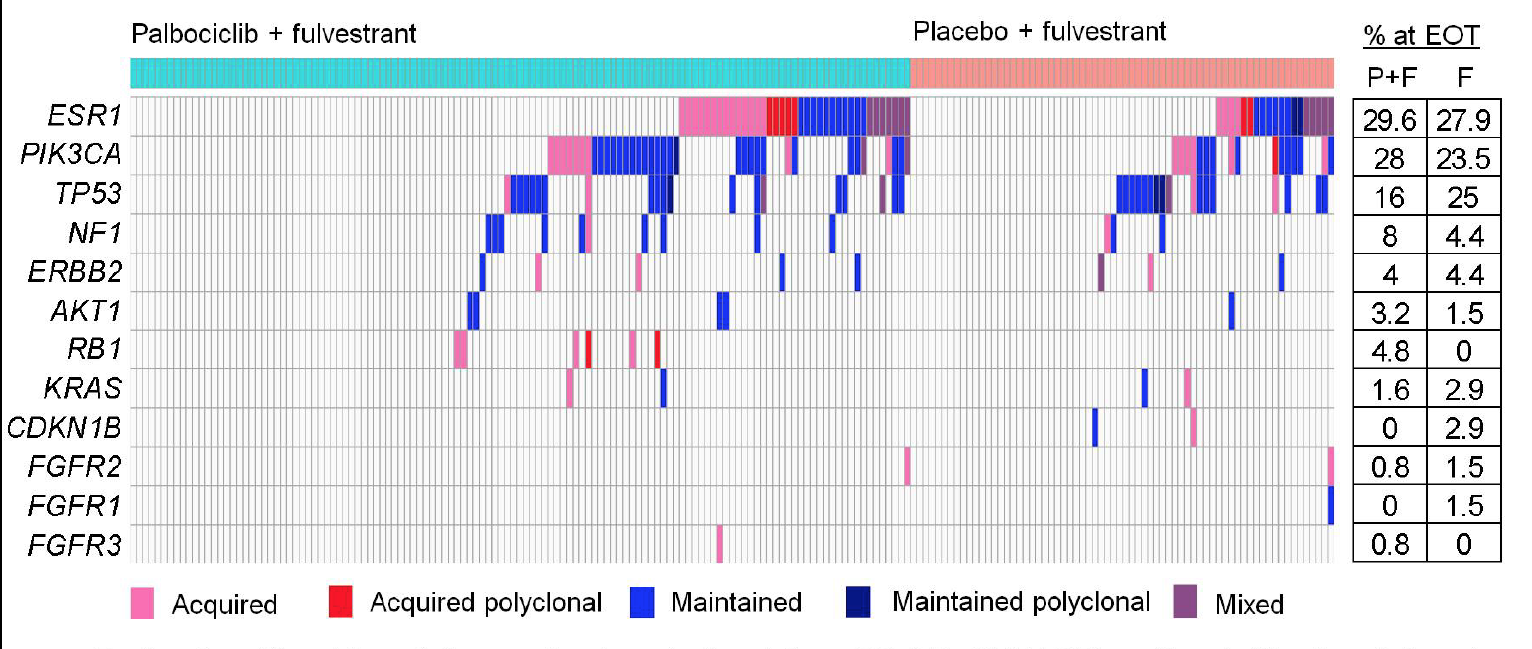
PALOMA-3: EOT Mutation Landscape
Patients with at least 1 acquired mutation:
35/125 (28%) palbociclib + fulvestrant arm
15/68 (22.1%) fulvestrant alone arm
Turner NC et al. Proc ASCO 2018;Abstract 1001.

Slide 19
PALOMA-3: Mutation Analysis Summary
RB1 mutations are enriched at EOT on the palbociclib/fulvestrant arm
No RB1 mutations were detected at baseline
6/125 (4.8%) patients on palbociclib treatment had acquired an RB1 mutation (all truncating mutations) at EOT, but 0/68 patients on the fulvestrant alone arm had acquired a mutation
PIK3CA mutations were acquired on both treatment arms
9/125 (7.2%) patients on palbociclib treatment and 7/68 (10.3%) of patients on the fulvestrant alone arm had acquired mutations at EOT
ESR1 mutations are both lost and acquired during treatment in both study arms
ESR1 Y537S mutation is likely selected by fulvestrant
Turner NC et al. Proc ASCO 2018;Abstract 1001.

Slide 20
mTOR Inhibitors and Anti-androgens for ER-Positive BC

Slide 21
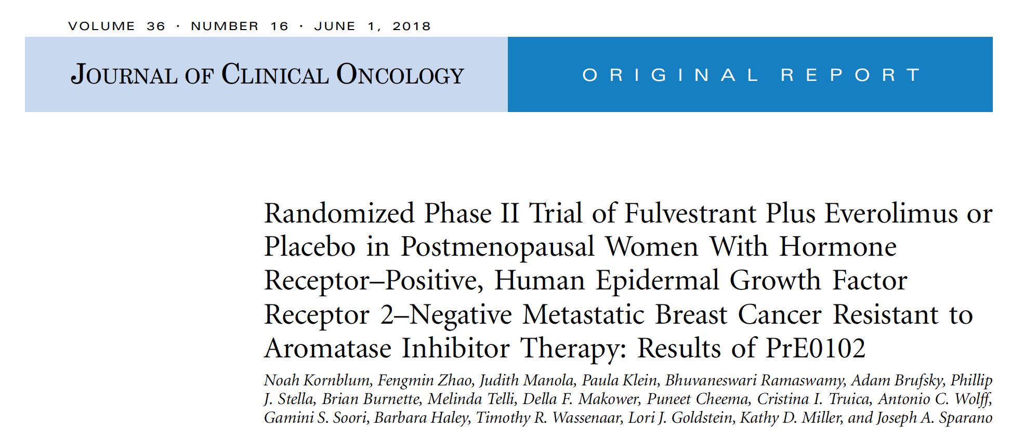
J Clin Oncol 2018;36(16):1556-63

Slide 22
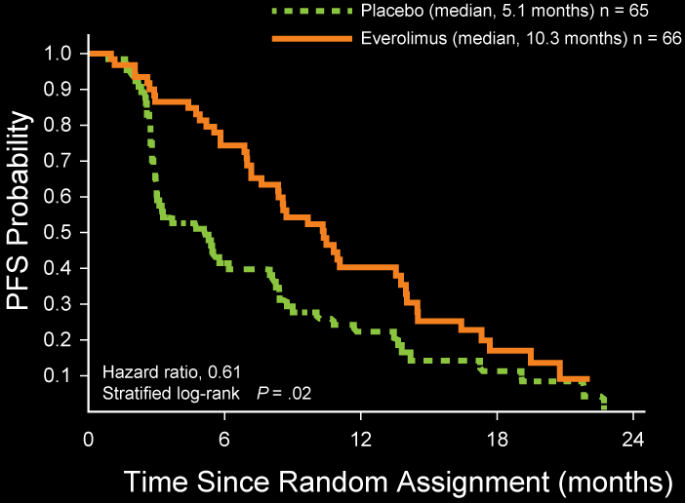
PrE0102: Efficacy Summary
There was no significant difference in OS (p = 0.37) or objective response rate (p = 0.47) between the study arms.
Kornblum N et al. J Clin Oncol 2018;36(16):1556-63.

Slide 23
PrE0102: Select Treatment-Related Adverse Events
Adverse event (%) | Fulvestrant + everolimus (n = 64) |  |  |  | Fulvestrant + placebo (n = 65)
 | Any gr | Gr 2 | Gr 3 | Gr 4 | Any gr | Gr 2 | Gr 3 | Gr 4
Oral mucositis | 53 | 25 | 11 | 0 | 12 | 3 | 0 | 0
Rash | 38 | 14 | 2 | 0 | 5 | 0 | 0 | 0
Hyperglycemia | 19 | 3 | 3 | 0 | 5 | 0 | 0 | 0
Pneumonitis | 17 | 6 | 6 | 0 | 0 | 0 | 0 | 0
Elevated AST | 5 | 2 | 3 | 0 | 2 | 0 | 0 | 2
Kornblum N et al. J Clin Oncol 2018;36(16):1556-63.

Slide 24
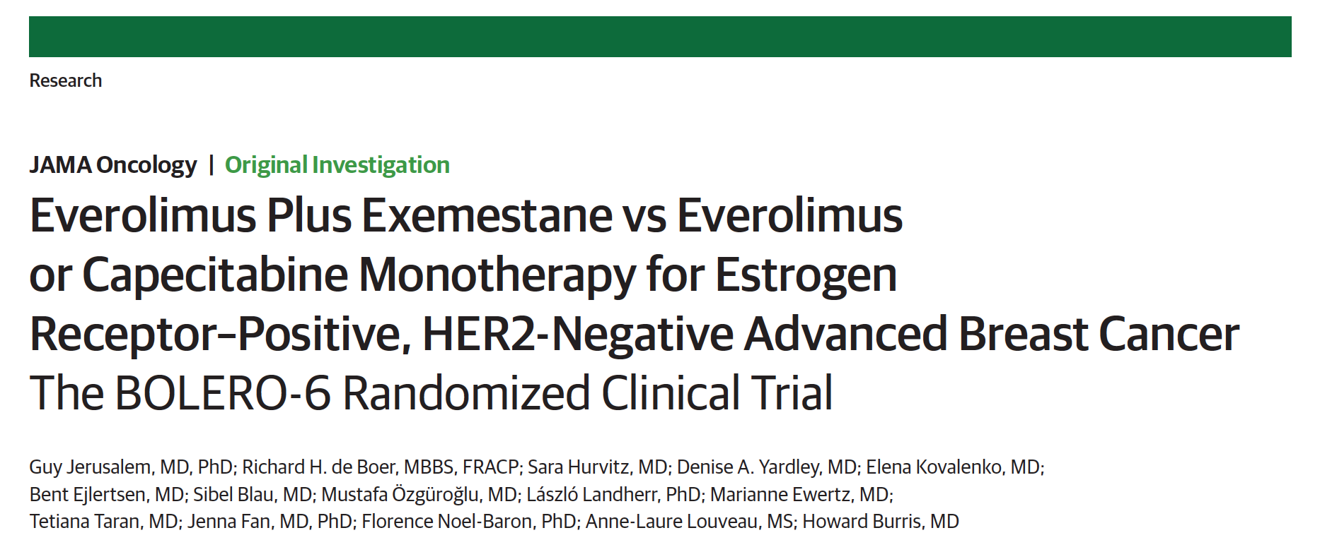
JAMA Oncol 2018;[Epub ahead of print].

Slide 25
BOLERO-6: Survival Analyses
Clinical endpoint | Everolimus (n = 103) | Everolimus + exemestane (n = 104) | Capecitabine (n = 102)
Median PFS* | 6.8 mo | 8.4 mo | 9.6 mo
HR | 0.74 |  | —
 | — | 1.26
Median OS | 29.3 mo | 23.1 mo | 25.6 mo
HR | 1.27 |  | —
 | — | 1.33
* A numerical PFS difference with capecitabine vs everolimus + exemestane should be
interpreted cautiously owing to imbalances among baseline characteristics and potential
informative censoring.
Jerusalem G et al. JAMA Oncol 2018;[Epub ahead of print].

Slide 26
BOLERO-6: Select Adverse Events
Adverse event, % | Everolimus (n = 103) |  | Everolimus + exemestane (n = 104) |  | Capecitabine (n = 102)
 | Any grade | Grade 3/4 | Any grade | Grade 3/4 | Any grade | Grade 3/4
Stomatitis | 46 | 5 | 49 | 9 | 25 | 7
Elevated 𝛾-GGT | 16 | 12 | 15 | 9 | 2 | 2
Elevated AST | 14 | 8 | 15 | 7 | 9 | 1
Pneumonia | 9 | 3 | 11 | 7 | 3 | 2
Hypertension | 8 | 2 | 14 | 6 | 5 | 3
PPE syndrome | 3 | 0 | 3 | 1 | 61 | 27
𝛾-GGT = gamma-glutamyl transferase; PPE = palmar-plantar erythrodysesthesia
Jerusalem G et al. JAMA Oncol 2018;[Epub ahead of print].

Slide 27
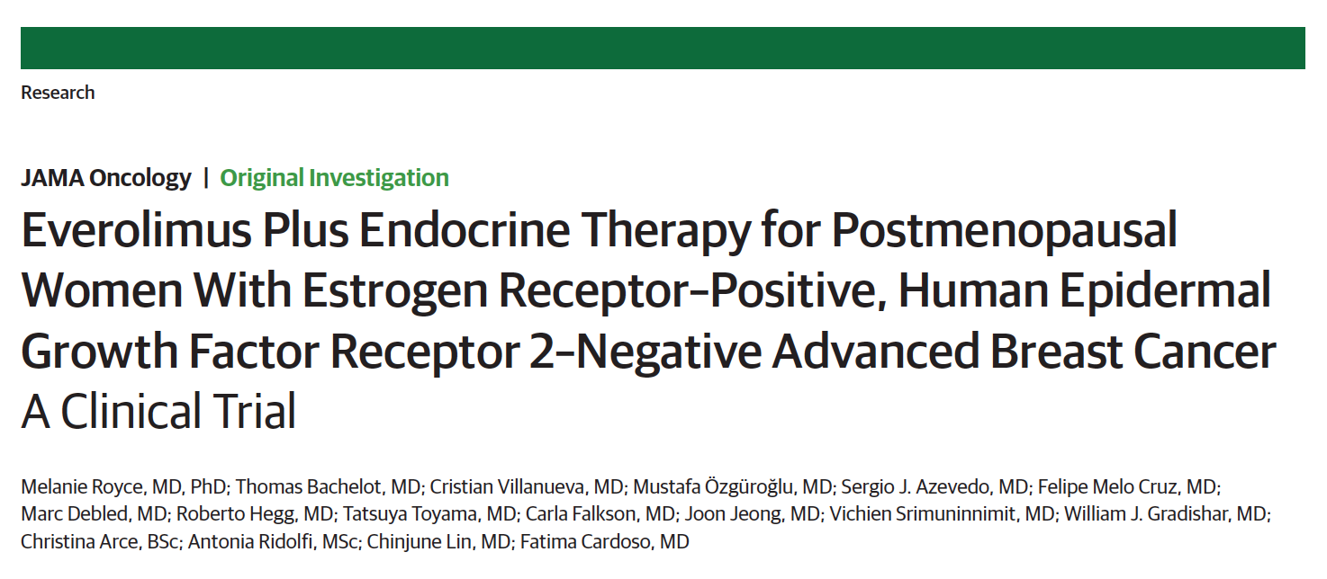
JAMA Oncol 2018;4(7):977-84

Slide 28
BOLERO-4: Phase II Efficacy Summary for First- and Second-Line Everolimus plus Endocrine Therapy
Clinical endpoint | First-line everolimus + letrozole (n = 202) | Second-line everolimus + exemestane (n = 50)
Median PFS | 22.0 mo | 3.7 mo
Median OS | Not reached | Not reported
30-month OS | 73.4% | Not reported
Overall response rate | 45% | 6.0%
Clinical benefit rate | 74.3% | 28.0%
Royce M et al. JAMA Oncol 2018;4(7):977-84.

Slide 29
BOLERO-4: Select Adverse Events
Adverse event, % | First-line everolimus + letrozole (n = 202) |  |  | Second-line everolimus + exemestane (n = 50)
 | Any grade | Grade 3 | Grade 4 | Any grade | Grade 3 | Grade 4
Stomatitis | 69 | 6 | 0 | 20 | 0 | 0
Hyperglycemia | 29 | 3 | 1 | NR | NR | NR
Rash | 27 | <1 | 0 | NR | NR | NR
Hypertension | 23 | 8 | 0 | 12 | 10 | 0
Elevated AST | 19 | 1 | <1 | 10 | 2 | 2
Pneumonitis | 18 | <1 | 0 | NR | NR | NR
NR = not reported
Royce M et al. JAMA Oncol 2018;4(7):977-84.

Slide 30
Results from a Randomized Placebo-Controlled Phase 2 Trial Evaluating Exemestane ± Enzalutamide in Patients with Hormone Receptor-Positive Breast Cancer
Krop I et al. San Antonio Breast Cancer Symposium 2017;Abstract GS4-07.

Slide 31
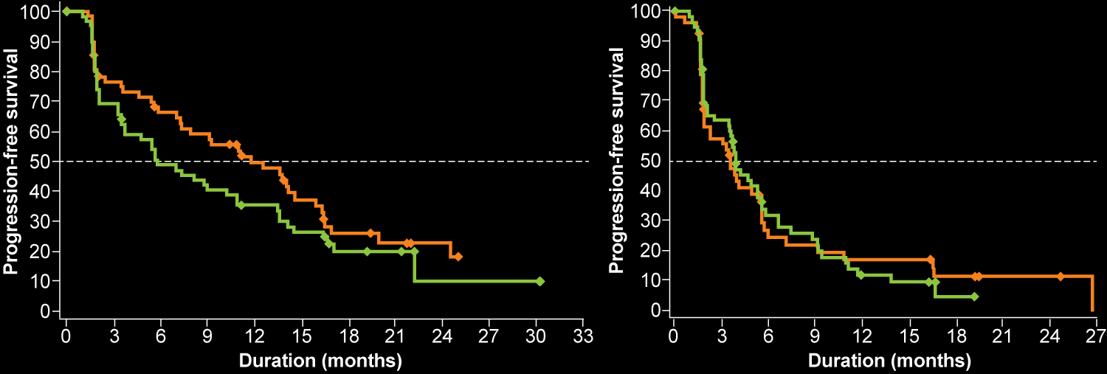
Phase II Study of Enzalutamide (ENZA) + Exemestane (EXE) in Postmenopausal Women: PFS in ITT Population
Cohort 1: No prior ET for advanced BC
Cohort 2: One prior ET for advanced BC
 | ENZA + EXE (N = 63) | PBO + EXE (N = 64)
PFS, median | 11.8 mo | 5.8 mo
P value | 0.3631
HR | 0.82
 | ENZA + EXE (N = 60) | PBO + EXE (N = 60)
PFS, median | 3.6 mo | 3.9 mo
P value | 0.9212
HR | 1.02
ET = endocrine therapy
Krop I et al. San Antonio Breast Cancer Symposium 2017;Abstract GS4-07.

Slide 32
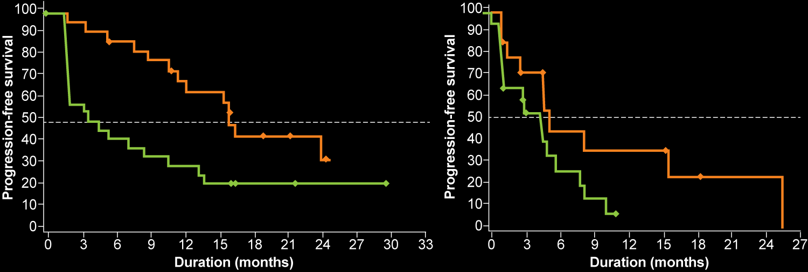
Phase II Study of ENZA + EXE: PFS in Biomarker-Positive (Bkmr+) Subgroup of ITT Population
Using tumor samples from patients with HR-positive breast cancer enrolled in the study, a gene signature-based biomarker indicating androgen receptor signaling predictive of response to ENZA was developed
Cohort 1: No prior ET for advanced BC
Cohort 2: One prior ET for advanced BC
 | ENZA + EXE (N = 24) | PBO + EXE (N = 26)
PFS, median | 16.5 mo | 4.3 mo
P value | 0.0335
HR | 0.44
 | ENZA + EXE (N = 15) | PBO + EXE (N = 20)
PFS, median | 6.0 mo | 5.3 mo
P value | 0.1936
HR | 0.55
Krop I et al. San Antonio Breast Cancer Symposium 2017;Abstract GS4-07.

Slide 33
Phase II Study of ENZA + EXE: Treatment-Emergent Adverse Events (TEAEs) Summary
 | Cohort 1: No prior ET for advanced BC |  | Cohort 2: One prior ET for advanced BC
 | ENZA + EXE (n = 62) | PBO + EXE (n = 63) | ENZA + EXE (n = 60) | PBO + EXE (n = 60)
Patients with ≥1 TEAE, no. (%) | 59 (95.2) | 58 (92.1) | 58 (96.7) | 53 (88.3)
TEAE Grade ≥3 | 20 (32.3) | 15 (23.8) | 22 (36.7) | 12 (20.0)
TEAE leading to interruption | 13 (21.0) | 13 (20.6) | 15 (25.0) | 9 (15.0)
TEAE leading to discontinuation* | 9 (14.5) | 10 (15.9) | 11 (18.3) | 5 (8.3)
TEAE leading to death* | 2 (3.2) | 2 (3.2) | 2 (3.3) | 0 (0)
Serious TEAE | 15 (24.2) | 12 (19.0) | 10 (16.7) | 8 (13.3)
* The majority of TEAEs leading to death or discontinuation were due to disease progression
Cohort 1 most common Grade ≥3 AEs with ENZA included: musculoskeletal chest pain, anxiety, dizziness, vomiting, diarrhea, nausea and fatigue
Cohort 2 most common Grade ≥3 AEs with ENZA included: anemia, headache, fatigue, hot flush, vomiting, diarrhea and back pain
Krop I et al. San Antonio Breast Cancer Symposium 2017;Abstract GS4-07.

Slide 34
Adjuvant Therapy for BC

Slide 35
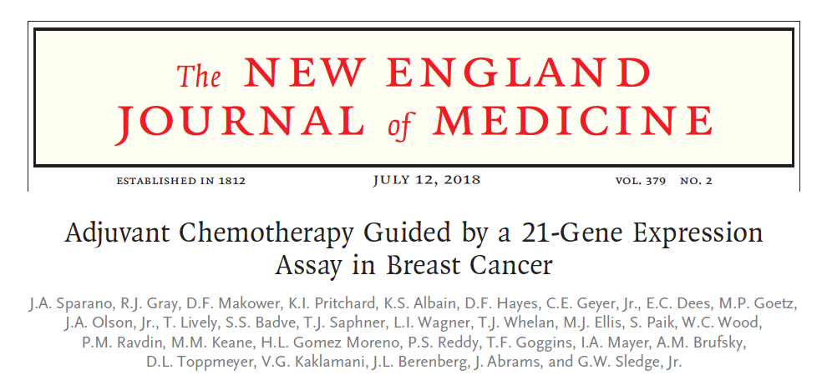

Slide 36
TAILORx: Patient Disposition
10,273 registered and were assigned to a treatment group
1,629 had Recurrence Score (RS) ≤10
Endocrine therapy alone
3,458 had RS 11-25
Randomly assigned to receive endocrine therapy alone
3,449 had RS 11-25
Randomly assigned to receive chemo-endocrine therapy
1,737 had RS ≥26 Chemoendocrine therapy
1,619 were included in the main analysis
56 withdrew consent for continued follow-up
93 were lost to follow-up
3,399 were included in the main analysis
3,214 received assigned treatment with endocrine therapy only
185 received adjuvant chemotherapy
116 withdrew consent for continued follow-up
224 were lost to follow-up
3,312 were included in the main analysis
2,704 received assigned treatment with adjuvant chemotherapy
608 did not receive chemotherapy
148 withdrew consent for continued follow-up
208 were lost to follow-up
1,389 were included in the main analysis
25 withdrew consent for the continued follow-up
25 were lost to follow-up
Sparano JA et al. N Engl J Med 2018;379(2):111-21.
Doxorubicin 2 x 15 mg IV

Slide 37
TAILORx: Invasive Disease-Free Survival (IDFS) in RS 11-25 Cohort
Primary endpoint of noninferiority of endocrine therapy alone to chemoendocrine therapy for IDFS was met
Sparano JA et al. N Engl J Med 2018;379(2):111-21.

Slide 38
TAILORx: Estimated IDFS Rates According to RS and Assigned Treatment in ITT Population
 | Rate at 5 years (%) | Rate at 9 years (%)
Score of ≤10, endocrine therapy | 94.0 ± 0.6 | 84.0 ± 1.3
Score of 11-25, endocrine therapy | 92.8 ± 0.5 | 83.3 ± 0.9
Score of 11-25, chemoendocrine therapy | 93.1 ± 0.5 | 84.3 ± 0.8
Score of ≥26, chemoendocrine therapy | 87.6 ± 1.0 | 75.7 ± 2.2
Sparano JA et al. N Engl J Med 2018;379(2):111-21.

Slide 39
TAILORx: Estimated IDFS Rates According to RS and Assigned Treatment in Women Aged 50 Years or Younger
 | Rate at 5 years (%) | Rate at 9 years (%)
Score of ≤10, endocrine therapy | 95.1 ± 1.1 | 87.4 ± 2.0
Score of 11-15, endocrine therapy | 95.1 ± 1.1 | 85.7 ± 2.2
Score of 11-15, chemoendocrine therapy | 94.3 ± 1.3 | 89.2 ± 1.9
Score of 16-20, endocrine therapy | 92.0 ± 1.3 | 80.6 ± 2.5
Score of 16-20, chemoendocrine therapy | 94.7 ± 1.1 | 89.6 ± 1.7
Score of 21-25, endocrine therapy | 86.3 ± 2.3 | 79.2 ± 3.3
Score of 21-25, chemoendocrine therapy | 92.1 ± 1.8 | 85.5 ± 3.0
Score of ≥26, chemoendocrine therapy | 86.4 ± 1.9 | 80.3 ± 2.9
Sparano JA et al. N Engl J Med 2018;379(2):111-21.

Slide 40
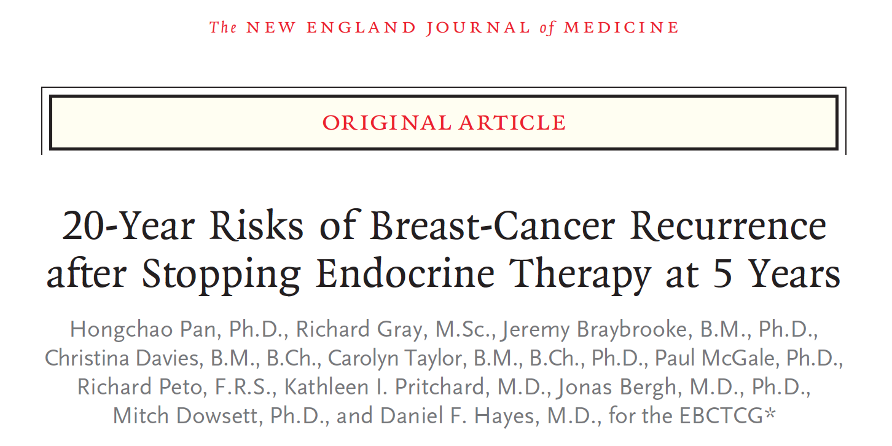
N Engl J Med 2017;377(19):1836-46.

Slide 41
Methods Summary
Meta-analysis of 88 trials involving 62,923 women with ER-positive breast cancer:
At diagnosis, were aged <75 years, had T1 or T2 disease, fewer than 10 involved nodes and no distant metastases
Were disease free after 5 years of scheduled endocrine therapy
The association of tumor characteristics such as diameter, nodal status and tumor grade with patient outcomes was assessed during the period from 5 to 20 years.
Pan H et al. N Engl J Med 2017;377(19):1836-46.

Slide 42
Association of Nodal Status and Tumor Size with Risk of Distant Recurrence
 | Total (n) | Annual rate of distant recurrence |  | Cumulative risk from 5 to 20 years
 |  | 5 to <10 years | 10 to 20 years
Nodal involvement N0 N1-3 N4-9 | 28,847 25,292 8,784 | 1.0% 1.9% 3.9% | 1.1% 1.7% 2.8% | 15% 23% 38%
Tumor diameter in N0 only T1a or T1b: ≤1.0 cm T1c: 1.1-2.0 cm T2: 2.1-3.0 cm T2: 3.1-5.0 cm | 5,527 13,875 6,700 2,745 | 0.5% 0.8% 1.5% 1.7% | 0.8% 1.1% 1.4% 1.4% | 10% 14% 19% 20%
There was a strong association of tumor grade and Ki-67 status with the risk of distant recurrence during years 0 to 5 but only a moderate association during years 5 to 20.
Pan H et al. N Engl J Med 2017;377(19):1836-46.

Slide 43
A Prospective Randomized Multi-Center Phase III Trial of Additional 2 versus Additional 5 Years of Anastrozole After Initial 5 Years of Adjuvant Endocrine Therapy – Results from 3,484 Postmenopausal Women in the ABCSG-16 Trial
Gnant M et al. San Antonio Breast Cancer Symposium 2017;Abstract GS3-01.

Slide 44
ABCSG-16: Disease-Free Survival (DFS)
All Patients
71.1%
70.3%
 | Number of events/patients | Hazard ratio vs 2 years | p-value
2 years | 378/1,731 | 1.007 | 0.925
5 years | 384/1,738
No difference was observed between an additional 2 versus additional 5 years of anastrozole for:
Overall survival
Time to contralateral breast cancer
Time to second primary cancer
Gnant M et al. San Antonio Breast Cancer Symposium 2017;Abstract GS3-01.

Slide 45
ABCSG-16: DFS in Adherent Patients Only
71.8%
70.6%
 | Number of events/patients | Hazard ratio vs 2 years | p-value
2 years | 315/1,375 | 0.985 | 0.857
5 years | 272/1,171
No difference was observed between an additional 2 versus additional 5 years of anastrozole for:
Time to contralateral breast cancer
Time to second primary cancer
Gnant M et al. San Antonio Breast Cancer Symposium 2017;Abstract GS3-01.

Slide 46
ABCSG-16: Fractures
 | Number of fractures/patients | Hazard ratio vs 2 years | p-value
2 years | 71/1,556 | 1.353 | 0.053
5 years | 98/1,571
6.3%
4.7%
Gnant M et al. San Antonio Breast Cancer Symposium 2017;Abstract GS3-01.

Slide 47
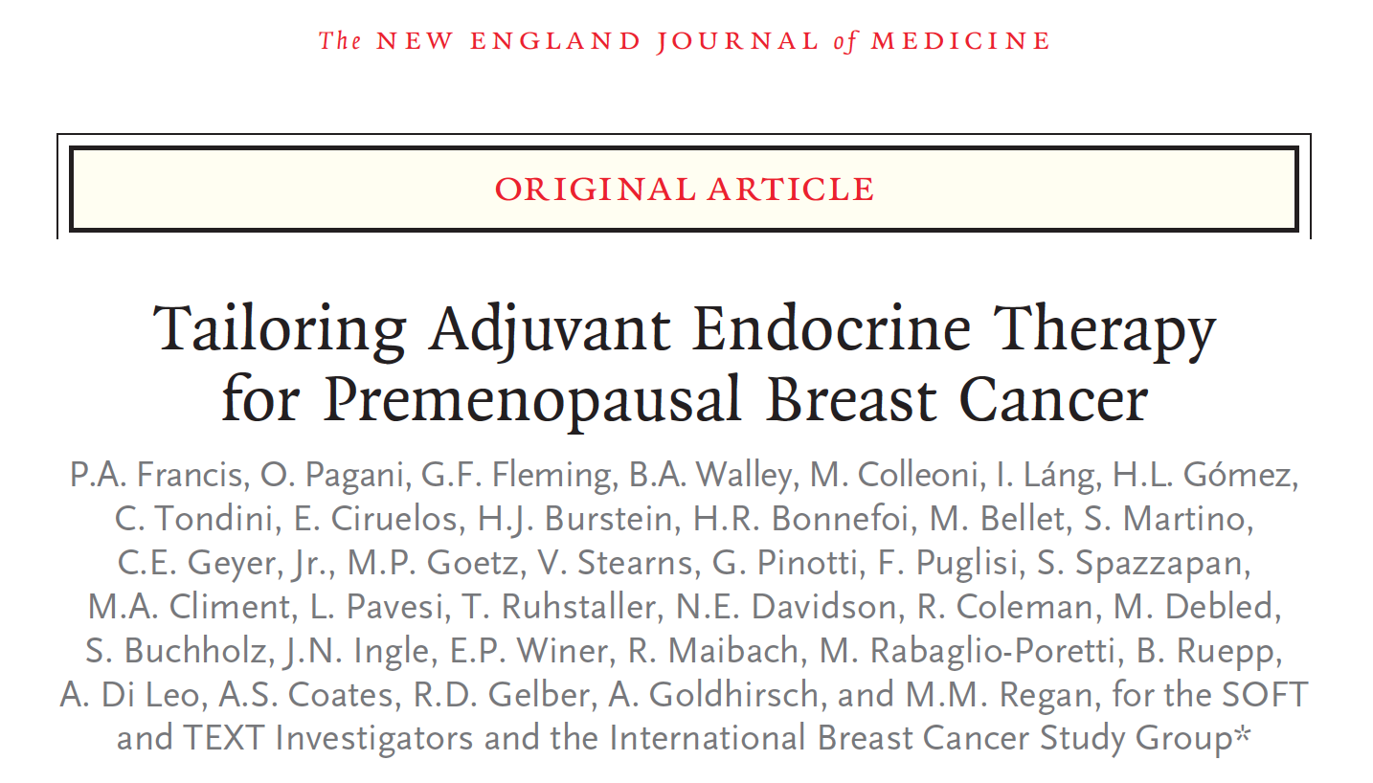
N Engl J Med 2018;379(2):122-37.

Slide 48
SOFT: DFS in All Patients (Median Follow-Up of 8 Years)
Tamoxifen plus ovarian suppression (T-OS)
Exemestane plus ovarian suppression (E-OS)
Tamoxifen alone (T)
Absolute difference
T-OS vs. T, 4.2 percentage points
E-OS vs. T, 7.0 percentage points
 | T (n = 1,108) | T-OS (n = 1,015) | E-OS (n = 1,014)
8-Yr DFS rate | 78.9% | 83.2% | 85.9%
HR vs T (p-value) | Ref | 0.76 (0.009) | 0.65 (NR)
8-year overall survival rates were significantly higher with the addition of ovarian suppression to tamoxifen compared to tamoxifen alone (93.3% vs 91.5%, p = 0.01)
Francis PA et al. N Engl J Med 2018;379(2):122-37.

Slide 49
SOFT and TEXT (Combined): DFS in All Patients (Median Follow-Up of 9 Years)
Disease-free survival
Tamoxifen plus ovarian suppression (T-OS)
Exemestane plus ovarian suppression (E-OS)
Absolute difference
4.0 percentage points
 | No. of patients | No. of events | 8-year disease-free survival rate | Hazard ratio p-value
E-OS | 2,346 | 318 | 86.8% | 0.77 p < 0.001
T-OS | 2,344 | 402 | 82.8%
There was no statistically significant difference in 8-year overall survival observed with tamoxifen plus ovarian suppression compared to exemestane plus ovarian suppression (93.3% vs 93.4%, p = 0.84)
Francis PA et al. N Engl J Med 2018;379(2):122-37.

Slide 50
DFS for Patients with HER2-Negative Breast Cancer
SOFT trial | 8-Yr DFS | HR
Tamoxifen-OS (n = 868) | 82.8% | 0.83
Tamoxifen alone (n = 860) | 79.9%
 |  | 0.60
Exemestane-OS (n = 858) | 88.0%
SOFT and TEXT (combined)
Tamoxifen-OS (n = 2,024) | 82.7% | 0.70
Exemestane-OS (n = 2,011) | 88.1%
Francis PA et al. N Engl J Med 2018;379(2):122-37.

Slide 51
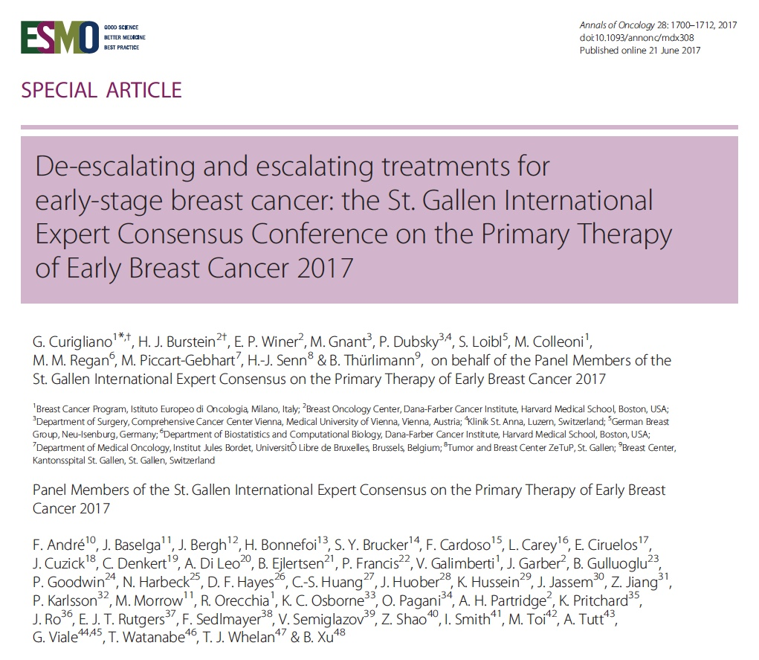
Ann Oncol 2018;28(8):1700-12.

Slide 52
St Gallen’s Panel Favored Several Interventions in Multiple Fields of Treatment
Surgery:
Acceptance of 2-mm margins for DCIS, the resection of residual cancer (but not baseline extent of cancer) in women undergoing neoadjuvant therapy
Acceptance of sentinel node biopsy after neoadjuvant treatment of many patients
The preference for neoadjuvant therapy in HER2-positive and triple-negative, Stage II and III breast cancer
Radiation therapy:
Favored escalating radiation therapy with regional nodal irradiation in high-risk patients, while encouraging omission of boost in low-risk patients.
Curigliano G et al. Ann Oncol 2018;[Epub ahead of print].

Slide 53
St Gallen’s Panel Favored Several Interventions in Multiple Fields of Treatment
Genetics:
Endorsed gene expression signatures that permit avoidance of chemotherapy in many patients with ER-positive breast cancer.
Adjuvant therapy:
For women with higher-risk tumors, the Panel escalated recommendations for adjuvant endocrine treatment to include ovarian suppression in premenopausal women and extended therapy for postmenopausal women.
However, low-risk patients can avoid these treatments.
Bone-modifying therapy:
Recommended bisphosphonate use in postmenopausal women to prevent breast cancer recurrence.
Curigliano G et al. Ann Oncol 2018;[Epub ahead of print].

Slide 54
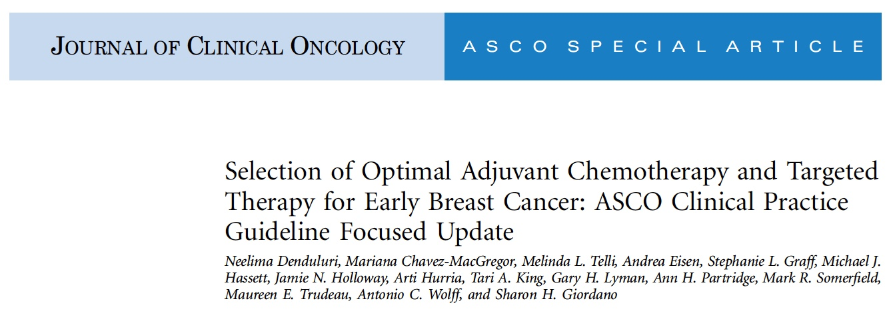
J Clin Oncol 2018;36(23):2433-43.

Slide 55
Recommendations from ASCO 2018 Focused Guideline Update
Patients with early-stage, HER2-negative breast cancer with pathologic invasive residual disease at surgery after standard anthracycline- and taxane-based preoperative therapy may be offered up to 6 to 8 cycles of adjuvant capecitabine
Clinicians may add 1 year of adjuvant pertuzumab to trastuzumab-based combination chemotherapy for patients with high-risk, early-stage, HER2-positive breast cancer
Clinicians may use extended adjuvant therapy with neratinib to follow trastuzumab for patients with early-stage, HER2-positive breast cancer. Neratinib causes substantial diarrhea, and diarrhea prophylaxis must be used
Denduluri N et al. J Clin Oncol 2018;36(23):2433-43.

Slide 56
Lancet Oncol 2017;18(12):1688-700.

Slide 57
ExteNET: Invasive Disease-Free Survival (IDFS)
ITT Population
5-Year IDFS (ITT)
90.2% vs 87.7%, HR: 0.73, p = 0.0083
5-Year DFS by HR Subset
HR-positive: 92.1% vs 86.8%
HR: 0.60
HR-negative: 88.9% vs 88.8%
HR: 0.95
Martin M et al. Lancet Oncol 2017;18(12):1688-700.

Slide 58
PARP Inhibitors for Advanced Disease

Slide 59
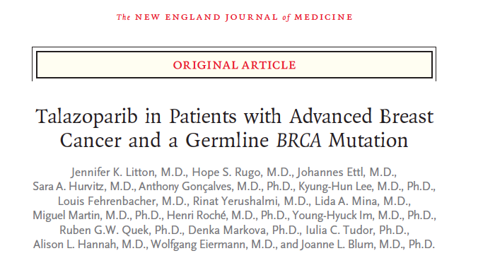
N Engl J Med 2018;379(8):753-63.

Slide 60
EMBRACA: Phase III Trial Design
Talazoparib 1 mg PO daily (n = 287)
Eligibility (N = 431)
Patients with locally advanced or metastatic HER2-negative breast cancer and a germline BRCA1 or BRCA2 mutation Stratification factors: Number of prior chemo regimens (0 or ≥1) TNBC or hormone receptor positive (HR+) History of CNS mets or no CNS mets
2:1
Treatment (21-day cycles) continues until progression or unacceptable toxicity
R
Physician’s choice of therapy (PCT): capecitabine, eribulin, gemcitabine or vinorelbine (n = 144)
Litton JK et al. N Engl J Med 2018;379(8):753-63; Litton J et al. San Antonio Breast Cancer Symposium 2017;Abstract GS6-07.

Slide 61
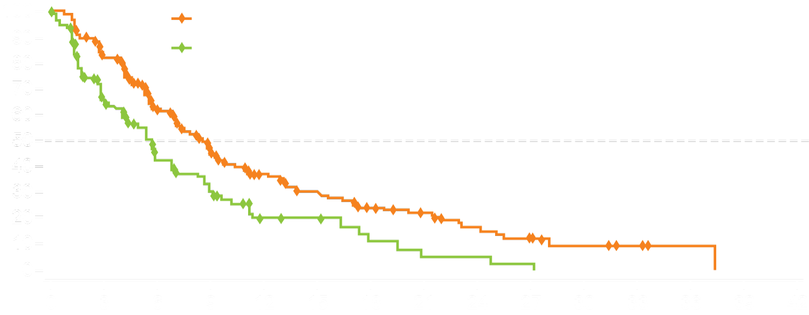
EMBRACA: Primary Endpoint PFS by Blinded Central Review
 | TALA (n = 287) | Overall PCT (n = 144)
Events, no (%) | 186 (65%) | 83 (58%)
Median PFS | 8.6 mo | 5.6 mo
 | HR = 0.54 p < 0.001
TALA
Overall PCT
Progression-free survival, %
Duration of PFS, mo
In all clinically relevant subgroups, the risk of disease progression was lower with talazoparib than standard therapy.
Prior exposure to platinum agents was the only factor resulting in a 95% confidence interval with an upper bound exceeding 1.0
Litton JK et al. N Engl J Med 2018;379(8):753-63; Litton J et al. San Antonio Breast Cancer Symposium 2017;Abstract GS6-07.

Slide 62
EMBRACA: Grade 3/4 Adverse Events
Adverse event, % | Talazoparib (n = 286) |  | Overall PCT (n = 126)
 | Grade 3 | Grade 4 | Grade 3 | Grade 4
Anemia | 38.5 | 0.7 | 4.0 | 0.8
Neutropenia | 17.8 | 3.1 | 19.8 | 15.1
Vomiting | 2.4 | 0 | 1.6 | 0
Diarrhea | 0.7 | 0 | 5.6 | 0
Nausea | 0.3 | 0 | 1.6 | 0
Palmar-plantar erythrodysesthesia syndrome | 0.3 | 0 | 2.4 | 0
Litton JK et al. N Engl J Med 2018;379(8):753-63; Litton J et al. San Antonio Breast Cancer Symposium 2017;Abstract GS6-07.

Slide 63
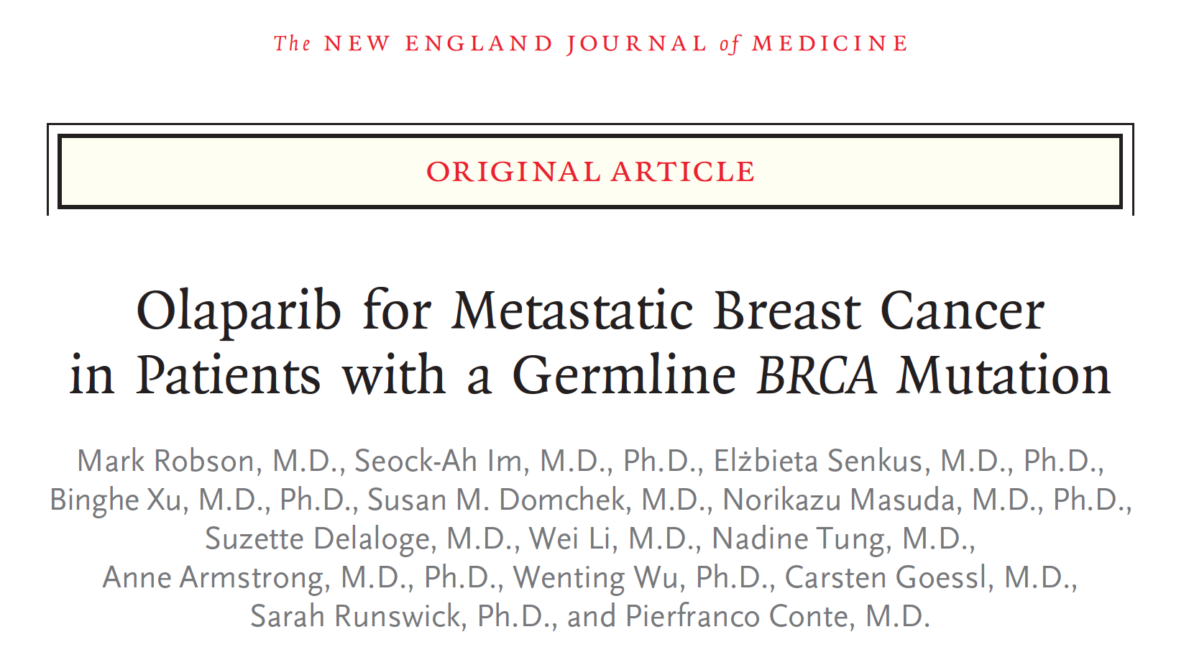
N Engl J Med 2017;377(6):523-33.

Slide 64
OlympiAD: Phase III Trial Design
Enrollment (N = 302)
Hormone receptor-positive metastatic breast cancer Germline mutation in BRCA1 or BRCA2 No HER2-positive disease Prior therapy with anthracycline and taxane in adjuvant or metastatic setting
Olaparib
300 mg BID PO (n = 205)
R
Physician’s choice of chemo
(capecitabine, vinorelbine or eribulin) (n = 97)
Primary endpoint: Progression-free survival
Robson M et al. N Engl J Med 2017;377(6):523-33.

Slide 65
OlympiAD: Survival and Response Rates
Median PFS:
Olaparib = 7.0 mo
Standard therapy = 4.2 mo
HR = 0.58
P < 0.001
100/167
19/66
Overall survival did not differ significantly between groups (p = 0.57)
Robson M et al. N Engl J Med 2017;377(6):523-33.

Slide 66
OlympiAD: Select Adverse Events (AEs)
 | Olaparib (n = 205) |  | Standard therapy (n = 91)
 | Any grade | Grade ≥3 | Any grade | Grade ≥3
Anemia* | 40% | 16% | 26% | 4%
Neutropenia† | 27% | 9% | 50% | 26%
Nausea | 58% | 0% | 35% | 1%
Vomiting | 30% | 0% | 15% | 1%
Dose reduction due to AE | 25% | NA | 31% | NA
Treatment interruption or delay due to AE | 35% | NA | 28% | NA
Treatment discontinuation due to AE | 5% | NA | 8% | NA
* Anemia, decreased hemoglobin level, decreased hematocrit, decreased red-cell count and erythropenia; † Febrile neutropenia, granulocytopenia, decreased granulocyte count, neutropenia, neutropenic sepsis, decreased neutrophil count and neutropenic infection
Robson M et al. N Engl J Med 2017;377(6):523-33; Robson M et al. Proc ASCO 2017;Abstract LBA4 (Plenary).

Slide 67
Role of Immune Checkpoint Inhibitors

Slide 68
Updated Efficacy, Safety, & PD-L1 Status of Patients with HR+, HER2- Metastatic Breast Cancer Administered Abemaciclib plus Pembrolizumab
Tolaney SM et al. Proc ASCO 2018;Abstract 1059.

Slide 69
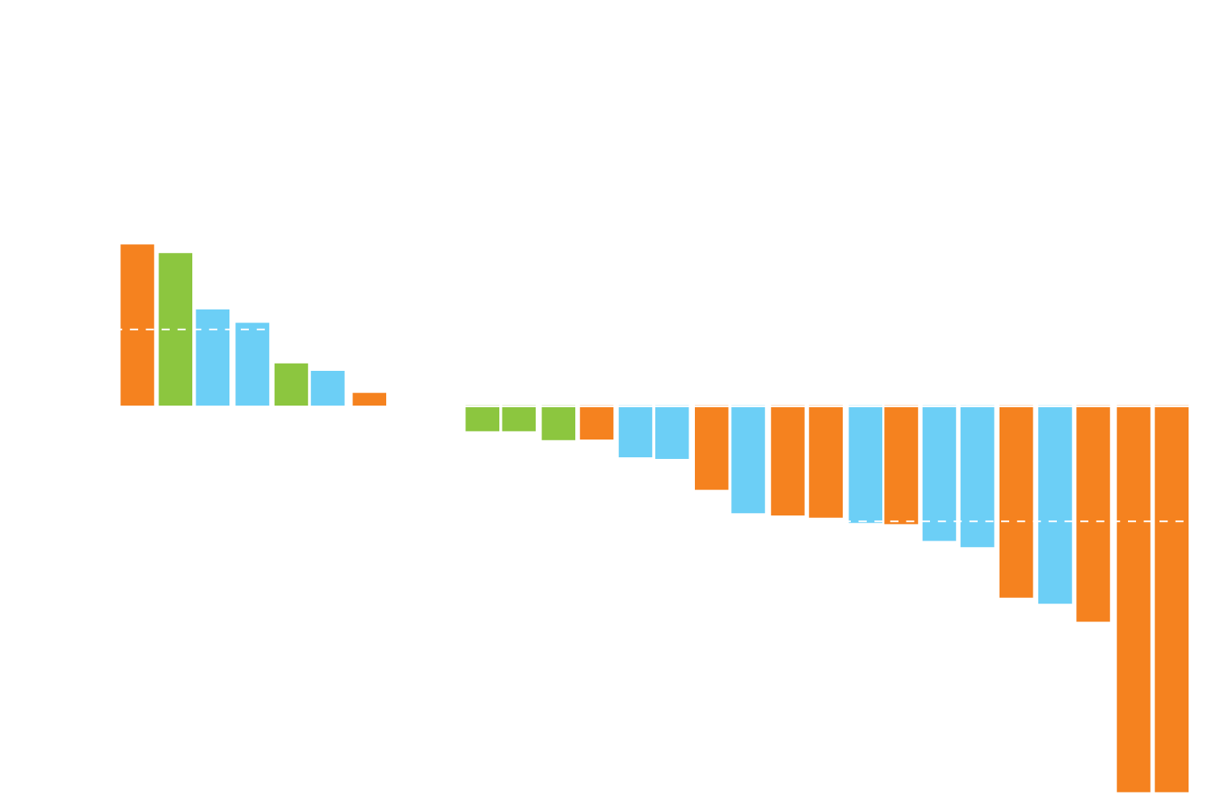
Abemaciclib/Pembrolizumab: Response Summary by PD-L1 Status
Investigator-assessed response (N = 28) | PD-L1-positive (n = 12) | PD-L1-negative (n = 11) | PD-L1 unkown (n = 5)
Confirmed ORR | 33.3% | 36.4% | 0%
CR | 0% | 0% | 0%
PR | 33.3% | 36.4% | 0%
CBR (CR + PR + SD ≥6 months) | 50.0% | 54.5% | 20.0%
N = 28
20% increase
Change from baseline (%)
-30% decrease
PD-L1-positive
PD-L1-negative
PD-L1 status unknown
Treatment ongoing
o
Baseline PD-L1 status was not predictive for response in patients who received treatment for up to 24 weeks
Tolaney SM et al. Proc ASCO 2018;Abstract 1059.

Slide 70
Abemaciclib/Pembrolizumab: Select AEs
Event (N = 28) | All grades n (%) | Grade 1-2 n (%) | Grade 3 n (%)
Diarrhea | 22 (78.6) | 19 (67.9) | 3 (10.7)
Neutropenia | 11 (39.3) | 3 (10.7) | 8 (28.6)
Pruritus | 11 (39.3) | 11 (39.3) | 0 (0.0)
Vomiting | 8 (28.6) | 7 (25.0) | 1 (3.6)
Abdominal pain | 7 (25.0) | 6 (21.4) | 1 (3.6)
Pneumonitis | 2 (7.1) | 2 (7.1) | 0 (0.0)
Acute kidney injury (renal failure) | 2 (7.1) | 2 (7.1) | 0 (0.0)
Colitis | 1 (3.6) | 1 (3.6) | 0 (0.0)
The combination of abemaciclib and pembrolizumab demonstrated a manageable safety profile.
Tolaney SM et al. Proc ASCO 2018;Abstract 1059.

Slide 71
Phase Ib/II Study Evaluating Safety and Efficacy of Pembrolizumab and Trastuzumab in Patients with Trastuzumab Resistant HER2-Positive Metastatic Breast Cancer: Results from the PANACEA (IBCSG 45-13/BIG 4-13/KEYNOTE-014) Study
Loi S et al. San Antonio Breast Cancer Symposium 2017;Abstract GS2-06.

Slide 72
PANACEA: Phase Ib/II Study Design
Phase Ib Pembrolizumab 2 mg/kg and 10 mg/kg IV + trastuzumab q3wk
Phase II Pembrolizumab 200 mg IV + trastuzumab q3wk
Centrally confirmed HER2+ advanced breast cancer ECOG 0-1 Tumor biopsy sample <1 yr Measurable disease RECIST 1.1 No limit prior systemic treatment Documented disease progression on trastuzumab or T-DM1
PD-L1+
PD-L1-
Phase II Pembrolizumab 200 mg IV + trastuzumab q3wk
Screening
IBCSG Central Pathology Office
HER2 IHC and ISH
ER status
% stromal tumor-infiltrating lymphocytes (sTILs)
PD-L1 central assessment
Loi S et al. San Antonio Breast Cancer Symposium 2017;Abstract GS2-06.

Slide 73
PANACEA: Response Rates to Pembrolizumab and Trastuzumab by PD-L1 status
 | PD-L1-positive Phase II n = 40 | PD-L1-negative Phase II n = 12
ORR, n (%) | 6 (15%) | 0 (0%)
DCR, n (%) | 10 (25%) | 0 (0%)
Best overall response, n (%)
Complete response | 1 (2.5%) | —
Partial response | 5 (12.5%) | —
Stable disease | 7 (17.5%) | 2 (16.7%)
Progressive disease | 25 (62.5%) | 9 (75.0%)
Not evaluable | 2 (5.0%) | 1 (8.3%)
Pembrolizumab + trastuzumab in trastuzumab-resistant HER2-positive metastatic breast cancer met its primary endpoint in the PD-L1-positive cohort
No response observed in patients with PD-L1-negative disease
Loi S et al. San Antonio Breast Cancer Symposium 2017;Abstract GS2-06.

Slide 74
PANACEA: Baseline sTILs by Response and Disease Control in PD-L1-Positive Cohorts
Baseline sTILs and ORR
Baseline sTILs and DCR
P = 0.006
P = 0.0006
Baseline stromal TILs
Baseline stromal TILs
Objective response
Disease control
Higher sTILs were associated with better response and disease control in PD-L1-positive cohorts
For patients with sTILs ≥5%: ORR 39%, DCR 47%
Loi S et al. San Antonio Breast Cancer Symposium 2017;Abstract GS2-06.

Slide 75
Adaptive Phase II Randomized Trial of Nivolumab After Induction Treatment in Triple Negative Breast Cancer (TONIC trial): Final Response Data Stage I and First Translational Data
Kok M et al. Proc ASCO 2018;Abstract 1012.

Slide 76
TONIC: Phase II Trial Design Schema
Control No induction
Anti-PD-1
Until progressive disease, intolerable toxicity or for 1 year
Radiotherapy 3 x 8 Gy
Anti-PD-1
R
Cyclophosphamide 2 weeks 50 mg daily
Anti-PD-1
Cisplatin 2 x 40 mg/m² IV
Anti-PD-1
Doxorubicin 2 x 15 mg IV
Anti-PD-1
2 weeks
8 weeks
Biopsy + blood
Biopsy + blood
Biopsy + blood
Kok M et al. Proc ASCO 2018;Abstract 1012.

Slide 77
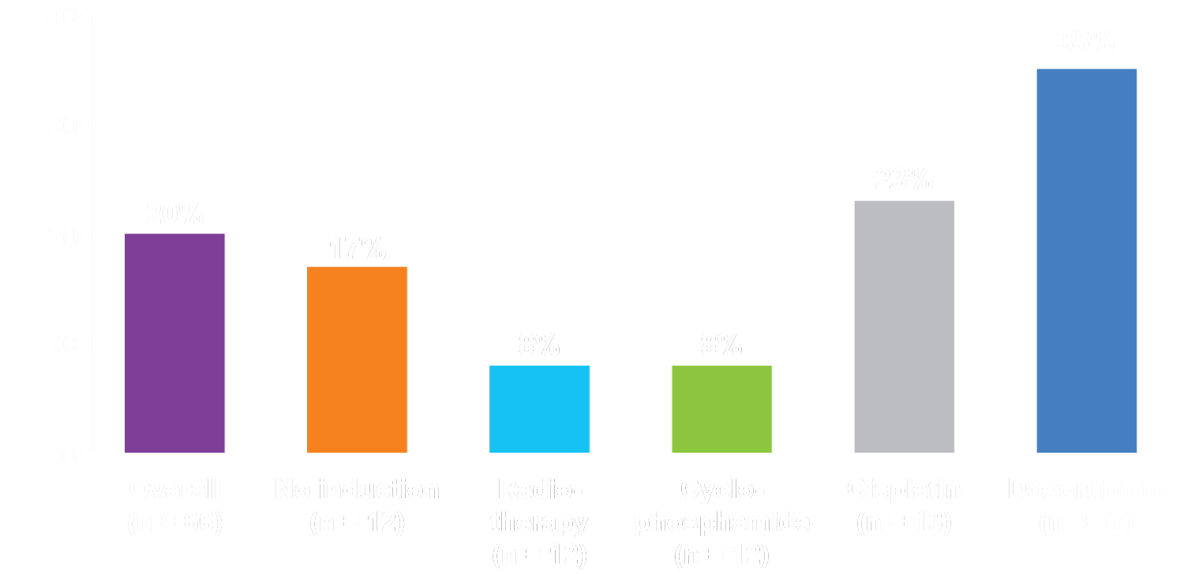
TONIC: Efficacy of Induction + Nivolumab per Cohort
Induction with doxorubicin or cisplatin may result in:
Increased likelihood to respond to nivolumab
Upregulation of gene signatures associated with response to anti-PD-1 therapy
Increased T cells and T cell clonality
Kok M et al. Proc ASCO 2018;Abstract 1012.

Slide 78
Phase 1b/2 Study to Evaluate Eribulin Mesylate in Combination with Pembrolizumab in Patients with Metastatic Triple-Negative Breast Cancer
Tolaney SM et al. San Antonio Breast Cancer Symposium 2017;Abstract PD6-13.

Slide 79
ENHANCE 1: Response to Eribulin Mesylate in Combination with Pembrolizumab
 | Overall (N = 82) | No prior chemo in metastatic setting (N = 48) | 1-2 prior lines of chemo in metastatic setting (N = 34)
ORR, n (%) | 21 (26) | 12 (25) | 9 (27)
CBR, n (%) | 25 (31) | 13 (27) | 12 (35)
DCR, n (%) | 46 (56) | 28 (58) | 18 (53)
Median PFS, mo | 4.1 | 4.1 | 3.9
Median OS, mo | NE | 17.7 | NE
Tolaney SM et al. San Antonio Breast Cancer Symposium 2017;Abstract PD6-13.

Slide 80
TOPACIO/Keynote-162: Niraparib + Pembrolizumab in Patients (pts) with Metastatic Triple-Negative Breast Cancer (TNBC), a Phase 2 Trial
Vinayak S et al. Proc ASCO 2018;Abstract 1011.

Slide 81
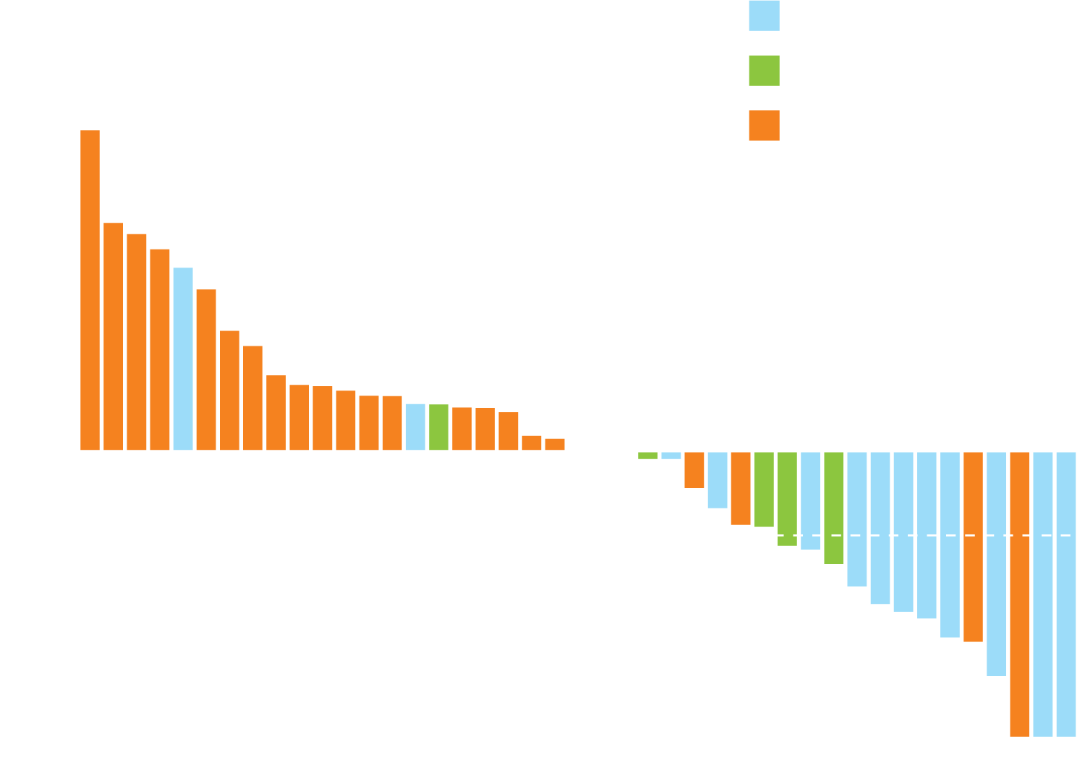
TOPACIO/Keynote-162: Best Overall Response and Objective Response Rate (ORR)
tBRCAmut
HRRmut
HRRwt/unknown
Ongoing
Response | ORR | DCR
tBRCAmut (n = 15) | 9 (60%) | 12 (80%)
HRRmut + tBRCAmut (n = 20) | 11 (55%) | 16 (80%)
PD-L1 positive (n = 25) | 9 (36%) | 13 (52%)
Percent change
30% decrease
tBRCAmut = tumor BRCA mutation
HRR = mutational status of 16 homologous recombination repair pathway genes excluding BRCA1/2; mut = mutant, wt = wild type
Patient
Vinayak S et al. Proc ASCO 2018;Abstract 1011.

Slide 82
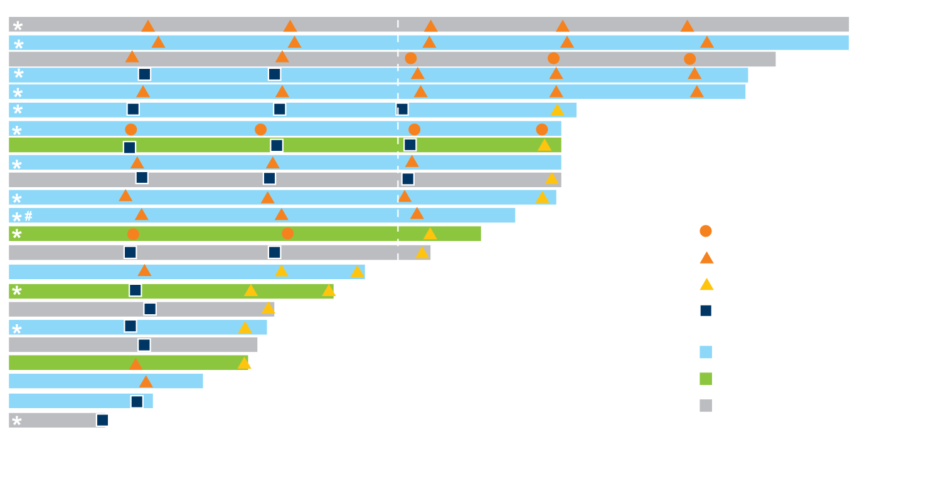
TOPACIO/Keynote-162: Durable Clinical Benefit Extends Beyond tBRCAmut
HRRwt
HRRwt
Overall response RECIST 1.1
Patient
Complete response
Partial response
Progressive disease
Stable disease
Ongoing
tBRCAmut
HRRmut
HRRwt/unknown
Duration on niraparib/pembrolizumab treatment (months)
Durable responses observed irrespective of BRCA1/2 or PD-L1 status or prior platinum exposure with the highest ORR in pts with BRCAmut disease
Vinayak S et al. Proc ASCO 2018;Abstract 1011.

