Slide 1
Please note, these are the actual video-recorded proceedings from the live CME event and may include the use of trade names and other raw, unedited content.

Slide 2
Consensus OR Controversy? Clinical Investigators Provide Perspectives on Targeted Treatment of Metastatic Non-Small Cell Lung Cancer March 16, 2017 6:30 PM – 8:00 PM
Faculty
Ramaswamy Govindan, MD
Joel W Neal, MD, PhD
Gregory J Riely, MD, PhD
Moderator Neil Love, MD

Slide 3
Disclosures for Dr Govindan
Advisory Committee | AbbVie Inc, Ariad Pharmaceuticals Inc, AstraZeneca Pharmaceuticals LP, Baxalta Inc, INC Research, Roche Laboratories Inc
Consulting Agreements | AbbVie Inc, Ariad Pharmaceuticals Inc, Astellas Pharma Global Development Inc, Baxalta Inc, Bristol-Myers Squibb Company, Genentech BioOncology, INC Research
Contracted Research and Speakers Bureau | AbbVie Inc, Ariad Pharmaceuticals Inc, Baxalta Inc, INC Research

Slide 4
Disclosures for Dr Neal
Consulting Agreements | Ariad Pharmaceuticals Inc, ARMO BioSciences, Boehringer Ingelheim Pharmaceuticals Inc, CARET/Physicians Resource Management, Clovis Oncology, Nektar
Contracted Research | Ariad Pharmaceuticals Inc, ArQule Inc, Boehringer Ingelheim Pharmaceuticals Inc, Exelixis Inc, Genentech BioOncology, Merck, Nektar, Novartis Pharmaceuticals Corporation, Roche Laboratories Inc

Slide 5
Disclosures for Dr Riely
Consulting Agreement | Genentech BioOncology
Contracted Research | Ariad Pharmaceuticals Inc, Astellas Pharma Global Development Inc, Novartis Pharmaceuticals Corporation, Pfizer Inc

Slide 6
Disclosures for Moderator Neil Love, MD
Dr Love is president and CEO of Research To Practice, which receives funds in the form of educational grants to develop CME activities from the following commercial interests: AbbVie Inc, Acerta Pharma, Agendia Inc, Amgen Inc, Ariad Pharmaceuticals Inc, Array BioPharma Inc, Astellas Pharma Global Development Inc, AstraZeneca Pharmaceuticals LP, Baxalta Inc, Bayer HealthCare Pharmaceuticals, Biodesix Inc, bioTheranostics Inc, Boehringer Ingelheim Pharmaceuticals Inc, Boston Biomedical Pharma Inc, Bristol-Myers Squibb Company, Celgene Corporation, Clovis Oncology, CTI BioPharma Corp, Daiichi Sankyo Inc, Dendreon Pharmaceuticals Inc, Eisai Inc, Exelixis Inc, Foundation Medicine, Genentech BioOncology, Genomic Health Inc, Gilead Sciences Inc, Halozyme Inc, ImmunoGen Inc, Incyte Corporation, Infinity Pharmaceuticals Inc, Janssen Biotech Inc, Jazz Pharmaceuticals Inc, Lexicon Pharmaceuticals Inc, Lilly, Medivation Inc, a Pfizer Company, Merck, Merrimack Pharmaceuticals Inc, Myriad Genetic Laboratories Inc, NanoString Technologies, Natera Inc, Novartis Pharmaceuticals Corporation, Novocure, Onyx Pharmaceuticals, an Amgen subsidiary, Pharmacyclics LLC, an AbbVie Company, Prometheus Laboratories Inc, Puma Biotechnology Inc, Regeneron Pharmaceuticals Inc, Sanofi Genzyme, Seattle Genetics, Sigma-Tau Pharmaceuticals Inc, Sirtex Medical Ltd, Spectrum Pharmaceuticals Inc, Taiho Oncology Inc, Takeda Oncology, Tesaro Inc, Teva Oncology, Tokai Pharmaceuticals Inc and VisionGate Inc.
Notes:
6
6
6

Slide 7
Agenda
Module 1: Optimal Testing Algorithms; Treatment of Patients with EGFR Tumor Mutations
Module 2: Treatment of Patients with ALK and ROS1 Tumor Alterations
Module 3: Treatment of Patients with Other Potentially Targetable Tumor Mutations (BRAF V600E, MET, RET, et cetera)

Slide 8
Consensus OR Controversy? Clinical Investigators Provide Perspectives on the Treatment of Metastatic Non-Small Cell Lung Cancer in Patients Without Targetable Tumor Mutations March 17, 2017 7:30 PM – 9:00 PM
Faculty
Julie R Brahmer, MD
Corey J Langer, MD
Heather Wakelee, MD
Moderator Neil Love, MD

Slide 9
Module 1: Optimal Testing Algorithms; Treatment of Patients with EGFR Tumor Mutations

Slide 10
What type of mutation testing, if any, should be ordered for a patient who is a current smoker presenting with metastatic adenocarcinoma?
EGFR, ALK and ROS1; if negative, initiate systemic therapy and order multiplex/NGS
EGFR, ALK and ROS1; if negative, initiate systemic therapy and order multiplex/NGS
Multiplex/NGS
EGFR, ALK and ROS1; if negative, initiate systemic therapy and order multiplex/NGS
EGFR, ALK and ROS1; if negative, initiate systemic therapy and order multiplex/NGS
Multiplex/NGS
NGS = next-generation sequencing

Slide 11
What type of mutation testing, if any, should be ordered for a patient who is a current smoker presenting with metastatic squamous cell carcinoma?
Multiplex/NGS panel
None
Multiplex/NGS unless diagnosis is based on resection specimen
None
Order NGS, but proceed with chemo or pembro if PD-L1(+) > 50%
Multiplex/NGS, but low likelihood to change therapy so just PD-L1 would be reasonable
NGS = next-generation sequencing

Slide 12
A plasma mutational assay ordered for a patient with newly diagnosed metastatic NSCLC demonstrates an EGFR exon 19 deletion. Is that result adequate to initiate treatment with an EGFR tyrosine kinase inhibitor (TKI)? Is a plasma mutational assay demonstrating no actionable mutation adequate to initiate treatment with chemotherapy?
INITIATE EGFR TKI?
INITIATE CHEMOTHERAPY?
Yes
No, I would send tissue for an assay
Yes
No, I would send tissue for an assay
Yes
No, I would send tissue for an assay
Yes
No, I would send tissue for an assay
Yes
No, I would send tissue for an assay
Yes
No, I would send tissue for an assay

Slide 13
Frequency of Oncogenic Drivers in Lung Adenocarcinoma (n = 875)
s = sensitizing; r = rearrangement; o = other; veBRAF = BRAF V600E
Aisner DL et al. Proc ASCO 2016;Abstract 11510.

Slide 14
Frequency of Mutations in LCMC I Compared to LCMC II
Gene | LCMC I | LCMC II | p-value
EGFR | 23% | 16% | 0.001
ALK | 9% | 4% | <0.001
KRAS | 25% | 27% | 0.434
ERBB2 | 3% | 2% | 0.653
BRAF V600E | 2% | 3% | 0.074
Smoking status | LCMC I | LCMC II | p-value
Current | 7% | 12% | <0.001
Former | 59% | 62%
Never | 34% | 25%
Aisner DL et al. Proc ASCO 2016;Abstract 11510.

Slide 15
Florida Cancer Specialists Case Survey: Patients with Metastatic Nonsquamous Lung Cancer (N = 91)
 | Mutated (n = 43) | Wild type* (n = 54)
Current heavy smoker | 1 (2%) | 18 (33%)
Current light smoker | 2 (5%) | 0 (0%)
Former heavy smoker | 14 (33%) | 26 (54%)
Former light smoker | 9 (21%) | 7 (13%)
Never smoker | 17 (39%) | 3 (6%)
*WT – 12 of 54 patients (22%) with wild-type (WT) tumors had multiplex testing

Slide 16
Next-Generation Sequencing (NGS) to Identify Actionable Genomic Alterations in “Pan-Negative” Lung Adenocarcinomas from Patients with No Smoking or a Light Smoking History
Genomic alteration/s identified with no targeted therapy option
No genomic alteration identified
Genomic alteration with targeted therapy in NCCN guidelines
EGFR G719A
BRAF V600E
SOCS5-ALK
CLIP4-ALK
CD74-ROS1
KIF5B-RET
CCDC6-RET
Genomic alteration with targeted agent available on or off a clinical trial
CDKN2A loss
EGFR L747P
EGFR exon 18 del (n = 2)
EGFR exon 20 ins
ERBB2 L755F
FGFR1 T141R
KRAS G12C
KRAS Q61H
MDM2 amp (n = 3)
6% (n = 2/31)
29% (n = 9/31)
26% (n = 8/31)
39% (n = 12/31)
Drilon A et al. Clin Cancer Res 2015;21(16):3631-9.

Slide 17
What type of assay is generally used to test ALK status in patients in your practice?
FISH
FISH, NGS
IHC
FISH
FISH
FISH

Slide 18
In general, what would be your likely initial treatment recommendation for a younger patient with metastatic adenocarcinoma of the lung, a PD-L1 tumor proportion score (TPS) of 10% and an EGFR…
EXON 19 DELETION MUTATION
EXON 21 L858R MUTATION
Erlotinib
Erlotinib
Erlotinib
Erlotinib
Erlotinib
Erlotinib
Afatinib
Erlotinib
Afatinib
Erlotinib
Erlotinib
Erlotinib

Slide 19
In general, what would be your likely initial treatment recommendation for a younger patient with metastatic adenocarcinoma of the lung with an EGFR exon 19 deletion mutation and a TPS of 60%?
Erlotinib
Erlotinib
Erlotinib
Afatinib
Afatinib
Erlotinib

Slide 20
Meta-Analysis of PFS Benefit Observed with EGFR TKIs: Exon 19 Deletion and Exon 21 L858R Substitution
Trial | HR | 95% CI | HR | 95% CI
 | Exon 19 deletions |  | Exon 21 L858R substitution
ENSURE | 0.20 | 0.12 to 0.33 | 0.54 | 0.32 to 0.91
EURTAC | 0.27 | 0.17 to 0.43 | 0.53 | 0.29 to 0.97
LUX-Lung 3 | 0.28 | 0.18 to 0.44 | 0.73 | 0.46 to 1.16
LUX-Lung 6 | 0.20 | 0.13 to 0.32 | 0.32 | 0.19 to 0.54
NEJ002 | 0.24 | 0.15 to 0.38 | 0.33 | 0.20 to 0.54
OPTIMAL | 0.13 | 0.07 to 0.24 | 0.26 | 0.14 to 0.48
WJTOG 3405 | 0.42 | 0.26 to 0.66 | 0.69 | 0.44 to 1.07
All | 0.24 | 0.20 to 0.29 | 0.48 | 0.39 to 0.58
Lee CK et al. J Clin Oncol 2015;33(17):1958-65.

Slide 21
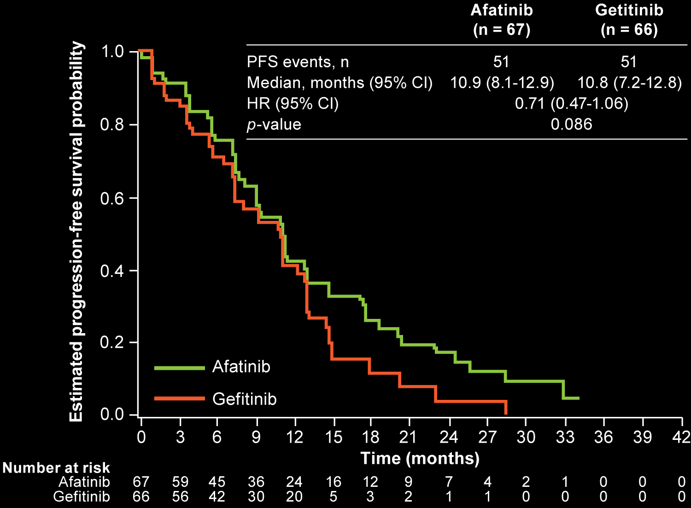
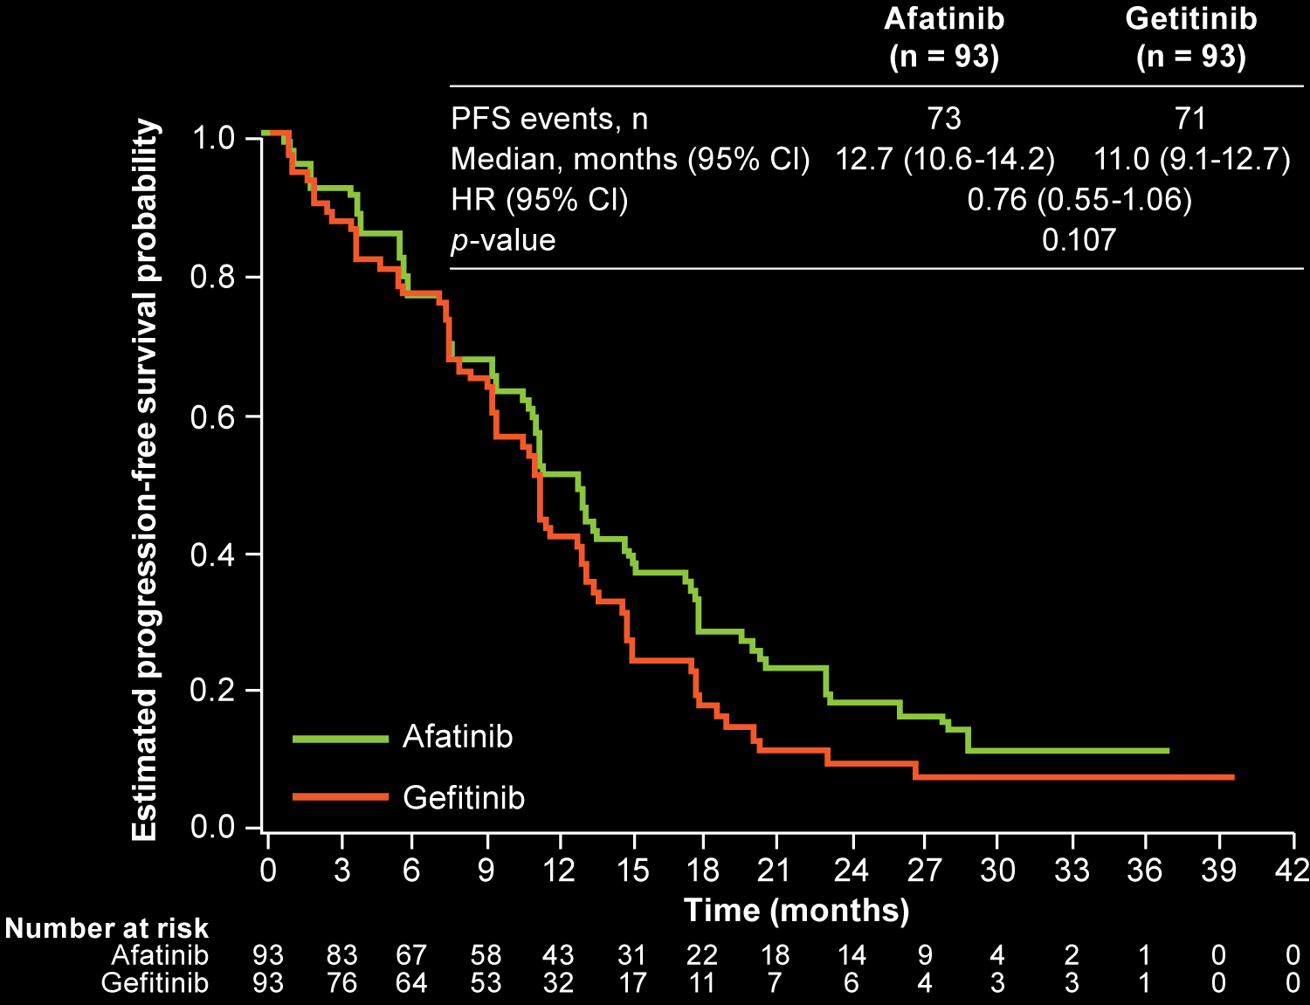
LUX-Lung 7: PFS with Afatinib and Gefitinib by EGFR Mutation
L858R
Ex19del
Final analysis for overall survival (the study’s co-primary endpoint) showed no statistically significant difference in OS between afatinib (27.9 mos) and gefitinib (24.5 mos) [HR 0.86, p = 0.258], including in ex19del subgroup
Park K et al. Lancet Oncol 2016;17(5):577-89.

Slide 22
For a patient with EGFR-mutant NSCLC who initially responds to an EGFR TKI and is now experiencing disease progression, how do you approach the issue of T790M mutation testing? Have you or would you use a urine mutation assay to evaluate for a T790M mutation?
SERUM AND/OR TISSUE
URINE
Plasma first; if negative, tissue
I haven't but would for the right patient
Plasma first; if negative, tissue
I have
Plasma first; if negative, tissue
I haven't but it is reasonable
Plasma and tissue concurrently
I haven't but would for the right patient
Plasma and tissue concurrently
I have
Plasma first; if negative, tissue
I have

Slide 23
Association between Plasma Genotyping and Outcomes with Osimertinib
Sensitivity of plasma genotyping for detection of EGFR mutations:
T790M: 70%
Exon 19 del: 82%
Exon 21 L858R: 86%
Plasma positive for T790M in 31% of cases negative for T790M in tumor
Outcome | Tumor T790M+ | Tumor T790M- | Plasma T790M+ | Plasma T790M-
ORR (n = 173, 58, 164, 102) | 62% | 26% | 63% | 46%
Median PFS (n = 179, 58, 169, 104) | 9.7 mo | 3.4 mo | 9.7 mo | 8.2 mo
Oxnard GR et al. J Clin Oncol 2016;34(28):3375-82.

Slide 24
Plasma and Urine Detection Is Sensitive and Complements Tissue T790M Testing
Tissue as reference, plasma sensitivity = 80.9% (313/387)
Plasma vs tissue
T790M |  | Tissue |  |  | Total
 |  | Positive | Negative | Inadequate
Plasma (BEAMing) | Positive | 313 | 23 | 38 | 374
 | Negative | 74 | 17 | 17 | 108
Total |  | 387 | 40 | 55 | 482
Tissue as reference, urine sensitivity = 81.1% (142/175)
Urine vs tissue
T790M |  | Tissue |  |  | Total
 |  | Positive | Negative | Inadequate
Urine | Positive | 142 | 11 | 16 | 169
 | Negative | 31 | 5 | 6 | 42
 | Inadequate | 2 | 0 | 0 | 2
Total |  | 175 | 16 | 22 | 213
In T790M-positive patients, response was similar whether status was identified by plasma, tissue or urine.
Wakelee HA et al. Proc ASCO 2016;Abstract 9001.

Slide 25
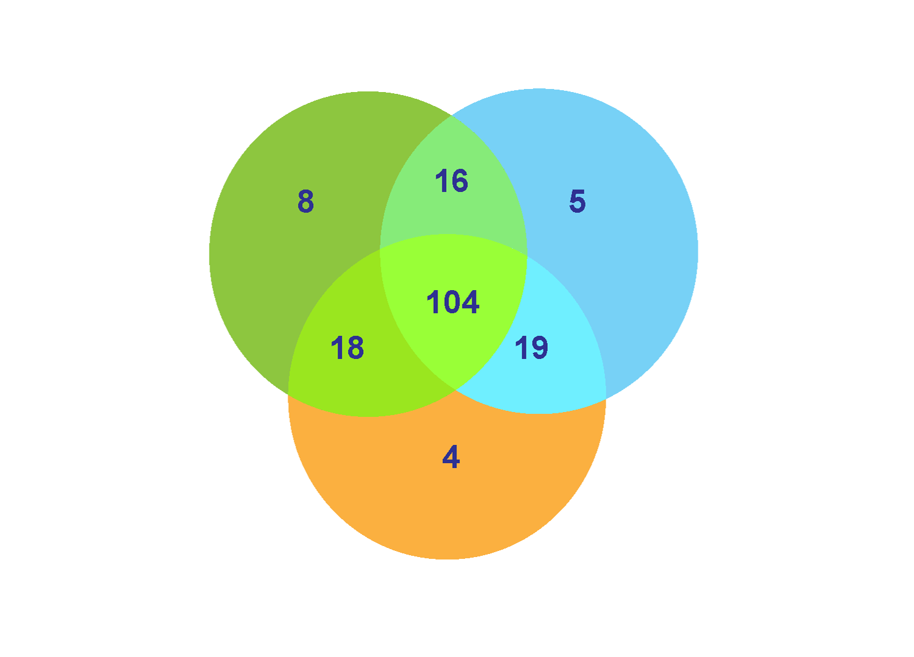
Plasma, Tissue and Urine Identify Unique and Overlapping Subsets of T790M-Positive Patients
181 samples with matched pretreatment T790M results in plasma, tissue and urine
57% were positive by all 3 sample types
Wakelee HA et al. Proc ASCO 2016;Abstract 9001.

Slide 26
In general, what would be your most likely systemic therapy recommendation for a patient with EGFR mutation-positive nonsquamous NSCLC who responded to erlotinib, is now experiencing disease progression and has a biopsy-proven T790M mutation and a PD-L1 TPS of 60%?
Osimertinib
Osimertinib
Osimertinib
Osimertinib
Osimertinib
Osimertinib

Slide 27
What is your usual treatment approach for a patient with EGFR mutation-positive lung adenocarcinoma and a PD-L1 TPS of 60% whose disease progresses 9 months after starting erlotinib for whom a biopsy is T790M-negative?
Discontinue erlotinib and start carbo/pem +/- bev
Discontinue erlotinib and start carbo/pem/bev
Continue erlotinib and add platinum/pem/bev
Discontinue erlotinib and start carbo/pem +/- bev or carbo/paclitaxel +/- bev
Discontinue erlotinib and start carbo/pem/bev if rapid or symptomatic PD
Discontinue erlotinib and add carbo/pem +/- bev
Carbo = carboplatin; pem = pemetrexed; bev = bevacizumab

Slide 28
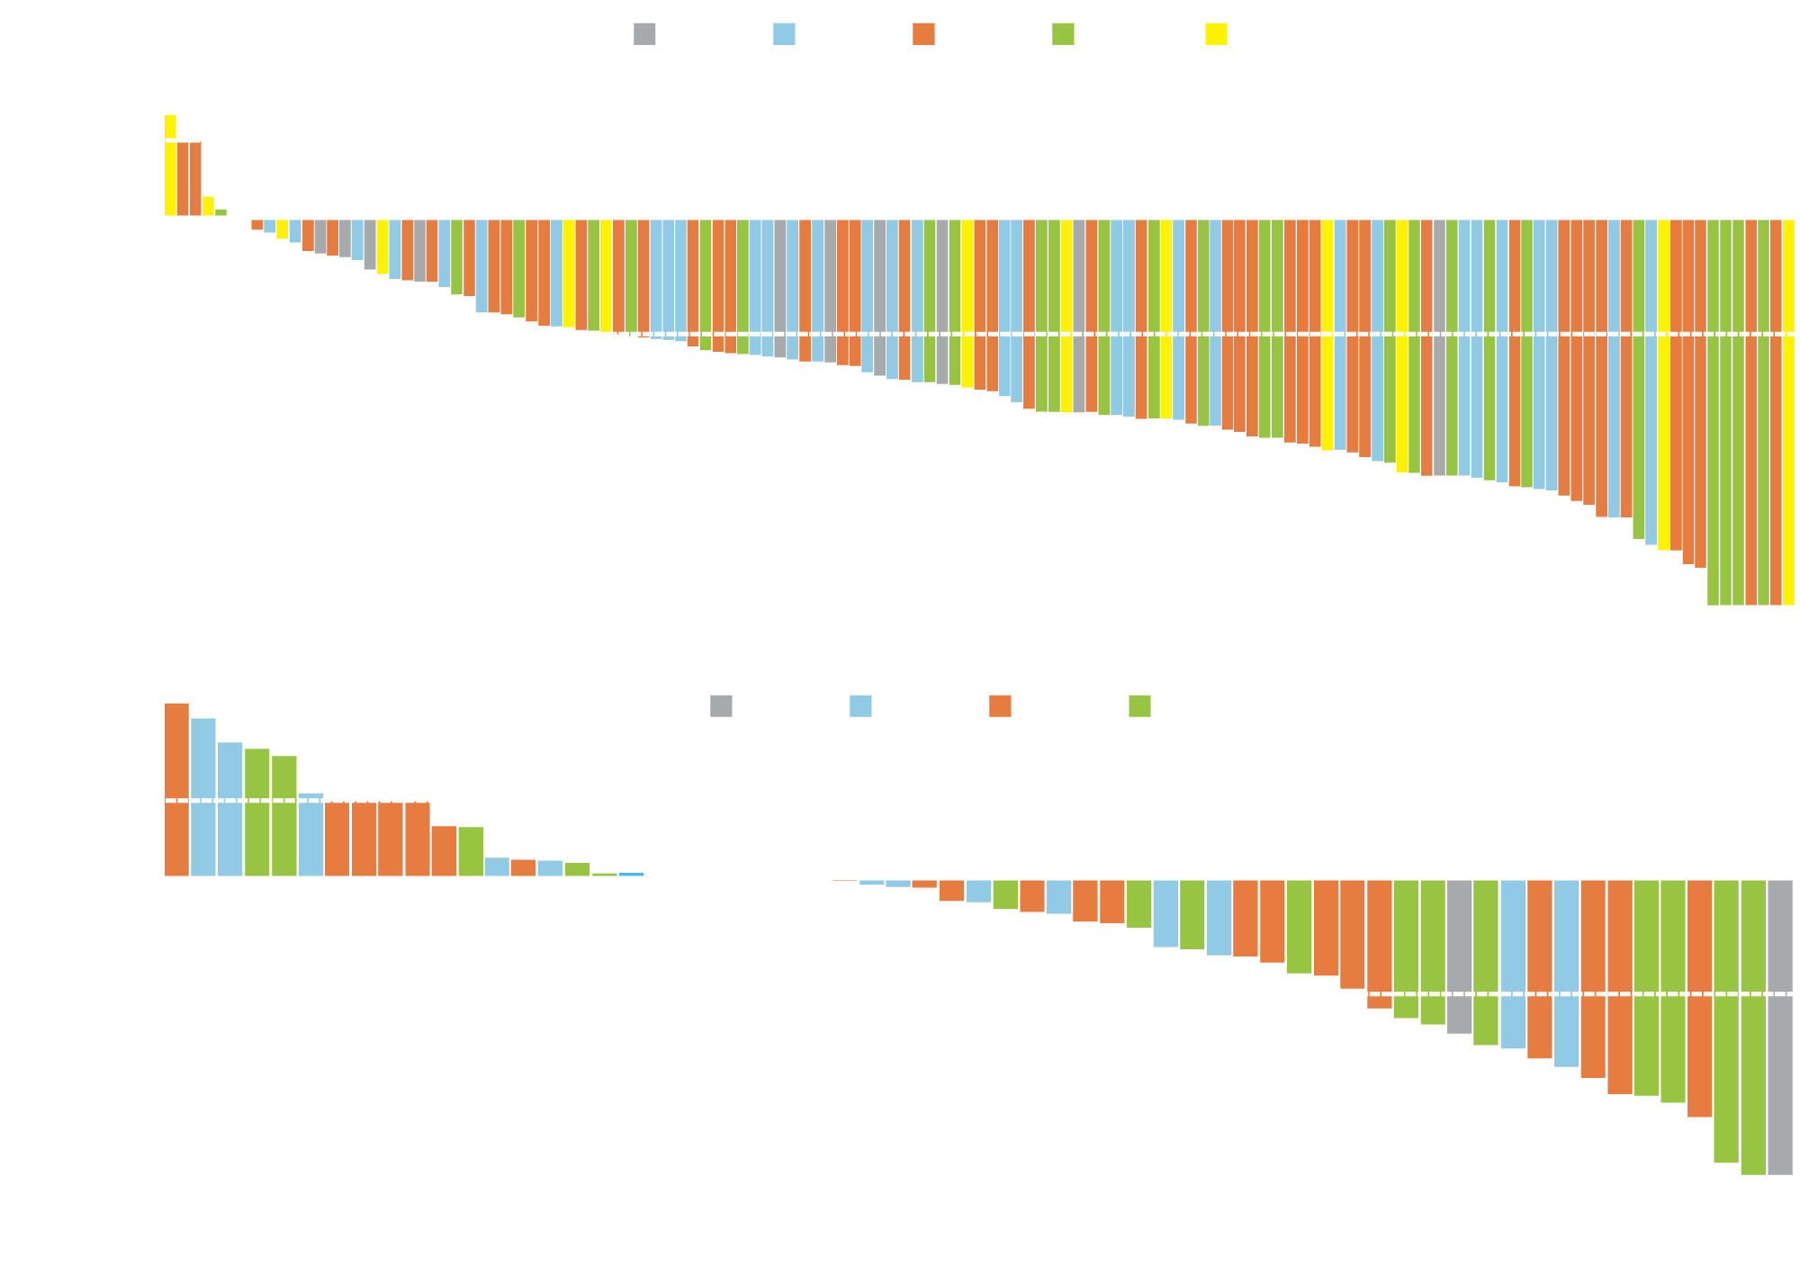
Change in Tumor Size with Osimertinib in EGFR TKI-Resistant T790M Mutation-Positive and -Negative NSCLC
EGFR T790M-Positive ORR = 61% N = 127 evaluable
D = study discontinuation
EGFR T790M-Negative ORR = 21% N = 61 evaluable
Jänne PA et al. N Engl J Med 2015;372(18):1689-99.

Slide 29
Select Adverse Events with Osimertinib
 | Osimertinib (N = 253)
 | Any grade | Grade 3-5
Diarrhea | 47% | 2%
Nausea | 22% | <0.5%
Rash | 40% | 1%
Pruritus | 19% | 0%
Decreased appetite | 21% | 1%
Constipation | 16% | 0%
Hyperglycemia | 6 (2.4%)
QT interval prolongation | 11 (4.3%)
Pneumonitis-like event | 6 (2.4%)
Jänne PA et al. N Engl J Med 2015;372(18):1689-99.

Slide 30
ADAURA: A Phase III Study of Osimertinib versus Placebo for EGFR Mutation-Positive Stage IB-IIIA NSCLC After Complete Tumor Resection with or without Adjuvant Chemotherapy
Osimertinib
Eligibility (N = 700)
Stage IB-IIIA EGFR mutation-positive NSCLC
R
Placebo
Primary Endpoint: Disease-free survival
Key Secondary Endpoints: Overall survival and quality of life
www.clinicaltrials.gov. NCT02511106

Slide 31
AURA3: A Phase III Study of Osimertinib versus Platinum-Based Doublet Chemotherapy for Locally Advanced or Metastatic NSCLC
Target accrual (N = 410)
Locally advanced or metastatic, EGFR mutation-positive NSCLC Disease progression after first-line EGFR TKI therapy T790M-positive
Osimertinib
R
2:1
Platinum-based doublet chemotherapy
Primary Endpoint: Progression-free survival by investigator assessment
Key Secondary Endpoints: Objective response rate, overall survival and safety
Mok TS et al. N Engl J Med 2017;376(7):629-40.

Slide 32
Cost and reimbursement issues aside, for a patient with untreated EGFR-mutant, widely metastatic nonsquamous cancer with multiple bilateral asymptomatic brain metastases that would require whole brain radiation therapy, do you generally start with a TKI and hold radiation therapy?
Yes, erlotinib
Yes, erlotinib
Yes, erlotinib
Yes, afatinib
Yes, erlotinib if exon 21
Yes, erlotinib

Slide 33
FLAURA: A Phase III Study of Osimertinib versus a Standard-of-Care EGFR TKI as First-Line Treatment for EGFR Mutation-Positive Locally Advanced or Metastatic NSCLC
Osimertinib
Eligibility (N = 650)
Advanced EGFR mutation-positive NSCLC
R
Erlotinib OR gefitinib
Primary Endpoint: Progression-free survival
Key Secondary Endpoints: Overall response rate, overall survival and quality of life
www.clinicaltrials.gov. NCT02296125

Slide 34
CNS Response to Osimertinib in Patients with T790M-Positive Advanced NSCLC: Pooled Data from Two Phase II Trials
100
The CNS ORR was 54% (95% CI 39, 68)
Median best percentage change from baseline in CNS target lesion size was -53% (range: -100% – +80%)
80
60
40
20
*
0
Best change from baseline in target lesion size (%)
-20
-40
Complete response
-60
Partial response
Stable response
-80
Progressive response
Not evaluable
-100
Goss G et al. Proc WCLC 2016;Abstract MA16.11.

Slide 35
BLOOM: Activity of Osimertinib Across Leptomeningeal Assessments
Best confirmed neurological status
Improved
No change
Worsened
Early withdrawal
Unconfirmed
Best MRI intracranial response, n (%) | N = 21
 | Confirmed | Unconfirmed
Responding | 7 (33) | 1 (5)
Stable disease | 9 (43) | 2 (10)
Early withdrawal | 2 (10)
10
Number of patients
5
3
1
1
1
Normal (N = 11)
Abnormal (N = 10)
Neurological status at baseline
Yang JC et al. Proc ASCO 2016;Abstract 9002.

Slide 36
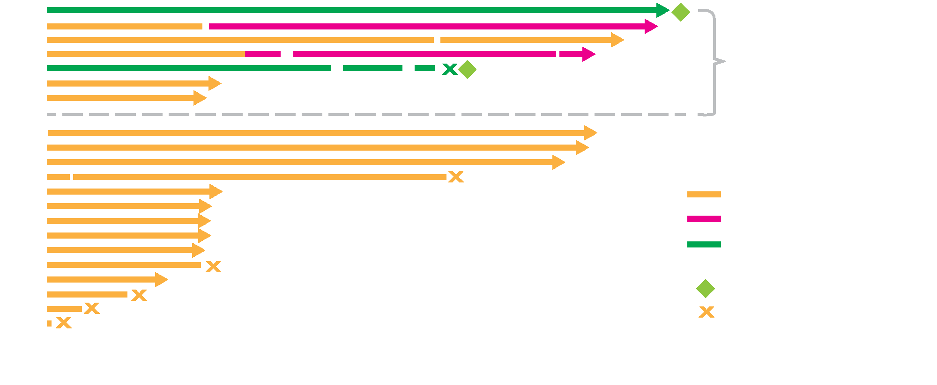
BLOOM: Time on Treatment with Osimertinib for Patients with Leptomeningeal Carcinomatosis
Yang JC et al. Proc ASCO 2016;Abstract 9002.

Slide 37
In general, when do you believe checkpoint inhibitors should be introduced into the treatment of patients with EGFR-mutant NSCLC and a TPS of <50%? Have you observed any meaningful clinical responses to anti-PD-1/PD-L1 antibodies in a patient with an EGFR or other tumor driver mutation?
CHECKPOINT INHIBITORS FOR EGFR+, TPS <50%
MEANINGFUL CLINICAL RESPONSES?
After appropriate targeted treatment and 2 lines of chemotherapy
No
After appropriate targeted treatment and 1 line of chemotherapy
No
After EGFR TKIs and platinum doublet with bevacizumab
Yes
After appropriate targeted treatment and 1 line of chemotherapy
Yes
After appropriate targeted treatment and 1 line of chemotherapy
No
After appropriate targeted treatment and 1 line of chemotherapy
Yes

Slide 38
Module 2: Treatment of Patients with ALK and ROS1 Tumor Alterations

Slide 39
What would be your preferred first-line systemic therapy recommendation for a younger, otherwise healthy patient with metastatic nonsquamous NSCLC and a TPS of 10% who is demonstrated to have an ALK translocation? A TPS of 60%?
TPS 10%
TPS 60%
Crizotinib
Crizotinib
Crizotinib
Crizotinib
Crizotinib
Crizotinib
Crizotinib
Crizotinib
Alectinib
Crizotinib
Crizotinib or ceritinib
Crizotinib

Slide 40
Cost and reimbursement issues aside, for a patient with untreated ALK-rearranged, widely metastatic nonsquamous cancer with multiple bilateral asymptomatic brain metastases that would require whole brain radiation therapy, do you generally start with a TKI and hold the radiation therapy?
Yes, alectinib
Yes, ceritinib or alectinib
Yes, alectinib or crizotinib if necessary
Yes, alectinib
Yes, alectinib if possible
Yes, ceritinib or alectinib

Slide 41
ALK Inhibitors: Comparison of Activity
 | Crizotinib | Ceritinib | Alectinib | Brigatinib
Indication | ALK+ NSCLC | ALK resistance | ALK resistance | (Not yet approved)
Highly active | Yes | Yes | Yes | Yes
Tolerability | Good | Moderate | Good | Good
CNS activity | Some | Good | Good | Good
Potency against resistance | Poor | Moderate | Moderate | Good
Courtesy of Geoffrey R Oxnard, MD
Kwak et al. NEJM 2010; Awad et al. Clin Adv Hematol Oncol 2014; Kodama et al. MCT 2014; Solomon et al. JCO 2016.
Notes:
41

Slide 42
J-ALEX: A Phase III Study Comparing Alectinib to Crizotinib in Japanese TKI-Naïve Patients
Eligibility
Stage IIIB/IV or recurrent ALK-positive NSCLC ALK centralized testing (IHC and FISH or RT-PCR) Treated/asymptomatic brain metastases allowed ≤1 prior chemotherapy
Alectinib 300 mg BID PO, 28-day cycle (N = 100)
R
Crizotinib 250 mg BID PO, 28-day cycle (N = 100)
1:1
Primary Endpoint: PFS assessed by independent review facility
Nokihara H et al. Proc ASCO 2016;Abstract 9008.

Slide 43
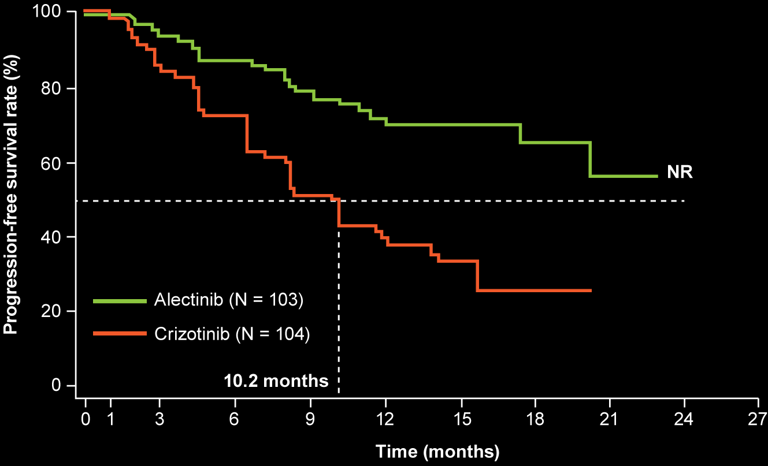
J-ALEX Study: Progression-Free Survival (ITT)
 | Alectinib | Crizotinib
Events, n (%) | 25 (24.3%) | 58 (55.8%)
Median, mo | NR | 10.2
p-value | <0.0001
HR | 0.34
Consistent benefit observed with alectinib in all subgroups
Patients with brain metastases: HR 0.08 favoring alectinib
Nokihara H et al. Proc ASCO 2016;Abstract 9008.

Slide 44
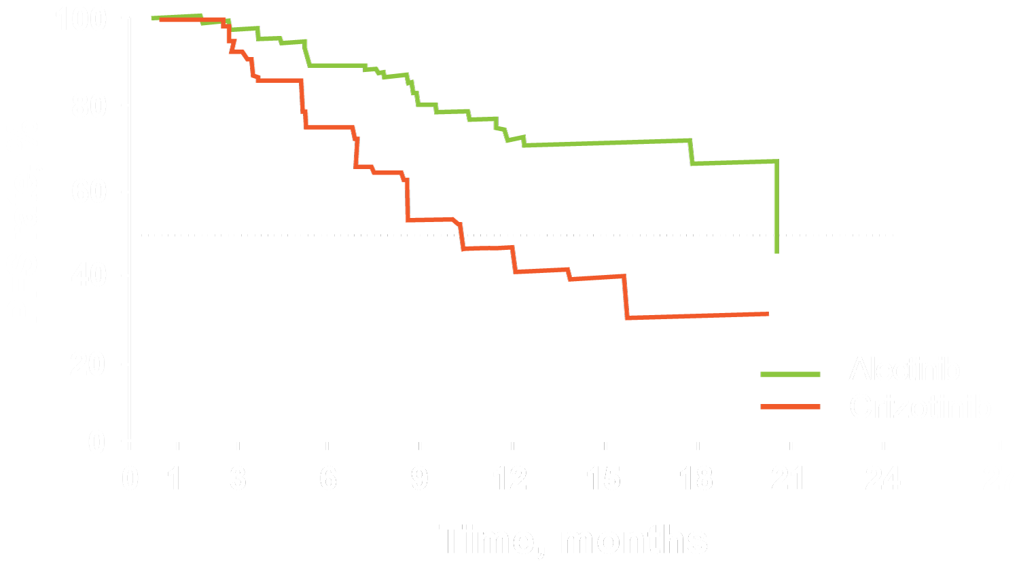
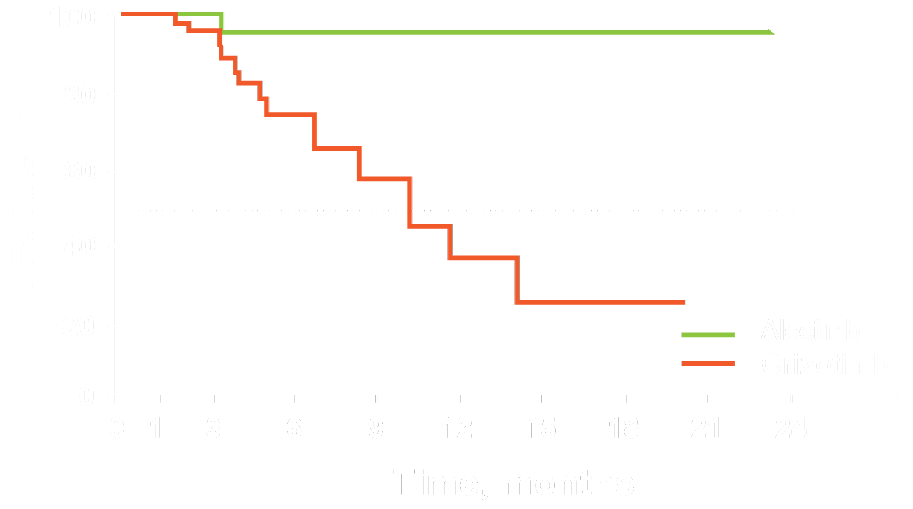
J-ALEX: PFS With or Without Brain Mets at Baseline
Without Brain Mets
With Brain Mets
 | Alectinib (N=89) | Crizotinib (N=75)
Event | 24 (27.0%) | 42 (55.2%)
Median [95% CI] | 20.3 [17.5, —] | 10.2 [6.5, 14.2]
P-value | 0.0001
HR [95% CI] | 0.37 [0.22, 0.62]
 | Alectinib (N=14) | Crizotinib (N=29)
Event | 1 (7.1%) | 16 (55.2%)
Median [95% CI] | — [—, —] | 10.2 [6.5, 14.2]
P-value | 0.0002
HR [95% CI] | 0.09 [0.1, 0.74]
Kim YH et al. WCLC 2016;Abstract 5597.

Slide 45
J-ALEX: Select Adverse Events
Adverse event | Alectinib (n = 103) |  | Crizotinib (n = 104)
 | All grades | Grade 3/4 | All grades | Grade 3/4
Constipation | 35.0% | 1.0% | 44.2% | 1.0%
Nausea | 10.7% | 0% | 74.0% | 1.9%
Diarrhea | 8.7% | 0% | 73.1% | 1.9%
Vomiting | 5.8% | 0% | 57.7% | 1.9%
Elevated AST level | 10.7% | 1.0% | 30.8% | 4.8%
Elevated ALT level | 8.7% | 1.0% | 31.7% | 12.5%
Visual disturbance | 1.0% | 0% | 54.8% | 0%
Dysgeusia | 18.4% | 0% | 51.9% | 0%
ALT = alanine aminotransferase; AST = aspartate aminotransferase
Nokihara H et al. Proc ASCO 2016;Abstract 9008.

Slide 46
ALEX Phase III Study Design
Alectinib 600 mg BID
(n = 143)
ALK+ Stage IIIB/IV or recurrent NSCLC Chemotherapy naïve ECOG PS 0-2
Until PD* or premature withdrawal (eg, due to toxicity)
R
Subsequent therapy and survival follow-up
1:1
Crizotinib 250 mg
BID (n = 143)
* Determined by investigators, based on RECIST v1.1
In comparison to crizotinib, alectinib demonstrated statistically significant improvement in PFS in the Japanese Phase III parallel trial J-ALEX (HR = 0.34, p < 0.0001).
Ou SHI et al. Proc ASCO 2015;Abstract 8008; Nokihara H et al. Proc ASCO 2016;Abstract 9008.

Slide 47
ASCEND-4: Randomized Phase III Study Comparing First-Line Ceritinib with Chemotherapy
Eligibility
Stage IIIB/IV ALK+ NSCLC by Ventana IHC test (central) Treatment naive (no prior chemotherapy or ALK inhibitor) WHO PS 0-2 Neurologically stable brain metastases (symptomatic or not)
Ceritinib 750 mg/day x 21 days
Daily oral dosing in fasted state
PD (BIRC confirmed)
Optional
R
1:1
Ceritinib 750 mg
Pemetrexed 500 mg/m² + cisplatin 75 mg/m²
Pemetrexed 500 mg/m² + carboplatin AUC 5-6
Optional crossover to extension treatment
PD (BIRC confirmed)
CR, PR, SD
Pemetrexed maintenance 500 mg/m² q21d
BIRC = blinded independent review committee
De Castro G et al. Proc WCLC 2016;Abstract PL03.07.

Slide 48
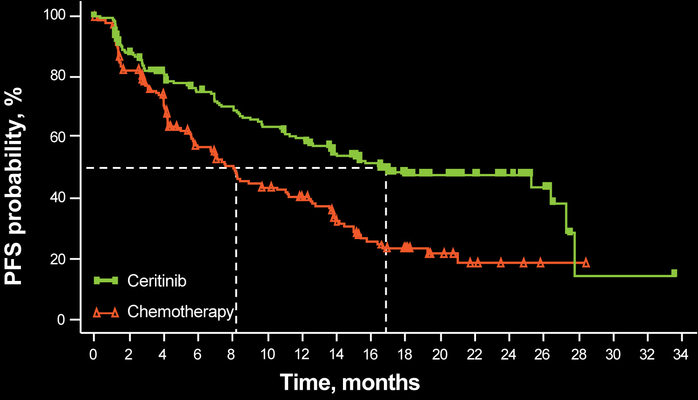
ASCEND-4 Primary Endpoint: PFS by BIRC
 | Ceritinib (N=189) | Chemotherapy (N=187)
Events, n (%) | 89 (47.1) | 113 (60.4)
Median (95% CI), months | 16.6 (12.6-27.2) | 8.1 (5.8-11.1)
Hazard ratio (95% CI) = 0.55 (0.42-0.73)
Stratified Log-rank P<0.001
Ceritinib demonstrated an estimated 45% risk reduction vs chemotherapy
De Castro G et al. Proc WCLC 2016;Abstract PL03.07.

Slide 49
ASCEND-4: PFS for Patients With or Without Brain Metastases
Brain metastases at baseline: No
Brain metastases at baseline: Yes
 | Ceritinib (N = 130) | Chemotherapy (N = 125)
Events, n (%) | 54 (41.5) | 72 (57.6)
Median (95% CI), months | 26.3 (15.4, 27.7) | 8.3 (6.0, 13.7)
Hazard ratio (95% CI) = 0.48 (0.33, 0.69)
 | Ceritinib (N = 59) | Chemotherapy (N = 62)
Events, n (%) | 35 (59.3) | 41 (66.1)
Median (95% CI), months | 10.7 (8.1, 16.4) | 6.7 (4.1, 10.6)
Hazard ratio (95% CI) = 0.70 (0.44, 1.12)
100
100
80
80
60
60
Probability (%) of event-free
40
Probability (%) of event-free
40
20
20
0
0
0
2
4
6
8
10
12
14
16
18
20
22
24
26
28
30
32
34
0
2
4
6
8
10
12
14
16
18
20
22
24
26
28
30
32
Time (months)
Time (months)
De Castro G et al. Proc WCLC 2016;Abstract PL03.07.

Slide 50
ASCEND-4: Select Adverse Events
 | Ceritinib (N = 189) |  | Chemotherapy (N = 175)
 | All grades (%) | Grade 3/4* (%) | All grades (%) | Grade 3/4* (%)
Diarrhea | 84.7% | 5.3% | 10.9% | 1.1%
ALT increased | 60.3% | 30.7% | 21.7% | 2.9%
AST increased | 52.9% | 16.9% | 19.4% | 1.7%
GGT increased | 37.0% | 28.6% | 10.3% | 1.7%
Asthenia | 17.5% | 2.6% | 20.6% | 3.4%
Dyspnea | 15.3% | 2.1% | 20.0% | 6.3%
Anemia | 14.8% | 2.1% | 35.4% | 7.4%
Neutropenia | 4.8% | 0.5% | 21.7% | 10.9%
ALT = alanine aminotransferase; AST = aspartate aminotransferase; GGT = gamma-glutamyl-transferase
* Grade 3/4 AEs in 148 (78.3%) patients in ceritinib and 108 (61.7%) in chemotherapy
De Castro G et al. Proc WCLC 2016;Abstract PL03.07.

Slide 51
In general, what is your usual starting dose of ceritinib? A 75-year-old patient with ALK-rearranged NSCLC that progressed on crizotinib is started on ceritinib at 750 mg qd leading to a rapid complete response but Grade 3 diarrhea, which abates upon cessation of treatment. Would you restart ceritinib, and if so, at what dose?
STARTING DOSE
RESTART CERITINIB?
600 mg daily
Restart at 600 mg daily
600 mg daily
Restart at 600 mg daily
450 mg daily
Restart at 450 mg daily
450 mg daily
Restart at 450 mg daily
450 mg daily
Restart at 600 mg daily
450 mg daily with food
Restart at 450 mg daily with food

Slide 52
In general, what would be your preferred choice of second-line therapy for a patient with ALK-rearranged metastatic nonsquamous cell cancer of the lung and a TPS of 60% who experiences disease progression on crizotinib?
Alectinib
Ceritinib or alectinib
Alectinib
Alectinib
Alectinib
Ceritinib or alectinib

Slide 53
In general, what would be your preferred choice of second-line therapy for a patient with ALK-rearranged metastatic nonsquamous cell cancer of the lung and a TPS of 60% who experiences disease progression on alectinib?
Carboplatin/pemetrexed +/- bev
Carboplatin/pemetrexed +/- bev
Carboplatin/pemetrexed/bev
Brigatinib*
Carboplatin/pemetrexed/bev
Carboplatin/pemetrexed +/- bev
* Depends also on mutations at time of resistance

Slide 54
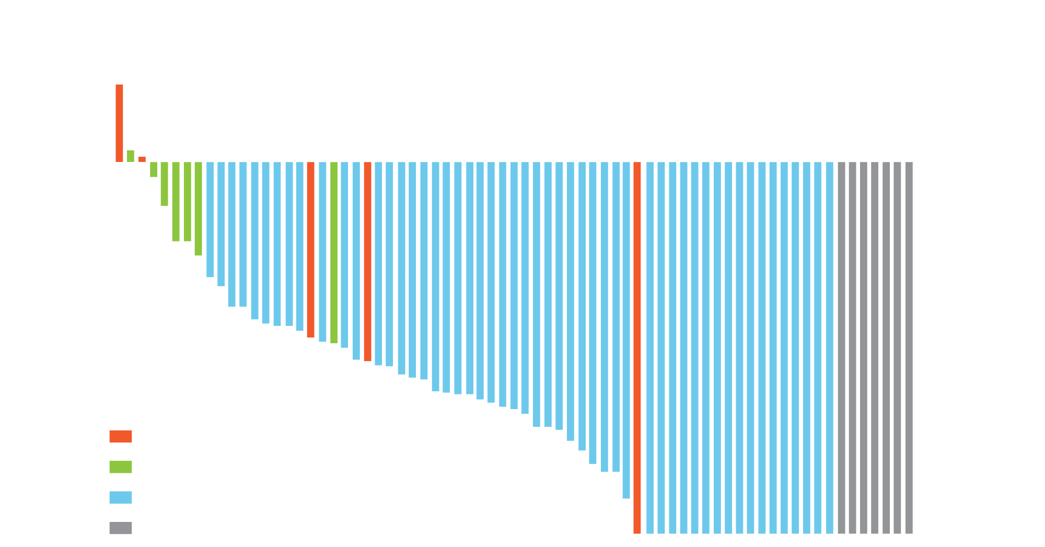
Brigatinib: Response in Phase I/II Trial in ALK-Rearranged NSCLC
ORR
All patients (n = 79): 75%
Previous crizotinib (n = 71): 72%
Crizotinib naïve (n = 8): 100%
Gettinger SN et al. Lancet Oncol 2016;17(12):1683-96.

Slide 55
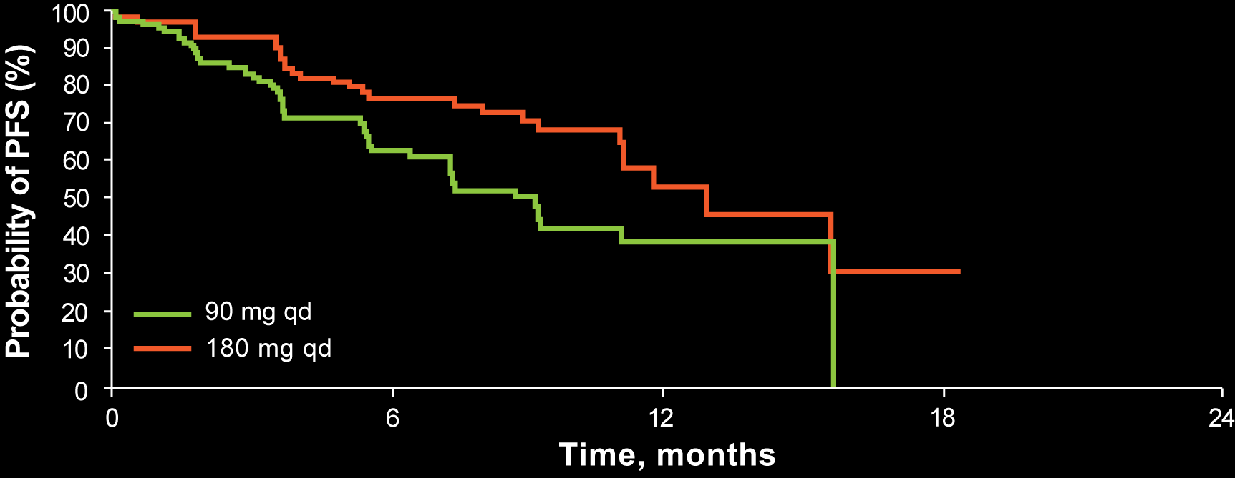
ALTA: A Phase II Trial of Brigatinib in Crizotinib-Refractory ALK-Rearranged NSCLC
 | ORR | Median PFS | PFS HR
90 mg qd (n = 112) | 45% | 9.2 months | 0.55 (0.35 – 0.86)
90 mg → 180 mg qd (n = 110) | 54% | 12.9 months
Broad activity against a range of resistance mutations
Kim D-W et al. Proc ASCO 2016;Abstract 9007.

Slide 56
ALTA: Select Adverse Events
Any grade AE (≥10% of patients) | Brigatinib 90 mg qd (n = 109) | Brigatinib 180 mg qd (n = 110)
Nausea | 33% | 40%
Diarrhea | 19% | 38%
Cough | 18% | 34%
Dyspnea | 21% | 21%
Hypertension | 11% | 21%
A subset of pulmonary AEs with early onset (including dyspnea, hypoxia, cough, pneumonia, pneumonitis) occurred in 14 (6%) of patients, before dose escalation to 180 mg
Kim D-W et al. Proc ASCO 2016;Abstract 9007.

Slide 57
ALTA-1L: A Phase III Trial of First-Line Brigatinib Versus Crizotinib in ALK-Rearranged NSCLC
Eligibility (N = 270)
Stage IIIB/IV, ALK+ NSCLC No prior TKI therapy ≤1 systemic anticancer therapy
Brigatinib
R
1:1
Crizotinib
Primary Endpoint: Progression-free survival
Key Secondary Endpoints: Objective response rate, overall survival, safety, intracranial PFS
www.clinicaltrials.gov. NCT02737501

Slide 58
A 56-year-old woman with metastatic adenocarcinoma of the lung with a PD-L1 TPS of 60% and a known ROS1 rearrangement experiences a 1-year response to crizotinib but now develops disease relapse in the brain and lung. In addition to local therapy to the brain, what would be your most likely next systemic treatment?
Carboplatin/pemetrexed +/- bev
Carboplatin/pemetrexed +/- bev
Platinum/pemetrexed/bev
Cabozantinib or pemetrexed/carboplatin
Carboplatin/pemetrexed/bev
Carboplatin/pemetrexed +/- bev

Slide 59
PROFILE 1001 Updated Results: Antitumor Activity and Response to Crizotinib in ROS1-Rearranged NSCLC
ORR = 69.8%
Shaw AT et al. Proc ESMO 2016;Abstract 1206PD.

Slide 60
Phase I Study of Lorlatinib in ALK- or ROS1-Rearranged NSCLC
ALK-Rearranged
Robust clinical activity in patients with ALK- or ROS1-rearranged NSCLC
Most patients had brain metastases and had received ≥1 prior ALK TKI
Solomon BJ et al. Proc ASCO 2016;Abstract 9009.

Slide 61
Other ROS1-Targeted Agents Under Clinical Investigation in Advanced NSCLC
Therapeutic agent | Trial identifier | Phase | Study population
Lorlatinib | NCT02927340 (Open) | II | Treatment-naïve or ≥1 ROS1 inhibitor CNS metastases without measurable extracranial lesions
Cabozantinib | NCT01639508 (Open) | II | Group C: Metastatic or unresectable NSCLC with ROS1 fusion
Ceritinib | SIGNATURE: NCT02186821 (Completed) | II | ≥1 treatment for recurrent, metastatic and/or locally advanced disease and for whom no standard therapy options are available
www.clinicaltrials.gov. Accessed March 2017.

Slide 62
Module 3: Treatment of Patients with Other Potentially Targetable Tumor Mutations (BRAF V600E, MET, RET, et cetera)

Slide 63
Frequency of Oncogenic Drivers in Lung Adenocarcinoma (n = 875)
s = sensitizing; r = rearrangement; o = other; veBRAF = BRAF V600E
Aisner DL et al. Proc ASCO 2016;Abstract 11510.

Slide 64
Cost and reimbursement issues aside, what targeted therapy, if any, would you most likely recommend for a patient with metastatic NSCLC and a BRAF V600E tumor mutation? In which line of therapy, if any, would you most likely administer a BRAF inhibitor (with or without a MEK inhibitor)?
TARGETED THERAPY
LINE OF TREATMENT
Dabrafenib with trametinib
First line
Dabrafenib and trametinib
First line
Dabrafenib with trametinib
First line
Dabrafenib with trametinib
Second line
Dabrafenib with trametinib
First line
Dabrafenib with trametinib
Second line

Slide 65
Dabrafenib and Trametinib in BRAF V600E-Mutant Metastatic NSCLC
40
Overall response rate: 63%
Disease control rate: 79%
20
0
-20
Maximum reduction from baseline measurement, %
-40
Best confirmed response
CR
PR
SD
PD
NE
-60
-80
-100
Patients
NE patients did not have a follow-up scan required for confirmation.
Planchard D et al. Lancet Oncol 2016;17:984-93.

Slide 66
Dabrafenib and Trametinib Combination Receives FDA Breakthrough Therapy Designation in NSCLC
The FDA breakthrough therapy designation in BRAF V600 mutation-positive NSCLC is based on interim analysis results from an ongoing single-arm, 2-stage Phase II trial investigating the combination in patients with metastatic NSCLC who had the BRAF V600E mutation and failed at least 1 line of chemotherapy. The data showed an ORR of 63% based on investigator assessment. The most common adverse events (incidence ≥20%) among patients included in this analysis were pyrexia, diarrhea, nausea, vomiting, decreased appetite, asthenia, cough, peripheral edema and rash.
https://www.novartis.com/news/media-releases/novartis-combination-therapy-tafinlar%C2%AE-and-mekinist%C2%AE-achieves-important-eu-and

Slide 67
Frequency of Oncogenic Drivers in Lung Adenocarcinoma (n = 875)
s = sensitizing; r = rearrangement; o = other; veBRAF = BRAF V600E
Aisner DL et al. Proc ASCO 2016;Abstract 11510.

Slide 68
Outside of a protocol setting, do you generally use targeted therapy for patients with NSCLC and a MET exon 14 alteration?
Yes, first line
Yes, crizotinib (and cabozantinib once) in second line, before checkpoint inhibitor
Yes, crizotinib during any line
Yes, second line with crizotinib
Yes, crizotinib in first line
Yes, crizotinib after first-line chemotherapy

Slide 69
MET Exon 14 Alterations
MET exon 14 encodes the ubiquitin ligase binding site which is used in receptor degradation
MET exon 14 alterations are heterogeneous and encompass deletions, insertions and base substitutions.
Many of these mutations disrupt splice sites resulting in MET exon 14 skipping and produce a MET receptor that lacks ubiquitin binding site → reduced degradation of MET protein → sustained MET activation
Next-generation sequencing is the preferred testing method
MET exon 14 alterations occur in approximately 3% of lung adenocarcinoma, 2% of squamous cell carcinoma, and 20% of pulmonary sarcomatoid carcinoma
Drilon A et al. Proc ASCO 2016;Abstract 108; Reungwetwattana T et al. Lung Cancer 2017;103:27-37.

Slide 70
Antitumor Activity of Crizotinib in Advanced MET Exon 14-Altered NSCLC
Maximum Response to Crizotinib in Patients with MET Exon 14-Altered Lung Cancers
(n = 16 with measurable disease at baseline and ≥1 response assessment scan)
20
0
*
*
-20
-40
% change from baseline
-60
Partial response (PR), confirmed
Stable disease: includes 4 unconfirmed PRs
Stable disease and 0% change from baseline
-80
*
-100
Drilon AE et al. Proc ASCO 2016;Abstract 108.

Slide 71
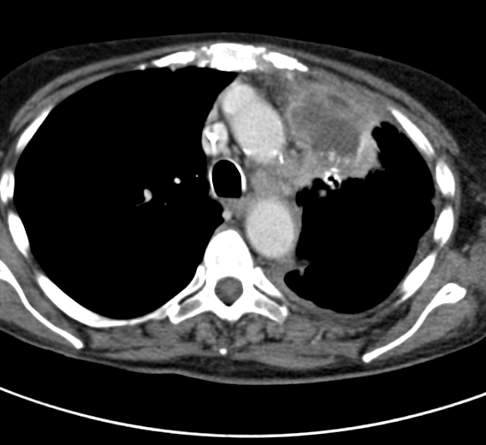
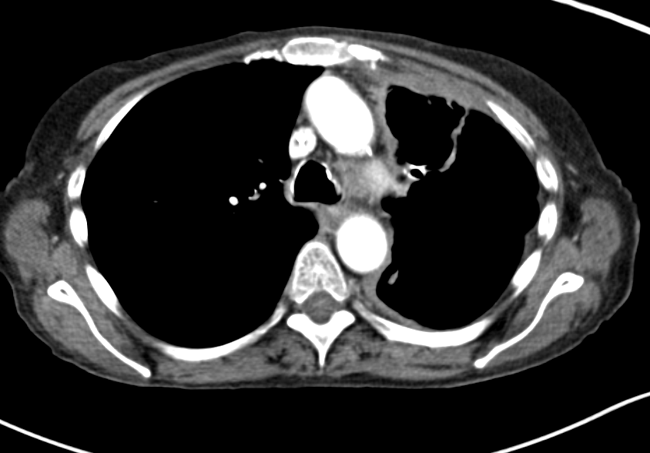
Cabozantinib in MET e14 Splice Alterations
Stanford series of 14 identified patients with MET e14 alterations, of which 6 were treated with a MET inhibitor (mostly crizotinib)
76F with MET e14 adenocarcinoma identified following carbo/pem and nivolumab failure
Crizotinib was started – rash, angioedema, pruritus after 1 week. Failed re-challenge. Took drug holiday
Cabozantinib started, scans showed great response with necrosis
S Wang, Chicago Multidisciplinary Symposium 2016

Slide 72
Frequency of Oncogenic Drivers in Lung Adenocarcinoma (n = 875)
s = sensitizing; r = rearrangement; o = other; veBRAF = BRAF V600E
Aisner DL et al. Proc ASCO 2016;Abstract 11510.

Slide 73
Outside of a protocol setting, do you generally use targeted therapy for patients with metastatic NSCLC and a tumor RET rearrangement?
Yes, cabozantinib in second line
Yes, cabozantinib in second or third line
Yes, any line
Yes, vandetanib and everolimus in patient with leptomeningeal disease in second line and beyond
Yes, cabozantinib in second or third line
Yes, cabozantinib in second or third line

Slide 74
Cost and reimbursement issues aside, what targeted therapy (alone or with chemotherapy), if any, would you most likely recommend for a patient with metastatic NSCLC and a HER2 tumor mutation?
Neratinib
Trastuzumab + either taxane or vinorelbine
T-DM1
Trastuzumab, lapatinib, trastuzumab/lapatinib, afatinib, T-DM1, pertuzumab
Trastuzumab with carboplatin/paclitaxel
Trastuzumab + docetaxel, afatinib or T-DM1

Slide 75
Do you believe there are currently any other actionable tumor mutations beyond those mentioned previously?
Yes, TSC1/TSC2 and DDR2
High MET amplification, NTRK alterations but only in clinical trials
No
Yes, NTRK alterations
Yes, NTRK and others
Yes, but only with clinical trial implications

Slide 76
Ongoing Phase II Trials Evaluating NTRK1-Targeted Agents in NSCLC
Therapeutic agent | Trial identifier | Phase | Study population
Entrectinib | STARTRK-2: NCT02568267 (Open) | II | Locally advanced or metastatic NSCLC with NTRK rearrangement
Cabozantinib | NCT01639508 (Open) | II | Group B: Metastatic or unresectable NSCLC with NTRK rearrangement
Larotrectinib (LOXO-101) | NAVIGATE: NCT02576431 (Open) | II | Locally advanced or metastatic NSCLC with NTRK rearrangement
www.clinicaltrials.gov. Accessed March 2017.

