Slide 1
Please note, these are the actual video-recorded proceedings from the live CME event and may include the use of trade names and other raw, unedited content.

Slide 2
Oncology Grand Rounds Ovarian Cancer Nurse and Physician Investigators Discuss New Agents, Novel Therapies and Actual Cases from Practice
Friday, May 5, 2017 12:15 PM – 1:45 PM
Faculty
Kimberly Camp, RN, BSN, MSN, ANP-BC, ONC Ursula A Matulonis, MD
Michele Peetz, FNP-C Angeles Alvarez Secord, MD, MHSc
Moderator Neil Love, MD

Slide 3
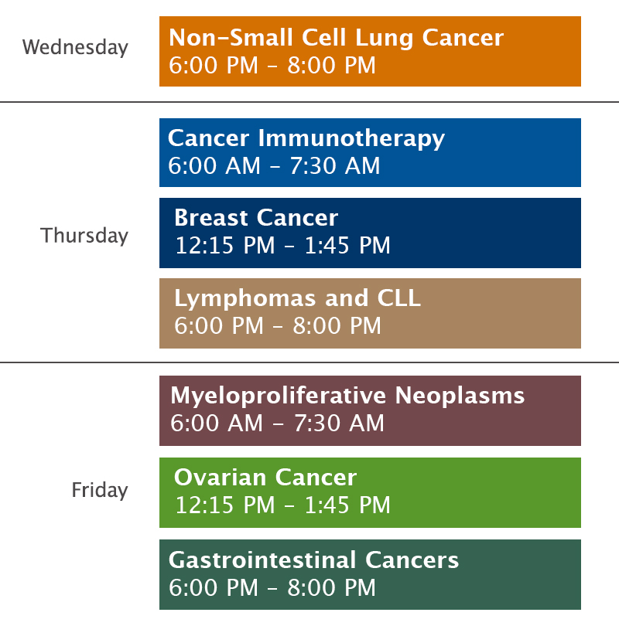
Oncology Grand Rounds Series

Slide 4
Oncology Grand Rounds: Themes
Identifying and understanding oncology clinical scenarios
Key determining factors; natural history and treatment
Evaluating and managing clinical symptoms
Patient and caregiver education
Integrating new agents and treatment strategies into practice
Benefits and risks
Prevention, identification and management of side effects/toxicity
Identifying patients at high risk for toxicity
Psychosocial issues in clinical oncology
Caring for family and loved ones, including minor children and grandchildren
Job satisfaction and disappointment
The bond that heals

Slide 5
Novel Agents Approved by the FDA in the Past 9 Weeks
Agent | Approval Date | FDA-Approved Use on Approval Date
Telotristat ethyl (tryptophan hydroxylase inhibitor) | February 28th | In combination with somatostatin analogue (SSA) therapy for the treatment of adults with carcinoid syndrome diarrhea inadequately controlled by SSA therapy alone
Ribociclib (CDK4/6 inhibitor) | March 13th | In combination with an aromatase inhibitor as initial endocrine-based therapy for postmenopausal women with hormone receptor-positive, HER2-negative advanced or metastatic breast cancer
Avelumab (anti-PD-L1 antibody) | March 23rd | For the treatment of patients (≥12 years) with metastatic Merkel cell carcinoma, including those who have not received prior chemotherapy
Niraparib (PARP inhibitor) | March 27th | For the maintenance treatment of adult patients with recurrent epithelial ovarian, fallopian tube or primary peritoneal cancer whose tumors have completely or partially shrunk in response to platinum-based chemotherapy
Brigatinib (ALK inhibitor) | April 28th | For the treatment of patients with ALK-positive metastatic non-small cell lung cancer who have progressed on or are intolerant to crizotinib
Midostaurin (FLT3 inhibitor) | April 28th | For the treatment of adults with newly diagnosed FLT3-positive acute myeloid leukemia in combination with standard cytarabine and daunorubicin induction and cytarabine consolidation
Durvalumab (anti-PD-L1 antibody) | May 1st | For the treatment of patients with PD-L1-positive inoperable or metastatic urothelial bladder cancer that has progressed during or after one standard platinum-based regimen
https://www.fda.gov/drugs/developmentapprovalprocess/druginnovation/ucm537040.htm

Slide 6
Pre-PARP Era: OC confined to abdomen
Pre-PARP Era: Recurrent disease (Platinum-sensitive and resistant)
PARP Era: OC confined to abdomen
PARP Era: Recurrent disease (Platinum-sensitive and resistant)
Notes:
6
6
6
6
6

Slide 11
Oncology Grand Rounds Ovarian Cancer Nurse and Physician Investigators Discuss New Agents, Novel Therapies and Actual Cases from Practice
Friday, May 5, 2017 12:15 PM – 1:45 PM
Faculty
Kimberly Camp, RN, BSN, MSN, ANP-BC, ONC Ursula A Matulonis, MD
Michele Peetz, FNP-C Angeles Alvarez Secord, MD, MHSc
Moderator Neil Love, MD

Slide 12
Module 1:
Overview of Ovarian Cancer (OC)
Notes:
12
12
12

Slide 13
Overview
Biology of OC and specific histologic and clinical subtypes
Clinical presentation and staging
Role of tumor markers (CA-125)

Slide 14
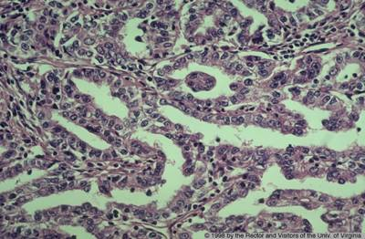
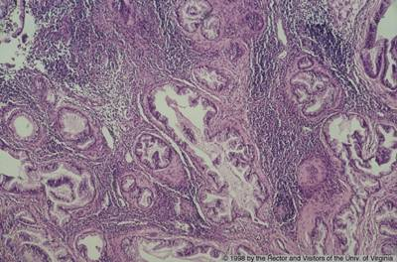
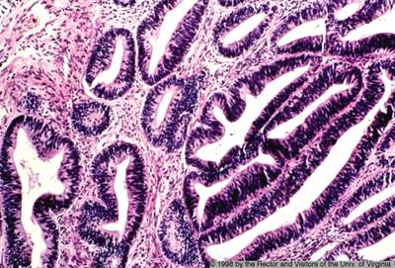
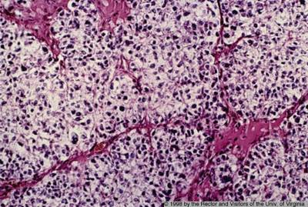
Ovarian Cancer Is Separated into Histological Categories
Low grade High grade
Specific molecular features define these categories and shape clinical trial design: Mucinous tumors KRAS mutations High-grade serous cancers Homologous recombination deficiency (HRD) is common and thus displays a high rate of platinum sensitivity Low-grade serous cancers KRAS mutations; usefulness of MEK inhibitors Clear cell cancers Chemotherapy insensitivity, PIK3CA mutations and sensitivity to VEGFR-2 inhibitors
Serous
Mucinous
Endometrioid
Clear cell
Courtesy of Ursula Matulonis, MD

Slide 15
Key Considerations for BRCA Mutation Testing for Patients with Ovarian Cancer
Frequency and clinical significance of BRCA germline and somatic mutations
Selection of patients with OC for genetic testing
Options for BRCA germline mutation testing: “One-off” versus multiplex assays
Significance of “BRCA-like” and other genomic signatures (eg, homologous recombination deficiency)
Indications for genetic counseling for patients with OC and their family members

Slide 16
Summary of Germline DNA Mutations in OC
Germline DNA sequenced from women with OC (N = 1,915) using a targeted capture and multiplex sequencing assay
University of Washington GYN tissue bank (n = 570)
GOG-218 (n = 788) and GOG-262 (n = 557)
Germline mutations associated with OC risk N = 347
Overall population
(not selected for age or family history) N = 1,915
Norquist BM et al. JAMA Oncol 2016;2(4):482-90.

Slide 17
Genetic Testing in Patients with Ovarian Cancer
SGO Position Paper on Risk Assessment for Inherited Gynecologic Cancer Predispositions, 2015
Patients with an increased likelihood of having an inherited predisposition to breast and ovarian/tubal/peritoneal cancer who should receive genetic counseling and be offered genetic testing
Women affected with high-grade epithelial ovarian/tubal/ peritoneal cancer
NCCN Ovarian Cancer Guidelines, v1.2017
All patients with ovarian cancer, fallopian tube cancer or primary peritoneal cancer should be referred for genetic risk evaluation
Lancaster JM et al. Gyn Oncol 2015;136:3-7. NCCN Ovarian Cancer Guidelines v1.2017

Slide 18
Examples of Assays for Genetic Testing
Test | Companion diagnostics | Turnaround time
BRACAnalysis CDx® | Olaparib companion diagnostic test | 2 weeks
FoundationFocusTM CDxBRCA test | Rucaparib companion diagnostic test — somatic and germline BRCA1/2 | 2 weeks
 | Breast/ovarian panels
Ambry Genetics BRCAplusTM | 6-gene panel | 1-2 weeks
Ambry Genetics OvaNextTM | 25-gene panel | 2-4 weeks
Invitae Breast/Gyn guidelines-based panel | 19-gene panel | 1-3 weeks
Color GenomicsTM | 19-gene panel | 4-8 weeks
GeneDx Breast/Ovarian | 21-gene panel | 3 weeks
 | Comprehensive panels
Ambry Genetics CancerNextTM | 32-gene panel | 2-3 weeks
GeneDx Comprehensive | 32-gene panel | 3 weeks
Myriad myRisk® | 28-gene panel | 2-4 weeks
Invitae Multi-Cancer | 80-gene panel | 1-3 weeks
GeneTests (www.genetests.org); Lynce F, Isaacs C. ASCO 2016 Education Book

Slide 19
Panel Testing
Advantages:
More “diagnoses”
Often cost effective
Disadvantages:
Unexpected results
Noncorrelative high-penetrant gene(s)
Mosaicism
Low and moderate penetrance genes
High uncertain variant rate
Slower turnaround time
Courtesy of Kathleen N Moore, MD

Slide 20
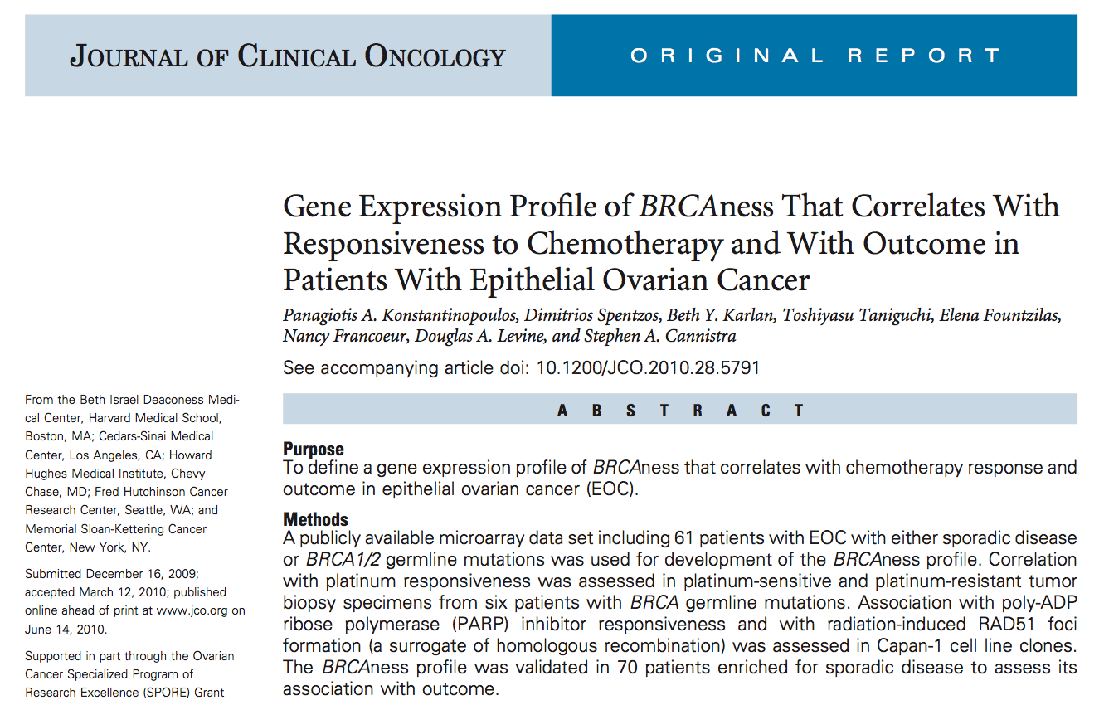
Even Wider Catch: BRCAness “Profile”
Konstantinopoulos PA et al. J Clin Oncol 2010;28:3555.

Slide 21
Module 2:
Treatment of OC in the Pre-PARP Era
Notes:
21
21
21

Slide 22
Pre-PARP Era: OC confined to abdomen
Pre-PARP Era: Recurrent disease (Platinum-sensitive and resistant)
PARP Era: OC confined to abdomen
PARP Era: Recurrent disease (Platinum-sensitive and resistant)
Notes:
22
22
22
22
22

Slide 23
Scenario 1: A patient with disease confined to the abdomen
Key considerations
Patient selection for neoadjuvant systemic therapy and choice of neoadjuvant regimen
Risks and benefits of intraperitoneal chemotherapy; indications for its use in clinical practice
Supportive management considerations for patients receiving intraperitoneal chemotherapy
Available data and ongoing Phase III trials with bevacizumab in the setting of primary OC

Slide 24
44-year-old woman with Stage IIIC high-grade ovarian cancer (Ms Camp)
March 2016: Exploratory laparotomy, TAH/BSO, omentectomy, optimal debulking, placement of IP catheter
April 2016: Paclitaxel 135 mg/m², cisplatin 75 mg/m² IP and paclitaxel 60 mg/m² IP
July 2016: Completed 6 cycles
OncoGeneDx custom breast/ovarian cancer panel
NGS genomic analysis is negative for mutation
Single mother with adult children, currently works in school system
Children adapting to life-threatening illness of parent
Patient concerned with body image changes

Slide 25
44-year-old woman with Stage IIIC high-grade ovarian cancer (Ms Camp)

Slide 27
65-year-old woman with ovarian cancer (Ms Peetz)
May 2008: Diagnosis of pT2c pMX with 3/7 positive metastatic right pelvic nodes
Administered paclitaxel/cisplatin IV/IP
Tolerated well, though has experienced lasting peripheral neuropathy
Remains disease free
No genetic testing performed
Daughter tested negative for BRCA 1/2 mutation
Married and retired elementary school teacher
Radioactive contamination
Issues with survivor’s remorse as son-in-law succumbed to brain cancer during her recovery

Slide 29
IP Extravasation, Complications
Pain during infusion is not normal
Erythema post infusion not normal
Renal dysfunction and electrolyte loss are observed
Bloating, discomfort due to abdominal “expansion” can last 2-5 days: normal
Fatigue, malaise, loss of appetite, nausea all common post IP and interfere with daily life
IP cisplatin is administered after IV paclitaxel day 1; IP paclitaxel is administered on day 8
Courtesy of Paula J Anastasia, RN, MN, AOCN

Slide 30
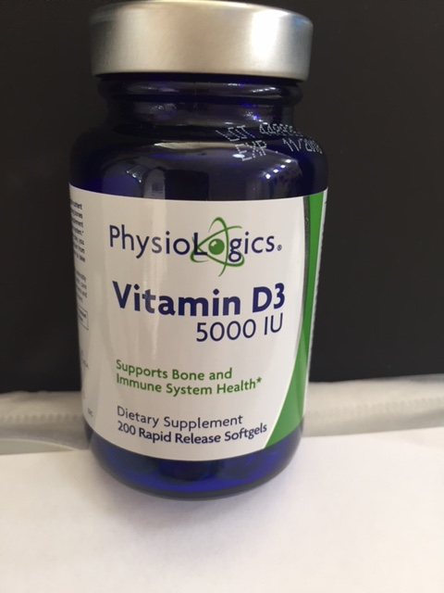
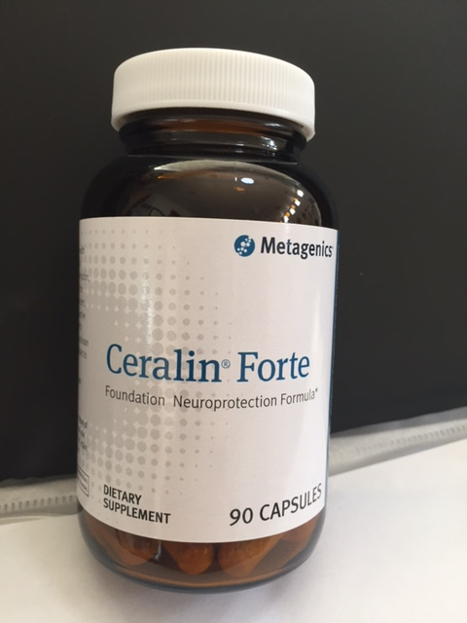
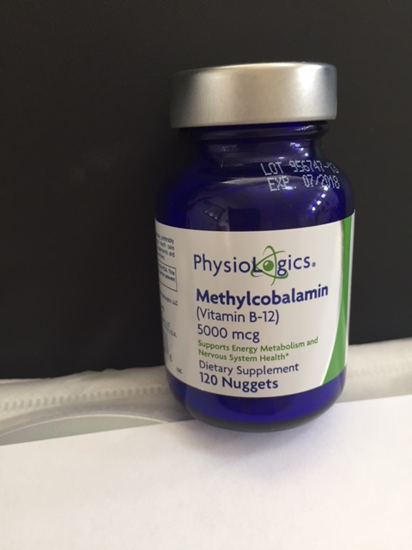
65-year-old woman with ovarian cancer (Ms Peetz)

Slide 31
Pre-PARP Era: OC confined to abdomen
Pre-PARP Era: Recurrent disease (Platinum-sensitive and resistant)
PARP Era: OC confined to abdomen
PARP Era: Recurrent disease (Platinum-sensitive and resistant)
Notes:
31
31
31
31
31

Slide 32
Scenario 2: A patient with disease recurrence after treatment with a platinum/taxane
Key considerations
Duration of response to initial platinum-based therapy
Selection of chemotherapeutic regimen
Indications for the use of maintenance therapy; impact of response to current treatment
Incorporation of bevacizumab with chemotherapy or as monotherapy

Slide 33
General Approach to Treatment of First or Second Recurrence
Platinum
refractory/resistant
Platinum sensitive
Platinum-free interval
<6 months
Platinum-free interval
>6 months
Nonplatinum treatment
+/- bevacizumab
(doublet)
Platinum retreatment
+/- bevacizumab
(triplet)
NCCN Clinical Practice Guidelines for Ovarian Cancer Version 1, 2017.
Notes:
.

Slide 34
Classes of Approved Systemic Treatments: Pre-PARP Era
Platinum Sensitive
Chemotherapy
Platinums, taxanes, gemcitabine, liposomal doxorubicin
Biologics
Bevacizumab
Platinum Resistant
Chemotherapy
Taxanes, gemcitabine, liposomal doxorubicin, etoposide, topotecan
Biologics
Bevacizumab

Slide 35
Bevacizumab – FDA Approvals
November 14, 2014:
In combination with paclitaxel, pegylated liposomal doxorubicin or topotecan for platinum-resistant, recurrent EOC
December 6, 2016:
Either in combination with carboplatin and paclitaxel or in combination with carboplatin and gemcitabine chemotherapy, followed by bevacizumab alone, for the treatment of platinum-sensitive recurrent epithelial ovarian, fallopian tube or primary peritoneal cancer
Notes:
35

Slide 36
Phase III Studies of Bevacizumab in Combination with Chemotherapy for EOC: Platinum-Sensitive, Recurrent Setting
Study | Randomization | N | Median PFS (mo) | HR, p-value | Median OS (mo) | HR, p-value
OCEANS¹ | C/gem + placebo | 242 | 8.4 | HR = 0.48 <0.0001 | 32.9 | HR = 0.952
 | C/gem + bev until progression | 242 | 12.4 |  | 33.6 | p = 0.6479
GOG-0213² | C/P | 374 | 10.4 | HR = 0.628 <0.0001 | 37.3 | HR = 0.823
 | C/P + bev | 374 | 13.8 |  | 42.2 | p = 0.0447
¹ Aghajanian C et al. J Clin Oncol 2012;30(17):2039-45; Gynecol Oncol 2015;139(1):10-6.
² Coleman RL et al. Lancet Oncol 2017;Apr 21 [epub ahead of print].

Slide 37
Bevacizumab Toxicities
Hypertension (maintain < 140/90)
Rhinitis
Proteinuria (maintain < 2+, → UPR or 24h CCl)
Epistaxis
Headache
Vascular: GI perforation, delayed wound healing, hemorrhage (28-day wait before or after surgery)
Reversible posterior encephalopathy syndrome (rare, but noteworthy)
Courtesy of Paula J Anastasia, RN, MN, AOCN

Slide 38
Module 3:
Integration of PARP Inhibitors into OC Management
Notes:
38
38
38

Slide 39
Key Considerations in the Integration of PARP Inhibitors into OC Management
Effect of BRCA mutation status on activity
Similarities and differences among companion diagnostics developed for FDA-approved PARP inhibitors
FDA-approved indications for and optimal integration of olaparib, rucaparib and niraparib
Dosing and administration of olaparib, rucaparib and niraparib
Recognition and management of PARP inhibitor side effects
Risk of AML/MDS for patients receiving PARP inhibitors
Current role of PARP inhibitors for patients without BRCA mutations

Slide 40
PARP and Base Excision Repair
DNA damage
PARP
NAD+
PARP recruitment
PARP
poly(ADP-ribose)
PARP activation and
assembly of repair factors
PARP
PARG
LigIII
XRCC1
PAR degradation via PARG
pol β
PNK 1
PNK 1
End processing,
gap filling and ligation
pol β
LigIII
XRCC1
Adapted from Vergote ND; Khanna et al, 2001; Sanchez-Perez, 2006; Kennedy et al, 2006.

Slide 41
Mechanism of Cell Death from Synthetic Lethality Induced by PARP Inhibition
Courtesy of Jenny C Chang, MD

Slide 42
Who Will Benefit from PARP Inhibitor Treatment?
Germline
Somatic
Sporadic tumors with intact BRCA function
Hypermethylated
Alternate Paths
Adapted from Coleman, 2009.
Courtesy of Robert Coleman, MD.

Slide 43
PARP Inhibitors – FDA Approvals
Olaparib:
December 2014: As monotherapy for advanced ovarian cancer after ≥3 prior lines of chemotherapy and with deleterious or suspected deleterious germline BRCA-mutated (as detected by an FDA-approved test)
Rucaparib:
As monotherapy for advanced ovarian cancer after 2 or more chemotherapies and with a specific gene mutation (deleterious BRCA) as identified by an FDA-approved companion diagnostic test.
Niraparib:
As maintenance treatment for recurrent epithelial ovarian, fallopian tube or primary peritoneal cancer that is in complete or partial response after platinum-based chemotherapy. Approval is not dependent on presence of a specific genetic mutation.

Slide 44
71-year-old woman with Stage IIIB ovarian cancer (Ms Peetz)
1995: Diagnosis of Stage IIIB serous ovarian cancer
Oophorectomy → Paclitaxel/carboplatin x 6 cycles
Discharged after 5 years of surveillance
2012: CT scan shows 18-cm pelvic mass consistent with serous primary
Paclitaxel/carboplatin x 3 cycles; switched to gemcitabine x 4 cycles due to reaction to carbo
January 2014: Topotecan plus bevacizumab
November 2015: PET/CT showed progression
December 2015: Olaparib 400 mg BID
Dose reduced to 200 mg BID due to anemia
Patient and sister are BRCA mutation-positive

Slide 45
Olaparib in Germline BRCA1/2 Mutation-Positive Advanced Ovarian Cancer
N = 137
Deleterious or suspected deleterious germline BRCA mutation status verified retrospectively in 59/61 (97%) patients for whom blood samples were available, using the companion diagnostic BRACAnalysis CDx
All patients had received 3 or more prior lines of chemotherapy
All patients received olaparib 400 mg twice daily until disease progression or unacceptable toxicity
Objective response rate: 34%
Complete/partial responses: 2%/32%
Median DOR: 7.9 months
Olaparib package insert 01/2017.

Slide 46
Rucaparib in Germline and/or Somatic BRCA1/2 Mutation-Positive Advanced Ovarian Cancer
N = 106 in 2 multicenter, single-arm, open-label clinical trials
Tumor BRCA mutation status was verified retrospectively in 64/67 (96%) patients for whom a tumor tissue sample was available, using the companion diagnostic FoundationFocus CDx_{BRCA} test
All patients had experienced disease progression after ≥2 prior lines of chemotherapy
All patients received rucaparib 600 mg twice daily as monotherapy until progression or unacceptable toxicity
Objective response rate: 54%
Complete/partial responses: 9%/45%
Median DOR: 9.2 months
Rucaparib package insert 12/2016.

Slide 47
Niraparib in Patients with Recurrent Ovarian Cancer Who are in Complete or Partial Response to Platinum-Based Chemotherapy
N = 553 – platinum-sensitive recurrent epithelial ovarian, fallopian tube, or primary peritoneal cancer
Eligible patients assigned to one of two cohorts based on the results of the BRACAnalysis CDx
gBRCAmut cohort: Deleterious or suspected deleterious germline BRCA mutations
Non-gBRCAmut cohort: Those without germline BRCA mutations
All patients received ≥2 prior platinum-containing regimens and were in CR or PR to their most recent platinum-based regimen
Patients received niraparib 300 mg orally daily or matched placebo
Niraparib package insert, 3/2017

Slide 48
ENGOT-OV16/NOVA
Accrual: N = 553
(N=203) gBRCA^{mut}
2:1
Niraparib 300 mg
Eligibility
Platinum-sensitive, recurrent ovarian cancer with high-grade serous histology Received and sensitive to at least 2 platinum-based regimens CR or PR and disease progression more than 6 months after last round of platinum-based chemo Germline BRCA mutant or mutation-negative* based on BRACAnalysis
R
Placebo
Niraparib 300 mg
R
Placebo
(N=350) Non-gBRCA^{mut}
2:1
Primary endpoint: PFS in gBRCAmut and non-gBRCAmut cohorts (HRD-positive subset followed by overall)
https://gciggroup.com/system/files/2015_Oct_NSGO_ENGOT-OV16-NOVA-MIRZA.pdf

Slide 49
ENGOT-OV16/NOVA: Progression-Free Survival
Median PFS | Niraparib | Placebo | Hazard ratio | p-value
Germline BRCA mutation (n = 138; 65) | 21.0 mo | 5.5 mo | 0.27 | <0.001
No germline BRCA mutation with HRD positivity (n = 106; 56) | 12.9 mo | 3.8 mo | 0.38 | <0.001
No germline BRCA mutation with HRD negativity (n = 92;42) | 6.9 mo | 3.8 mo | 0.58 | 0.02
No germline BRCA mutation (n = 234; 116) | 9.3 mo | 3.9 mo | 0.45 | <0.001
Mirza MR et al. N Engl J Med 2016;375(22):2154-64.

Slide 50
SOLO2 Phase III Trial of Olaparib Monotherapy as Maintenance
Eligibility
Platinum-sensitive, relapsed ovarian cancer with germline BRCA mutation Must be in response to most recent platinum-based chemotherapy after ≥2 lines of therapy
Maintenance olaparib
300 mg BID
(n = 195)
R
(2:1)
Placebo
(n = 99)
Clinical endpoint | Olaparib (n = 196) | Placebo (n = 99) | HR (p-value)
Median PFS | 19.1 mo | 5.5 mo | 0.30 (<0.0001)
Pujade-Lauraine E et al. Proc SGO 2017;Abstract LBA2.

Slide 51
66-year-old woman with BRCA1 mutation and recurrent metastatic ovarian cancer (Ms Camp)
April 2015: Neoadjuvant carboplatin AUC 6 with paclitaxel 175 mg/m² - severe hypersensitivity
August 2015: Interval debulking surgery (TLH/BSO, omentectomy) and peritoneal biopsies
September 2015: Adjuvant carboplatin AUC 6 with paclitaxel 175 mg/m²
May 2016: Admitted to hospital with gait instability; cerebellar and parietal metastases detected
May 2016 - June 2016: Craniotomy and SRS
September 2016: Liposomal doxorubicin
February 2017: Rucaparib 600 mg x 1 cycle; LFTs elevated → Dose reduced to 500 mg

Slide 53
Module 4:
Future Directions and New Agents
Notes:
53
53
53

Slide 54
Reminder
Please turn in your CNE course evaluation for credit as you exit the activity.
Thank you for joining us.
Notes:
54
54
54

