Slide 1
Please note, these are the actual video-recorded proceedings from the live CME event and may include the use of trade names and other raw, unedited content.

Slide 2
Oncology Grand Rounds Breast Cancer Nurse and Physician Investigators Discuss New Agents, Novel Therapies and Actual Cases from Practice
Thursday, May 4, 2017 12:15 PM – 1:45 PM
Faculty
Emily Olson, APRN, CNP, MSN Elizabeth O’Reilly, RN, NP, MSN, MPH
Joyce O’Shaughnessy, MD
Denise A Yardley, MD
Moderator Neil Love, MD

Slide 3
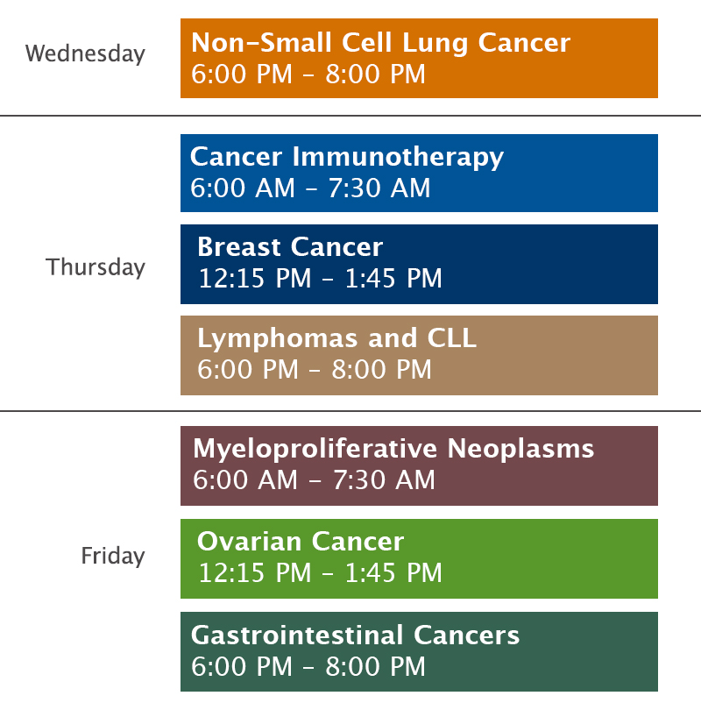
Oncology Grand Rounds Series

Slide 4
Oncology Grand Rounds: Themes
Identifying and understanding oncology clinical scenarios
Key determining factors; natural history and treatment
Evaluating and managing clinical symptoms
Patient and caregiver education
Integrating new agents and treatment strategies into practice
Benefits and risks
Prevention, identification and management of side effects/toxicity
Identifying patients at high risk for toxicity
Psychosocial issues in clinical oncology
Caring for family and loved ones, including minor children and grandchildren
Job satisfaction and disappointment
The bond that heals

Slide 5
Novel Agents Approved by the FDA in the Past 9 Weeks
Agent | Approval Date | FDA-Approved Use on Approval Date
Telotristat ethyl (tryptophan hydroxylase inhibitor) | February 28th | In combination with somatostatin analogue (SSA) therapy for the treatment of adults with carcinoid syndrome diarrhea inadequately controlled by SSA therapy alone
Ribociclib (CDK4/6 inhibitor) | March 13th | In combination with an aromatase inhibitor as initial endocrine-based therapy for postmenopausal women with hormone receptor-positive, HER2-negative advanced or metastatic breast cancer
Avelumab (anti-PD-L1 antibody) | March 23rd | For the treatment of patients (≥12 years) with metastatic Merkel cell carcinoma, including those who have not received prior chemotherapy
Niraparib (PARP inhibitor) | March 27th | For the maintenance treatment of adult patients with recurrent epithelial ovarian, fallopian tube or primary peritoneal cancer whose tumors have completely or partially shrunk in response to platinum-based chemotherapy
Brigatinib (ALK inhibitor) | April 28th | For the treatment of patients with ALK-positive metastatic non-small cell lung cancer who have progressed on or are intolerant to crizotinib
Midostaurin (FLT3 inhibitor) | April 28th | For the treatment of adults with newly diagnosed FLT3-positive acute myeloid leukemia in combination with standard cytarabine and daunorubicin induction and cytarabine consolidation
Durvalumab (anti-PD-L1 antibody) | May 1st | For the treatment of patients with PD-L1-positive inoperable or metastatic urothelial bladder cancer that has progressed during or after one standard platinum-based regimen
https://www.fda.gov/drugs/developmentapprovalprocess/druginnovation/ucm537040.htm

Slide 6
HER2-positive: Neoadjuvant systemic therapy
HER2-positive: Adjuvant treatment
HER2-positive: Metastatic disease
ER-positive: Neoadjuvant systemic therapy
ER-positive: Adjuvant treatment
ER-positive: Metastatic disease
TNBC: Neoadjuvant systemic therapy
TNBC: Adjuvant treatment
TNBC: Metastatic disease
Notes:
6
6
6
6
6

Slide 11
Oncology Grand Rounds Breast Cancer Nurse and Physician Investigators Discuss New Agents, Novel Therapies and Actual Cases from Practice
Thursday, May 4, 2017 12:15 PM – 1:45 PM
Faculty
Emily Olson, APRN, CNP, MSN Elizabeth O’Reilly, RN, NP, MSN, MPH
Joyce O’Shaughnessy, MD
Denise A Yardley, MD
Moderator Neil Love, MD

Slide 12
Module 1:
Overview of Breast Cancer
Notes:
12
12
12

Slide 13
Overview of Breast Cancer
Estimated number of new cases and deaths in 2017:
New cases = 255,180
Deaths = 41,070
Stage at diagnosis:
Localized disease = 60%
Regional disease = 33%
Metastatic disease = 5%
Unstaged disease = 2%
Five-year survival estimates (2006-2012) = 91%
Cancer Facts and Figures 2017; American Cancer Society Surveillance Research 2011; SEER Stat Fact Sheet.

Slide 14
Critical Scenario/Pathway Factors
Disease stage:
Localized (neoadjuvant/adjuvant)
Locally advanced
Metastatic
ER/PR and HER2 status
Disease symptomatology, patient performance status

Slide 15
Distribution of Breast Cancer Subtypes
TNBC
12%
HER2+ 14%
ER+/HER2-
74%
DeSantis CE et al. CA Cancer J Clin 2016;66(1):31-42.

Slide 16
HER2-positive: Neoadjuvant systemic therapy
HER2-positive: Adjuvant treatment
HER2-positive: Metastatic disease
ER-positive: Neoadjuvant systemic therapy
ER-positive: Adjuvant treatment
ER-positive: Metastatic disease
TNBC: Neoadjuvant systemic therapy
TNBC: Adjuvant treatment
TNBC: Metastatic disease
Notes:
16
16
16
16
16

Slide 17
Module 2:
HER2-Positive Breast Cancer
Notes:
17
17
17

Slide 18
HER2-positive: Neoadjuvant systemic therapy
HER2-positive: Adjuvant treatment
HER2-positive: Metastatic disease
ER-positive: Neoadjuvant systemic therapy
ER-positive: Adjuvant treatment
ER-positive: Metastatic disease
TNBC: Neoadjuvant systemic therapy
TNBC: Adjuvant treatment
TNBC: Metastatic disease
Notes:
18
18
18
18
18

Slide 19
Key Considerations in Neoadjuvant Systemic Therapy (NST) for HER2-Positive Breast Cancer
Impact of NST on type of surgical approach for breast and axilla
Use of NST in patients who are borderline candidates for breast-conserving surgery based on tumor-to-breast size ratio
NST as a research tool to identify new therapies
Ensure early access to pertuzumab

Slide 20
44-Year-Old Woman with ER-Positive, HER2-Positive Breast Cancer (Ms O’Reilly)
January 2017: Neoadjuvant TCHP (docetaxel, carboplatin, trastuzumab, pertuzumab)
Excellent clinical response
Grade 2 diarrhea, nonpruritic acneiform rash, severe fatigue
Single woman, working full time
Transition to being a patient and requesting support from friends and family

Slide 21
44-Year-Old Woman with ER-Positive, HER2-Positive Breast Cancer (Ms O’Reilly)

Slide 22
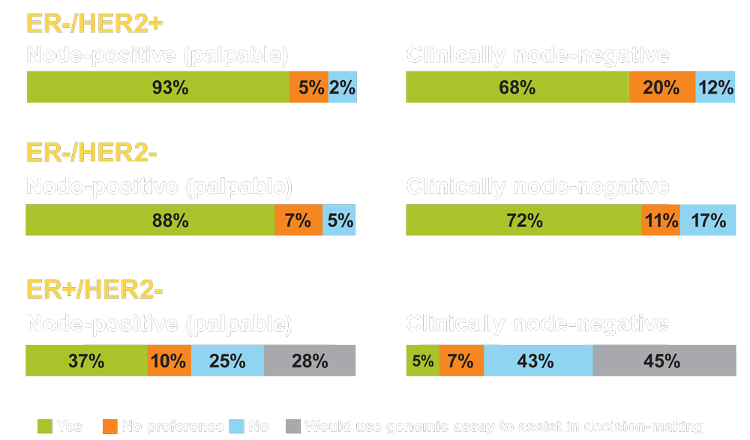
Would You Recommend Neoadjuvant Chemotherapy? (2.1- to 3.0-cm tumor)
Love N et al. SABCS 2015;Abstract P1-14-20.

Slide 23
Available Anti-HER2 Agents
Agent | Mechanism of action
Trastuzumab | HER2-targeted antibody
Pertuzumab | Antibody that prevents HER2 dimerization and signaling
Lapatinib | Tyrosine kinase inhibitor
T-DM1 | Antibody-drug conjugate

Slide 24
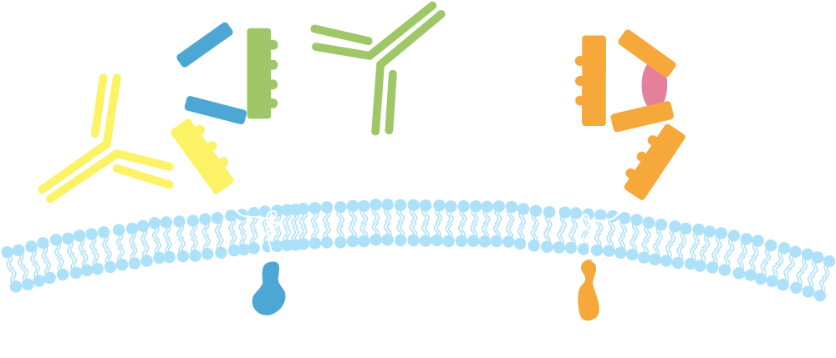
Pertuzumab and Trastuzumab: Mechanisms of Action
Pertuzumab
HER2
Trastuzumab
HER1/3/4
Dimerization domain
Subdomain IV
Trastuzumab:
Inhibits ligand-independent HER2 signaling
Activates ADCC
Prevents HER2 ECD shedding
Pertuzumab:
Inhibits ligand-dependent HER2 dimerization and signaling
Activates ADCC
ADCC = antibody-dependent cell-mediated cytotoxicity; ECD = extracellular domain
Adapted from Harbeck N et al. Breast Care (Basel) 2013;8(1):49-55.

Slide 25
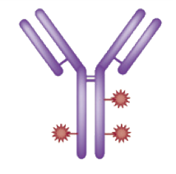
Trastuzumab Emtansine (T-DM1): Mechanisms of Action
Immune effector cell
HER2
T-DM1
HER2
T-DM1
Inhibition of HER2 shedding
Fcγ receptor
Antibody-dependent cellular cytotoxicity (ADCC)
Internalization
Emtansine release
P
P
P
P
P
Inhibition of HER2 signaling
P
Inhibition of microtubule polymerization
Lysosome
PI3K
MAPK
Nucleus
Adapted from LoRusso PM et al. Clin Cancer Res 2011.

Slide 26
NEOSPHERE: Analysis of Neoadjuvant Pertuzumab and Trastuzumab
Trastuzumab (H) + docetaxel (T)
Eligibility (n = 417)
Locally advanced, inflammatory or early- stage breast cancer HER2-positive disease
Pertuzumab (P) + H + T
R
P + H
P + T
Outcome | H + T (n = 107) | P + H + T (n = 107) | P + H (n = 107) | P + T (n = 96)
pCR | 29.0% | 45.8% | 16.8% | 24.0%
5-year PFS | 81% | 86% | 73% | 73%
5-year DFS | 81% | 84% | 80% | 75%
Gianni L et al. Lancet Oncol 2016;17(6):791-800; Lancet Oncol 2012;13(1):25-32.

Slide 27
NCCN Clinical Practice Guidelines — Breast Cancer v2.2017
Sept 30, 2013: FDA granted accelerated approval to pertuzumab for use in combination with trastuzumab and docetaxel for the neoadjuvant treatment of HER2-positive, locally advanced, inflammatory or early-stage breast cancer as part of a complete treatment regimen for early breast cancer.
“A pertuzumab-containing regimen may be administered preoperatively to patients with ≥T2 or ≥N1, HER2-positive early-stage breast cancer.”
“Patients who have not received a pertuzumab-containing regimen can receive adjuvant pertuzumab.”
NCCN Guidelines Breast Cancer v2.2017; www.fda.gov.

Slide 28
HER2-positive: Neoadjuvant systemic therapy
HER2-positive: Adjuvant treatment
HER2-positive: Metastatic disease
ER-positive: Neoadjuvant systemic therapy
ER-positive: Adjuvant treatment
ER-positive: Metastatic disease
TNBC: Neoadjuvant systemic therapy
TNBC: Adjuvant treatment
TNBC: Metastatic disease
Notes:
28
28
28
28
28

Slide 29
Key Considerations in Adjuvant Therapy for HER2-Positive Breast Cancer
Selection of patients: Risk criteria for treatment
Response to neoadjuvant therapy and presence of residual disease
Anthracyclines or not
Current and future use of adjuvant pertuzumab
Duration and potential role of extended adjuvant therapy

Slide 30
APHINITY: A Phase III Adjuvant Study
Target accrual: 4,805
Chemotherapy
Trastuzumab x 1 year
Pertuzumab x 1 year
Resected HER2+ BC
Node+ (except T0)
Baseline LVEF ≥55%
R
Chemotherapy
Trastuzumab x 1 year
Placebo x 1 year
Primary endpoint: Invasive disease-free survival
www.clinicaltrials.gov (NCT01358877); www.ibcsg.org

Slide 31
Phase III APHINITY Study Met Its Primary Endpoint
Press release March 1, 2017:
Adjuvant treatment with the combination of pertuzumab, trastuzumab and chemotherapy achieved a statistically significant reduction in the risk of recurrence of invasive disease or death (invasive disease-free survival) in patients with HER2-positive early breast cancer compared to trastuzumab and chemotherapy alone.
The safety profile of the pertuzumab regimen was consistent with that seen in previous studies, with no new safety signals identified.
Results from the APHINITY trial will be presented at ASCO 2017 on June 5th at 9:45 AM by Von Minckwitz G et al (Abstract LBA500).
https://www.gene.com/media/press-releases/14655/2017-03-01/phase-iii-aphinity-study-shows-genentech

Slide 32
ATEMPT: A Phase II Trial for Stage I HER2-Positive BC
Target Accrual: 500
Eligibility
Stage I HER2-positive breast cancer No prior chemotherapy or trastuzumab
T-DM1 q3wk x 17
R
Paclitaxel + Trastuzumab
Weekly x 12
→ Trastuzumab q3wk x 13
Primary endpoint: Disease-free survival

Slide 33
KATHERINE: A Phase III Adjuvant Study
Target accrual: 1,487
HER2+ BC
Completion of preop trastuzumab- and taxane-based treatment
Residual invasive cancer
Trastuzumab
R
T-DM1
Radiation per standard guidance;
Hormone therapy if ER+ or PR+
Primary endpoint: Invasive disease-free survival
www.clinicaltrials.gov (NCT01772472)

Slide 34
ExteNET: A Phase III Study of Neratinib After Trastuzumab-Based Adjuvant Therapy
Stage I-III HER2+ BC
Completion of neoadjuvant and adjuvant trastuzumab up to 1 year prior
Neratinib
(n = 1,420)
R
Placebo
(n = 1,420)
Primary endpoint: Invasive disease-free survival
Chan A et al. Lancet Oncol 2016;17(3):367-77.

Slide 35
CONTROL: Loperamide Prophylaxis for Neratinib-Associated Diarrhea
Patients with HER2-positive early BC treated with neratinib
Loperamide prophylaxis either alone or with budesonide (oral corticosteroid)
Loperamide prophylaxis reduced the incidence, severity and duration of diarrhea compared to no prophylaxis on the ExteNET trial
Adding budesonide may further diminish the duration and number of episodes of diarrhea
Diarrhea | CONTROL |  | ExteNET (n = 1,408)
 | Loperamide (n = 135) | Loperamide + budesonide (n = 40)
Any grade | 75.6% | 65.0% | 95.4%
Grade 3/4 | 28.1% | 15.0% | 39.9%
Barcenas C et al. SABCS 2016;Abstract P2-11-03; Chan A et al. Lancet Oncol 2016;17(3):367-77.

Slide 36
HER2-positive: Neoadjuvant systemic therapy
HER2-positive: Adjuvant treatment
HER2-positive: Metastatic disease
ER-positive: Neoadjuvant systemic therapy
ER-positive: Adjuvant treatment
ER-positive: Metastatic disease
TNBC: Neoadjuvant systemic therapy
TNBC: Adjuvant treatment
TNBC: Metastatic disease
Notes:
36
36
36
36
36

Slide 37
ExteNET: DFS at 2-Year Follow-Up (Intent to Treat)
 | Neratinib (n = 1,420) | Placebo (n = 1,420) | Hazard ratio | p-value
DFS including DCIS | 93.9% | 91.0% | 0.63 | 0.0017
Invasive DFS (IDFS) | 93.9% | 91.6% | 0.67 | 0.0091
HR-positive | 95.4% | 91.2% | 0.51 | 0.0013
HR-negative | 92.0% | 92.2% | 0.93 | 0.74
Grade 3/4 AEs | Neratinib (n = 1,408) |  | Placebo (n = 1,408)
Diarrhea | 40% |  | 2%
Vomiting | 3% |  | <1%
Nausea | 2% |  | <1%
DFS = disease-free survival; DCIS = ductal carcinoma in situ; AE = adverse event
Neratinib for 12 mo after trastuzumab significantly improved 2-y IDFS
Grade 3 or 4 diarrhea was the most common adverse event, leading to dose reductions/discontinuation of neratinib in 26%/17% of patients
Chan A et al. Lancet Oncol 2016;17(3):367-77.

Slide 38
Key Considerations in Systemic Therapy for HER2-Positive Metastatic Breast Cancer
Choice of therapy in patients who receive pertuzumab in the (neo)adjuvant setting (time since prior therapy)
Sequencing of therapies
“CLEOPATRA” regimens as first-line treatment
CLEOPATRA versus T-DM1 in patients with early recurrence
Nonchemotherapy regimens
Integration of endocrine treatment for patients with “triple-positive” tumors
Presence of CNS metastases

Slide 39
61-Year-Old Saudi Arabian Woman with ER-Positive, HER2-Positive Metastatic Breast Cancer (Ms Olson)
2008: T3N2 ER-positive, HER2-positive BC
Mastectomy
Adjuvant AC/docetaxel (taxane pneumonitis) + trastuzumab (T)
RT, tamoxifen
2013: Extended adjuvant letrozole
2014: Rising tumor markers, PET/CT: lung mass not biopsy confirmed
2014-2016: Capecitabine/lapatinib; vinorelbine/TP; fulvestrant/TP
Sep 2016: Increase in SOB, progression in lungs, new pleural effusion
T-DM1 initiated
Nov 2016 restaging: Response and improvement in symptoms
Dec 2016: Lost to follow-up due to embassy revocation of coverage
P = pertuzumab

Slide 40
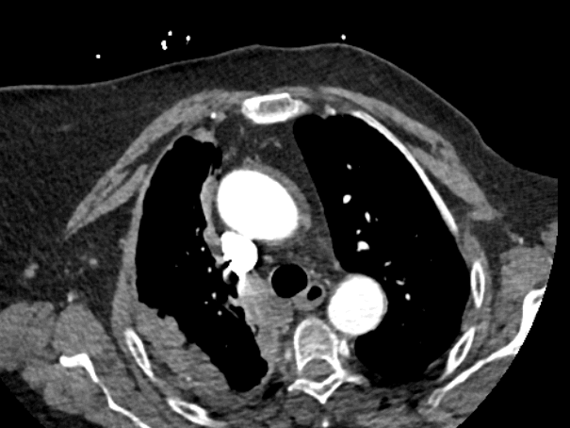
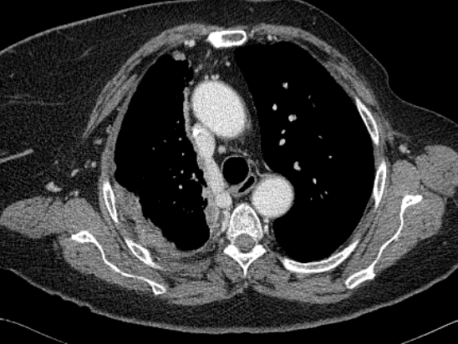
61-Year-Old Saudi Arabian Woman with ER-Positive, HER2-Positive Metastatic Breast Cancer (Ms Olson)
Before T-DM1: Pleural thickening and nodularity
After 3 cycles of T-DM1: Reduction in pleural nodularity

Slide 41
Module 3:
ER-Positive Breast Cancer
Notes:
41
41
41

Slide 42
HER2-positive: Neoadjuvant systemic therapy
HER2-positive: Adjuvant treatment
HER2-positive: Metastatic disease
ER-positive: Neoadjuvant systemic therapy
ER-positive: Adjuvant treatment
ER-positive: Metastatic disease
TNBC: Neoadjuvant systemic therapy
TNBC: Adjuvant treatment
TNBC: Metastatic disease
Notes:
42
42
42
42
42

Slide 43
Key Considerations in Neoadjuvant Therapy for ER-Positive Breast Cancer
Use of neoadjuvant chemotherapy
Use of neoadjuvant endocrine treatment
Role, if any, of genomic assays in decision-making
Menopausal status

Slide 44
HER2-positive: Neoadjuvant systemic therapy
HER2-positive: Adjuvant treatment
HER2-positive: Metastatic disease
ER-positive: Neoadjuvant systemic therapy
ER-positive: Adjuvant treatment
ER-positive: Metastatic disease
TNBC: Neoadjuvant systemic therapy
TNBC: Adjuvant treatment
TNBC: Metastatic disease
Notes:
44
44
44
44
44

Slide 45
Key Considerations in Adjuvant Therapy for ER-Positive Breast Cancer
Selection of patients: Risk criteria for treatment
Use of genomic assays in node-positive disease
Choice of endocrine therapy based on menopausal status
Chemotherapy or not: Role of genomic assays (21-gene Recurrence Score®, 70-gene assay)
Continuation of endocrine therapy at 5 years: Role of genomic assays (Breast Cancer Index)

Slide 46
Genomic Assays in Breast Cancer
Oncotype DX®
IHC4
MammaPrint ®
PAM50/risk of recurrence/Prosigna ®
Genomic grade index
Breast Cancer Index
EndoPredict ®
Győrffy B et al. Breast Cancer Res 2015;17:11.

Slide 47
HER2-positive: Neoadjuvant systemic therapy
HER2-positive: Adjuvant treatment
HER2-positive: Metastatic disease
ER-positive: Neoadjuvant systemic therapy
ER-positive: Adjuvant treatment
ER-positive: Metastatic disease
TNBC: Neoadjuvant systemic therapy
TNBC: Adjuvant treatment
TNBC: Metastatic disease
Notes:
47
47
47
47
47

Slide 48
Key Considerations in Systemic Therapy for ER-Positive Metastatic Breast Cancer
Choice of endocrine therapy; implications of menopausal status
Single-modality endocrine therapy with a biologic agent
Endocrine therapy in combination with a CDK4/6 inhibitor or everolimus
Chemotherapy versus endocrine therapy: The symptomatic patient who needs an antitumor response

Slide 49
47-Year-Old Woman with ER-Positive, HER2-Negative Metastatic Breast Cancer (Ms O’Reilly)
2009: 3-cm, node-positive, ER-positive, PR-positive, HER2-negative infiltrating ductal carcinoma
Neoadjuvant AC/taxane
Bilateral mastectomy with residual DCIS and 1/17 nodes positive
Adjuvant tamoxifen
March 2016: Recurrent chest wall disease; ER-positive, HER2-negative liver metastases
April 2016: Ovarian suppression (OS), letrozole, palbociclib
Significant reduction in liver metastases, dramatic decline in tumor markers
Palbociclib dose reduced for neutropenia and thrombocytopenia

Slide 50
47-Year-Old Woman with ER-Positive, HER2-Negative Metastatic Breast Cancer (Ms O’Reilly)
Before OS/palbociclib/letrozole
After 10 months of OS/palbociclib/letrozole
Significant reduction in liver metastases

Slide 51
47-Year-Old Woman with ER-Positive, HER2-Negative Metastatic Breast Cancer (Ms O’Reilly)
Reduction in tumor markers

Slide 52
Comparison of CDK4/6 Inhibitors
 | Palbociclib |  | Abemaciclib |  | Ribociclib
Dosing | 125 mg qd 3 wk on, 1 wk off |  | 200 mg BID continuously |  | 600 mg qd 3 wk on, 1 wk off
ORR (monotherapy) | 6% |  | 17% |  | 3%
CNS penetration | No |  | Yes |  | No
Common adverse events | All grades | Grade 3/4 | All grades | Grade 3/4 | All grades | Grade 3/4
Neutropenia Thrombocytopenia | 95% 76% | 54% 19% | 88% 42% | 27% 2% | 46% 37% | 29% 10%
Diarrhea Nausea Vomiting | 16% 23% 5% | 0 0 0 | 90% 65% 35% | 20% 5% 2% | 22% 46% 25% | 3% 2% 0
Barroso-Sousa R et al. Breast Care 2016;11:167-73.

Slide 53
Key Efficacy Data with CDK4/6 Inhibitors
Agent | Indication | Key efficacy data
Palbociclib (approved) | First line, postmenopausal, HR+, HER2-, advanced BC, with an aromatase inhibitor Second line, HR+, HER2-, advanced BC, with FULV | PALOMA-2: Median PFS with PALB + LET 24.8 mo vs LET 14.5 mo (p < 0.0001) PALOMA-3: Median PFS with PALB + FULV 9.5 mo vs FULV 4.6 mo (p < 0.001)
Ribociclib (approved) | First line, postmenopausal, HR+, HER2-, advanced BC, with LET | MONALEESA-2: Median PFS with RIBO + LET not reached vs LET 14.7 mo (p < 0.0001)
Abemaciclib (investigational) | Not approved Breakthrough designation as monotherapy for heavily pretreated, refractory, HR+, advanced BC | MONARCH 1: ORR 19.7%, CBR 42.4%
FULV = fulvestrant; PALB = palbociclib; LET = letrozole; RIBO = ribociclib; ORR = overall response rate; CBR = clinical benefit rate
Finn RS et al. Proc ASCO 2016;Abstract 507; N Engl J Med 2016;375:1925-36; Cristofanilli M et al. N Engl J Med 2016;17(4):425-39; Hortobagyi GN et al. N Engl J Med 2016;375(18):1738-48; Dickler MN et al. Proc ASCO 2016;Abstract 510.

Slide 54
Phase III MONARCH 2 Schema
Target accrual = 630
Postmenopausal HR-positive, HER2-negative Inoperable locally advanced or metastatic breast cancer Relapsed after or have not received prior endocrine therapy
Abemaciclib +
fulvestrant 500 mg
2:1
R
Placebo +
fulvestrant 500 mg
Primary endpoint: Progression-free survival
Results from the MONARCH 2 trial will be presented at ASCO
2017 on June 3rd at 1:15 PM by Sledge G et al (Abstract 1000).
Llombart A et al. SABCS 2014;Abstract OT1-01-07; www.clinicaltrials.gov, May 2, 2017.

Slide 55
Phase III MONARCH 2 Study of Abemaciclib with Fulvestrant Met Primary Endpoint of Progression-Free Survival (PFS)
Press release March 20, 2017:
MONARCH 2 evaluated abemaciclib in combination with fulvestrant in women with HR+, HER2-, advanced breast cancer and disease relapse or progression after endocrine therapy. The addition of abemaciclib to fulvestrant resulted in a statistically significant improvement in PFS when compared to the control arm of placebo with fulvestrant.
Results from the MONARCH 2 trial will be presented at ASCO 2017 on June 3rd at 1:15 PM by Sledge G et al (Abstract 1000).
https://investor.lilly.com/releasedetail.cfm?ReleaseID=1017952

Slide 56
MONARCH 3: A Phase III Study of First-Line Abemaciclib with a Nonsteroidal Aromatase Inhibitor (NSAI)
Postmenopausal women with HR+, HER2-, locoregionally recurrent or metastatic BC with disease-free interval >12 mo after (neo)adjuvant endocrine therapy or presenting de novo with metastatic disease (N = 450)
Abemaciclib + NSAI until PD
R
2:1
Placebo + NSAI until PD
Primary endpoint: Progression-free survival (PFS)
Stratification factors:
Nature of disease (visceral metastases versus bone-only metastases versus other)
Prior (neo)adjuvant endocrine therapy (AI therapy versus other versus no prior endocrine therapy)
Goetz MP et al. Proc ASCO 2015;Abstract TPS624; www.clinicaltrials.gov; NCT02246621

Slide 57
MONARCH 3 Study of Abemaciclib Demonstrated Superior PFS at Interim Analysis
Press release April 24, 2017:
MONARCH 3 evaluated abemaciclib in combination with an aromatase inhibitor (letrozole or anastrozole) compared to an aromatase inhibitor alone for women with HR-positive, HER2-negative advanced breast cancer.
A preplanned interim analysis for MONARCH 3 demonstrated that the trial met its primary endpoint of statistically significant improvement in PFS.
Improvement was also demonstrated in objective response rate, a key secondary endpoint.
https://investor.lilly.com/releasedetail.cfm?ReleaseID=1022428

Slide 58
Crosstalk between ER and PI3K/AKT/mTOR Signaling: Rationale for Dual Inhibition
EGFR HER2
E
mTOR activates ER in a ligand-independent manner
Estradiol suppresses apoptosis induced by mTOR blockade
Hyperactivation of the mTOR pathway is observed in endocrine therapy-resistant breast cancer cells
mTOR is a rational target to enhance the efficacy of hormonal therapy
P
P
E
RAS
PI3K
PTEN
RAF
E
AKT
ER
MEK
MAPK
mTOR
E
E
ER target gene transcription
ER
ER
Adapted from: Di Cosimo S, Baselga J. Nat Rev Clin Oncol 2010;7:139-47.

Slide 59
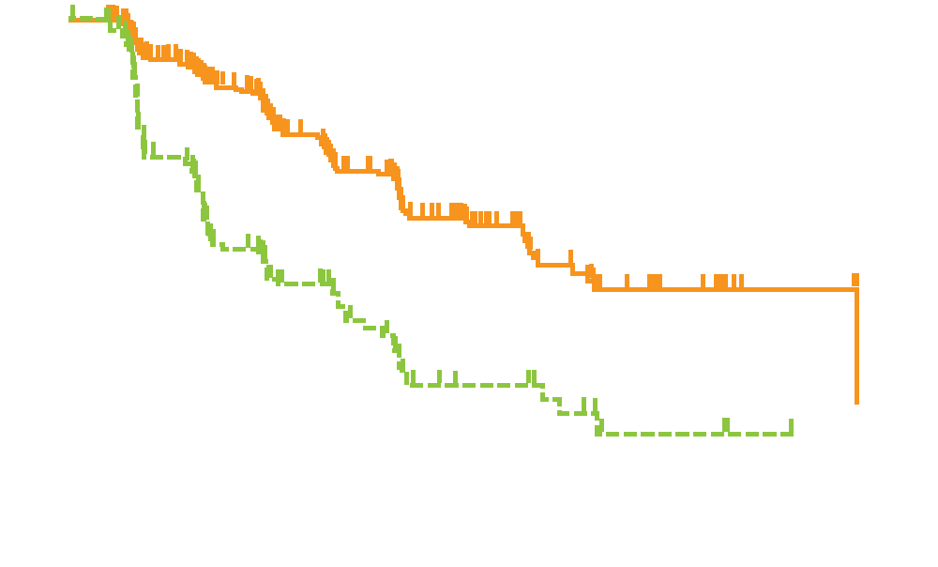
BOLERO-2: PFS with Everolimus/Exemestane for HR-Positive Advanced Breast Cancer
Hazard ratio, 0.36
p < 0.001
Everolimus with exemestane
median PFS, 10.6 mo
Probability of Event (%)
Placebo with exemestane
median PFS, 4.1 mo
Weeks
Baselga J et al. N Engl J Med 2012;366(6):520-9.

Slide 60
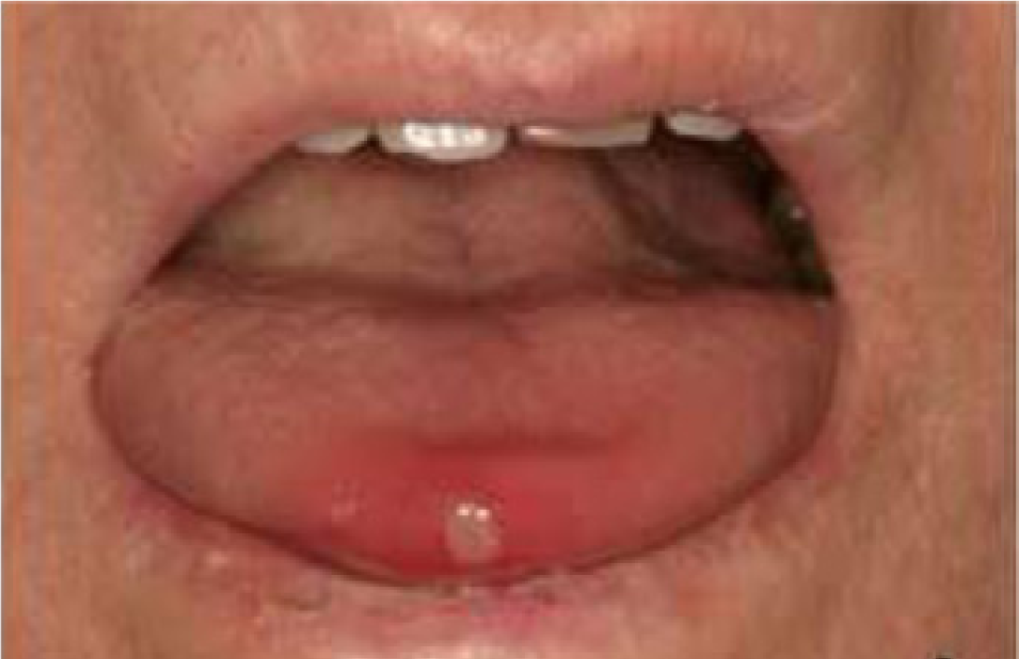
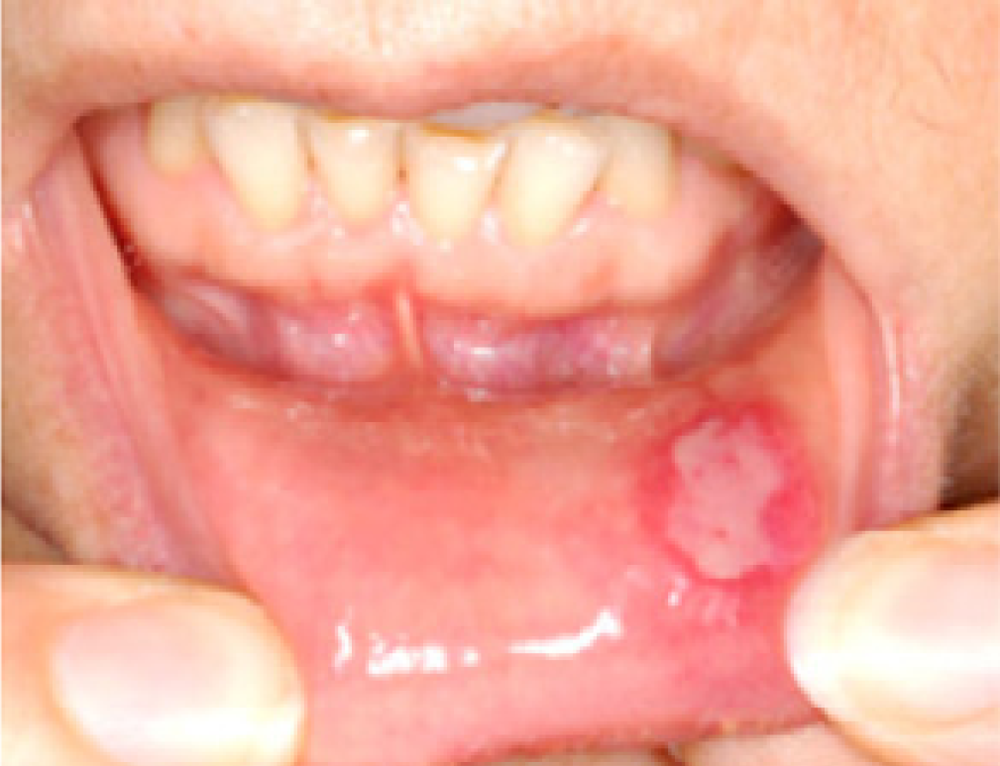
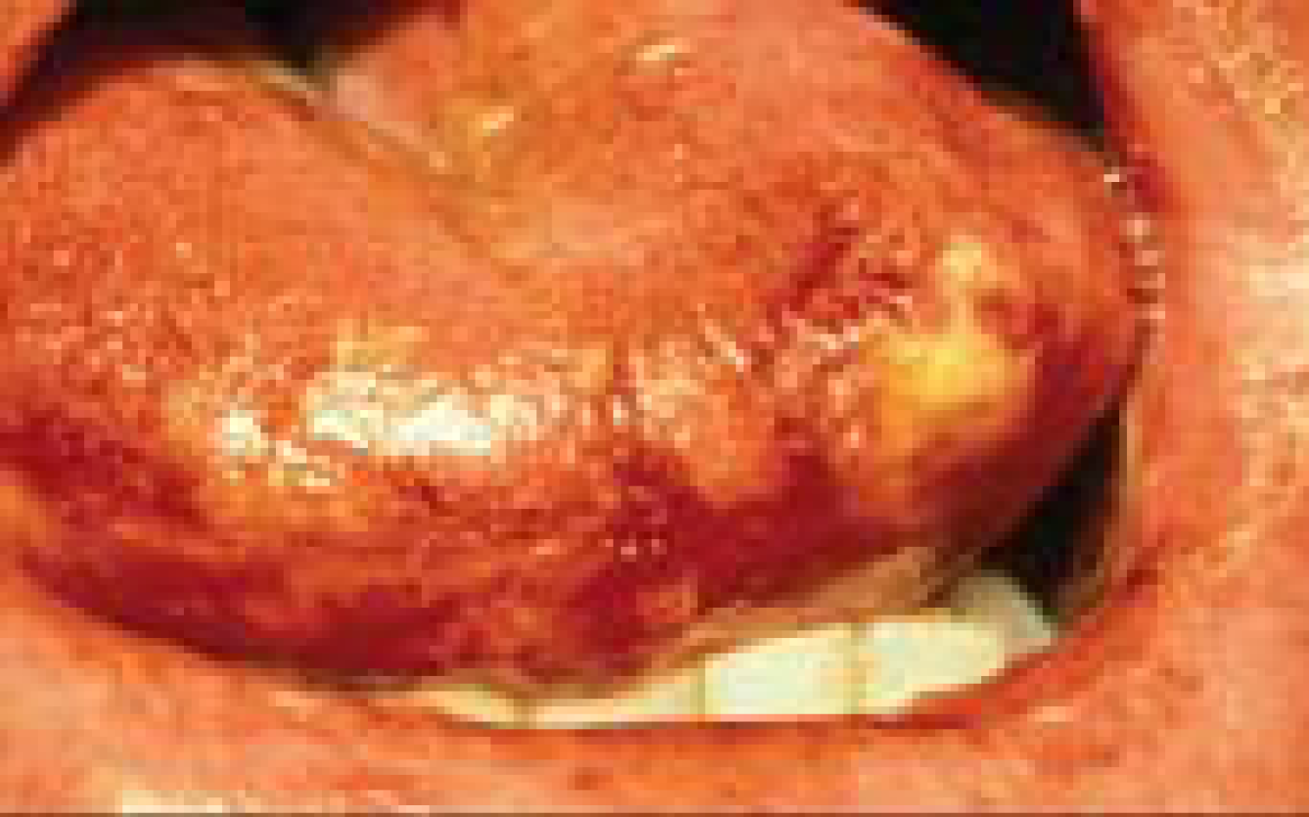
Everolimus-Associated Stomatitis
 | Grade 1 | Grade 2 | Grade 3 | Grade 4
Clinical exam | Erythema of the mucosa | Patchy ulcerations or pseudomembranes | Confluent ulcerations or pseudomembranes, bleeding with minor trauma | Tissue necrosis, significant spontaneous bleeding
Functional symptoms | Minimal symptoms, normal diet | Symptomatic but can eat and swallow modified diet | Symptomatic and unable to adequately aliment or hydrate orally | Symptoms associated with life-threatening consequences
de Oliveira MA et al.
Oral Oncol 2011
Ferte C et al.
Eur J Cancer 2011
Cawley M et al.
Clin J Oncol Nurs 2005

Slide 61
SWISH: Prevention of Everolimus-Related Stomatitis with a Dexamethasone-Based Mouthwash
Patients with HR-positive metastatic BC treated with everolimus/exemestane
Dexamethasone solution (0.5 mg/5 mL) 10 mL per day for 8 weeks, starting day 1
INCIDENCE OF STOMATITIS
BOLERO-2
SWISH (week 8)
Grade 3, 0%
Grade 4, 0%
Rugo H et al. Proc ASCO 2016;Abstract 525.

Slide 62
Module 4:
Triple-Negative Breast Cancer (TNBC)
Notes:
62
62
62

Slide 63
HER2-positive: Neoadjuvant systemic therapy
HER2-positive: Adjuvant treatment
HER2-positive: Metastatic disease
ER-positive: Neoadjuvant systemic therapy
ER-positive: Adjuvant treatment
ER-positive: Metastatic disease
TNBC: Neoadjuvant systemic therapy
TNBC: Adjuvant treatment
TNBC: Metastatic disease
Notes:
63
63
63
63
63

Slide 64
Key Considerations in NST for TNBC
Role of platinum-based chemotherapy
High rate of clinical response and downstaging
Opportunity for less surgery
BRCA mutation status

Slide 65
Role of Neoadjuvant Platinum in TNBC: Randomized Trials
Study | # | Backbone regimen | pCR in breast/axilla
 |  |  | No carboplatin | Carboplatin
GeparSixto¹ | 315 | Weekly paclitaxel + liposomal doxorubicin + bevacizumab | 36.9% | 53.2%
CALGB-40603² | 433 | Sequential weekly pac → AC ± bev | 41% | 54%
Tamura et al³ | 75 | Sequential weekly pac ± carboplatin AUC5 → CEF | 26.3% | 61.2%
Alba et al⁴ | 94 | EC → docetaxel ± carbo AUC6 | 30% | 30%
¹ Von Minckwitz et al. Lancet Oncol 2014;15(7):747-56; ² Sikov et al. JCO 2015;33(1):13-21; ³ Tamura et al. Proc ASCO 2014;Abstract 1017; ⁴ Alba et al. Breast Cancer Res Treat 2012;136(2):487-93.

Slide 66
HER2-positive: Neoadjuvant systemic therapy
HER2-positive: Adjuvant treatment
HER2-positive: Metastatic disease
ER-positive: Neoadjuvant systemic therapy
ER-positive: Adjuvant treatment
ER-positive: Metastatic disease
TNBC: Neoadjuvant systemic therapy
TNBC: Adjuvant treatment
TNBC: Metastatic disease
Notes:
66
66
66
66
66

Slide 67
Key Considerations in Adjuvant Systemic Therapy for TNBC
Choice of chemotherapeutic regimen
Response to neoadjuvant therapy and presence of residual disease
BRCA mutation status

Slide 68
CREATE-X: Adjuvant Capecitabine for Patients with HER2-Negative BC and Residual Invasive Disease After Neoadjuvant Chemotherapy
Efficacy (5 y) | Capecitabine (n = 440) | Control (n = 445) | HR, p-value
Disease-free survival | 74.1% | 67.7% | 0.7, 0.00524
Overall survival | 89.2% | 83.9% | 0.6, <0.01
Subgroup analysis of DFS by hormone receptor status:
HR-positive (n = 561), hazard ratio = 0.84
HR-negative (n = 296), hazard ratio = 0.58
Toi M et al. SABCS 2015;Abstract S1-07.

Slide 69
HER2-positive: Neoadjuvant systemic therapy
HER2-positive: Adjuvant treatment
HER2-positive: Metastatic disease
ER-positive: Neoadjuvant systemic therapy
ER-positive: Adjuvant treatment
ER-positive: Metastatic disease
TNBC: Neoadjuvant systemic therapy
TNBC: Adjuvant treatment
TNBC: Metastatic disease
Notes:
69
69
69
69
69

Slide 70
Commonly Used Chemotherapy Agents in TNBC
Platinum agents (carboplatin, cisplatin)
Anthracyclines
Taxanes
Eribulin
Gemcitabine
Capecitabine
NCCN Clinical Practice Guidelines; Breast Cancer v2.2017.

Slide 71
Atezolizumab for Metastatic TNBC
 | All patients | Atezo as first line | Atezo after ≥2 lines of therapy
ORR (n = 112, 19, 93) | 10% | 26% | 7%
Median duration of response | 21 mo | 21 mo | Not evaluable
OS rate (n = 113, 19, 94) 1-year 3-year | 41% 22% | 63% Not evaluable | 37% 18%
Durable clinical benefit observed in responders
Schmid P et al. Proc AACR 2017;Abstract 2986.

Slide 72
Atezolizumab with Nab Paclitaxel for Metastatic TNBC
Response | First line (n = 13) | Second line (n = 9) | Third line + (n = 10)
Confirmed objective response | 46% | 22% | 40%
Complete response | 8% | 0 | 0
Partial response | 38% | 22% | 40%
Stable disease | 38% | 67% | 30%
PFS not mature and median duration of response not reached
Treatment-related Grade 3-4 adverse events: neutropenia/decreased neutrophil (47%), thrombocytopenia, anemia and diarrhea (6% each)
Adams S et al. Proc ASCO 2016;Abstract 1009.

Slide 73
60-Year-Old Divorced Mother with Triple-Negative Metastatic Breast Cancer (Ms Olson)
Dec 2015: De novo TNBC to liver
Feb 2016: Clinical trial of pembrolizumab, with PD
Jun 2016: Carboplatin/paclitaxel
Discontinued carboplatin after 2 cycles due to prolonged neutropenia
Transitioned to nab paclitaxel due to paclitaxel hypersensitivity
Dec 2016: Liposomal doxorubicin → MATCH trial → carboplatin
April 2017: Progression in liver, increasingly symptomatic, abdominal pain – chemotherapy versus hospice?... Eribulin initiated
Unable to work and relies on government assistance
Extremely supportive brother and children

Slide 74
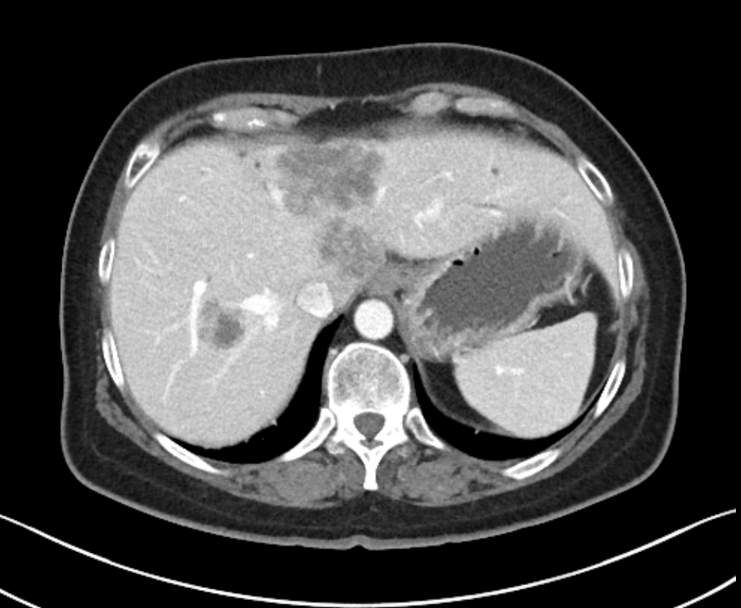
60-Year-Old Divorced Mother with Triple-Negative Metastatic Breast Cancer (Ms Olson)
Baseline staging for TNBC: Multiple hepatic lesions

Slide 75
Module 5:
Patients with BRCA Germline Mutations: Role of PARP Inhibitors?
Notes:
75
75
75

Slide 76
HER2-positive: Neoadjuvant systemic therapy
HER2-positive: Adjuvant treatment
HER2-positive: Metastatic disease
ER-positive: Neoadjuvant systemic therapy
ER-positive: Adjuvant treatment
ER-positive: Metastatic disease
TNBC: Neoadjuvant systemic therapy
TNBC: Adjuvant treatment
TNBC: Metastatic disease
Notes:
76
76
76
76
76

Slide 77
BRCA and PARP Inhibitors
Incidence and clinical significance of BRCA1/2 mutations
Available BRCA mutation testing assays
Current and future (June 2017) indications for BRCA testing
Preventive implications of positive BRCA results
PARP inhibitors in patients with BRCA mutations

Slide 78
PARP and Base Excision Repair
DNA damage
PARP
NAD+
PARP recruitment
poly(ADP-ribose)
PARP
PARP activation and
assembly of repair factors
PARP
PARG
XRCC1
LigIII
PNK 1
PAR degradation via PARG
pol β
pol β
PNK 1
End processing,
gap filling and ligation
LigIII
XRCC1
Adapted from Vergote, ND; Khanna et al, 2001; Sanchez-Perez, 2006; Kennedy et al, 2006.

Slide 79
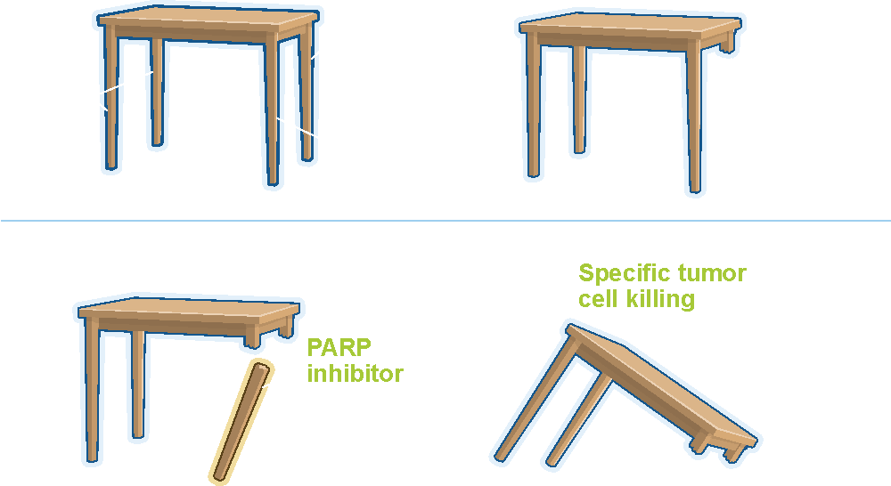
Mechanism of Cell Death from Synthetic Lethality Induced by PARP Inhibition
Courtesy of Jenny C Chang, MD

Slide 80
PARP Inhibitors in Clinical Development for Breast Cancer
Agent | Dose | Phase
Olaparib | 400 mg orally BID | I, II, III
Rucaparib | 600 mg orally BID | II
Veliparib | 400 mg orally BID | I, II, III
Niraparib | 300 mg orally per day | I, II, III
Talazoparib | 1 mg orally per day | I, II, III
www.clinicaltrials.gov

Slide 81
OlympiAD: Phase III Study of Olaparib for Metastatic Breast Cancer with Germline BRCA1/2 Mutations
Enrollment (N = 2,128)
Metastatic breast cancer Germline mutation in BRCA1 or BRCA2 No HER2-positive disease Prior therapy with anthracycline and taxane in adjuvant or metastatic setting
Olaparib
300 mg BID PO
R
Physician’s choice of chemo
(capecitabine, vinorelbine or eribulin)
Primary endpoint: Progression-free survival
www.clinicaltrials.gov (NCT02000622). Accessed May 1, 2017.

Slide 82
Olaparib Meets Primary Endpoint in Phase III Trial in BRCA Mutation-Positive Metastatic BC
Press release February 17, 2017:
Patients with HER2-negative metastatic breast cancer and germline BRCA1 or BRCA2 mutations who received olaparib showed a statistically significant and clinically meaningful improvement in PFS compared to those who received chemotherapy (capecitabine, vinorelbine or eribulin).
To be presented at ASCO 2017:
Results from a phase III clinical trial evaluating the PARP inhibitor olaparib vs standard chemotherapy for women with BRCA-related advanced breast cancer. Abstract LBA4, Plenary
https://www.astrazeneca.com/media-centre/press-releases/2017/lynparza-meets-primary-endpoint-in-phase-iii-trial-in-brca-mutated-metastatic-breast-cancer-17022017.html

Slide 83
OlympiA: Phase III Study of Olaparib as Adjuvant Therapy for High-Risk, HER2-Negative Primary Breast Cancer with Germline BRCA1/2 Mutations
Olaparib
300 mg BID PO
Enrollment (N = 1,500)
TNBC Germline mutation in BRCA1 or BRCA2 Completed neoadjuvant or adjuvant chemotherapy High risk of recurrence
R
Matched placebo
Primary endpoint: Invasive disease-free survival
Tutt A et al. Proc ASCO 2015;Abstract TPS1109; www.clinicaltrials.gov; NCT02032823.

Slide 84
Olaparib Education: Premeds and Side Effects
PI side effects: Anemia, fatigue, emesis
Real life side effects:
Fatigue, thrombocytopenia, nausea
All patients receive weekly CBC, diff for 1st month (pretend they are on clinical trial)
8 pills BID — individualize. Start with antiemetic with evening dose and prn during day
Fatigue, nausea, hematologic side effects common
Courtesy of Paula J Anastasia, RN, MN, AOCN

Slide 85
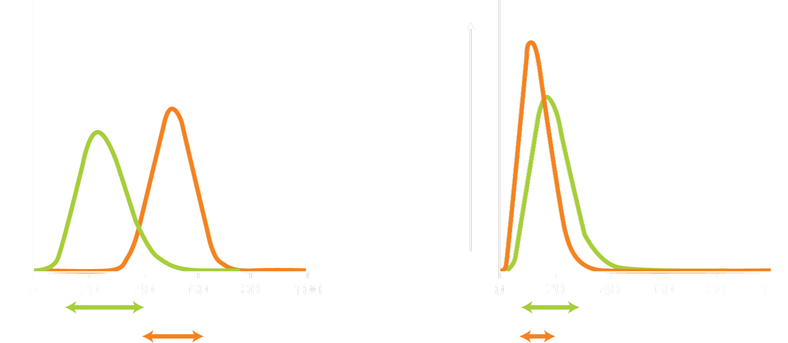
I-SPY 2: Veliparib/Carboplatin in HER2-Negative BC
Triple negative
Hormone-receptor positive and HER2 negative
Probability of veliparib-carboplatin being superior to control, 99%
Probability of success in phase 3 trial, 88%
Veliparib-carboplatin, 14%
Veliparib-carboplatin, 51%
Control, 19%
Control, 26%
Probability of veliparib-carboplatin being superior to control, 28%
Probability of success in phase 3 trial, 8%
Density of probability distribution
Density of probability distribution
PI, 9% to 43%
PI, 5% to 33%
PI, 36% to 66%
PI, 3% to 25%
Rate of pathological complete response
Rate of pathological complete response
PI = probability interval
Patients with TNBC benefited whereas patients with HER2-negative, hormone receptor-positive tumors did not benefit from veliparib/carboplatin
Toxic effects were greater with veliparib/carboplatin than with control
Rugo HS et al. N Engl J Med 2016;375(1):23-34.

Slide 86
Phase II Study of Veliparib with Carboplatin/Paclitaxel (C/P) for BRCA1/2 Mutation-Positive Metastatic Breast Cancer
Efficacy | Veliparib + C/P (n = 95) | Placebo + C/P (n = 98) | HR, p-value
ORR | 77.8% | 61.3% | —, 0.027
PFS | 14.1 mo | 12.3 mo | 0.789, 0.231
OS | 28.5 mo | 25.0 mo | 0.725, 0.148
No meaningful increase in toxicity was observed with the addition of veliparib
The most common Grade ≥3 adverse events were neutropenia, (placebo 55%, veliparib 56%) and thrombocytopenia (placebo 26%, veliparib 31%)
Han HS et al. SABCS 2016;Abstract S2-05.

Slide 87
47-Year-Old Woman with Triple-Negative, BRCA Mutation-Positive Metastatic Breast Cancer (Ms O’Reilly)
Jan 2012: Diagnosed with left-side TNBC with BRCA mutation
Neoadjuvant cisplatin, paclitaxel, everolimus on protocol
Bilateral mastectomy followed by RT
Adjuvant AC x 2, discontinued due to psychosocial difficulties
May 2014: Left occipital brain metastases
Jun 2014: Neurosurgical resection and WBRT
Fall 2014: Liver and lymph node metastases in the porta hepatis
Paclitaxel
Feb 2015: Disease progression, enrollment on OlympiAD, with olaparib
Complex psychosocial history, including heroin abuse and physical abuse; death of friends and family due to opioid overdoses

Slide 88
47-Year-Old Woman with Triple-Negative, BRCA Mutation-Positive Metastatic Breast Cancer (Ms O’Reilly)
Before olaparib
After 2 years of olaparib

