Slide 1
In preparation for this meeting, we conducted a survey of 8 lung cancer clinical investigators:
University of Michigan Rogel Cancer Center
Perelman School of Medicine
Stanford University School of Medicine
The University of Chicago
Penn Center for Precision Medicine
Price Family Comprehensive Center for Chest Care
Sarah Cannon Research Institute

Slide 2
Module 1: Established Management Paradigms and Biologic Rationale for the Evaluation of Immune Checkpoint Inhibition for Patients with Locally Advanced Non-Small Cell Lung Cancer (NSCLC) — Dr Jolly

Slide 3
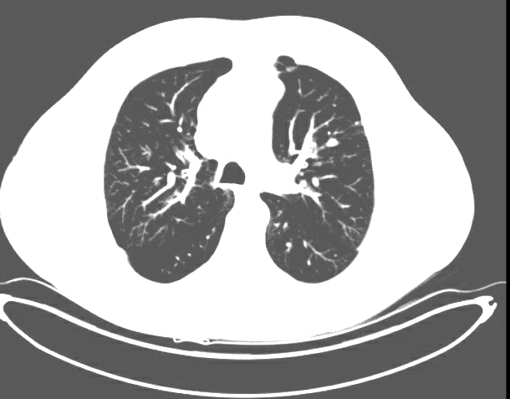
A 65-year-old former smoker with Stage IIIB squamous cell lung cancer and a history of COPD completes 6 cycles of carboplatin/paclitaxel/radiation therapy but develops Grade 2 esophagitis resulting in a 10-lb weight loss. Durvalumab is planned but not started, and the esophagitis totally resolves in 6 weeks.
Before chemoradiation therapy
After chemoradiation therapy

Slide 4
Should durvalumab be initiated at this point?
Yes
Yes
Yes
Yes
Yes
Yes
Yes
Yes

Slide 5
Should PD-L1 levels generally be tested in patients with locally advanced NSCLC? Should durvalumab be used as consolidation treatment after chemoradiation therapy for patients with locally advanced NSCLC and a PD-L1 TPS of ≤1%?
Test PD-L1 levels?
Durvalumab for TPS ≤1%?
No
Yes
Yes
Yes
Yes
Yes
Yes
Yes
Yes
Yes
No
Yes
Yes
Yes
No
Yes

Slide 6
Should durvalumab be used as consolidation treatment after chemoradiation therapy for patients with locally advanced NSCLC with an EGFR or ALK mutation?
Yes, for both
Yes, for both
Yes, for both
No
Yes, for ALK only
No
Yes, for both
Yes, for both

Slide 7
Module 2: Integration of Immune Checkpoint Inhibition into the Management of Locally Advanced NSCLC — Dr Langer

Slide 8
A 70-year-old former smoker is about to undergo chemoradiation therapy for Stage IIIB NSCLC. What do you estimate to be the chance that he or she will experience disease progression within 18 months with no further treatment beyond chemoradiation therapy? What would you estimate to be the absolute reduction in risk of disease progression with consolidation durvalumab?
Disease progression with chemoradiation alone
Risk reduction with chemoradiation → durvalumab
70%
50%
50%-60%
15%-20%
60%
20%
60%
15%
40%
20%
80%
45%
65%
20%
70%
50%

Slide 9
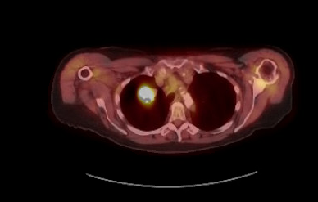
An 82-year-old patient with Stage IIIB adenocarcinoma of the lung and multiple comorbidities, including supraventricular tachycardia, receives and responds to 6 cycles of carboplatin/paclitaxel/radiation therapy.
Before chemoradiation therapy

Slide 10
In general, should durvalumab be recommended as consolidation treatment for an older, frail patient who is unable to tolerate chemotherapy and receives only radiation therapy for unresectable Stage IIIB NSCLC? What about a patient who underwent surgical excision and chemoradiation therapy as initial treatment?
After RT only
After surgical resection + chemoRT
Yes
I don’t know
No
No
No
No
No
I don’t know
I don’t know
No
No
Yes
No
No
Yes
No

Slide 11
Module 3: Incidence, Recognition and Management of Immune-Mediated and Other Toxicities with the Use of Anti-PD-L1 Antibody Therapy for Locally Advanced Disease — Dr Patel

Slide 12
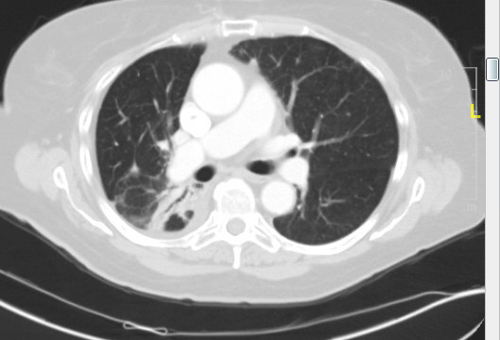
An 82-year-old patient with Stage IIIB adenocarcinoma of the lung and multiple comorbidities, including supraventricular tachycardia, is started on consolidation durvalumab after 6 cycles of carboplatin/paclitaxel/radiation therapy. Six weeks later the patient develops mild shortness of breath. CT scan of the chest shows no evidence of pneumonitis.

Slide 13
What should be done?
Continue the durvalumab
Continue the durvalumab
Rule out other causes; continue the durvalumab
Rule out other causes; continue the durvalumab
Continue the durvalumab
Continue the durvalumab
Continue the durvalumab
Continue the durvalumab

Slide 14
A 65-year-old patient with COPD and other comorbidities is s/p 6 cycles of carboplatin/paclitaxel/radiation therapy for Stage IIIB adenocarcinoma of the lung. The patient is started on consolidation durvalumab but after 2 months presents with diarrhea (8 stools per day for 2 days). A GI specialist does not want to perform a colonoscopy because of risk of infection.
After chemoradiation therapy

Slide 15
In addition to supportive medication, would you initiate corticosteroids?
Yes
Yes
Yes
Yes
Yes
Yes
No
Yes

Slide 16
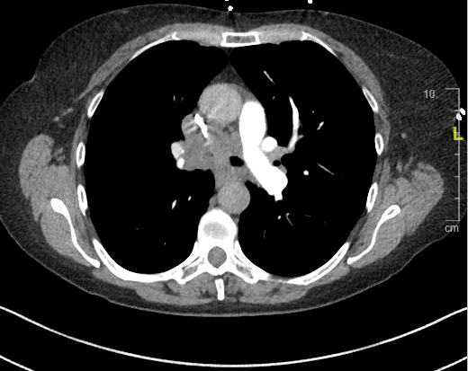
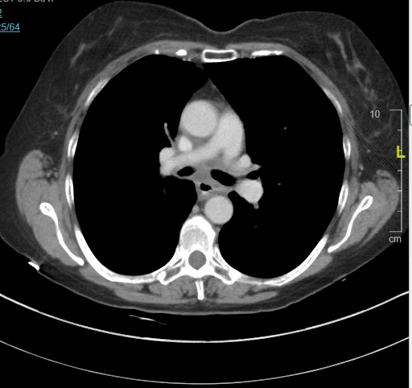
A 63-year-old current heavy smoker with a history of polymyalgia rheumatica mainly manifested by shoulder discomfort (receiving 10 mg/d of prednisone) presents to the ER with obstructive pulmonary symptoms, and biopsy reveals Stage IIIB adenocarcinoma of the lung. The patient receives and responds to 6 cycles of carboplatin/paclitaxel/radiation therapy.
Before chemoradiation therapy
After chemoradiation therapy

Slide 17
Should durvalumab be initiated?
Yes
No
Yes
Yes
Yes
No
No
Yes

Slide 18
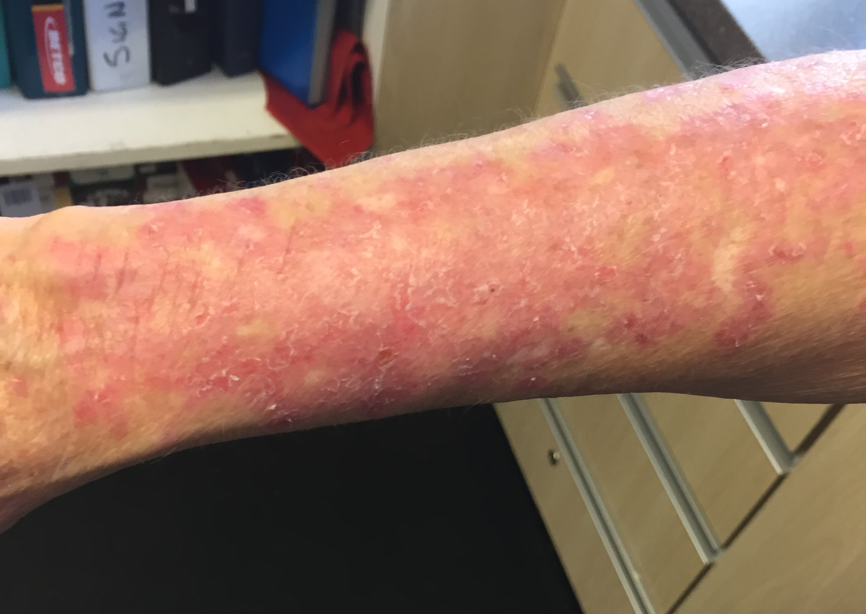
The patient in the previous scenario begins consolidation durvalumab and 2 months later presents with an erythematous rash on the upper extremities, which is biopsied and found to be consistent with lupus erythematosus.

Slide 19
Outside of a protocol setting, should durvalumab generally be offered as consolidation treatment after chemoradiation therapy to a patient with locally advanced NSCLC and Crohn’s disease that is well controlled on infliximab? What about a patient who has undergone a kidney transplant?
On infliximab for Crohn’s disease
Previous kidney transplant
Not sure
No
Not sure
No
No
No
No
No
Yes
No
No
No
No
No
Yes
No

Slide 20
Module 4: Ongoing and Planned Clinical Trials of Immune Checkpoint Inhibitors for Patients with Nonmetastatic NSCLC — Dr Loo

Slide 21
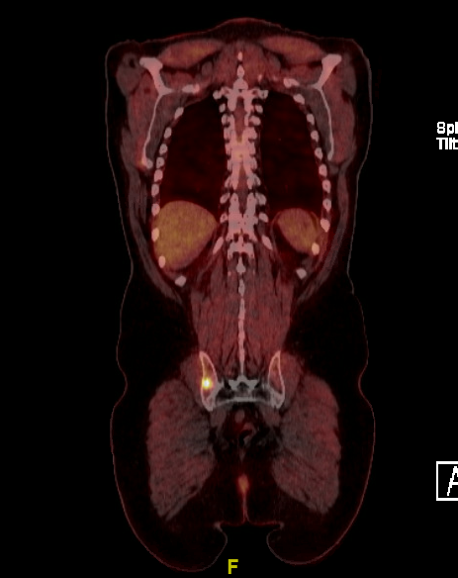
A 54-year-old patient presents with adenocarcinoma of the lung, hilar adenopathy and an isolated right iliac bone metastasis. PD-L1 TPS = 5%.

Slide 22
What treatment strategy is optimal?
ChemoRT → durvalumab + RT to the bone lesion
Chemotherapy + anti-PD-1/PD-L1
Chemo + anti-PD-1/PD-L1 → local consolidation therapy
Chemo + anti-PD-1/PD-L1, consider local consolidation
Chemotherapy + anti-PD-1/PD-L1 antibody
Chemotherapy + anti-PD-1/PD-L1 antibody
Chemo + anti-PD-1/PD-L1 → SBRT → maint. systemic tx
Chemotherapy + anti-PD-1/PD-L1 antibody

